Slide 1
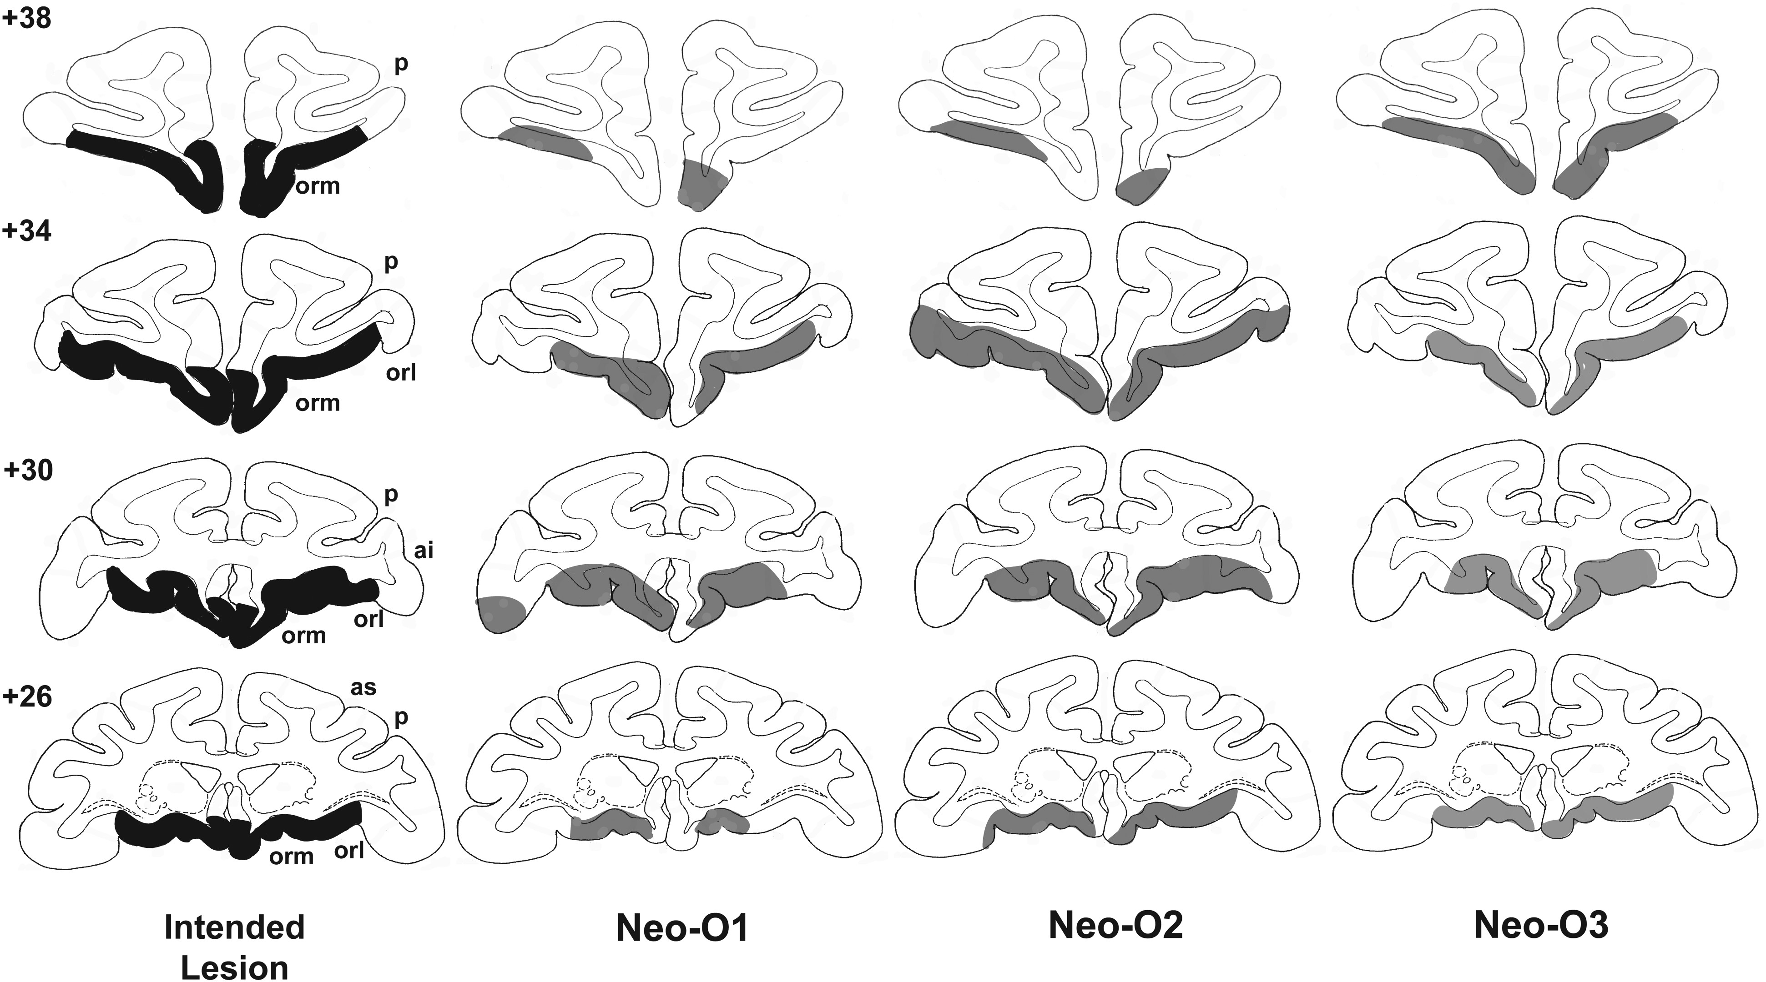
Figure 1. Intended lesions of the orbital frontal cortex (shown in dark gray, left column) and reconstruction of the ...
Notes:
Figure 1. Intended lesions of the orbital frontal cortex (shown in dark gray, left column) and reconstruction of the actual damage (in light gray) for the 3 cases in Group O onto standard coronal sections of a normal monkey brain. The numerals on the left of the coronal sections indicate the distance in millimeters from the interaural plane. ai, inferior arcuate sulcus; as, superior arcuate sulcus; orl, lateral orbital sulcus; orm, medial orbital sulcus; p, principal sulcus.
Unless provided in the caption above, the following copyright applies to the content of this slide: © The Author 2014. Published by Oxford University Press. All rights reserved. For Permissions, please e-mail: journals.permissions@oup.com

Slide 2
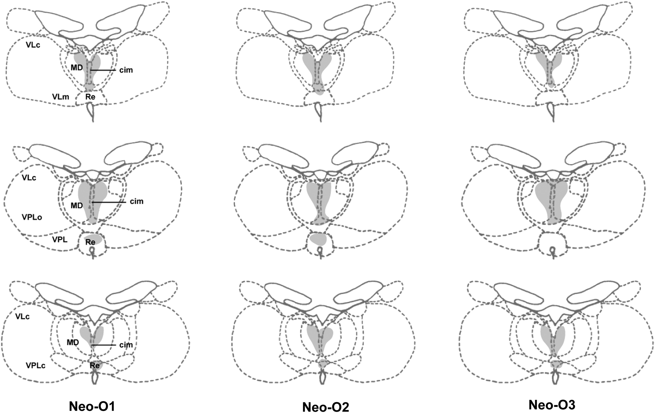
Figure 2. Retrograde degeneration in the thalamus following orbital frontal cortex lesions for the 3 cases in Group O. ...
Notes:
Figure 2. Retrograde degeneration in the thalamus following orbital frontal cortex lesions for the 3 cases in Group O. Areas of moderate degeneration are shown in light shading. cim, central intermedial; MD, medial dorsal thalamus; Re, reuniens; VLc, ventral lateral caudal part; VLm, ventral lateral, medial part; VPLo, ventral posterior, lateral oral part; VPLc, ventral posterior, lateral caudal part; VPL, ventral posterior lateral.
Unless provided in the caption above, the following copyright applies to the content of this slide: © The Author 2014. Published by Oxford University Press. All rights reserved. For Permissions, please e-mail: journals.permissions@oup.com

Slide 3
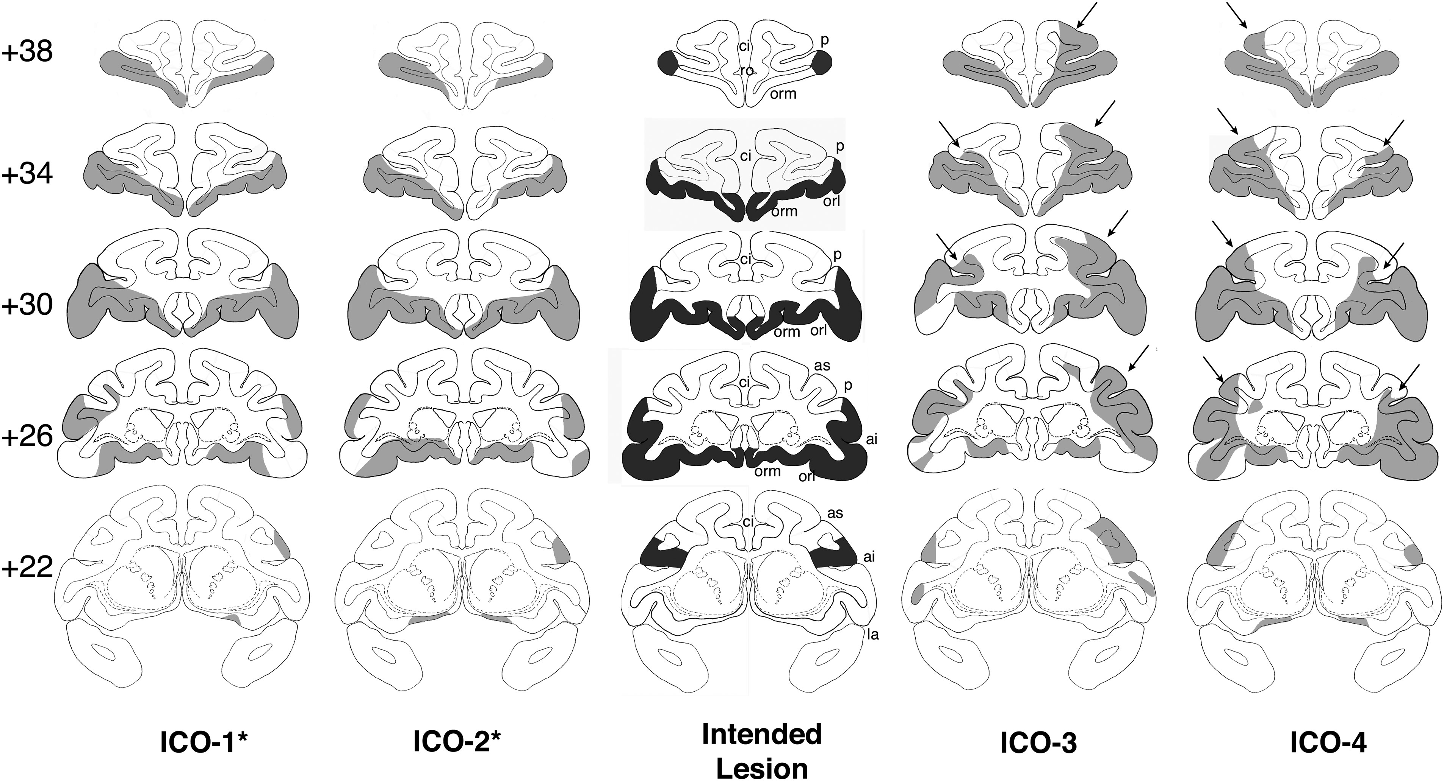
Figure 3. Intended combined lesions of the inferior prefrontal convexity and orbital frontal cortex (shown in dark ...
Notes:
Figure 3. Intended combined lesions of the inferior prefrontal convexity and orbital frontal cortex (shown in dark gray, center column) and reconstruction of the actual damage (in light gray) for the 4 cases in Group ICO onto standard coronal sections of a normal monkey brain. The numerals on the left of the coronal sections indicate the distance in millimeters from the interaural plane. ai, inferior arcuate sulcus; as, superior arcuate sulcus; ci, cingulate sulcus; la, lateral fissure; orl, lateral orbital sulcus; orm, medial orbital sulcus; p, principal sulcus; ro, rostral sulcus. Asterisk indicates 2 subjects in Group ICO* with damage similar to the intended lesions. Cases ICO-3 and 4 had unintended damage to area 46 as indicated by the arrows.
Unless provided in the caption above, the following copyright applies to the content of this slide: © The Author 2014. Published by Oxford University Press. All rights reserved. For Permissions, please e-mail: journals.permissions@oup.com

Slide 4
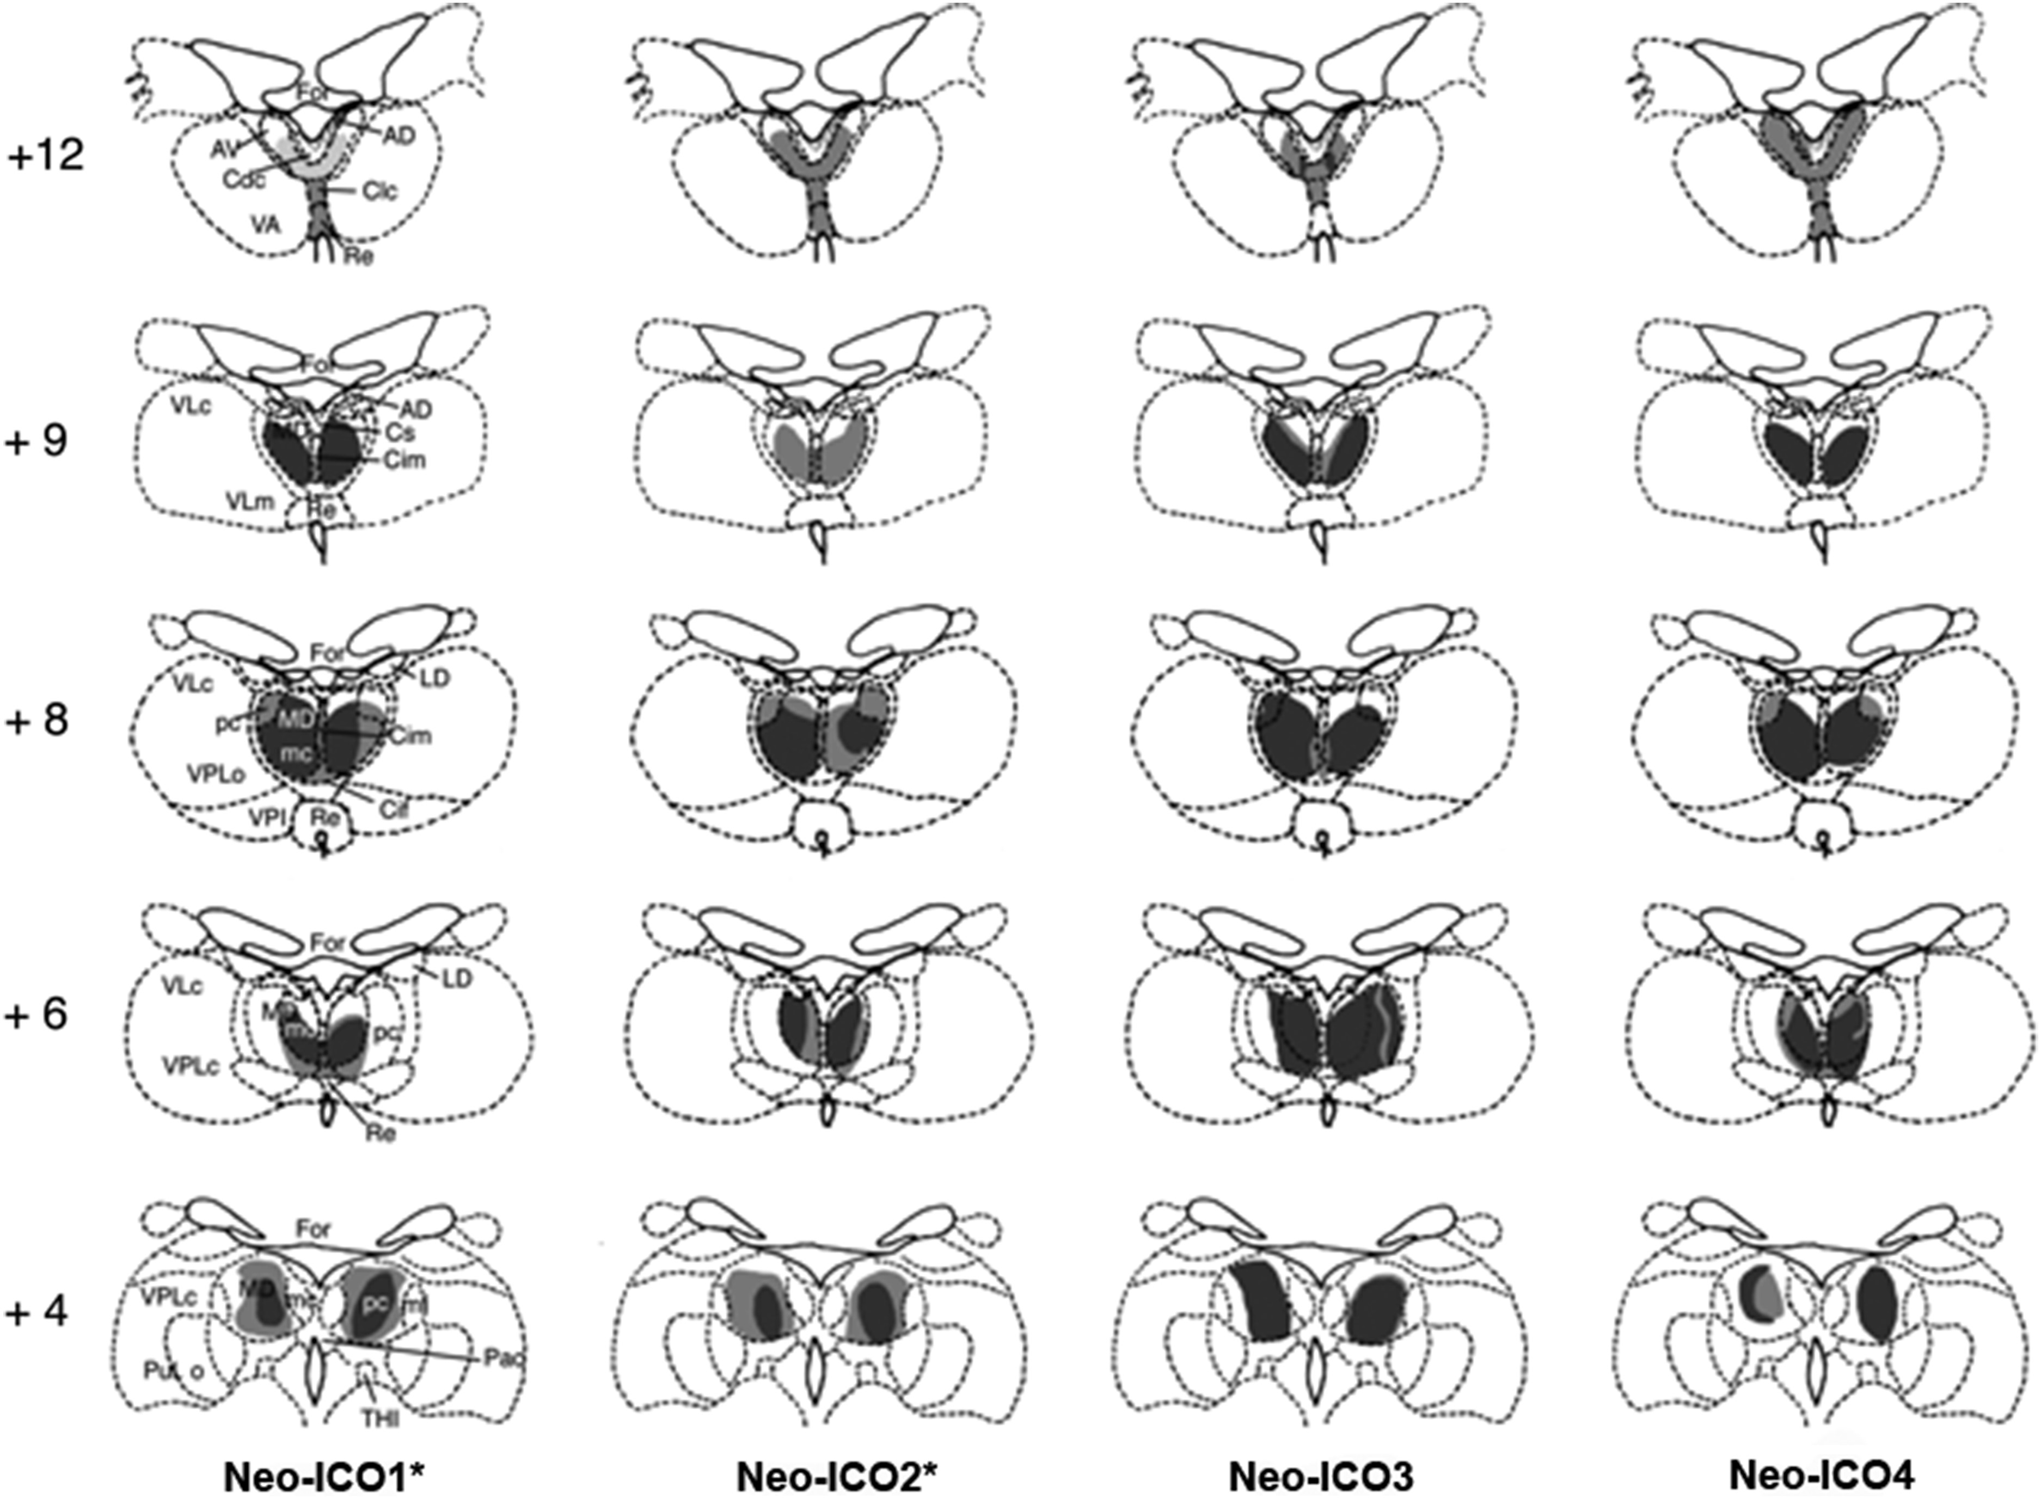
Figure 4. Retrograde degeneration in the thalamus following combined inferior prefrontal convexity and orbital frontal ...
Notes:
Figure 4. Retrograde degeneration in the thalamus following combined inferior prefrontal convexity and orbital frontal cortex lesions for the 4 cases in Group ICO. Areas of severe degeneration are shown in dark gray and areas of moderate degeneration are shown in light shading. AD, anterior dorsal; AV, anterior ventral; Cdc, central densocellular; Clc, central latocellular; Cif, central inferior; Cim, central intermedial; Cs, central superior; For, fornix; LD, lateral dorsal; MDmc, medial dorsal, magnocellular division; MDmf, medial dorsal multiform division; MDpc, medial dorsal, parvocellular division; Re, reuniens; THI, habenulo-interpeduncular tract; VLc, ventral lateral caudal part; VLm, ventral lateral, medial part; VPi, ventral posterior inferior; VPLo, ventral posterior, lateral oral part; VPLc, ventral posterior, lateral caudal part.
Unless provided in the caption above, the following copyright applies to the content of this slide: © The Author 2014. Published by Oxford University Press. All rights reserved. For Permissions, please e-mail: journals.permissions@oup.com

Slide 5
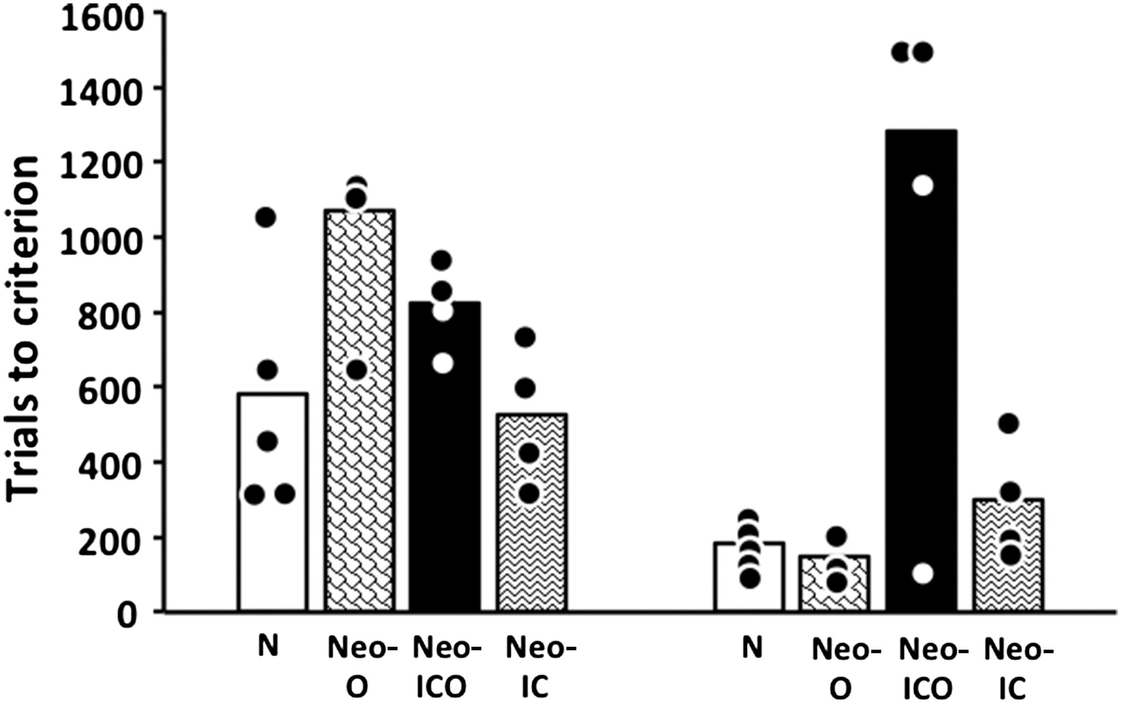
Figure 5. Mean number of trials to learn the delayed nonmatching-to-sample rule at 3 months (left panel) and 2 years of ...
Notes:
Figure 5. Mean number of trials to learn the delayed nonmatching-to-sample rule at 3 months (left panel) and 2 years of age (right panel). Circles indicate individual scores. Conventions: N, normal controls; Neo O, animals with neonatal damage to the orbital frontal cortex; Neo-ICO, animals with neonatal damage to the inferior convexity and the orbital frontal cortex; Neo-IC, animals with neonatal damage to the inferior convexity.
Unless provided in the caption above, the following copyright applies to the content of this slide: © The Author 2014. Published by Oxford University Press. All rights reserved. For Permissions, please e-mail: journals.permissions@oup.com

Slide 6
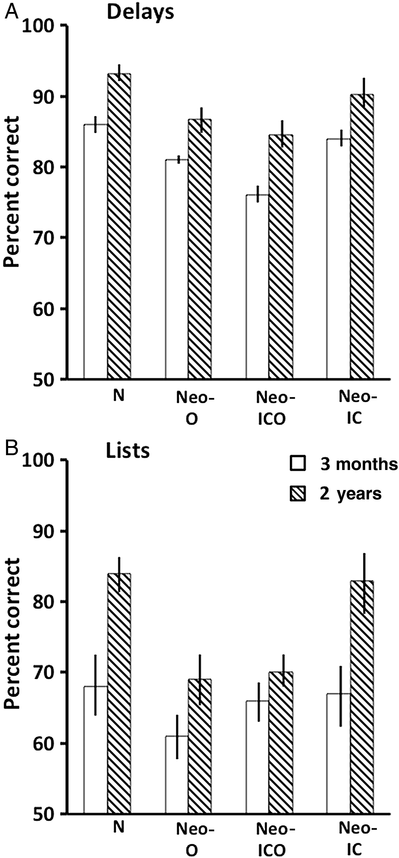
Figure 6. Mean scores (+SEM) on the memory performance test across the 4 delay conditions (A) and the 3 list conditions ...
Notes:
Figure 6. Mean scores (+SEM) on the memory performance test across the 4 delay conditions (A) and the 3 list conditions (B) at 3 months (white bars) and 2 years (striped bars). Conventions: N, normal controls; Neo O, animals with neonatal damage to the orbital frontal cortex; Neo-ICO, animals with neonatal damage to the inferior convexity and the orbital frontal cortex; Neo-IC, animals with neonatal damage to the inferior convexity.
Unless provided in the caption above, the following copyright applies to the content of this slide: © The Author 2014. Published by Oxford University Press. All rights reserved. For Permissions, please e-mail: journals.permissions@oup.com

Slide 7
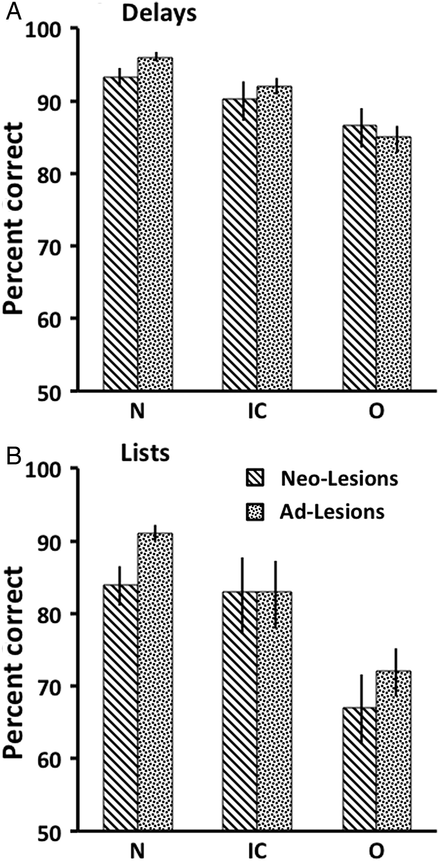
Figure 7. Mean scores (+SEM) on the memory performance test across the 4 delay conditions (A) and the 3 list conditions ...
Notes:
Figure 7. Mean scores (+SEM) on the memory performance test across the 4 delay conditions (A) and the 3 list conditions (B) for animals with neonatal lesions (Neo-Lesions) tested at 2 years and animals with adult-onset lesions (Ad-Lesions). Conventions: N, normal controls; O, animals with damage to the orbital frontal cortex; IC, animals with damage to the inferior convexity.
Unless provided in the caption above, the following copyright applies to the content of this slide: © The Author 2014. Published by Oxford University Press. All rights reserved. For Permissions, please e-mail: journals.permissions@oup.com

