Slide 1
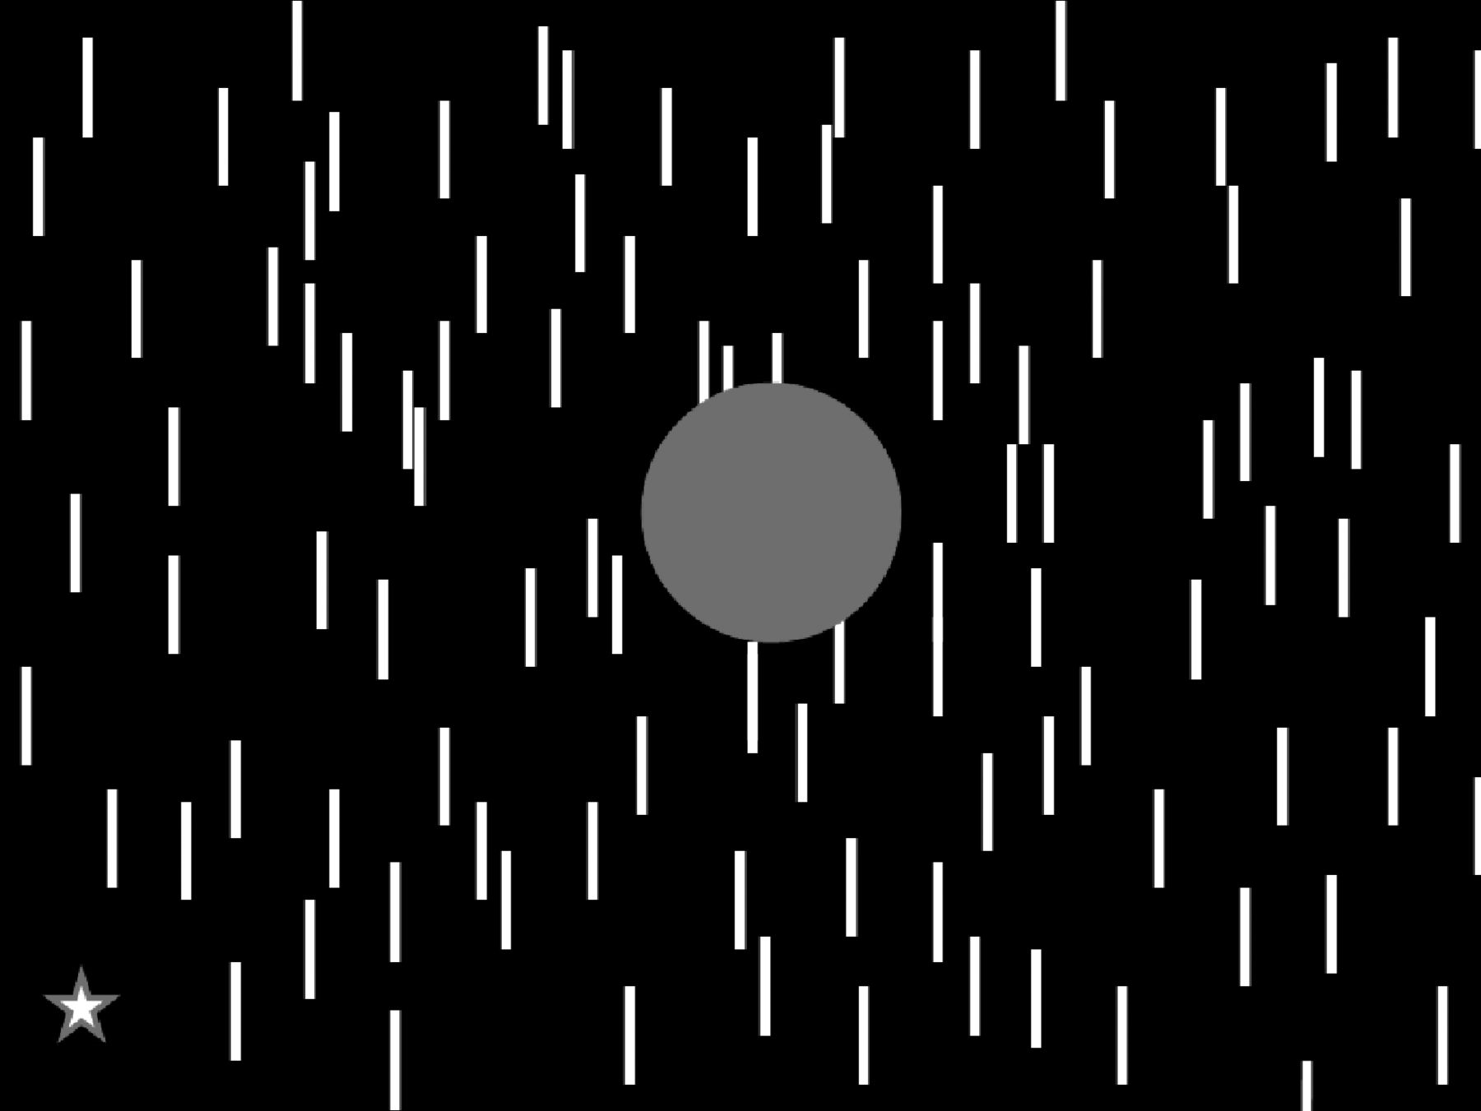
Figure 1. A static depiction of an artificial scotoma display. The perceptual effect can be observed, even in a static ...
Notes:
Figure 1. A static depiction of an artificial scotoma display. The perceptual effect can be observed, even in a static display, if one fixates the star in the lower left corner. After several seconds of viewing, the gray circle will appear to fade from view, becoming filled-in by the textured background.
Unless provided in the caption above, the following copyright applies to the content of this slide: © The Author 2012. Published by Oxford University Press. All rights reserved. For permissions, please e-mail: journals.permissions@oup.com

Slide 2
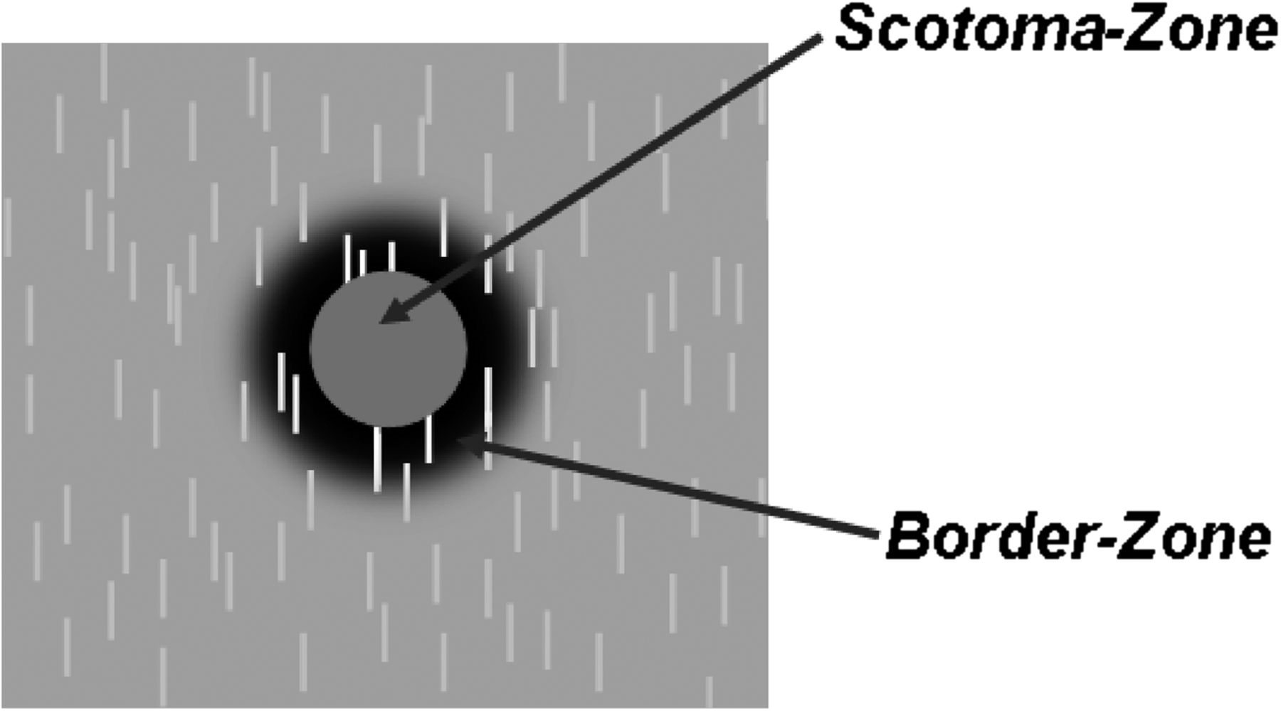
Figure 2. Illustration of scotoma-zone and border-zone regions.
Notes:
Figure 2. Illustration of scotoma-zone and border-zone regions.
Unless provided in the caption above, the following copyright applies to the content of this slide: © The Author 2012. Published by Oxford University Press. All rights reserved. For permissions, please e-mail: journals.permissions@oup.com

Slide 3
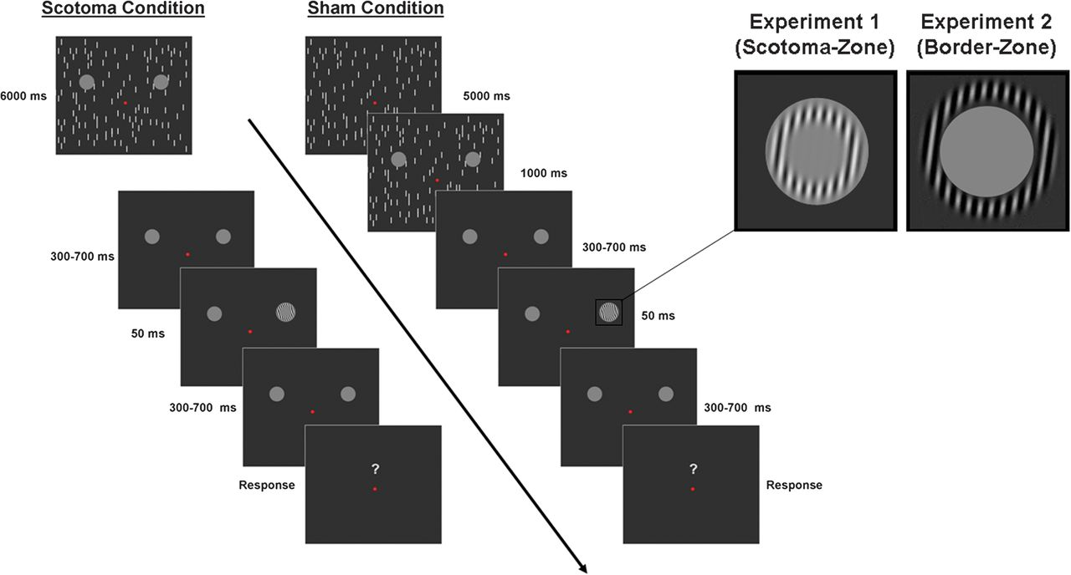
Figure 3. Sequence of event for Scotoma and Sham conditions. In the Scotoma condition, the 2 gray circles (scotoma ...
Notes:
Figure 3. Sequence of event for Scotoma and Sham conditions. In the Scotoma condition, the 2 gray circles (scotoma discs) were superimposed upon the dynamically refreshing background of lines for the entire 6-s conditioning period. In the Sham condition, the scotoma discs appeared only for the last 1 s of the conditioning period. Note that all stimulus parameters were identical for the last second of the display and at the time of visual probe presentation.
Unless provided in the caption above, the following copyright applies to the content of this slide: © The Author 2012. Published by Oxford University Press. All rights reserved. For permissions, please e-mail: journals.permissions@oup.com

Slide 4
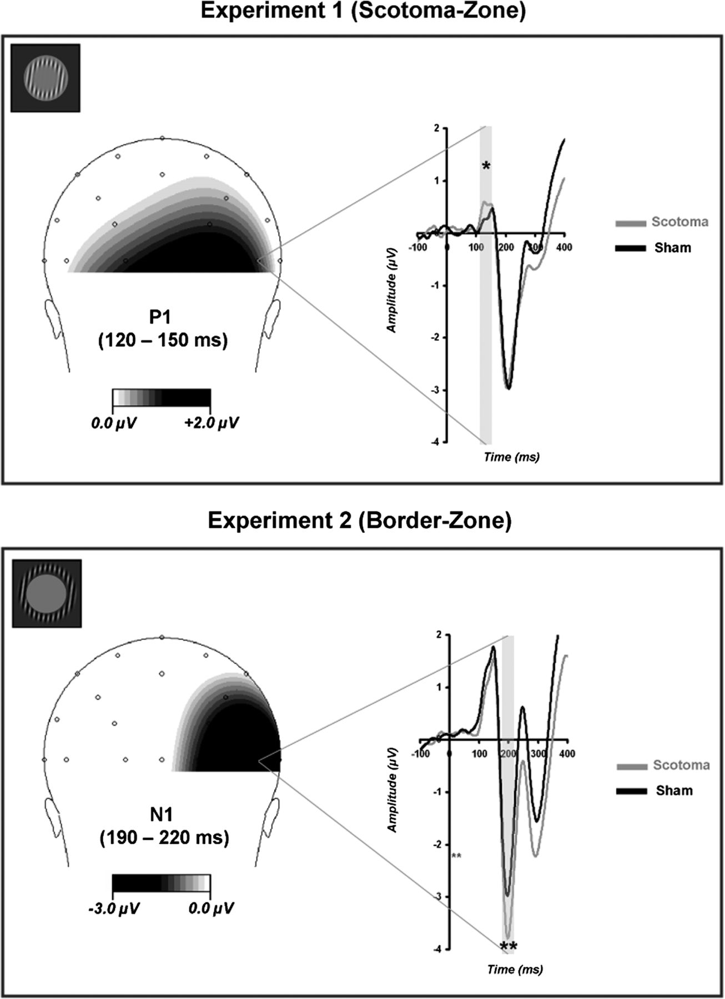
Figure 4. ERP waveforms comparing Scotoma and Sham conditions from Experiments 1 and 2. Waveforms are collapsed across ...
Notes:
Figure 4. ERP waveforms comparing Scotoma and Sham conditions from Experiments 1 and 2. Waveforms are collapsed across left and right visual fields and displayed at electrode P7/8 contralateral to visual field of probe presentation. Scalp distributions are an average of Scotoma and Sham conditions and are arbitrarily coded such that the right represents the contralateral hemisphere and left represents ipsilateral. Scotoma-zone probes from Experiment 1 revealed a significant P1 difference. Border-zone probes of Experiment 2 revealed a significant N1 effect. Single asterisk indicates significance at a level of 0.05, whereas double asterisks denote significance at a level of 0.01 or lower.
Unless provided in the caption above, the following copyright applies to the content of this slide: © The Author 2012. Published by Oxford University Press. All rights reserved. For permissions, please e-mail: journals.permissions@oup.com

Slide 5
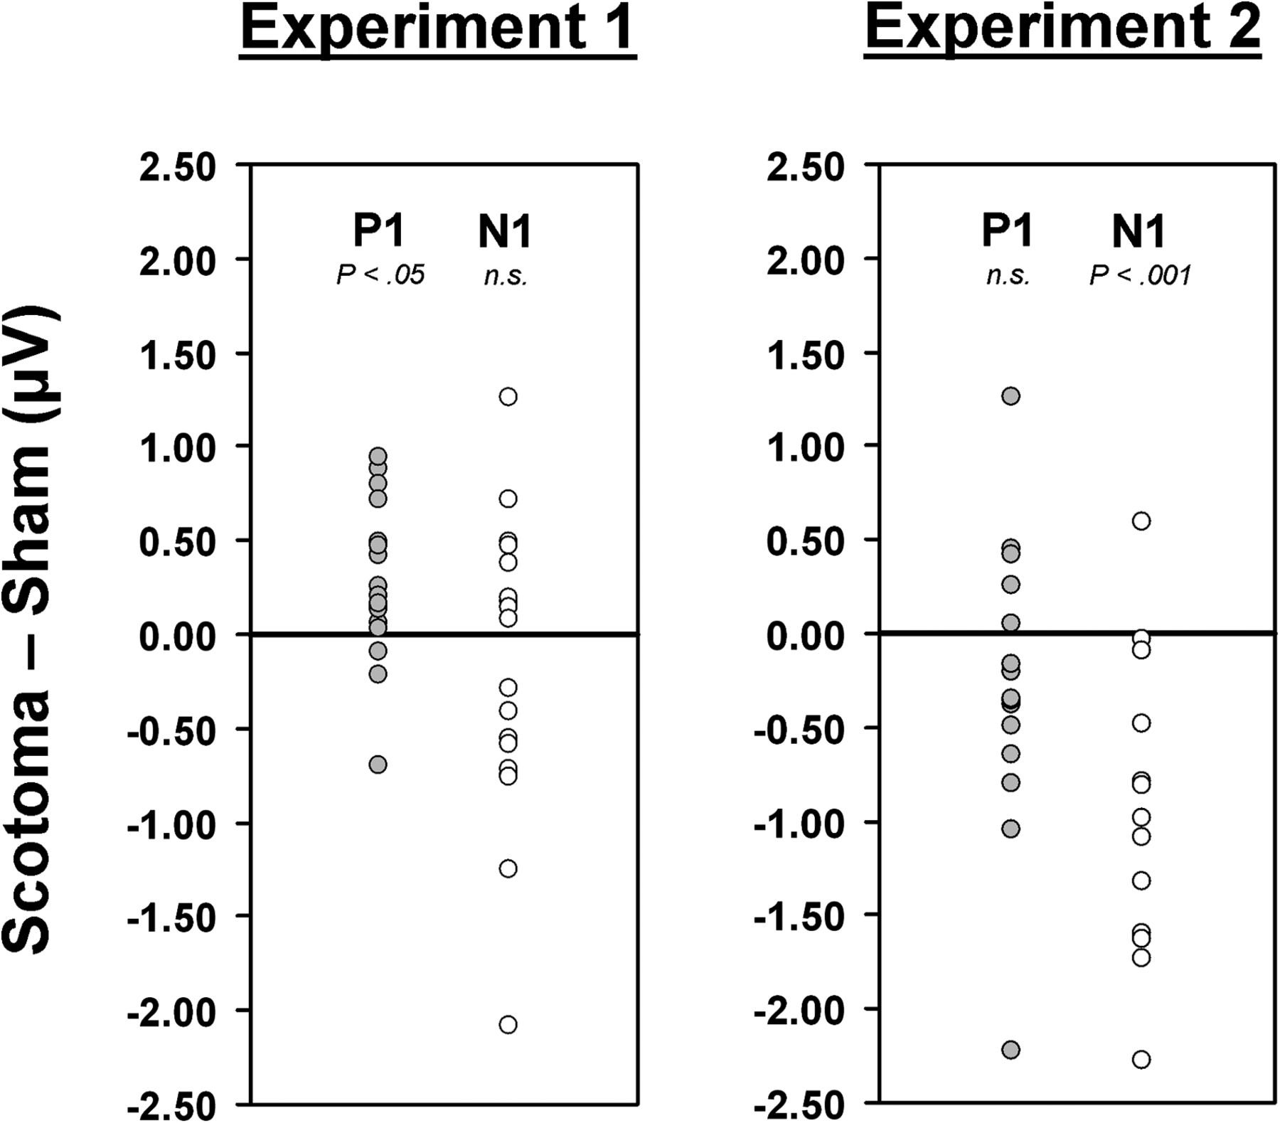
Figure 5. P1 and N1 amplitude differences (Scotoma–Sham) for each subject in Experiments 1 and 2.
Notes:
Figure 5. P1 and N1 amplitude differences (Scotoma–Sham) for each subject in Experiments 1 and 2.
Unless provided in the caption above, the following copyright applies to the content of this slide: © The Author 2012. Published by Oxford University Press. All rights reserved. For permissions, please e-mail: journals.permissions@oup.com

