Slide 1
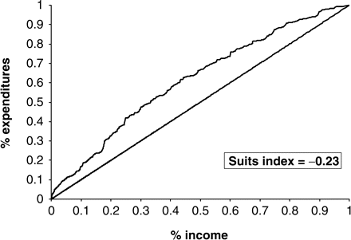
Figure 1 Lorenz curve of tax concentration by income; Suits index
Notes:
Figure 1 Lorenz curve of tax concentration by income; Suits index
Unless provided in the caption above, the following copyright applies to the content of this slide: © The Author 2008. Published by Oxford University Press. All rights reserved. For permissions, please e-mail: journals.permissions@oxfordjournals.org

