Slide 1
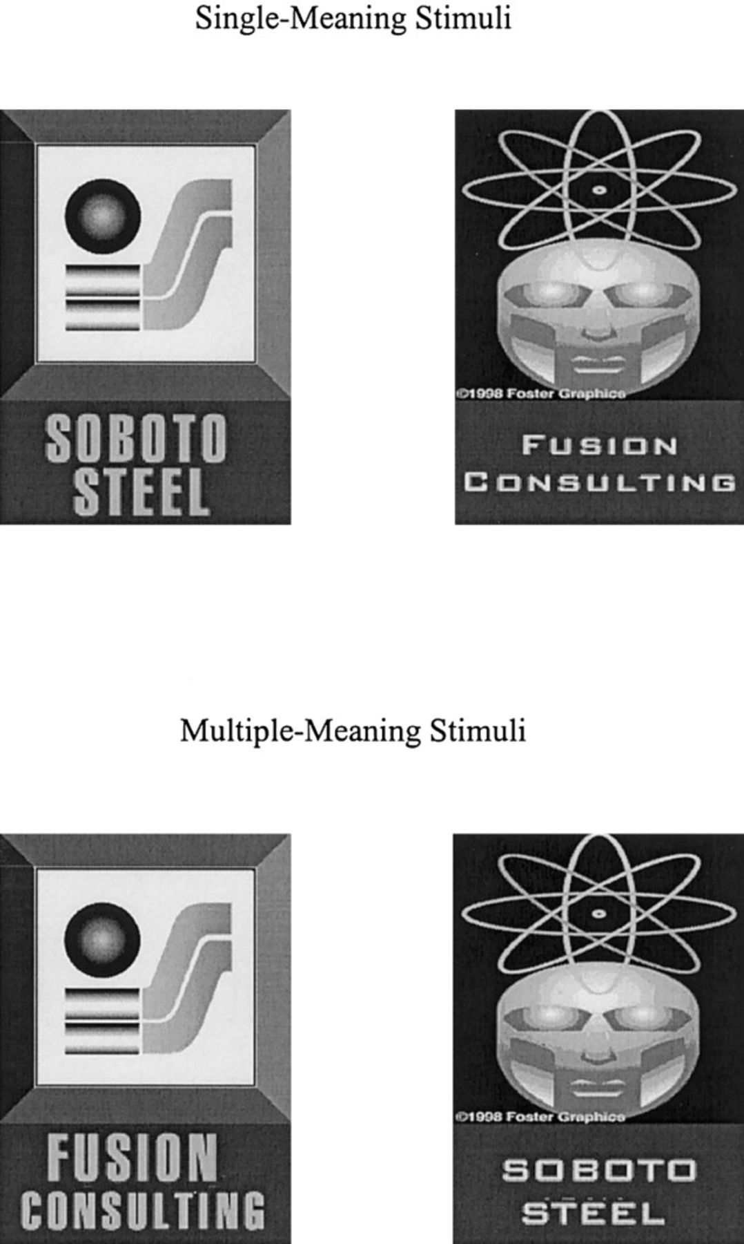
Figure 1 Samples of Single-Meaning and Multiple-Meaning Stimuli
Notes:
Figure 1 Samples of Single-Meaning and Multiple-Meaning Stimuli
Unless provided in the caption above, the following copyright applies to the content of this slide: © 2001 by JOURNAL OF CONSUMER RESEARCH, Inc.

Slide 2
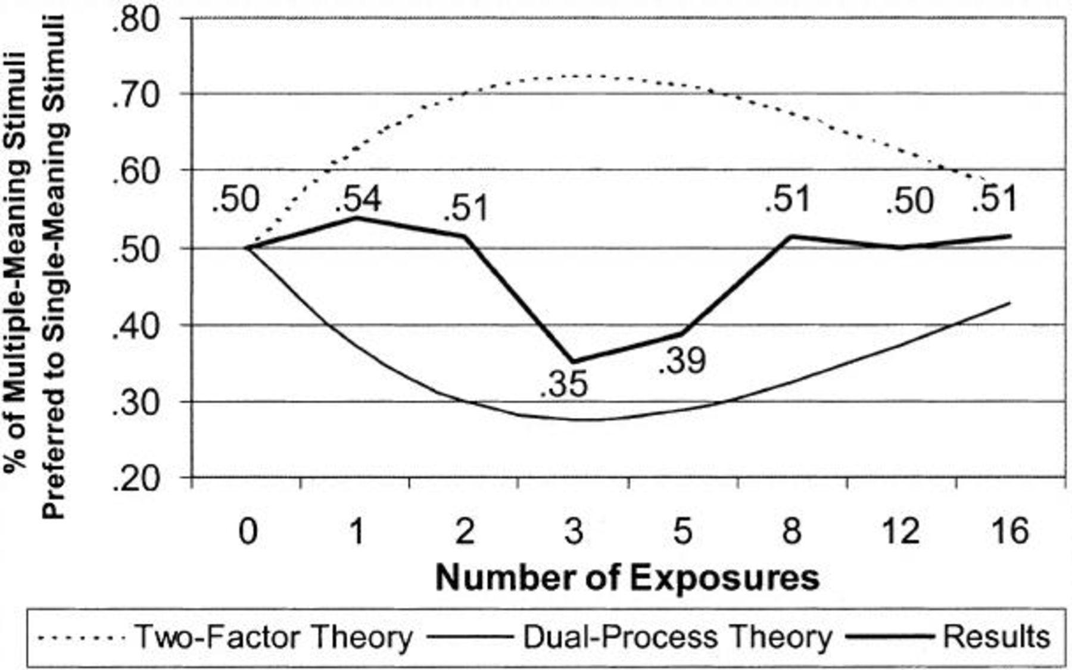
Figure 2 Experiment 1 Predicted and Observed Results: Preference for Multiple-Meaning Stimuli over Single-Meaning ...
Notes:
Figure 2 Experiment 1 Predicted and Observed Results: Preference for Multiple-Meaning Stimuli over Single-Meaning Stimuli at Different Levels of Exposure
Unless provided in the caption above, the following copyright applies to the content of this slide: © 2001 by JOURNAL OF CONSUMER RESEARCH, Inc.

Slide 3
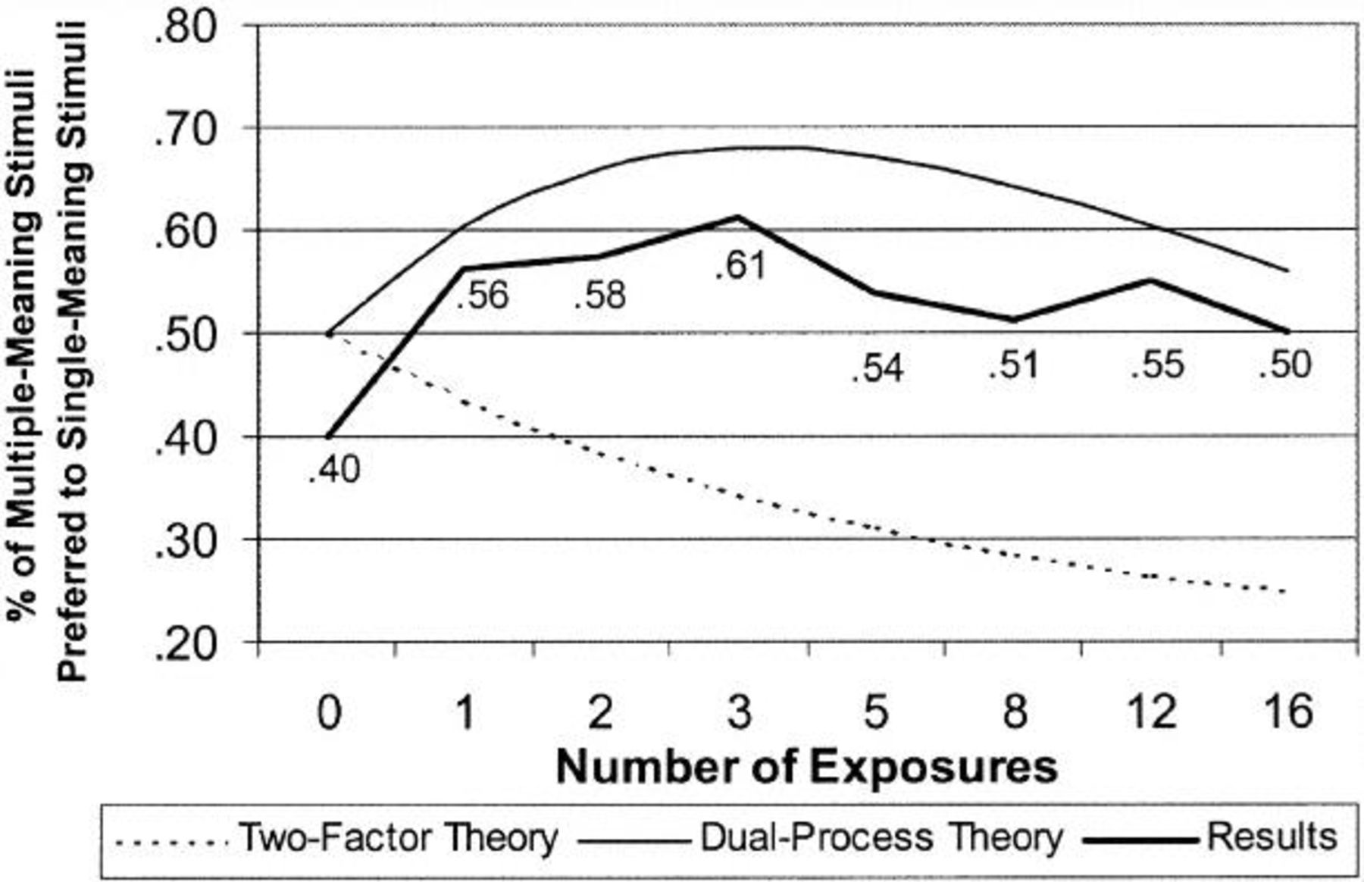
Figure 3 Experiment 2 Predicted and Observed Results: Preference for Multiple-Meaning Stimuli over Single-Meaning ...
Notes:
Figure 3 Experiment 2 Predicted and Observed Results: Preference for Multiple-Meaning Stimuli over Single-Meaning Stimuli at Different Levels of Distributed Exposure
Unless provided in the caption above, the following copyright applies to the content of this slide: © 2001 by JOURNAL OF CONSUMER RESEARCH, Inc.

Slide 4
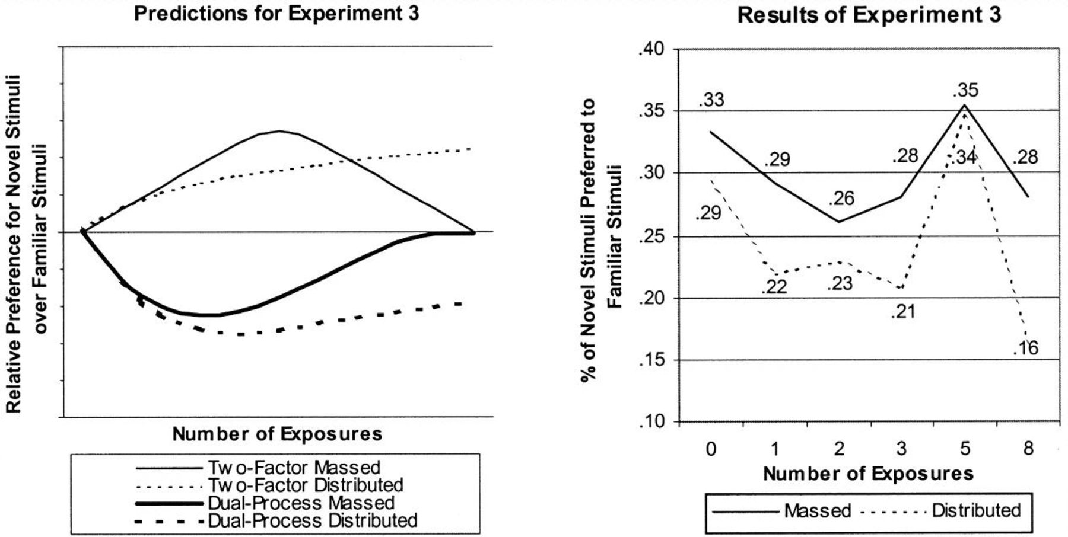
Figure 4 Experiment 3 Predicted and Observed Results: Preference for Novel Stimuli over Familiar Stimuli at Different ...
Notes:
Figure 4 Experiment 3 Predicted and Observed Results: Preference for Novel Stimuli over Familiar Stimuli at Different Levels of Exposure
Unless provided in the caption above, the following copyright applies to the content of this slide: © 2001 by JOURNAL OF CONSUMER RESEARCH, Inc.

Slide 5
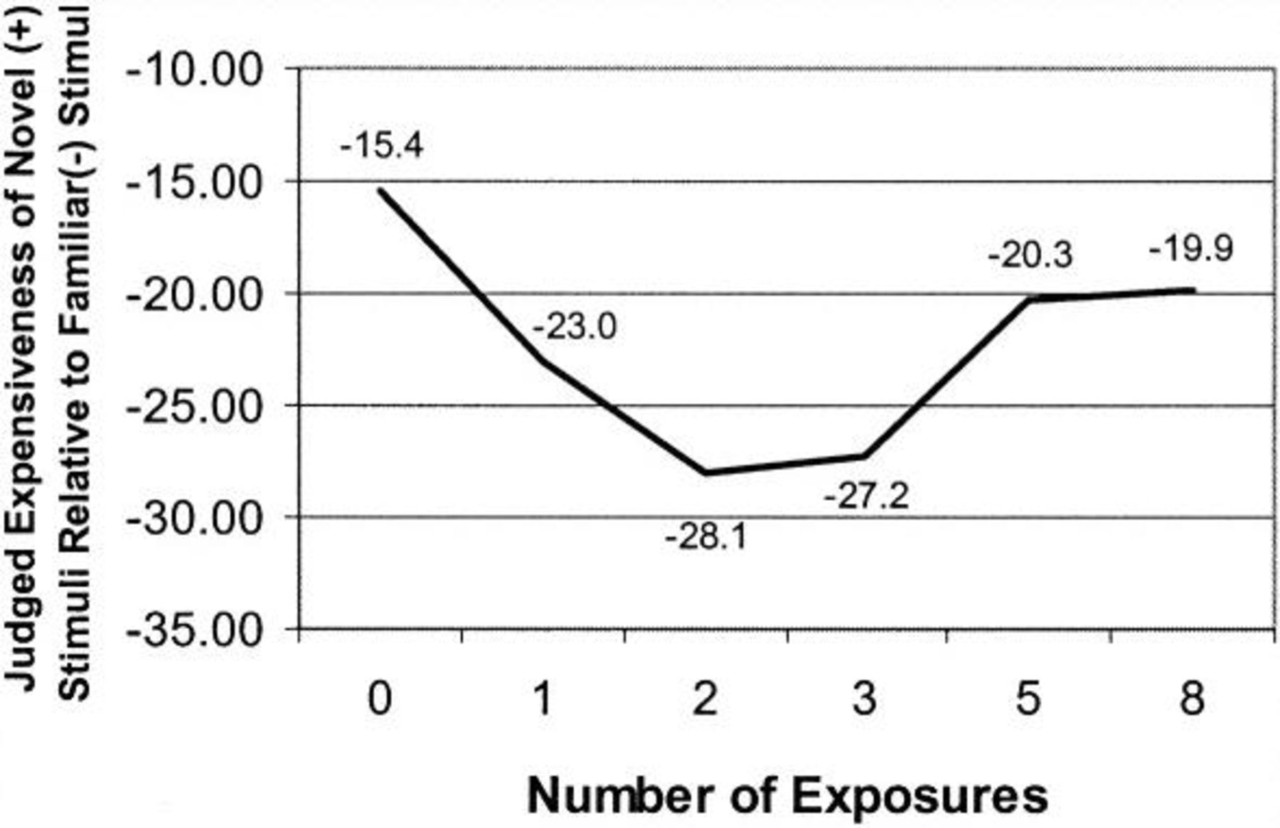
Figure 5 Experiment 4 Results: Judged Expensiveness of Novel Stimuli Relative to Familiar Stimuli at Different Levels ...
Notes:
Figure 5 Experiment 4 Results: Judged Expensiveness of Novel Stimuli Relative to Familiar Stimuli at Different Levels of Exposure
Unless provided in the caption above, the following copyright applies to the content of this slide: © 2001 by JOURNAL OF CONSUMER RESEARCH, Inc.

