Slide 1
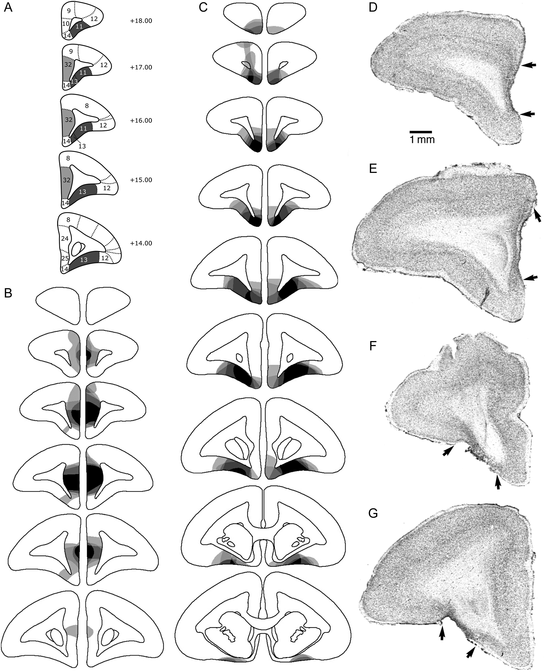
Figure 1. (A–C) Schematic diagrams of a series of coronal sections through the frontal lobe of the marmoset, ...
Notes:
Figure 1. (A–C) Schematic diagrams of a series of coronal sections through the frontal lobe of the marmoset, illustrating the site of the lesion of the pgACC and OFC. (A) Diagram showing target regions for the pgACC (light gray) and OFC (dark gray). (B,C) The different levels of shading, ranging from solid black to pale gray, represent the areas of cortex that were damaged in all monkeys, in all monkeys but one, etc., to just one monkey, in pgACC and OFC, respectively. (D–G) Photomicrographs of cresyl fast violet-stained coronal sections through rostral (D,F) and intermediate (E,G) levels of the prefrontal cortex taken from a representative marmoset from the pgACC- (D,E) and OFC (F,G)-lesioned groups. The extensive cell loss in the lesioned areas is in stark contrast to the dense layering of neurons seen in the adjacent intact areas. In addition, the loss of orbitofrontal tissue in the OFC-lesioned monkey is in contrast to the intact OFC in the pgACC-lesioned monkey (D,E) and vice versa. The arrows mark the borders of the lesions. Cytoarchitectonic numbering according to (Paxinos et al. 2012).
Unless provided in the caption above, the following copyright applies to the content of this slide: © The Author 2016. Published by Oxford University PressThis is an Open Access article distributed under the terms of the Creative Commons Attribution License (http://creativecommons.org/licenses/by/4.0/), which permits unrestricted reuse, distribution, and reproduction in any medium, provided the original work is properly cited.

Slide 2
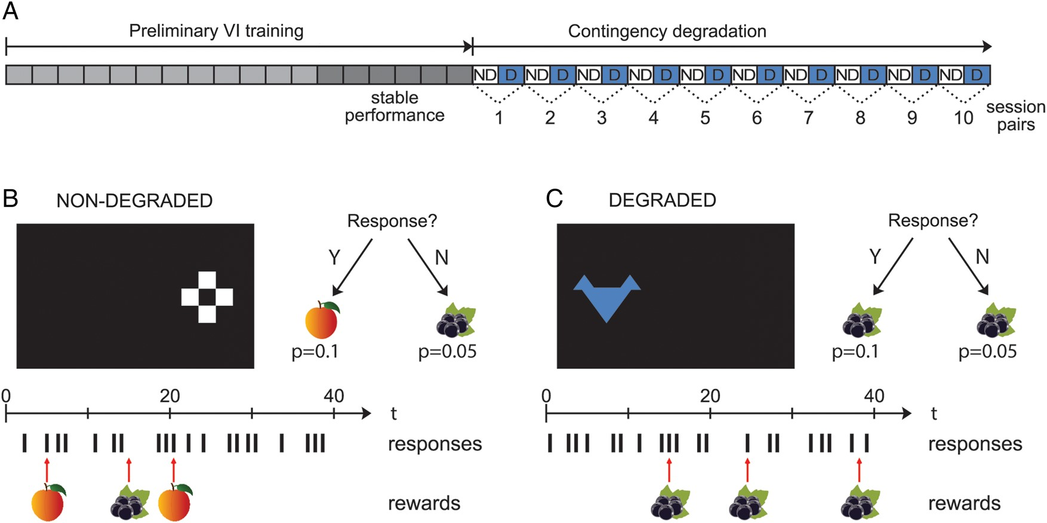
Figure 2. Example contingency degradation for the pairing of response to the left stimulus with blackcurrant juice. (A) ...
Notes:
Figure 2. Example contingency degradation for the pairing of response to the left stimulus with blackcurrant juice. (A) Schematic diagram outlining the schedule of sessions in the training phase and the subsequent contingency degradation test. Following 18 sessions of preliminary VI training, subjects were presented with 20 sessions of the contingency degradation test. On alternate sessions, the white stimulus was presented on the right (responding on which was associated with peach juice) and the blue stimulus was presented on the left (responding on which was associated with blackcurrant juice), as indicated by the white and blue shading of the sessions. For half the subjects, blackcurrant juice was delivered noncontingently across all sessions, whereas peach juice was delivered noncontingently for the others. In the 10 “degraded” sessions, shown by “D” labeling, the juice delivered noncontingently was the same as that delivered contingent upon responding, and in the 10 “nondegraded” sessions, represented by “ND” labelling, the juice delivered noncontingently was not the same as that delivered contingent upon responding. In this example, the contingent relationship between responding to the left blue stimulus and delivery of blackcurrant juice is degraded. (B,C) Illustration of stimuli and their relative positions on the touchscreen along with a simulated series of responses with contingent and noncontingent rewards. (B) Nondegraded contingency condition. Subjects receive peach juice reward for responding to right stimulus with P = 0.1 and noncontingent blackcurrant juice reward with P = 0.05. (C) Degraded contingency condition. Subjects receive blackcurrant juice reward for responding to left stimulus with P = 0.1 and noncontingent blackcurrant juice reward with P = 0.05.
Unless provided in the caption above, the following copyright applies to the content of this slide: © The Author 2016. Published by Oxford University PressThis is an Open Access article distributed under the terms of the Creative Commons Attribution License (http://creativecommons.org/licenses/by/4.0/), which permits unrestricted reuse, distribution, and reproduction in any medium, provided the original work is properly cited.

Slide 3
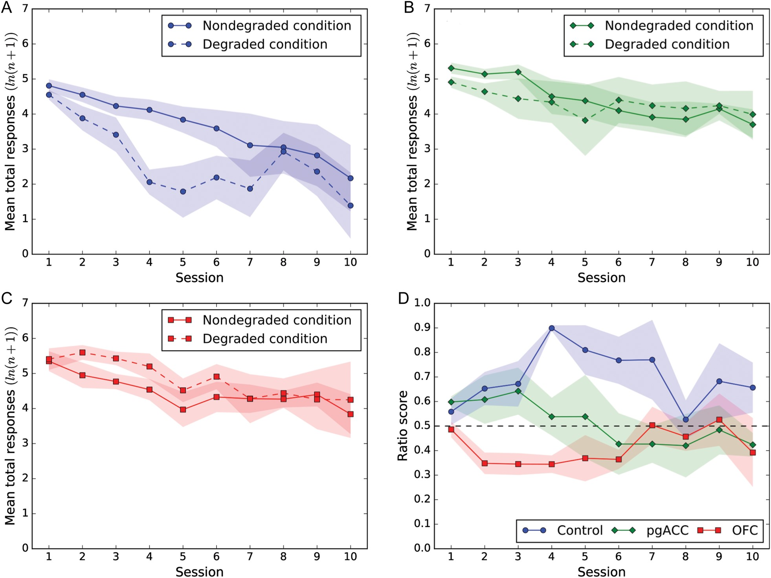
Figure 3. (A–C) Mean total numbers of responses (log transformed) across sessions for each group. Responding in the ...
Notes:
Figure 3. (A–C) Mean total numbers of responses (log transformed) across sessions for each group. Responding in the degraded (dotted line) and nondegraded (solid line) conditions are shown. (A) Control n = 5. (B) pgACC n = 4. (C) OFC n = 5. (D) Ratio scores showing mean responses normalized for the overall response rates of individual animals. The solid fill surrounding each point represents the standard error of the mean. The ratio score was calculated for each pair by dividing the number of responses in the nondegraded session by the sum of the responses from the degraded and nondegraded sessions (nondegraded/(nondegraded + degraded)). The ratio score therefore represents the proportion of responses in the nondegraded condition relative to the degraded condition with a value >0.5 indicating a greater number of responses in the nondegraded condition relative to the degraded condition.
Unless provided in the caption above, the following copyright applies to the content of this slide: © The Author 2016. Published by Oxford University PressThis is an Open Access article distributed under the terms of the Creative Commons Attribution License (http://creativecommons.org/licenses/by/4.0/), which permits unrestricted reuse, distribution, and reproduction in any medium, provided the original work is properly cited.

