Slide 1
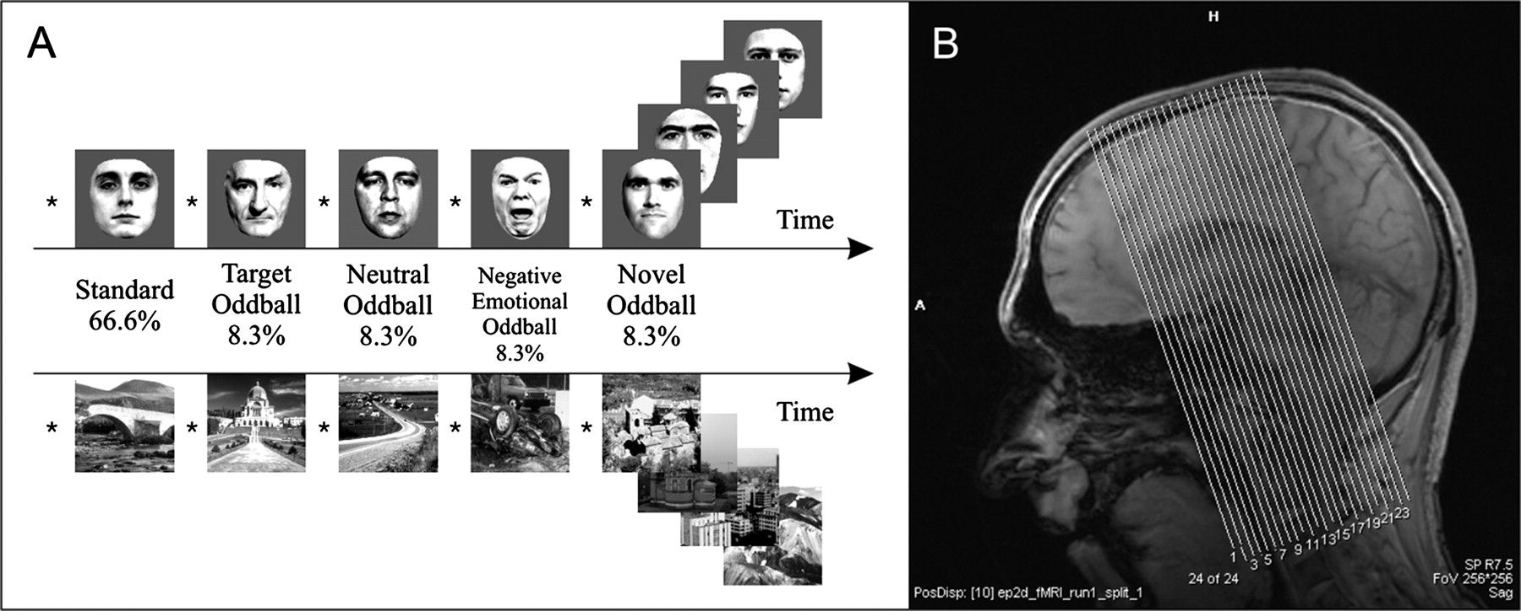
Figure 1. Stimuli, experimental design (A), and fMRI slice acquisition (B). In an oddball paradigm, we used standard ...
Notes:
Figure 1. Stimuli, experimental design (A), and fMRI slice acquisition (B). In an oddball paradigm, we used standard stimuli, target oddballs, neutral oddballs, negative emotional oddballs, and novel oddballs—the numbers denote frequency of occurrence (in %). In one half of the experiment we presented pictures of male faces and in the other half outdoor scenes. The order was counterbalanced across subjects. For each fMRI volume, 24 slices were acquired parallel to the midbrain covering the SN/VTA, hippocampus, amygdala, parts of the cerebellum, and prefrontal cortex (B).
Unless provided in the caption above, the following copyright applies to the content of this slide: © The Author 2007. Published by Oxford University Press. All rights reserved. For permissions, please e-mail: journals.permissions@oxfordjournals.org

Slide 2
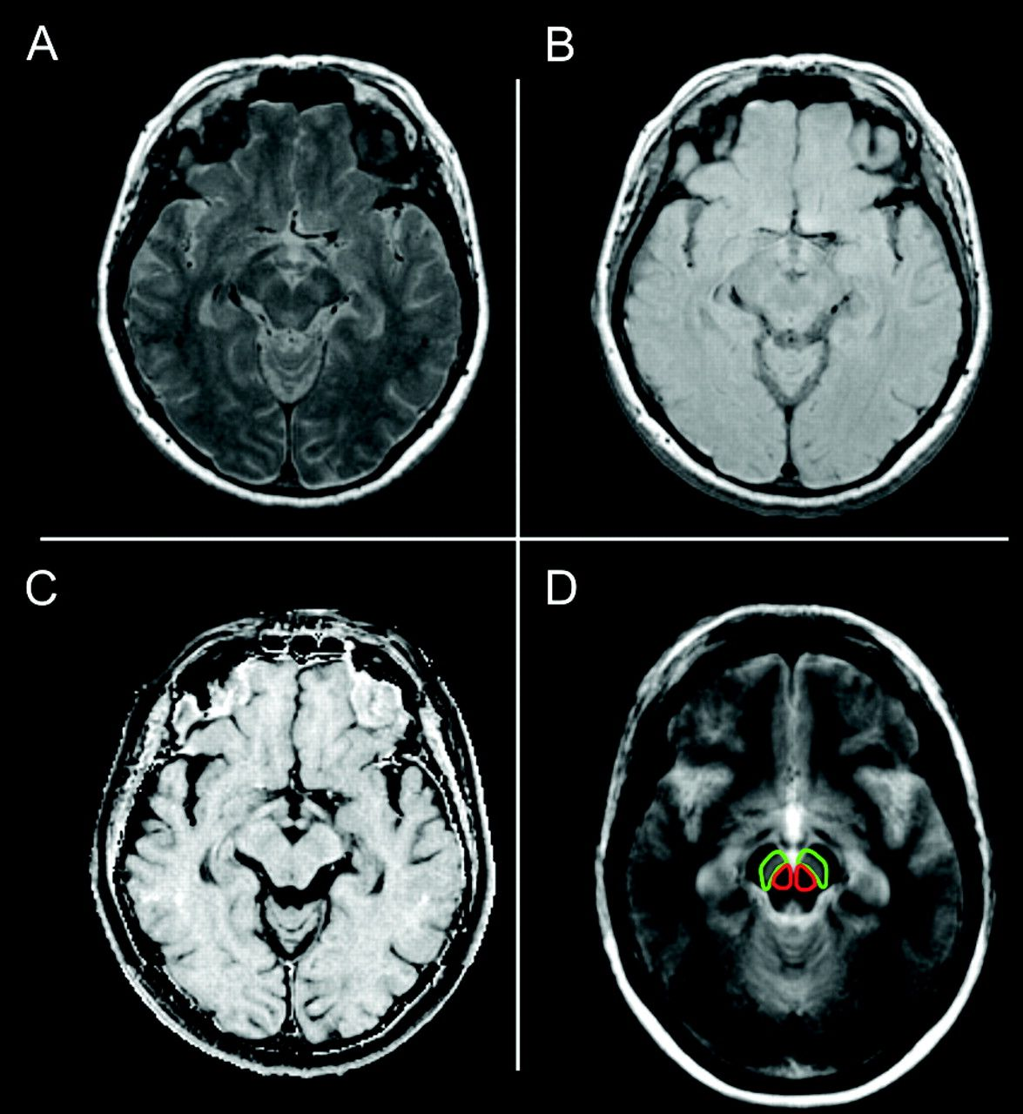
Figure 2. Anatomical MR images. For each subject 2 proton density images were acquired: one proton density image with a ...
Notes:
Figure 2. Anatomical MR images. For each subject 2 proton density images were acquired: one proton density image with a preparing saturation pulse resulting in an MT image (A) and a second proton density image without a preparing saturation pulse resulting in a noMT image (B). Both images were used to calculate the subject's MTR image (C) (see Materials and Methods), which was used to determine the structural integrity of the subjects' SN/VTA, hippocampus, and amygdala. All older subjects' normalized MT images were averaged resulting in an MT template of the group (D), which was used to localize activations within the SN/VTA (encircled in green) and red nucleus (encircled in red).
Unless provided in the caption above, the following copyright applies to the content of this slide: © The Author 2007. Published by Oxford University Press. All rights reserved. For permissions, please e-mail: journals.permissions@oxfordjournals.org

Slide 3
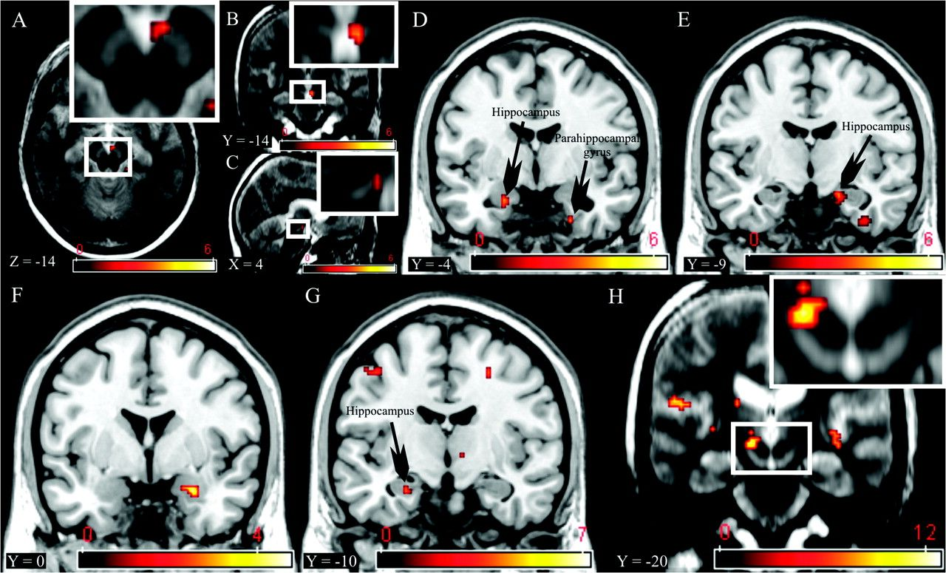
Figure 3. FMRI activation patterns. Novelty processing (novel oddballs vs. neutral oddballs) was associated with ...
Notes:
Figure 3. FMRI activation patterns. Novelty processing (novel oddballs vs. neutral oddballs) was associated with activation in SN/VTA (A–C), hippocampus, and parahippocampal cortex (D, E). Negative emotional valence (negative emotional oddballs vs. neutral oddballs) activated the right amygdala (F) and rareness (neutral oddballs vs. standards) activated the hippocampus (G). Both negative emotional valence and rareness did not activate the SN/VTA. Targetness (target oddballs vs. neutral oddballs) activated the left red nucleus (H). Activation maps were superimposed on an MT template in (A, B, C, and H) (see Materials and Methods) and on the T1-weighted standard MNI brain in (D, E, F, and G). Activation maps were thresholded at P = 0.005 (uncorrected) except from (H) were activations were thresholded at P = 0.05 (corrected).
Unless provided in the caption above, the following copyright applies to the content of this slide: © The Author 2007. Published by Oxford University Press. All rights reserved. For permissions, please e-mail: journals.permissions@oxfordjournals.org

Slide 4
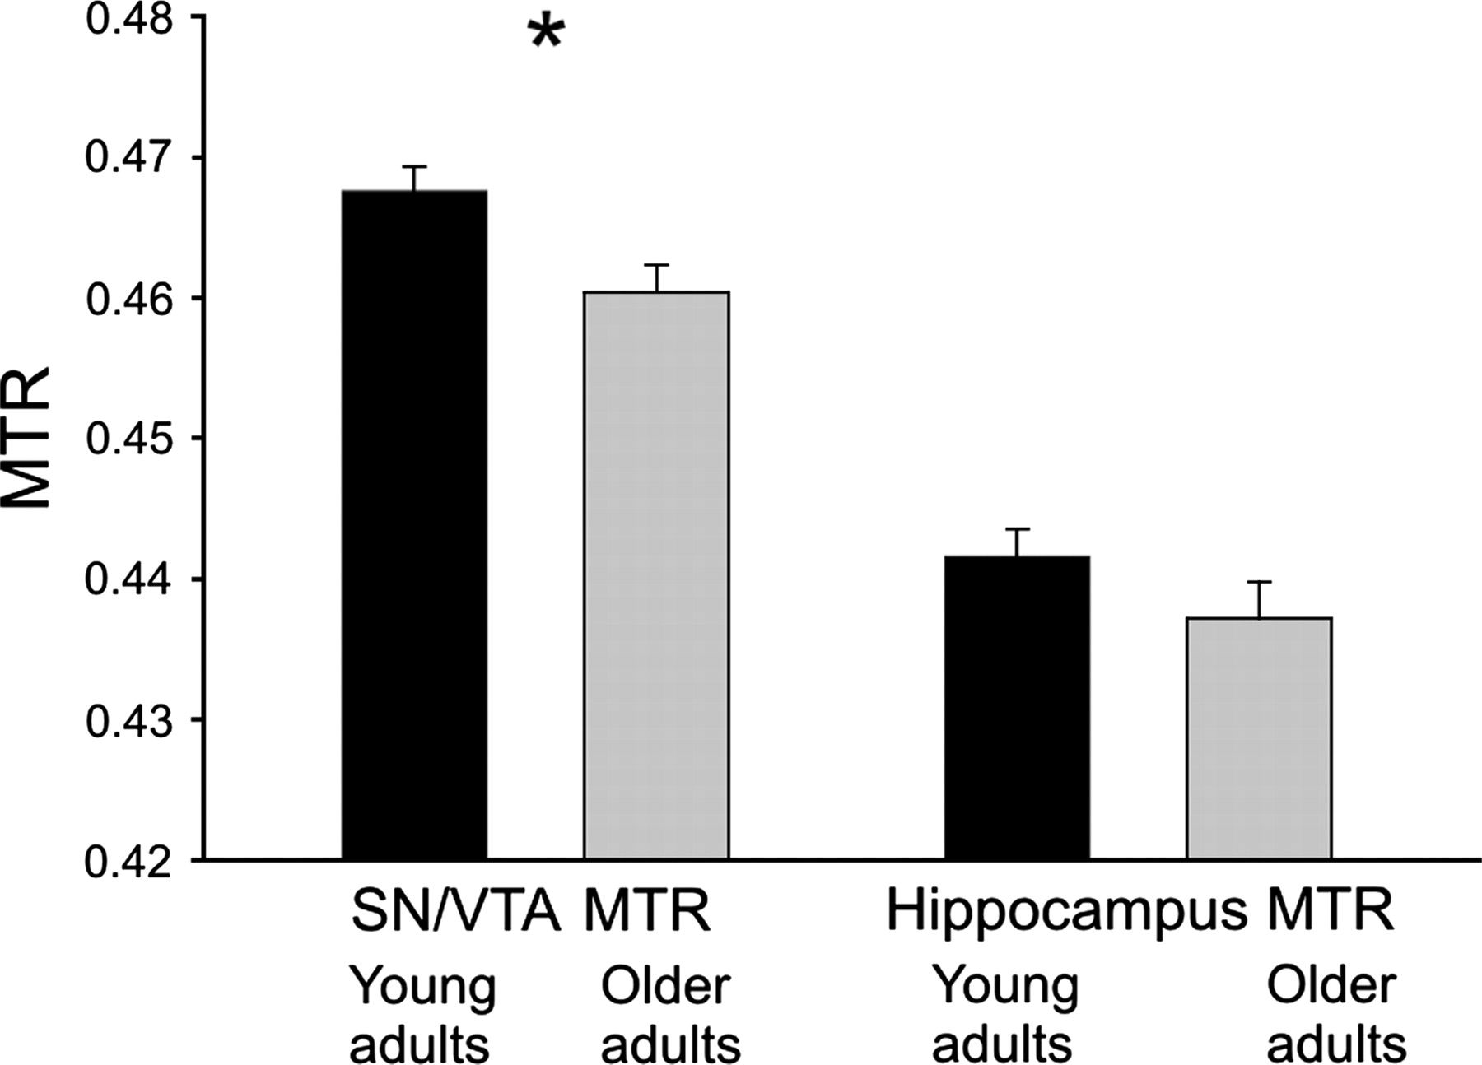
Figure 4. MTR comparison between young and older adults. While the SN/VTA MTR was significantly higher in the ...
Notes:
Figure 4. MTR comparison between young and older adults. While the SN/VTA MTR was significantly higher in the population of young adults (two-tailed comparison, P = 0.008, T = 2.8) (indicated by the star), the hippocampi MTR did not differ significantly between both populations but tended to be higher in the sample of young adults (two-tailed comparison, P = 0.17, T = 1.4). Error bars indicate the standard error of the mean.
Unless provided in the caption above, the following copyright applies to the content of this slide: © The Author 2007. Published by Oxford University Press. All rights reserved. For permissions, please e-mail: journals.permissions@oxfordjournals.org

Slide 5
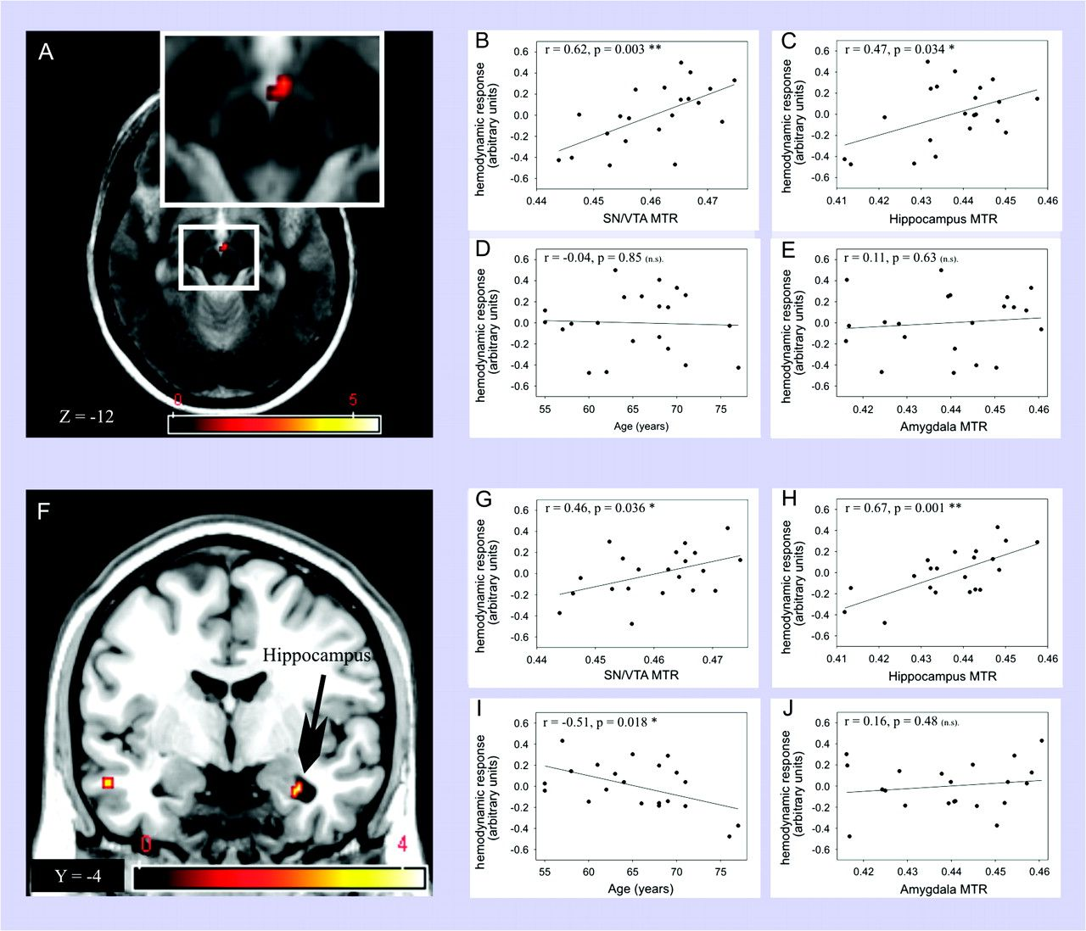
Figure 5. Correlations between novelty-related HRs and MTRs. Novelty HR in SN/VTA (A) correlated positively with SN/VTA ...
Notes:
Figure 5. Correlations between novelty-related HRs and MTRs. Novelty HR in SN/VTA (A) correlated positively with SN/VTA MTR (B) and hippocampus MTR (C) but not age (D) or amygdala MTR (E). In the hippocampus (F), novelty HR correlated positively with SN/VTA MTR (G), hippocampus MTR (H) and negatively with age (I) but not with amygdala MTR (J). Activation maps were superimposed on the group MT template (A) or the T1-weighted standard MNI brain (F) and thresholded at P = 0.005 (uncorrected). Asterisks indicate a significant correlation at *P = 0.05 or **P = 0.01—n.s. abbreviates “not significant” (P > 0.05).
Unless provided in the caption above, the following copyright applies to the content of this slide: © The Author 2007. Published by Oxford University Press. All rights reserved. For permissions, please e-mail: journals.permissions@oxfordjournals.org

