Slide 1
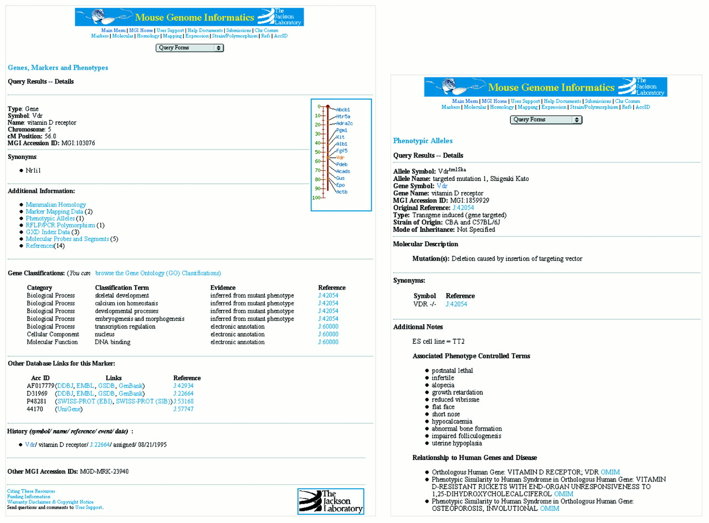
Figure 1. MGD gene and allele detail pages for Vdr. Gene detail report for Vdr, the gene for the vitamin D ...
Notes:
Figure 1. MGD gene and allele detail pages for Vdr. Gene detail report for Vdr, the gene for the vitamin D receptor, and the new allele detail report for an allele of the Vdr gene. The gene detail report includes annotation to the GO as well as extensive links to sequence representations for this gene. The allele detail report includes information about the source of the allele as well as details of the phenotype presentation and information about its utility as a model for human phenotypes.
Unless provided in the caption above, the following copyright applies to the content of this slide:

