Slide 1
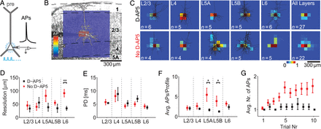
Figure 1. Calibration of the stimulation parameters for uncaging experiments. (A) Cells in all layers were directly ...
Notes:
Figure 1. Calibration of the stimulation parameters for uncaging experiments. (A) Cells in all layers were directly stimulated with light flashes to determine the minimal stimulation strength necessary to elicit at least 1 AP, as well as the area within the slice where this minimal stimulation leads to spiking of the cell. (B) Typical excitation profile from a L2/3 pyramidal neuron, overlaid on the transmission light image taken during the experiment. Black dashed lines denote second-order polynomial fits to the layer borders. The pixel values code for the normalized mean number of APs. (C) Averaged excitation profiles from all layers with overlaid reconstructions of recoverable neurons, same color-code as in (B). One pixel represents 75 × 75 µm2. Data are presented for control conditions (lower row) and with D-AP5 (upper row). (D) Spatial resolution R of photostimulation. For L6, the spatial resolution is significantly increased with D-AP5 (P 0.05). (F) The average number of APs per profile is markedly reduced with D-AP5 in L5A and L5B (P < 0.05), which is primarily due to a reduction in the number of bursts per pixel. (G) Mean number of APs during repeated stimulation of the same neuron. Without D-AP5, there is a clear rise in excitability, leading to a decrease in resolution over time when using the uncaging approach.
Unless provided in the caption above, the following copyright applies to the content of this slide: © The Author 2014. Published by Oxford University Press. All rights reserved. For Permissions, please e-mail: journals.permissions@oup.com

Slide 2
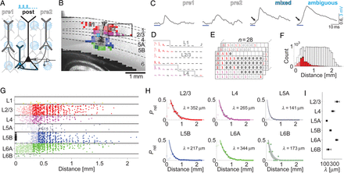
Figure 2. Functional mapping of horizontal connectivity (A) A region ∼2 mm to each side of the somato-dendritic axis of ...
Notes:
Figure 2. Functional mapping of horizontal connectivity (A) A region ∼2 mm to each side of the somato-dendritic axis of the postsynaptic cell (black cell) was scanned. When APs were elicited in cells with an intact projection onto the postsynaptic cell (white cells), a postsynaptic potential was detected. Stimulation of presynaptic cells close to the postsynaptic cell's dendrite led to mixed responses (cyan cell). (B) Typical functional map of a postsynaptic L5B-pyr overlaid on the transmission light image taken during the experiment. The layer of origin of the projection is color-coded (same color assignment used in all following figures). Marked positions correspond to the EPSP-traces in C, whereas the black box marks the region displayed in D. The approximate contour of the dendritic tree of the L5B-pyr was spared from stimulation (empty pixels). (C) Mean postsynaptic responses from the activation of presynaptic cells (pre1 and 2) display fast onsets after long latencies, whereas direct/ambiguous (cyan) or mixed (cyan/black) responses typically show slower rising phases and shorter latencies (arrows). (D) Averaged postsynaptic potentials recorded after stimulation; identified projections are marked in red/magenta (black: no response, pale: direct stimulation, strong responses are clipped), scale bars are 50 ms and 1 mV. Gray lines denote layer borders. (E) Calculation of the relative connection probability as the ratio between tested and connected/ambiguous positions in bins of 100 µm from n = 28 experiments. Positions containing presynaptic cells are marked as 1 (connected), 0 (not connected), or 0.5 (ambiguous). Grayed-out positions denote bins that contained more than 20% of ambiguous responses and were excluded from further analysis. (F) Distance-dependent number of tested (white) and connected (red) positions pooled over all experiments and layers. Green fraction denotes ambiguous positions included in the fitting whereas grayed-out areas denote distances excluded from analysis according to our rejection criteria (see Materials and Methods). (G) Identified locations of presynaptic cells from all mapping experiments (black triangles: postsynaptic L5B-pyr). Black horizontal lines denote the normalized layer borders. We found a total of 2260 intact projections up to 2 mm lateral to the somato-dendritic axis of the postsynaptic L5B-pyr. Filled circles indicate projections used for fitting (n = 1083) whereas pale, open circles indicate excluded projections according to our rejection criteria. (H) Relative connection probability (Prel) as determined in E fitted with an exponential function (filled circles: values used for fitting; open circles: rejected bins; gray area: 95% confidence interval for decay constant λ). For L6B, there were not enough data points to robustly fit the decay (n = 18, dashed line), but the fit is depicted for completeness. (I) The direct comparison of λ from each fit shows that L2/3 and L6A have the largest extent of horizontal connectivity for L5B-pyr. Error bars denote 95% confidence interval of the fits from H.
Unless provided in the caption above, the following copyright applies to the content of this slide: © The Author 2014. Published by Oxford University Press. All rights reserved. For Permissions, please e-mail: journals.permissions@oup.com

Slide 3
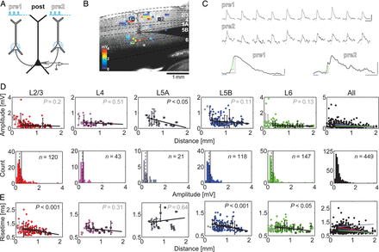
Figure 3. Synaptic physiology of horizontal projections. (A) Selected presynaptic locations were repetitively ...
Notes:
Figure 3. Synaptic physiology of horizontal projections. (A) Selected presynaptic locations were repetitively stimulated, and postsynaptic EPSPs were recorded. (B) Subset of stimulated projections to a postsynaptic L5B-pyr (black) overlaid with the transmission light image taken during the experiment. Average postsynaptic response strength is color-coded, white pixels denote false-positives identified with offline sorting, white squares (pre1 and 2) mark the positions where stimulation led to the responses shown in C. (C) EPSPs evoked by activating putative monosynaptic projections. Blue bars mark stimulation; scale bars are 50 ms and 1 mV. Extraction of physiological parameters was performed on single trials (lower panels, scale bars are 10 ms and 0.5 mV), the gray dashed line denotes the amplitude and the green solid line the 20–80% rise time of the EPSP. In case of bursts of EPSPs, only the first response was taken into account. (D) EPSP amplitudes versus distance (upper row) and EPSP amplitude distributions (lower row) for each layer and all layers pooled (black, rightmost panels). The linear regression shows that the decay in EPSP amplitude for distances larger than 300 µm is not significant for all layers except L5A (P < 0.05; black empty squares, mean ± SD; gray squares were not used for fitting; bin size: 100 µm). The shape of the amplitude distribution is consistent with that known for local projections (mean: solid line; median: dashed line). (E) EPSP rise times versus distance for each layer and all layers pooled (black, rightmost panel). The linear regression shows that the rise time in Layers 2/3, 5B, and 6 decreases significantly for distances larger than 300 µm (same notation as in D).
Unless provided in the caption above, the following copyright applies to the content of this slide: © The Author 2014. Published by Oxford University Press. All rights reserved. For Permissions, please e-mail: journals.permissions@oup.com

Slide 4
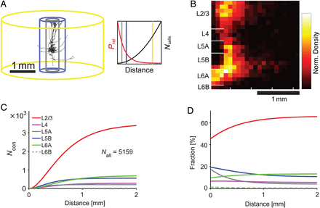
Figure 4. (A) Representation of cortical space under simplified assumptions of homogeneity and isotropy. The cylinders ...
Notes:
Figure 4. (A) Representation of cortical space under simplified assumptions of homogeneity and isotropy. The cylinders represent the 3 different distances from the postsynaptic cell (gray: 250 µm, the local network or “column”; blue: 500 µm, the extent of the axonal plexus of L5B neurons; yellow: 2000 µm, extent of our measurements) used for our estimations on the numbers of connected neurons. The total number of cells increases in a quadratic fashion with distance (right panel, black curve), whereas the connection probability decreases exponentially (red curve). (B) The normalized density plot of all identified projections depicts the predominance of L2/3 and L5B/L6A projections for distances >500 µm. (C) Cumulative display of the estimated number of connected cells (Ncon) as derived from the data in Figure 2 (see Table 1 for parameters). The local network (<250 µm) only provides a small fraction of the overall input to L5B-pyr. The curves depicting the estimates of connected cells from each layer separate with increasing distance, showing that L2/3 and L5B/L6A provide most of the synaptic input to L5B-pyr. The overall number of connected cells was estimated to be 5159. (D) Change in layer-resolved relative contribution to the total synaptic input with distance. In the local network (<250 µm), L5B provides the second largest source of synaptic input, whereas the contribution of L6A starts to dominate that of L5B with increasing distance.
Unless provided in the caption above, the following copyright applies to the content of this slide: © The Author 2014. Published by Oxford University Press. All rights reserved. For Permissions, please e-mail: journals.permissions@oup.com

Slide 5
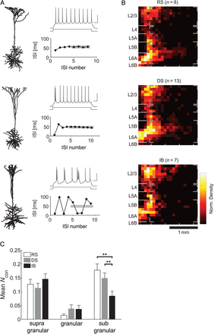
Figure 5. Differential analysis of the data set according to firing patterns of L5B-pyr. (A) Example neurons that were ...
Notes:
Figure 5. Differential analysis of the data set according to firing patterns of L5B-pyr. (A) Example neurons that were classified as “regular spiking” (RS), “doublet spiking” (DS), or “intrinsically bursting” (IB) according to the analysis of the inter-spike-interval of their responses to step current injections (see Hedrick and Waters 2012 for details). (B) Normalized density plots as in Fig. 4B for the 3 cell-classes. RS- as well as DS-cells receive horizontal projections mainly from L2/3, L5B, and L6A. For IB cells, the L5B/L6A input is weak at larger distances. Gray brackets denote regions of interest (ROI) for analysis in C. (C) Comparison of the mean number of found horizontal projections (weighted by the number of experiments in each group) to the 3 types of cells from subgranular, granular, and supragranular layers. These results show that IB cells receive significantly less input from subgranular layers (KW-test, P < 0.01).
Unless provided in the caption above, the following copyright applies to the content of this slide: © The Author 2014. Published by Oxford University Press. All rights reserved. For Permissions, please e-mail: journals.permissions@oup.com

Slide 6
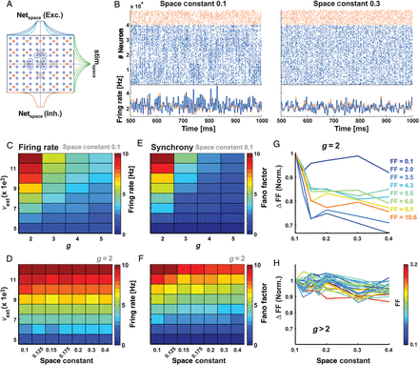
Figure 6. (A) Scheme of the cortical network model. 50 000 neurons (80% excitatory, pale blue dots; 20% inhibitory, ...
Notes:
Figure 6. (A) Scheme of the cortical network model. 50 000 neurons (80% excitatory, pale blue dots; 20% inhibitory, orange dots) were arranged in a grid on a 2D-sheet. The spatial connectivity profiles of excitatory (netspace, blue) and inhibitory neurons (orange) are shown on top and bottom, respectively. The space constant of the stimulus projection (stimspace, green) is shown on the right side. Different saturation levels refer to different space constants. In every simulation, 500 neurons (400 excitatory and 100 inhibitory, schematically marked with blue circles) received external input in addition to the background Poisson inputs. (B) Two examples showing raster plots of network activity with a small space constant (left panel) and a larger space constant (right panel). The blue dots refer to spikes from excitatory neurons whereas the orange dots refer to those from inhibitory neurons. The corresponding average population firing rate is shown in the bottom row. (C) Average firing rate in the network as a function of external excitatory input (νext) and the ratio of recurrent inhibition and excitation g, for netspace = 0.1. (D) Average firing rate in the network at a given g (g = 2, the only value tested that gave substantial synchrony; see Panel E) as a function of netspace and external excitatory input. Changing the space constant does not affect average firing rates. (E) Global synchrony (Fano Factor) in the network as a function of external excitatory input and the ratio of recurrent inhibition and excitation g, for netspace = 0.1. Substantial synchrony only develops with g = 2. (F) Global synchrony in the network as a function of netspace and external excitatory input for g = 2. Synchrony decreases monotonically as a function of netspace. (G) Relative change in the synchrony as a function of netspace for g = 2. The synchrony for netspace > 0.1 was normalized with the synchrony value at netspace = 0.1. Warmer line colors refer to higher total values of synchrony. The actual value of the synchrony for netspace = 0.1 is shown on the side. When there is synchrony in the network, increasing the space constant reduces the synchrony. (H) Same as in G, but for synchrony values of g > 2. When there is only little synchrony in the network, increasing the space constant does not alter synchrony.
Unless provided in the caption above, the following copyright applies to the content of this slide: © The Author 2014. Published by Oxford University Press. All rights reserved. For Permissions, please e-mail: journals.permissions@oup.com

Slide 7
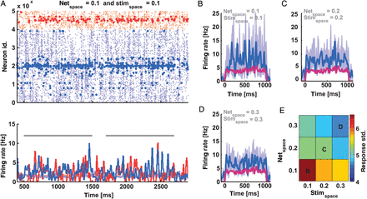
Figure 7. Trial-by-trial variability of the stimulus response in the recurrent network. (A) Stimulus response of a ...
Notes:
Figure 7. Trial-by-trial variability of the stimulus response in the recurrent network. (A) Stimulus response of a locally connected random network. Top: raster diagram of spiking activity. Spikes of the stimulated cells (400 excitatory and 100 inhibitory neurons) are marked in dark blue and red. Pale dots refer to neurons that were not stimulated (gray bars denote stimulation epochs). Corresponding population average firing rate is shown below. (B–D) Average firing rates of the stimulated neurons. The pale blue traces show 10 individual trials whereas the dark blue trace is the average of the 10 trials. Only the response of excitatory neurons is shown. The purple trace shows the average input, which was identical in all cases. The recurrent excitatory and stimulus space constants are specified on top of each panel. (E) Pseudo-color map of the variance of the trial-by-trail responses for an identical stimulus as a function of netspace and stimspace. Increasing both results in a reduced trial-by-trail variability, whereas netspace is the more effective parameter.
Unless provided in the caption above, the following copyright applies to the content of this slide: © The Author 2014. Published by Oxford University Press. All rights reserved. For Permissions, please e-mail: journals.permissions@oup.com

