Slide 1
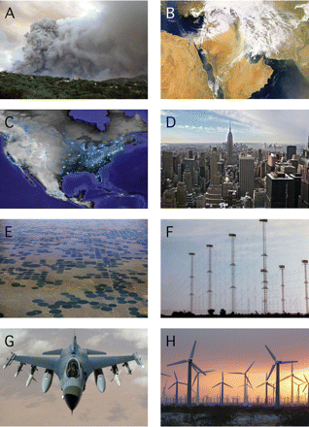
Fig. 1 The aerosphere is influenced by both natural phenomena and anthropogenic factors. (A) Aerospheric view of a ...
Notes:
Fig. 1 The aerosphere is influenced by both natural phenomena and anthropogenic factors. (A) Aerospheric view of a volcanic eruption on the island of Montserrat (news.nationalgeographic.com); (B) Counter-clockwise swirl of clouds as a cyclone passed over Iraq, and dust being transported within the warm sector of the system (ucsu.colorado.edu/~drewsc/sandstorm/); (C) Aerial view of the North American landscape at night, showing lighted cites and towns (www.usgcrp.gov/usgcrp/images/ocp2003/8.1b-HCR); (D) Aerospheric view of skyscrapers New York City (www.justinlagace.com); (E) Aerial view of an agricultural landscape, showing the influence of center pivot irrigation in an arid region of Colorado (www.discoverlife.org/IM/EL_DP/0010/mx); (F) Aerospheric view of land-based communication towers (hawkins.pair.com/voadelano/voa_delano03.jpg); (G) Aerospheric view of a modern U.S. Air Force F-16 Fighting Falcon aircraft (galleries.fototagger.com/image/f-16_fighting_); (H) Aerospheric view of a modern, utility-scale wind energy facility in Palm Springs, California (www.planetscience.org/revisiontime/wind2.jpg).
Unless provided in the caption above, the following copyright applies to the content of this slide: © The Author 2008. Published by Oxford University Press on behalf of the Society for Integrative and Comparative Biology. All rights reserved. For permissions please email: journals.permissions@oxfordjournals.org.

