Slide 1
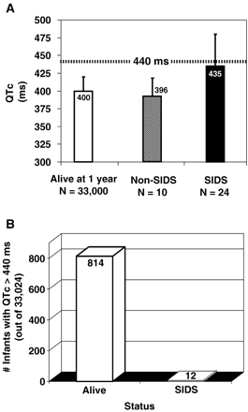
Fig. 1 Fulfillment of the QT hypothesis. (A) Summary of the corrected QT interval (QTc) derived from the screening ...
Notes:
Fig. 1 Fulfillment of the QT hypothesis. (A) Summary of the corrected QT interval (QTc) derived from the screening day 3/day 4 of life ECG in over 34,000 infants by Schwartz and colleagues [28]. Although QTc measurements were made on a random sampling of 9725 infants, the data is shown in the controls as an extrapolation for the entire cohort of 33,000 infants alive at their first birthday. (B) Utilizing the derived 97.5th percentile cutoff of 440 ms, this graph summarizes the number of infants alive and well at 1 year of age compared to the number of decendents, all of whom would have exceeded this cutoff. Although the odds ratio associated with a QTc cutoff of 440 ms was > 40, the positive predictive value was approximately 1.5%.
Unless provided in the caption above, the following copyright applies to the content of this slide: Copyright © 2005, European Society of Cardiology

Slide 2
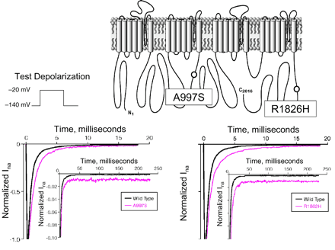
Fig. 2 SCN5A mutations in SIDS. Summary of the molecular and functional characterization of LQT3-associated SCN5A ...
Notes:
Fig. 2 SCN5A mutations in SIDS. Summary of the molecular and functional characterization of LQT3-associated SCN5A mutations found in 2 of 58 white SIDS infants. The locations of the two mutations are displayed on the linear topology of the SCN5A-encoded sodium channel alpha subunit. In vitro heterologous expression studies for each variant show typical LQT3-like “gain-of-function” channel phenotype.
Unless provided in the caption above, the following copyright applies to the content of this slide: Copyright © 2005, European Society of Cardiology

Slide 3
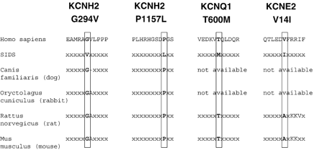
Fig. 4 Species conservation of putative SIDS-causing K channel mutations. Sequence alignments across several species ...
Notes:
Fig. 4 Species conservation of putative SIDS-causing K channel mutations. Sequence alignments across several species are shown for the four K channel variants found in three decendents.
Unless provided in the caption above, the following copyright applies to the content of this slide: Copyright © 2005, European Society of Cardiology

Slide 4
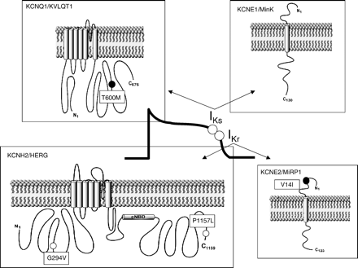
Fig. 3 K channel mutations in SIDS. This schematic depicts the linear topologies for the four K channel subunits ...
Notes:
Fig. 3 K channel mutations in SIDS. This schematic depicts the linear topologies for the four K channel subunits implicated in congenital LQTS. The approximate locations and amino acid substitutions for the four K channel variants that were found in three decedents are displayed. Both variants found in two white infants are shown by white circles and the two channel variants present in a single black infant are shown as black circles.
Unless provided in the caption above, the following copyright applies to the content of this slide: Copyright © 2005, European Society of Cardiology

