Slide 1
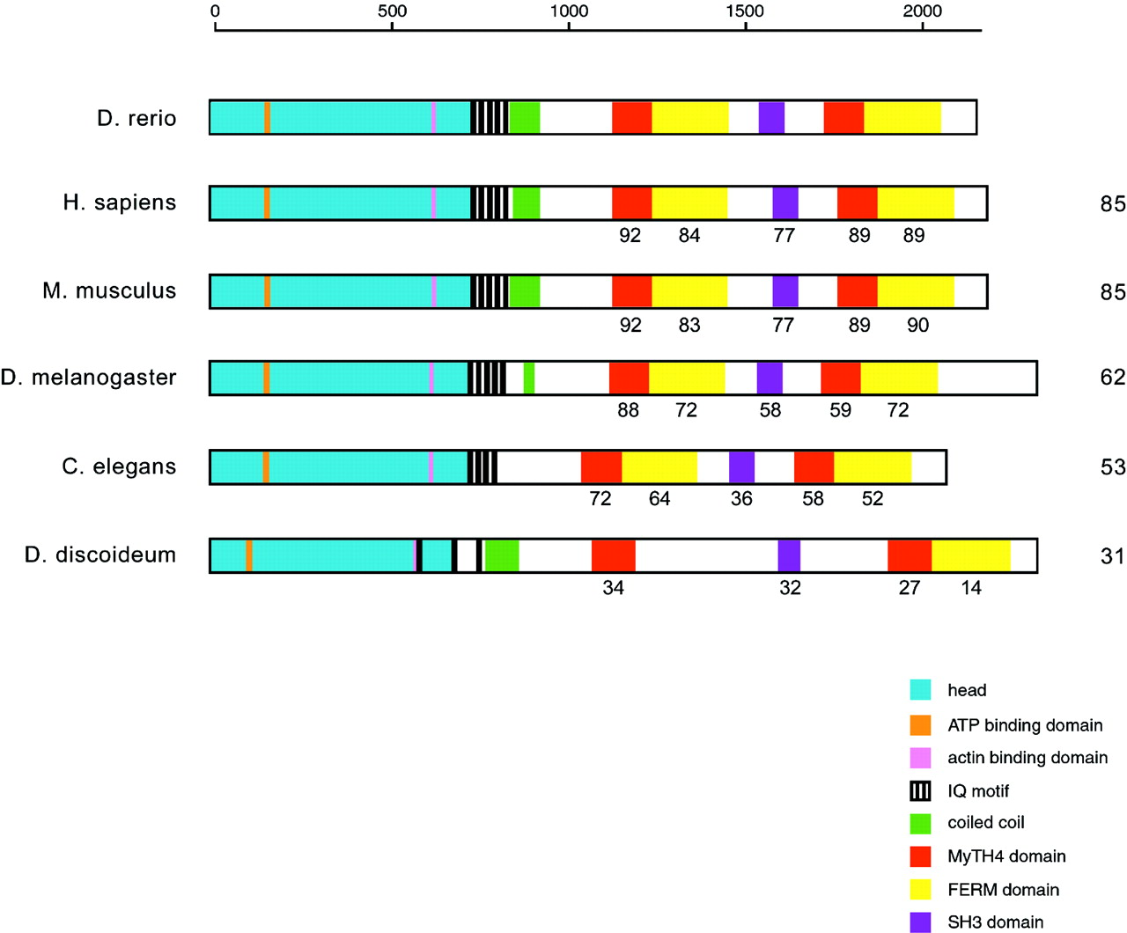
Figure 1. Schematic representation of zebrafish (D. rerio) Myosin VIIA along with other Myosin VIIA proteins ...
Notes:
Figure 1. Schematic representation of zebrafish (D. rerio) Myosin VIIA along with other Myosin VIIA proteins identified in the databases. The cloned zebrafish Myosin VIIA contains a head domain (amino acids 59–742) with an ATP-binding domain and an actin-binding domain, a neck domain with five IQ motifs (743–857) and a tail composed of a coiled-coil domain (857–935), a first repeat formed of a MyTH4 (1148–1253) and a FERM (1254–1473) domain, an SH3 domain (1567–1632), and the second MyTH4 (1752–1858) and FERM (1860–2077) repeat. All domains and motifs found with the Smart (31) and/or Pfam (32) softwares are illustrated. Species are: Homo sapiens (HSU39226), Mus musculus (MMU81453), D.melanogaster (AC002502), C.elegans (U80848, hum-6 gene), and D.discoideum (L35321, myoI gene). The percentages of overall amino acid identity between these proteins and zebrafish Myosin VIIA are 85, 84, 62, 53 and 31%, respectively. Drosophila melanogaster Myosin VIIA was predicted from the genomic sequence AC002502 using the Genscan software (33). The percentages of amino acid identity between the MyTH4, FERM and SH3 domains of zebrafish Myosin VIIA tail and the corresponding domains of other species Myosin VIIA are noted underneath each domain. The SH3 domain is the least conserved of all Myosin VIIA tail domains. Zebrafish Myosin VIIA corresponds to the splice variant HSU55208 of human Myosin VIIA which, as a consequence of the splicing of exon 35a (34), lacks 38 amino acids between the first FERM domain and the SH3 domain.
Unless provided in the caption above, the following copyright applies to the content of this slide:

Slide 2
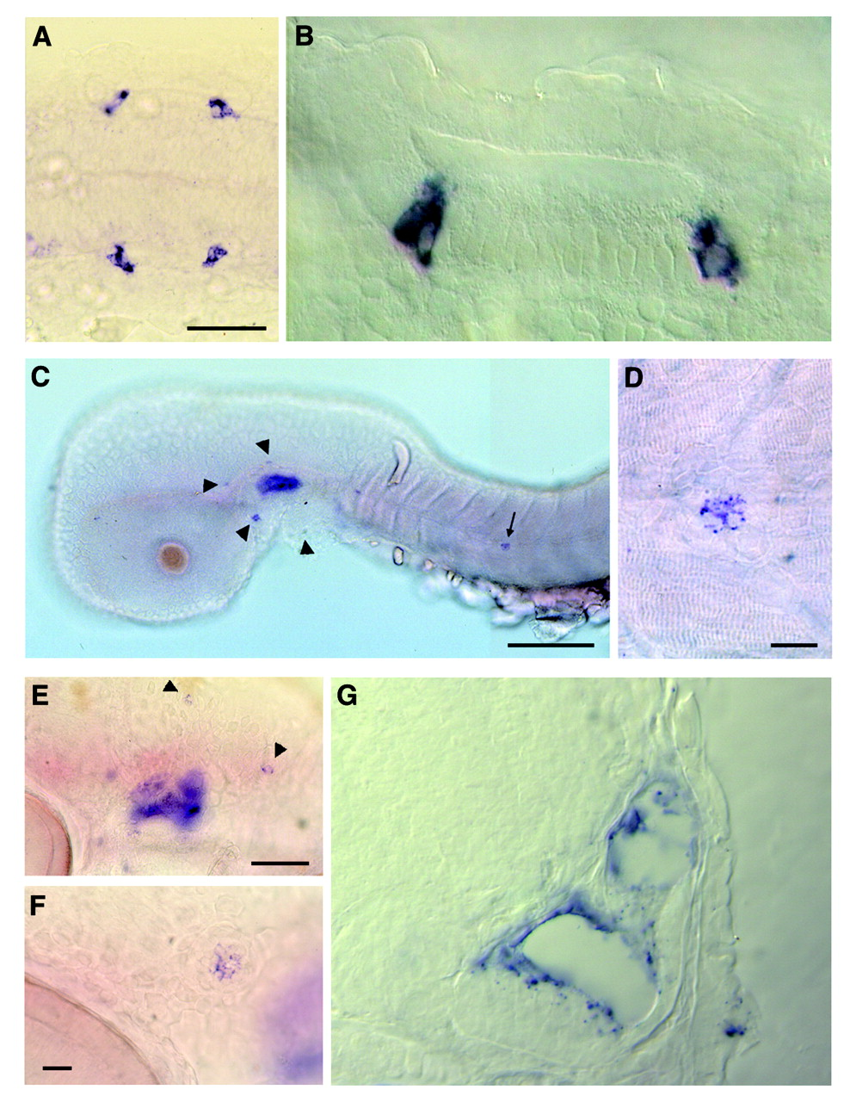
Figure 2. Detection of myosin VIIA mRNA by whole-mount in situ hybridization in zebrafish embryos. myosin ...
Notes:
Figure 2. Detection of myosin VIIA mRNA by whole-mount in situ hybridization in zebrafish embryos. myosin VIIA mRNA was detected by non-radioactive in situ hybridization in 24 h.p.f. (A and B), 48 h.p.f. (C and D) and 5 d.p.f. (E–G) wild-type zebrafish embryos. (A and B) myosin VIIA mRNA is expressed in the sensory cells of the 24 h.p.f. otic vesicle (dorsal views, anterior to the left; scale bars, 50 and 10 µm, respectively). (C) Forty-eight hour post-fertilization embryos showing inner ear and anterior lateral line neuromasts (arrowheads) labeling (scale bar, 100 µm). (D) High magnification of the posterior lateral line neuromast indicated by an arrow in (C) (scale bar, 10 µm). (E) Region around the inner ear (out of the plane of focus) of a 5 d.p.f. embryo, focus is on the labeled neuromasts (arrowheads); scale bar, 50 µm; note a portion of the eye at the bottom left corner. (F) High magnification view of a neuromast of the anterior lateral line (scale bar, 10 µm); a portion of the eye is visible at the bottom left corner and part of the stained inner ear (out of focus) appears at the bottom right corner. (G) Tranverse section of the inner ear of a 5 d.p.f. embryo showing the anterior macula and a labeled neuromast (scale bar, 10 µm).
Unless provided in the caption above, the following copyright applies to the content of this slide:

Slide 3
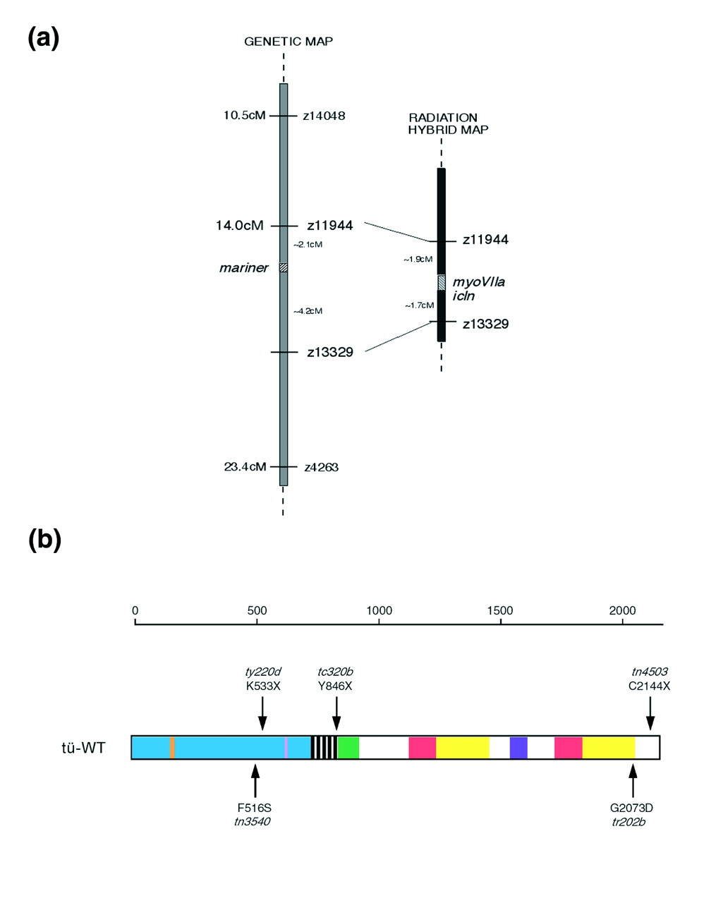
Figure 3. Mapping of the mariner locus and identification of the mutations in myosin VIIA. (a) Position of ...
Notes:
Figure 3. Mapping of the mariner locus and identification of the mutations in myosin VIIA. (a) Position of the mariner locus and of myosin VIIA on the zebrafish genetic and radiation hybrid map. Linkage of mariner to chromosome LG18 was established with a set of SSLP markers. Fine mapping was then performed with single larvae using additional SSLP markers. myosin VIIA was placed on a zebrafish radiation hybrid panel (19) using primers which were specific for the 3′-untranslated region of the zebrafish myosin VIIA cDNA. The SSLP markers z11944 and z13329 were used to anchor the radiation hybrid map to the genetic map (see http://wwwmap.tuebingen.mpg.de/lg18.html ). (b) Identification of the mutations in the different alleles of mariner. A schematic representation of zebrafish Myosin VIIA (tü-WT, Tübingen wild-type allele) with its structural domains is depicted. Mariner nonsense mutations K533X (ty220d), Y846X (tc320b) and C2144X (tn4503) are shown on the upper side of the protein. Mariner missense mutations F516S (tn3540) and G2073D (tr202b) are indicated on the lower side of the protein.
Unless provided in the caption above, the following copyright applies to the content of this slide:

Slide 4
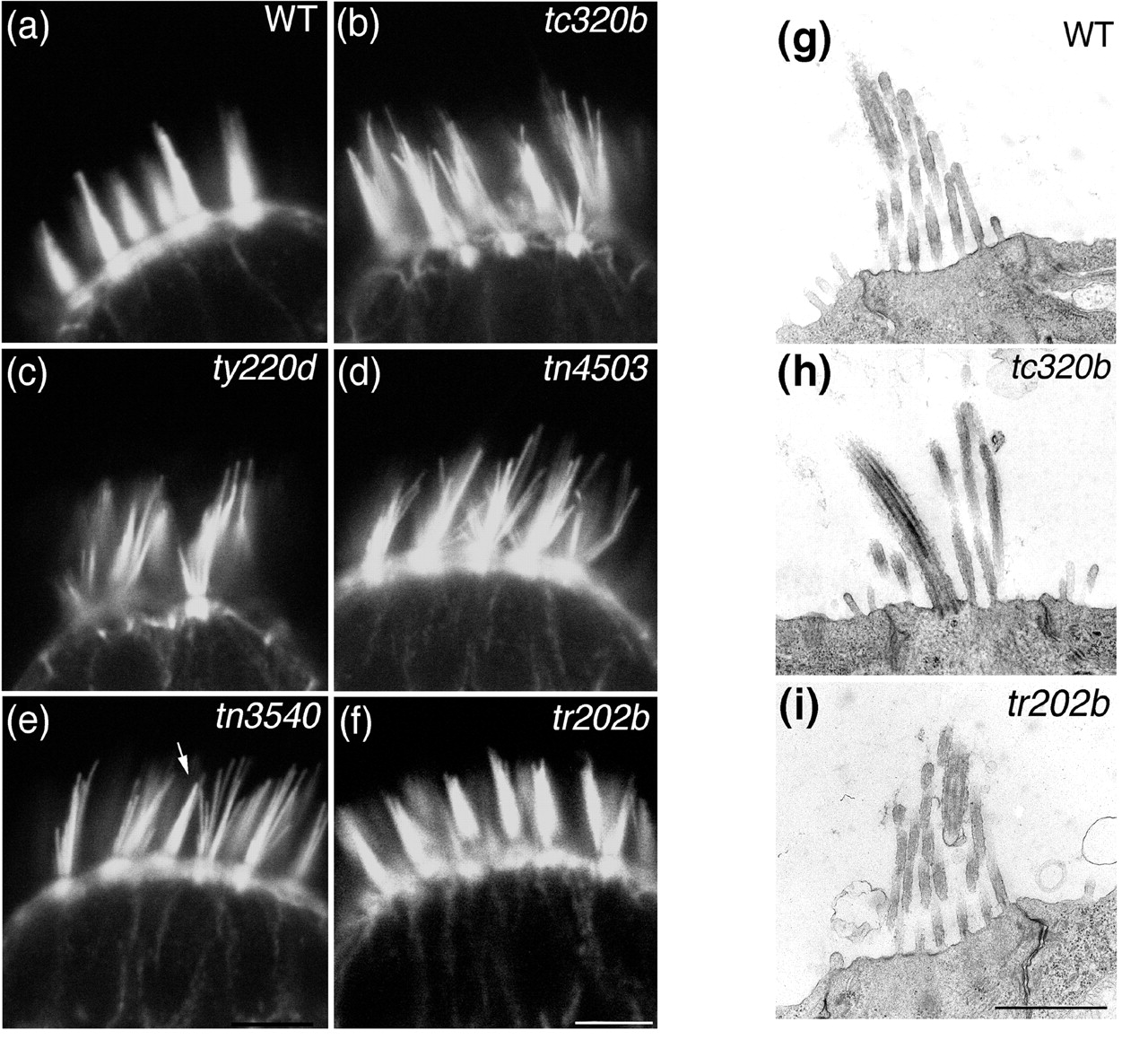
Figure 4. Splaying of inner ear stereociliary bundles in mutant mariner larvae. Whole larvae (5 d.p.f.) were ...
Notes:
Figure 4. Splaying of inner ear stereociliary bundles in mutant mariner larvae. Whole larvae (5 d.p.f.) were fixed and then labeled with Oregon green phalloidin. Confocal images of medial cristae in wild-type (a) and mutant mariner specimens (b–f). (a) Wild-type sensory hair cell bundles appear conical in shape. (b–d) Mutant mariner larvae carrying the nonsense alleles show pronounced splaying of bundles. (e) marinertn3540 mutants have slightly less splayed bundles. An intact bundle is indicated by the white arrow. (f) Marinertr202b bundles are relatively intact, although less conical in shape. Scale bar, 5 µm. (g–i) Transmission electron micrographs of inner ear sensory hair cell bundles in mutant larvae carrying a strong or weak allele of mariner. Transverse sections of hair cell bundles in a wild-type (g), mutant marinertc320b (h) and mutant marinertr202b (i) anterior maculae in the inner ear. Scale bar, 1 µm
Unless provided in the caption above, the following copyright applies to the content of this slide:

