Slide 1
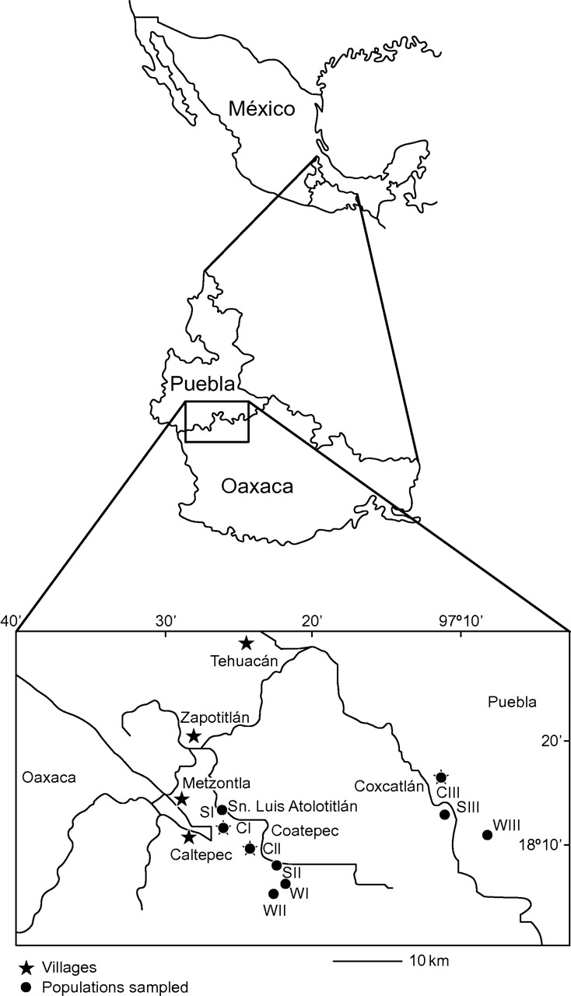
Fig. 1. Study area. The Tehuacán–Cuicatlán Valley. Location of the villages and populations of Stenocereus pruinosus ...
Notes:
Fig. 1. Study area. The Tehuacán–Cuicatlán Valley. Location of the villages and populations of Stenocereus pruinosus studied. WI = Wild Santa Lucía; WII = Wild Fiscal; WIII = Wild Coxcatlán; SI = Silvicultural from San Luis Atolotitlán (S.L.A); SII = Silvicultural Coatepec; SIII = Silvicultural Coxcatlán; CI = Cultivated from San Luis Atolotitlán (S.L.A); CII = Cultivated Coatepec; CIII = Cultivated Coxcatlán.
Unless provided in the caption above, the following copyright applies to the content of this slide: © The Author 2010. Published by Oxford University Press on behalf of the Annals of Botany Company. All rights reserved. For Permissions, please email: journals.permissions@oxfordjournals.org

Slide 2
Fig. 2. Populations of Stenocereus pruinosus under different management types. (A) Wild population forming part of a ...
Notes:
Fig. 2. Populations of Stenocereus pruinosus under different management types. (A) Wild population forming part of a tropical deciduous forest, (B) silvicultural managed population in an agroforestry system, (C) cultivated population in a home garden.
Unless provided in the caption above, the following copyright applies to the content of this slide: © The Author 2010. Published by Oxford University Press on behalf of the Annals of Botany Company. All rights reserved. For Permissions, please email: journals.permissions@oxfordjournals.org

Slide 3
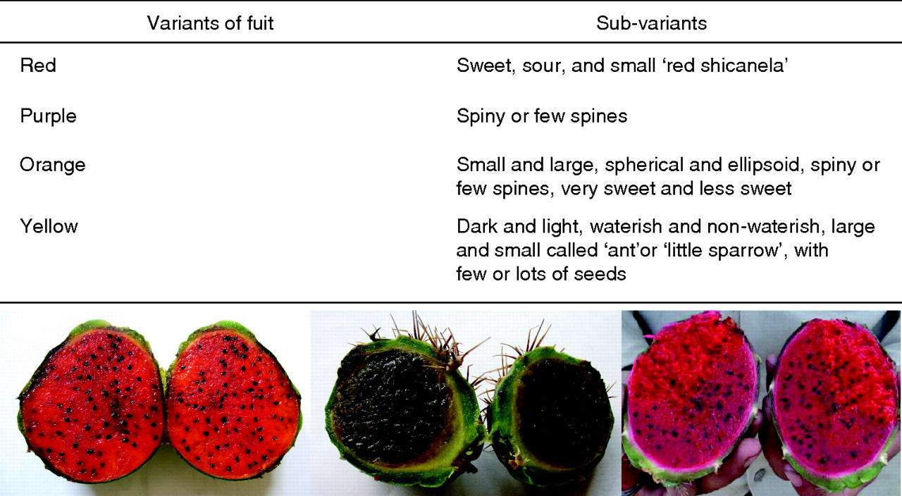
Fig. 3. Examples of variants of pulp colour of fruits of Stenocerus pruinosus, the ‘pitaya de mayo’, and sub-variants ...
Notes:
Fig. 3. Examples of variants of pulp colour of fruits of Stenocerus pruinosus, the ‘pitaya de mayo’, and sub-variants associated with more specific characters.
Unless provided in the caption above, the following copyright applies to the content of this slide: © The Author 2010. Published by Oxford University Press on behalf of the Annals of Botany Company. All rights reserved. For Permissions, please email: journals.permissions@oxfordjournals.org

Slide 4
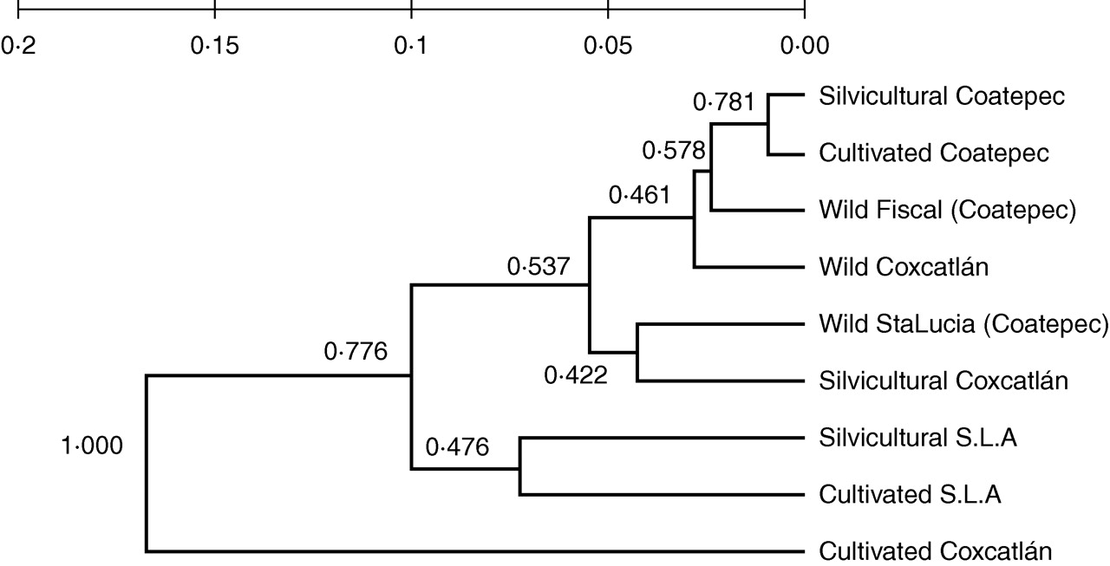
Fig. 4. UPGMA phenogram of minimum genetic distances (Nei, 1972) among the wild silviculture managed and cultivated ...
Notes:
Fig. 4. UPGMA phenogram of minimum genetic distances (Nei, 1972) among the wild silviculture managed and cultivated populations of Stenocereus pruinosus studied. Proportions of similar replicates after 10 000 permutations are shown for each grouping.
Unless provided in the caption above, the following copyright applies to the content of this slide: © The Author 2010. Published by Oxford University Press on behalf of the Annals of Botany Company. All rights reserved. For Permissions, please email: journals.permissions@oxfordjournals.org

Slide 5
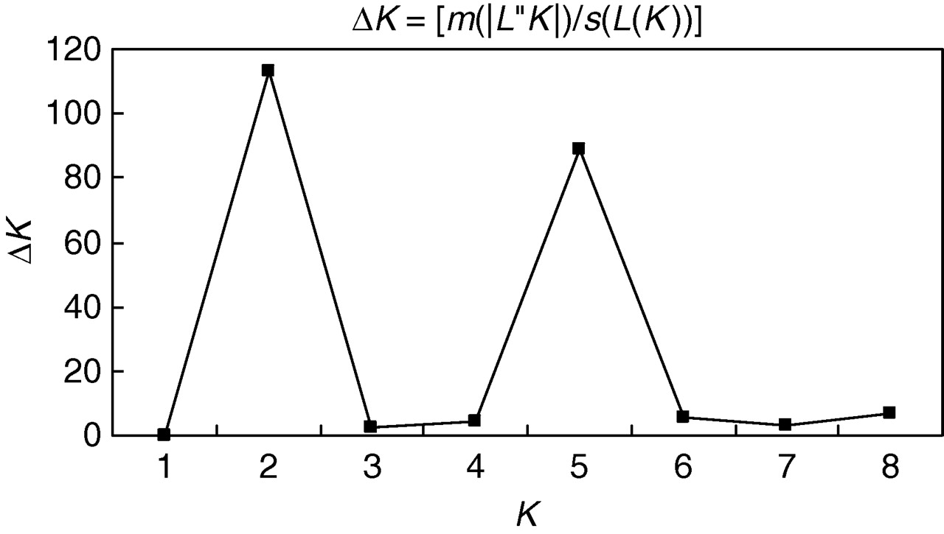
Fig. 5. Estimated number of populations (K) derived from the structure clustering analyses. The magnitude of ΔK was ...
Notes:
Fig. 5. Estimated number of populations (K) derived from the structure clustering analyses. The magnitude of ΔK was calculated using the method described by Evanno et al. (2005).
Unless provided in the caption above, the following copyright applies to the content of this slide: © The Author 2010. Published by Oxford University Press on behalf of the Annals of Botany Company. All rights reserved. For Permissions, please email: journals.permissions@oxfordjournals.org

Slide 6
Fig. 6. Genetic clusters obtained with five groups. Each individual plant is represented by one vertical line with K ...
Notes:
Fig. 6. Genetic clusters obtained with five groups. Each individual plant is represented by one vertical line with K segments coloured proportionally according to their belonging to a genetic cluster. Black lines separate individual plants from different populations, classified according to management type. WI = Wild Santa Lucía; WII = Wild Fiscal; WIII = Wild Coxcatlán; SI = Silvicultural from San Luis Atolotitlán (S.L.A); SII = Silvicultural Coatepec; SIII = Silvicultural Coxcatlán; CI = Cultivated from San Luis Atolotitlán (S.L.A); CII = Cultivated Coatepec; CIII = Cultivated Coxcatlán.
Unless provided in the caption above, the following copyright applies to the content of this slide: © The Author 2010. Published by Oxford University Press on behalf of the Annals of Botany Company. All rights reserved. For Permissions, please email: journals.permissions@oxfordjournals.org

Slide 7
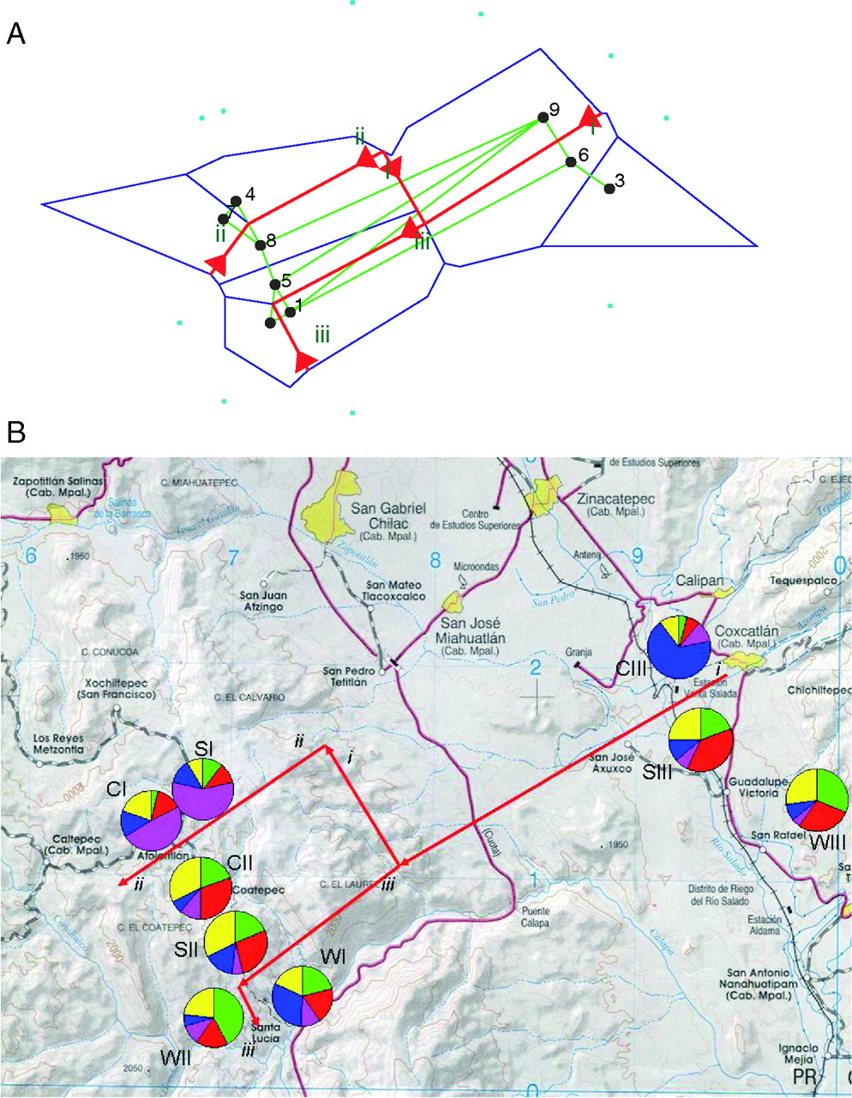
Fig. 7. Distribution of populations of Stenocereus pruinosus in the Tehuacán Valley indicating barriers between ...
Notes:
Fig. 7. Distribution of populations of Stenocereus pruinosus in the Tehuacán Valley indicating barriers between populations (A) and the frequency distribution of genotypes obtained by Bayesian analysis among populations associated with barriers (B). WI = Wild Santa Lucía; WII = Wild Fiscal; WIII = Wild Coxcatlán; SI = Silvicultural from San Luis Atolotitlán (S.L.A); SII = Silvicultural Coatepec; SIII = Silvicultural Coxcatlán; CI = Cultivated from San Luis Atolotitlán (S.L.A); CII = Cultivated Coatepec; CIII = Cultivated Coxcatlán.
Unless provided in the caption above, the following copyright applies to the content of this slide: © The Author 2010. Published by Oxford University Press on behalf of the Annals of Botany Company. All rights reserved. For Permissions, please email: journals.permissions@oxfordjournals.org

