Slide 1
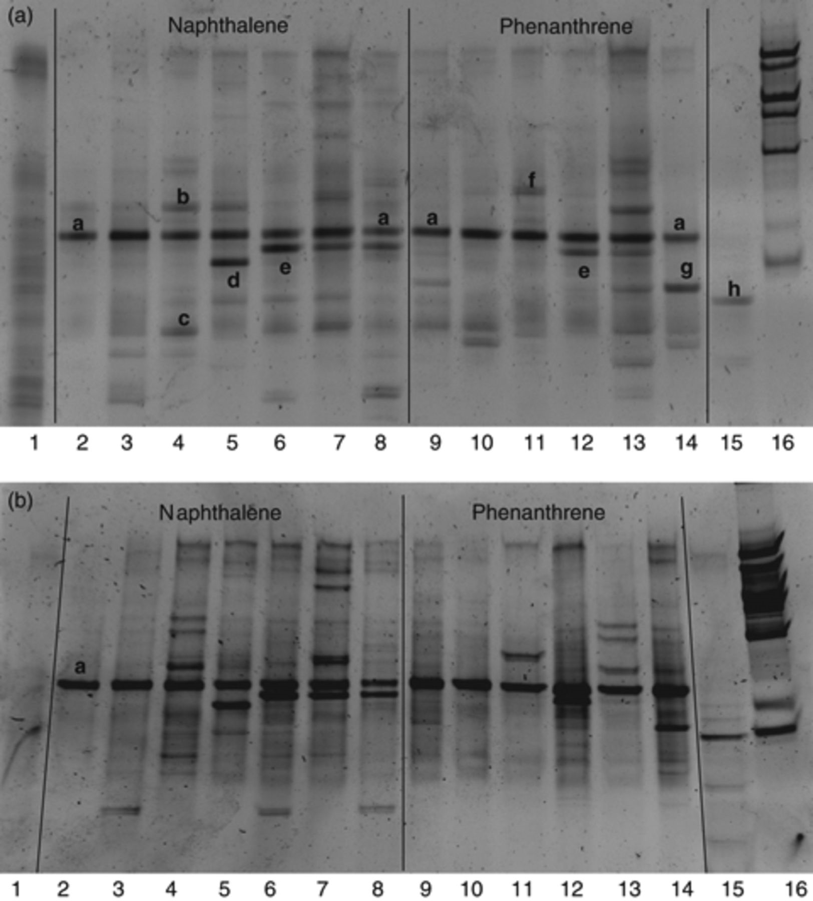
1 Dynamics analysis of the bacterial community in the February 2008 set of microcosms revealed by DGGE profiles ...
Notes:
1 Dynamics analysis of the bacterial community in the February 2008 set of microcosms revealed by DGGE profiles of PCR-amplified V3 region fragments of the 16S rRNA genes from DNA (a) and cDNA (b). Lane 1, initial bacterial community. Lanes 2–8, supplemented with naphthalene (lane 2, after 3 days; lanes 3–4, after 7 days; lane 5, after 21 days; lanes 6–7, after 42 days; lane 8, after 63 days). Lanes 9–14, supplemented with phenanthrene (lanes 9–10, after 7 days; lane 11, after 21 days; lanes 12–13, after 42 days; lane 14, after 63 days). Lane 15, supplemented with fluorene, after 63 days. Lane 16, SmartLadder (Eurogentec). About 160 bp of the 16S rRNA gene sequences were determined from dominant bands denoted by a letter.
Unless provided in the caption above, the following copyright applies to the content of this slide: © 2009 Federation of European Microbiological Societies. Published by Blackwell Publishing Ltd. All rights reserved

Slide 2
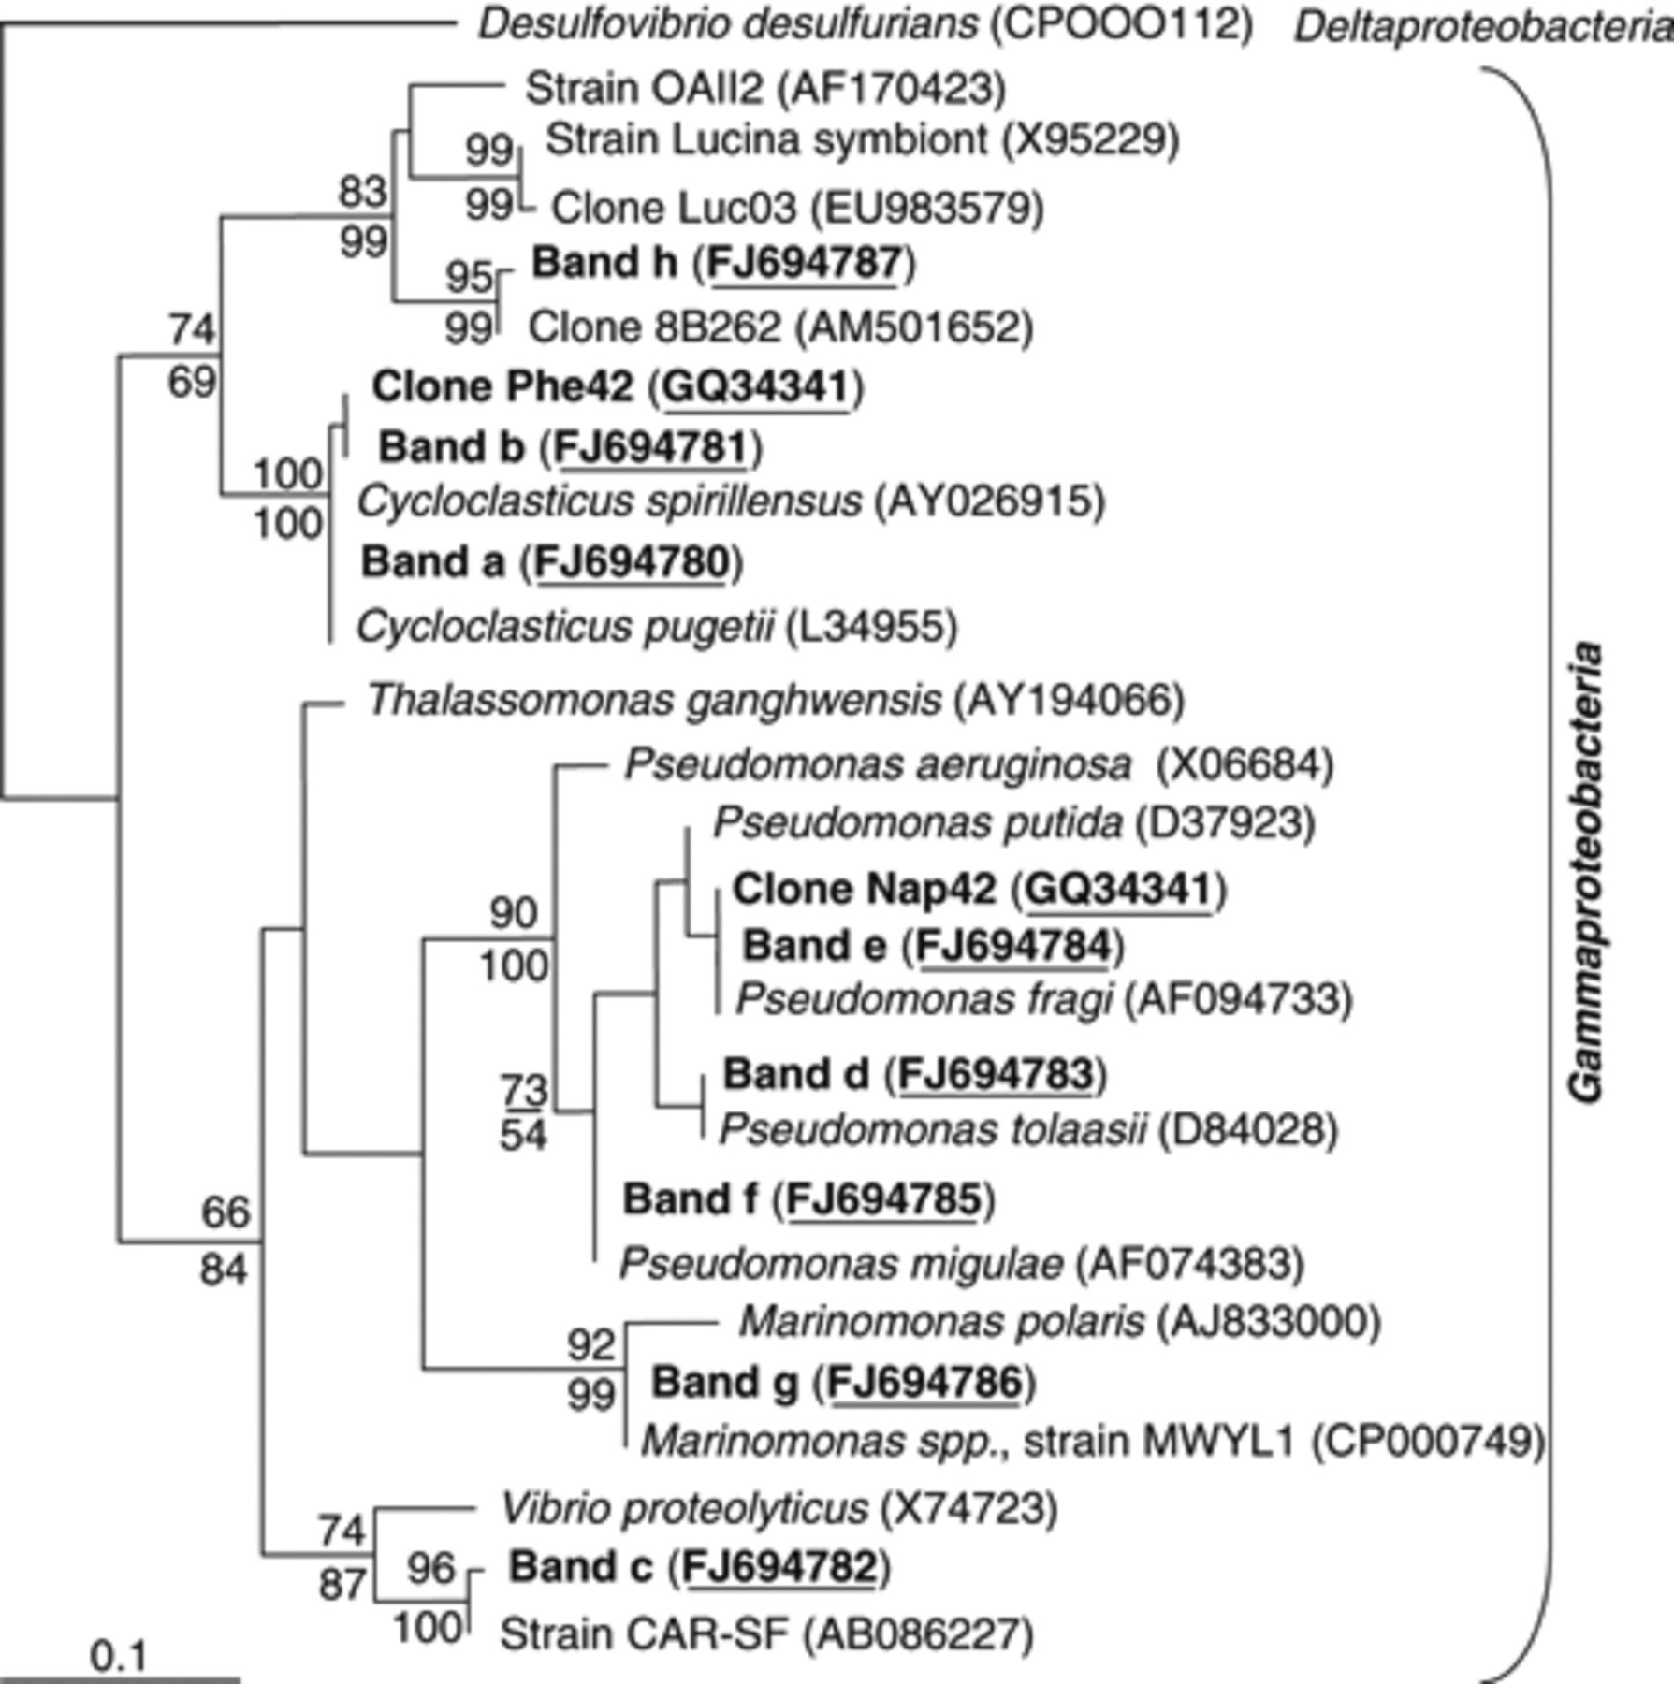
2 16S rRNA gene phylogeny of dominant bacteria from seawater microcosms enriched with different PAHs. Sequences ...
Notes:
2 16S rRNA gene phylogeny of dominant bacteria from seawater microcosms enriched with different PAHs. Sequences of closest relatives and representative PAH-degrading bacteria are included in the analysis. The unrooted dendrogram was generated using maximum likelihood analysis. The scale bar corresponds to 0.1 substitutions per nucleotide position. Numbers on tree branches indicate bootstrap results from maximum likelihood analysis (above branch) and distance matrix (below branch) analyses for those branches having ≥50% support. Sequences provided in this study are in bold.
Unless provided in the caption above, the following copyright applies to the content of this slide: © 2009 Federation of European Microbiological Societies. Published by Blackwell Publishing Ltd. All rights reserved

Slide 3
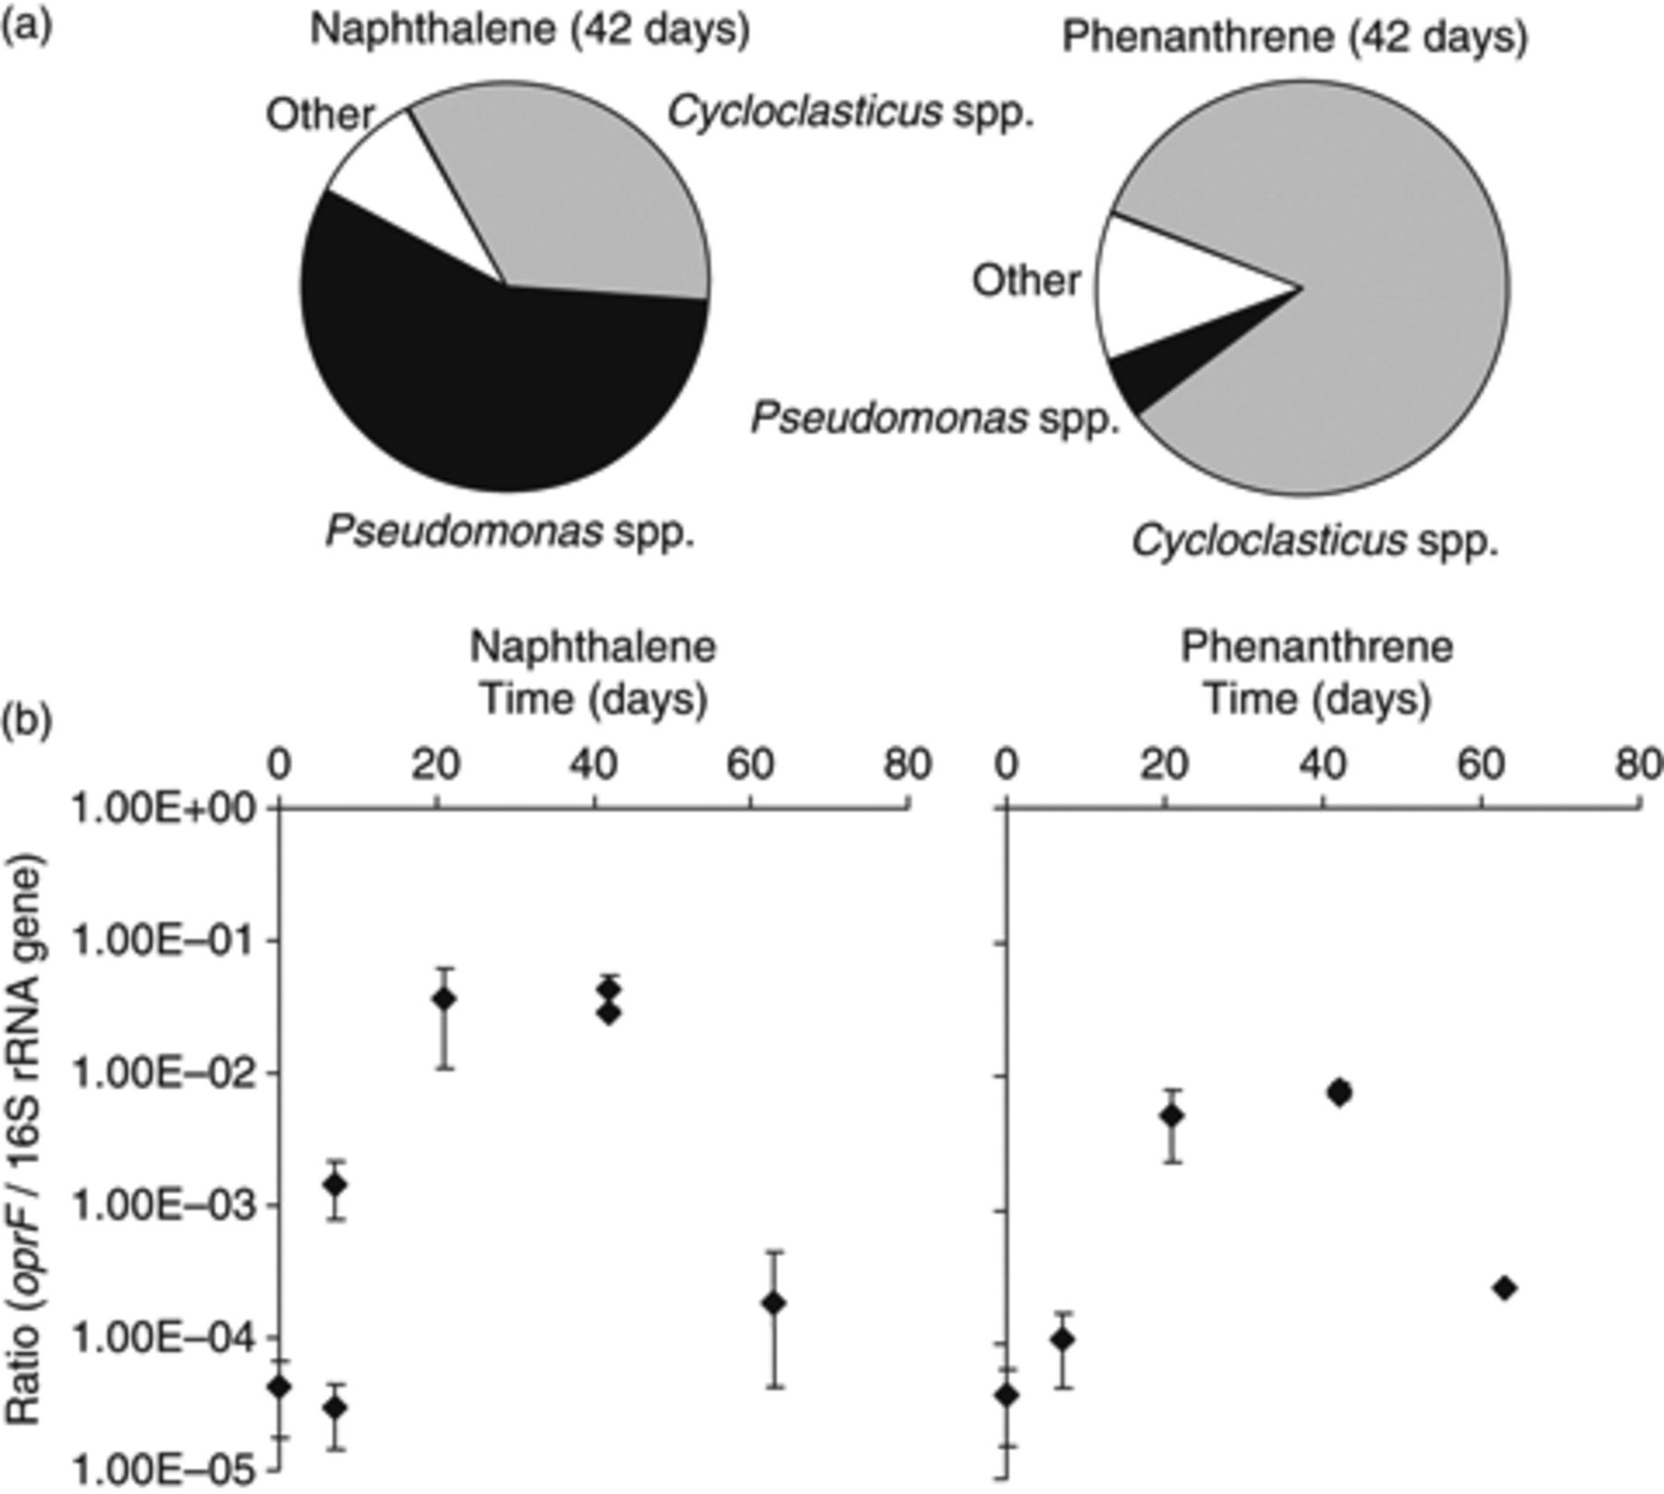
3 (a) Relative abundance (%) of clones in 16S rRNA gene clone libraries from the February 2008 set of ...
Notes:
3 (a) Relative abundance (%) of clones in 16S rRNA gene clone libraries from the February 2008 set of microcosms after 42 days. For each library, 44 (for naphthalene) and 43 (for phenanthrene) sequences (about 800 bp) were identified using the Ribosomal Database Project database (http://rdp.cme.msu.edu/index.jsp). Sectors titled ‘other’ were comprised of some bacterial genera present only as single clones. (b) Proportion of Pseudomonas in the total bacterial community (number of oprF gene copies/number of 16S rRNA gene copies) from microcosms enriched with naphthalene and phenanthrene, as determined by real-time PCR (n=2).
Unless provided in the caption above, the following copyright applies to the content of this slide: © 2009 Federation of European Microbiological Societies. Published by Blackwell Publishing Ltd. All rights reserved

