Slide 1
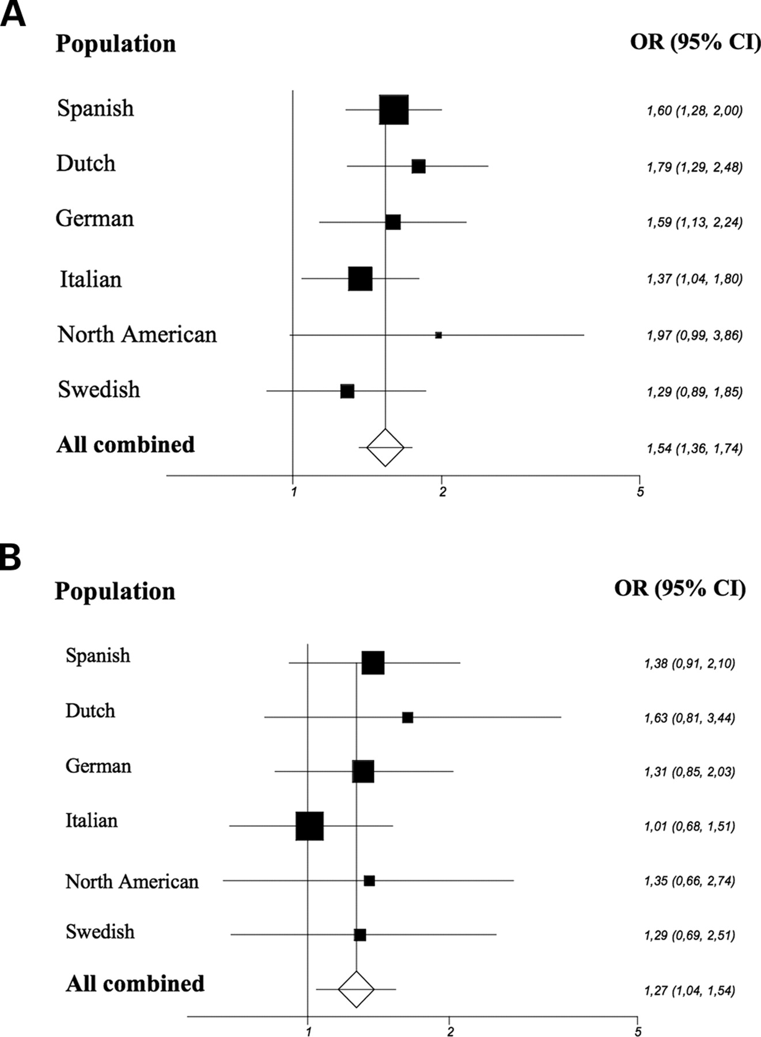
Figure 1. Effect of the STAT4 rs7574865 T allele in lcSSc in Caucasian populations. ( A ) lcSSc versus controls. ...
Notes:
Figure 1. Effect of the STAT4 rs7574865 T allele in lcSSc in Caucasian populations. ( A ) lcSSc versus controls. Mantel–Haenszel test for overall association of rs7574865 T allele with lcSSc susceptibility P < 0.0001. ( B ) lcSSc versus dcSSc. Mantel–Haenszel test for overall association of rs7574865 T allele in lcSSc susceptibility P = 0.019.
Unless provided in the caption above, the following copyright applies to the content of this slide: © The Author 2009. Published by Oxford University Press. All rights reserved. For Permissions, please email: journals.permissions@oxfordjournals.org

