Slide 1
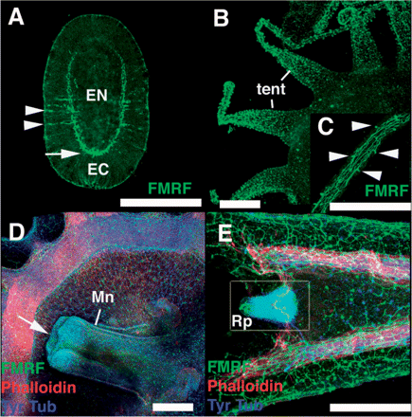
Fig. 1 Spatial distribution of FMRFamide-positive neurons (in green) in larval stages of Aurelia sp.1. (A) Planula ...
Notes:
Fig. 1 Spatial distribution of FMRFamide-positive neurons (in green) in larval stages of Aurelia sp.1. (A) Planula larva. Aboral side is towards the bottom. Note a neuropil-like concentration of neurons in the aboral region at the base of the ectoderm (arrow) and a lateral projection of cell bodies near the middle region of the body (arrowheads). (B and C) Polyp larva. Oral view showing a dense distribution of FMRF-positive neurons in the tentacles (B: tent). Higher magnification of a polyp tentacle showing a regularly spaced array of ectodermal sensory cells (C: arrowheads). (D and E) Oral view of an ephyra larva. FMRF-positive and tyrosine-tublin-positive (in blue) cell bodies are concentrated in the manubrial lip (D: arrow) and rhopalia (E: Rp). Phalloidin (in red) showing the distribution of muscle fibers. Scale bars correspond to 200 μm. EC = ectoderm; EN = endoderm; Tent = tentacles; Mn = manubrium; Rp = rhopalium.
Unless provided in the caption above, the following copyright applies to the content of this slide: © The Author 2007. Published by Oxford University Press on behalf of the Society for Integrative and Comparative Biology. All rights reserved. For permissions please email: journals.permissions@oxfordjournals.org.

