Slide 1
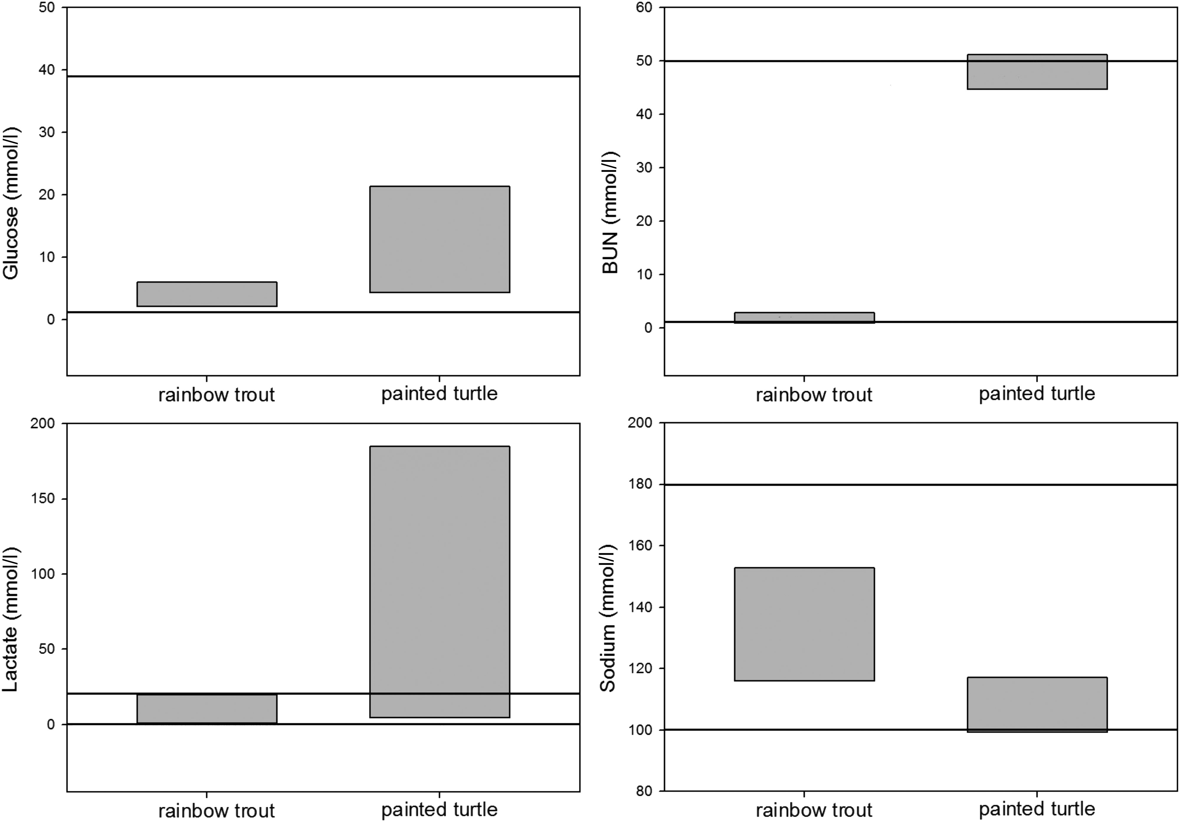
Figure 1: Whole blood values for select analytes on representative commonly studied species, the rainbow trout ...
Notes:
Figure 1: Whole blood values for select analytes on representative commonly studied species, the rainbow trout (Oncorhynchus mykiss) and the painted turtle (Chrysemys picta). Box plots represent the maximal ranges from the literature and horizontal lines represent the maximal reportable range of the most commonly used point-of-care device in the present study, the i-STAT analyser.
Unless provided in the caption above, the following copyright applies to the content of this slide: © The Author 2014. Published by Oxford University Press and the Society for Experimental Biology.This is an Open Access article distributed under the terms of the Creative Commons Attribution License (http://creativecommons.org/licenses/by/3.0/), which permits unrestricted distribution and reproduction in any medium, provided the original work is properly cited.

Slide 2
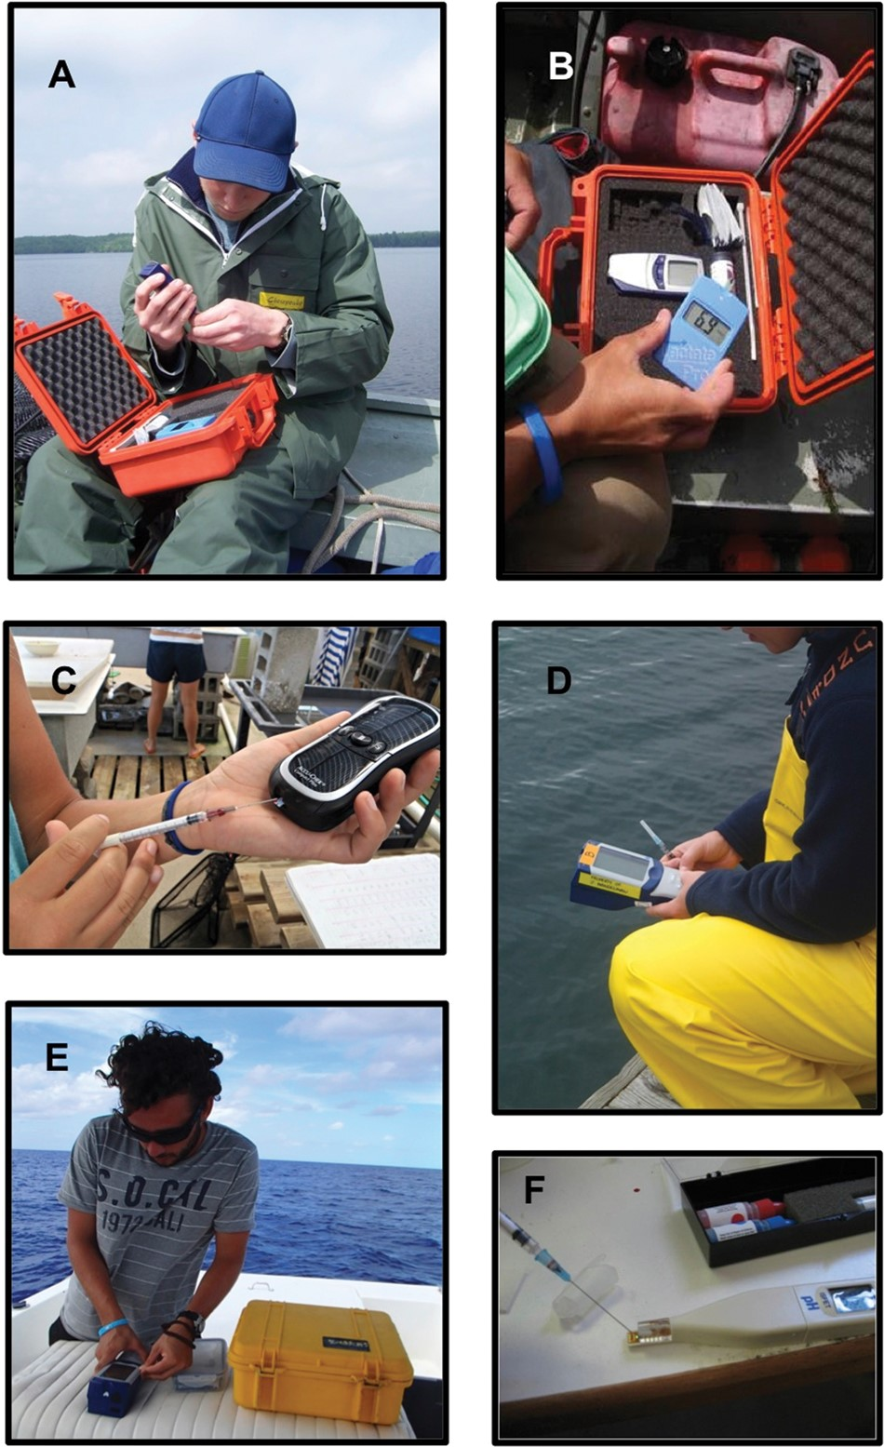
Figure 2: Point-of-care (POC) devices can be used in the field in a variety of situations. (A) Point-of-care glucose ...
Notes:
Figure 2: Point-of-care (POC) devices can be used in the field in a variety of situations. (A) Point-of-care glucose meter being set up on a boat (photograph by Lisa Thompson). (B) Protective cases, similar to the one shown, are useful for ensuring that POC devices are not damaged by the elements (photograph by Lisa Thompson). (C) Point-of-care devices, such as this glucose meter, can be used in laboratory trials to obtain immediate results on the condition of the individual (photograph by Petra Szekeres). (D) Some POC devices, such as the i-STAT, can obtain multiple blood parameters to be measured from one sample (photograph by John Mandelman). (E) Point-of-care i-STAT device in use on a boat (photograph by John Mandelman). (F) Point-of-care pH meter in use to examine blood pH in freshwater turtles (photograph by Sarah Larocque).
Unless provided in the caption above, the following copyright applies to the content of this slide: © The Author 2014. Published by Oxford University Press and the Society for Experimental Biology.This is an Open Access article distributed under the terms of the Creative Commons Attribution License (http://creativecommons.org/licenses/by/3.0/), which permits unrestricted distribution and reproduction in any medium, provided the original work is properly cited.

