Slide 1
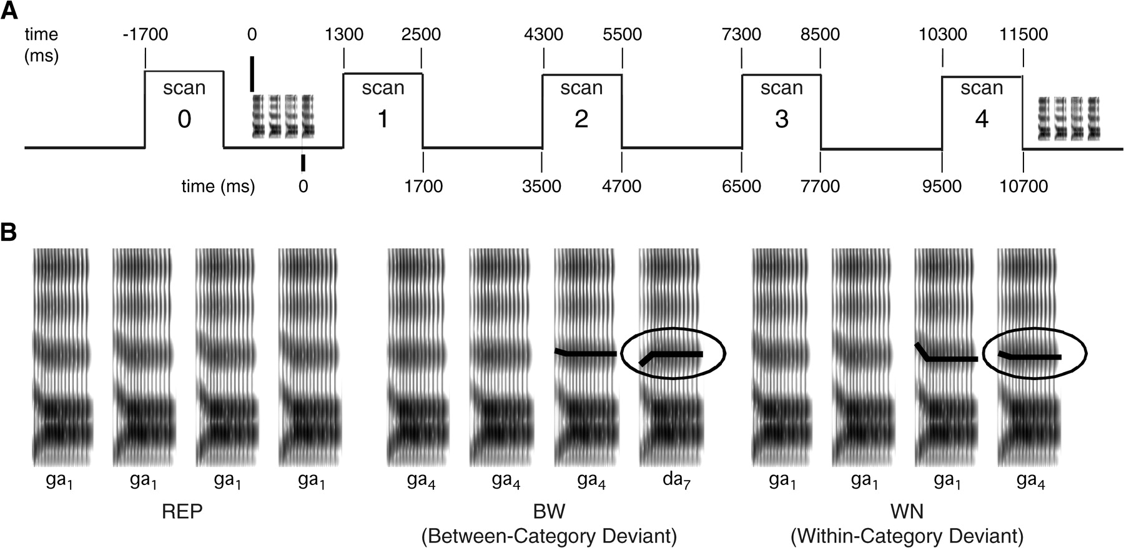
Figure 1. Schematic diagram of the stimulus presentation paradigm. (A) Timing of scans relative to stimulus ...
Notes:
Figure 1. Schematic diagram of the stimulus presentation paradigm. (A) Timing of scans relative to stimulus presentation, taking as the stimulus onset either the onset of speech sounds (upper numbers) or the onset of the fourth stimulus that distinguishes the deviant trials (lower numbers). (B) Spectrograms of REP, WN (within category), and BW (between category) stimulus trains. The cue that differentiated the deviant from the preceding standards is the onset frequency of the second and third formants (third formant difference is emphasized and circled). In the WN condition, the standard and deviant are acoustically different (ga1 and ga4), but both are perceived as /ga/. In contrast, the BW condition uses the ga4 and da7 syllables, such that the standard is perceived as /ga/ and the deviant is perceived as /da/.
Unless provided in the caption above, the following copyright applies to the content of this slide: © 2006 The AuthorsThis is an Open Access article distributed under the terms of the Creative Commons Attribution Non-Commercial License (http://creativecommons.org/licenses/by-nc/2.0/uk/) which permits unrestricted non-commercial use, distribution, and reproduction in any medium, provided the original work is properly cited.

Slide 2
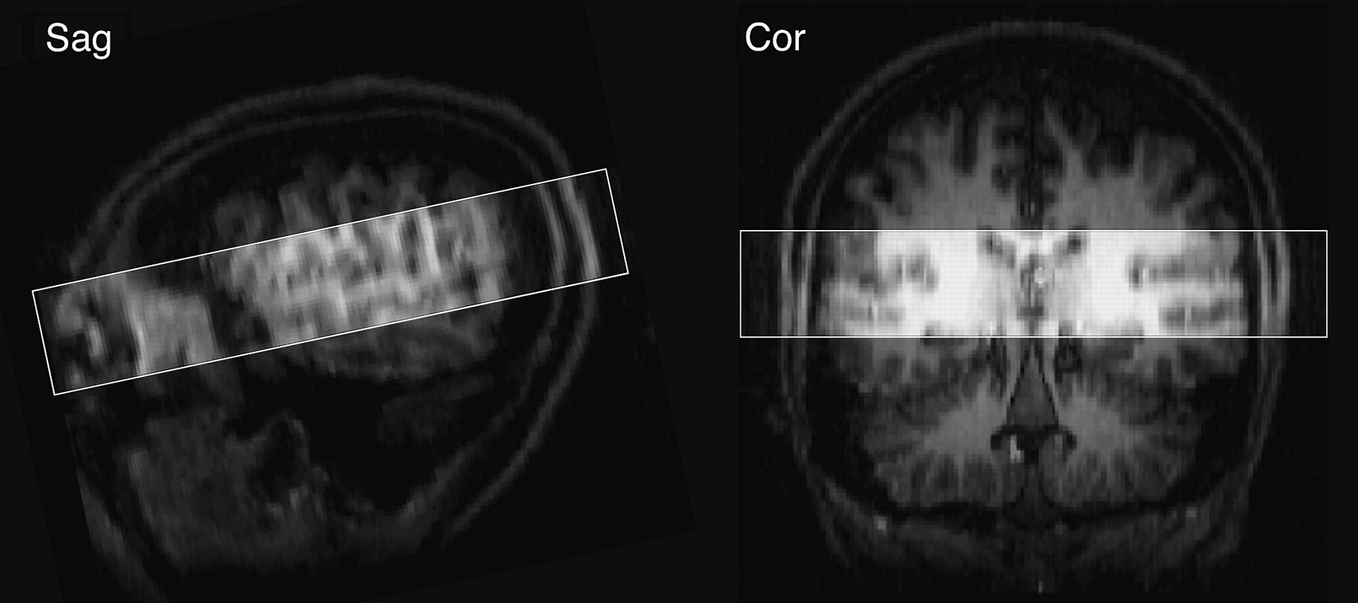
Figure 2. Slice plan of functional scans for a representative participant. A 33-mm-thick volume was acquired ...
Notes:
Figure 2. Slice plan of functional scans for a representative participant. A 33-mm-thick volume was acquired (rectangular region), with the center slice aligned along the sylvian fissure. The narrow slice prescription permitted the acquisition of high-resolution images within a relatively short volume acquisition time (1200 ms).
Unless provided in the caption above, the following copyright applies to the content of this slide: © 2006 The AuthorsThis is an Open Access article distributed under the terms of the Creative Commons Attribution Non-Commercial License (http://creativecommons.org/licenses/by-nc/2.0/uk/) which permits unrestricted non-commercial use, distribution, and reproduction in any medium, provided the original work is properly cited.

Slide 3
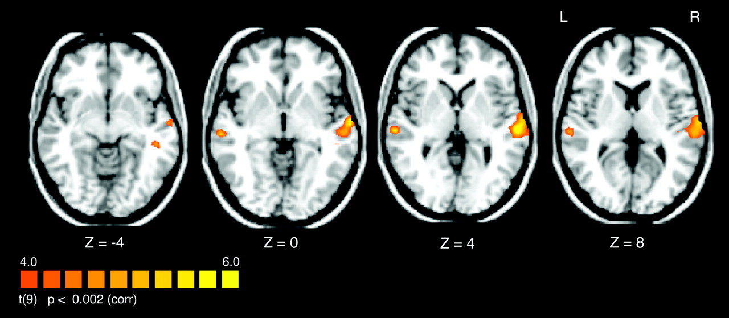
Figure 3. SPCH > SIL contrast: fMRI activation of the combined speech conditions (REP, BW, WN) compared with SIL trials ...
Notes:
Figure 3. SPCH > SIL contrast: fMRI activation of the combined speech conditions (REP, BW, WN) compared with SIL trials during which no stimulus was played. Activation was observed in the posterior portions left and right superior temporal gyri and sulci (STG, STS), including primary and secondary auditory regions. Statistical maps are overlaid on a Talairach-transformed T1-weighted anatomical scan.
Unless provided in the caption above, the following copyright applies to the content of this slide: © 2006 The AuthorsThis is an Open Access article distributed under the terms of the Creative Commons Attribution Non-Commercial License (http://creativecommons.org/licenses/by-nc/2.0/uk/) which permits unrestricted non-commercial use, distribution, and reproduction in any medium, provided the original work is properly cited.

Slide 4
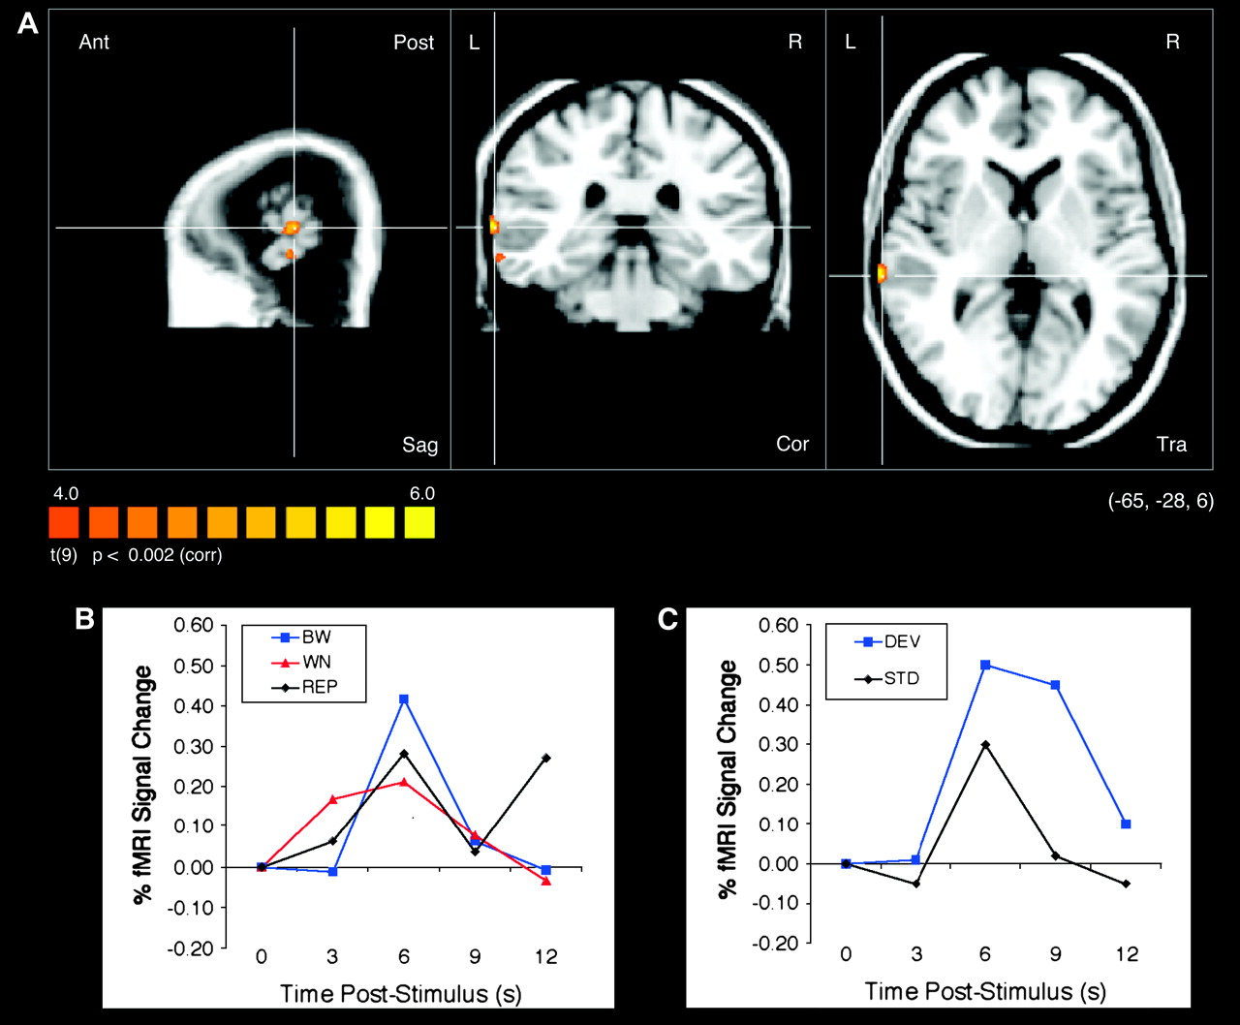
Figure 4. BW > WN contrast. (A) Region of lateral left temporal cortex exhibiting habituation effects for a ...
Notes:
Figure 4. BW > WN contrast. (A) Region of lateral left temporal cortex exhibiting habituation effects for a between-category change in a consonant sound. (B) Event-related curves showing the time course and magnitude of fMRI activation for the conditions in the experiment. (C) Event-related curve from Zevin and McCandliss (2005) obtained from left STG showing greater activation levels for a deviant condition compared with a repeated standard.
Unless provided in the caption above, the following copyright applies to the content of this slide: © 2006 The AuthorsThis is an Open Access article distributed under the terms of the Creative Commons Attribution Non-Commercial License (http://creativecommons.org/licenses/by-nc/2.0/uk/) which permits unrestricted non-commercial use, distribution, and reproduction in any medium, provided the original work is properly cited.

Slide 5
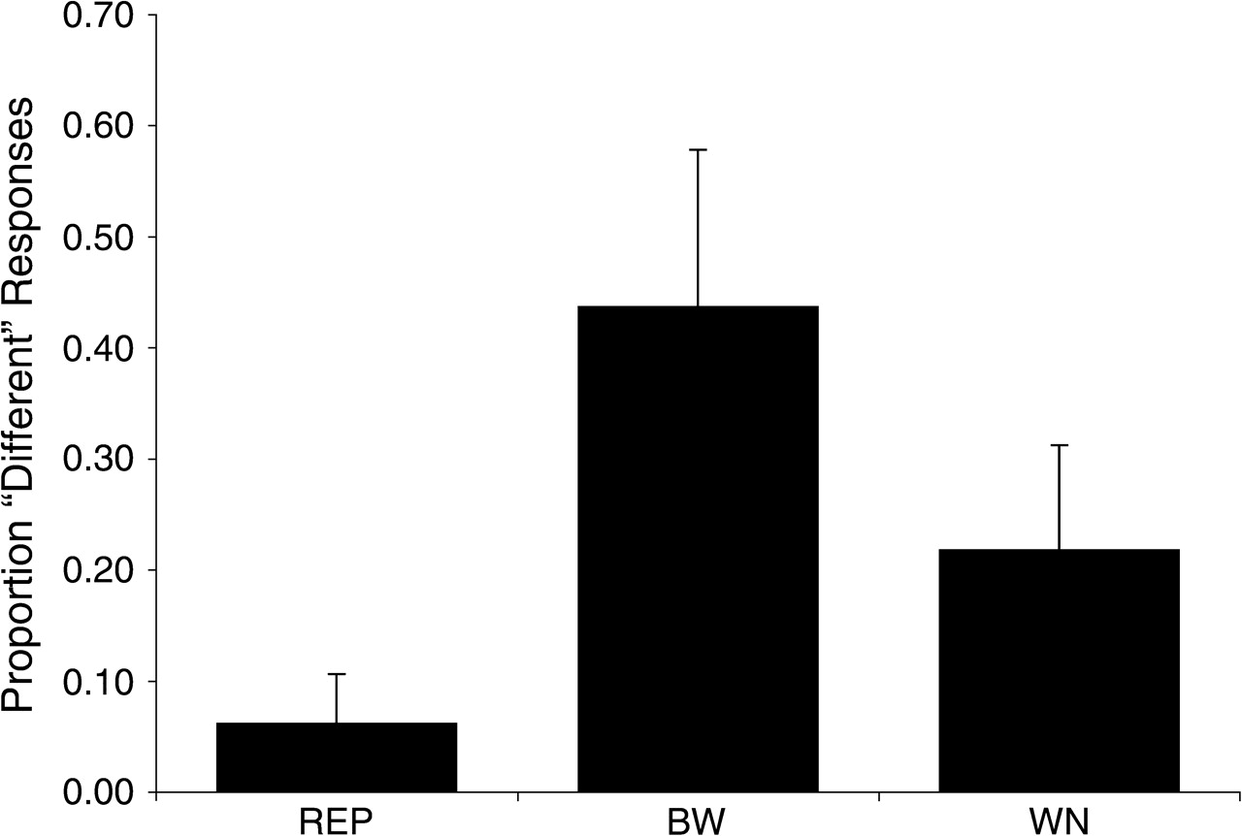
Figure 5. Overt discrimination of stimuli in the fMRI experiment obtained from 8 participants a minimum 6 months after ...
Notes:
Figure 5. Overt discrimination of stimuli in the fMRI experiment obtained from 8 participants a minimum 6 months after scanning. Participants heard the same 4-syllable stimulus trains as in scanning but were asked to explicitly identify whether the fourth stimulus was different from the first 3.
Unless provided in the caption above, the following copyright applies to the content of this slide: © 2006 The AuthorsThis is an Open Access article distributed under the terms of the Creative Commons Attribution Non-Commercial License (http://creativecommons.org/licenses/by-nc/2.0/uk/) which permits unrestricted non-commercial use, distribution, and reproduction in any medium, provided the original work is properly cited.

