Slide 1
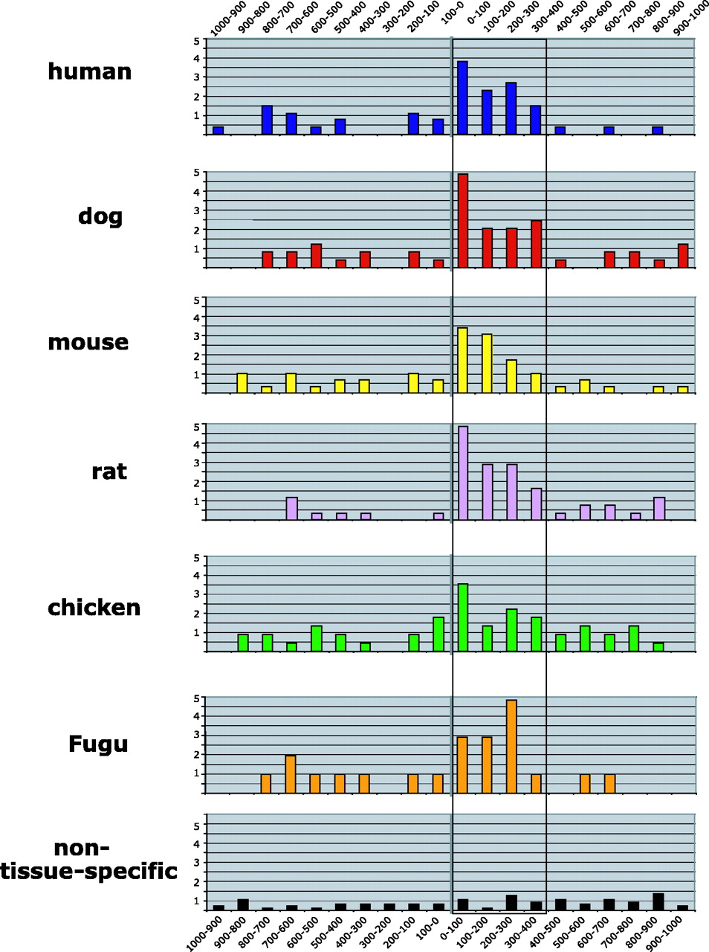
Figure 1 Enrichment of candidate UGCAUG alternative splicing enhancers in the proximal downstream intron region is ...
Notes:
Figure 1 Enrichment of candidate UGCAUG alternative splicing enhancers in the proximal downstream intron region is conserved among vertebrate species. Histograms show the frequency of UGCAUG elements at 100 nt intervals in the introns upstream and downstream of the brain-enriched exons. Top six panels represent the analysis of intron sequences for the vertebrate species indicated at the left. Note the highest abundance of UGCAUG elements is consistently within the downstream ∼400 nt (D400) region. The bottom panel shows the much lower incidence of UGCAUG elements that occurs near a group of non-tissue-specific alternative exons. Vertical axis, frequency; horizontal axis, nucleotide range relative to the alternative exon.
Unless provided in the caption above, the following copyright applies to the content of this slide: © The Author 2005. Published by Oxford University Press. All rights reserved The online version of this article has been published under an open access model. Users are entitled to use, reproduce, disseminate, or display the open access version of this article for non-commercial purposes provided that: the original authorship is properly and fully attributed; the Journal and Oxford University Press are attributed as the original place of publication with the correct citation details given; if an article is subsequently reproduced or disseminated not in its entirety but only in part or as a derivative work this must be clearly indicated. For commercial re-use, please contact journals.permissions@oupjournals.org

Slide 2
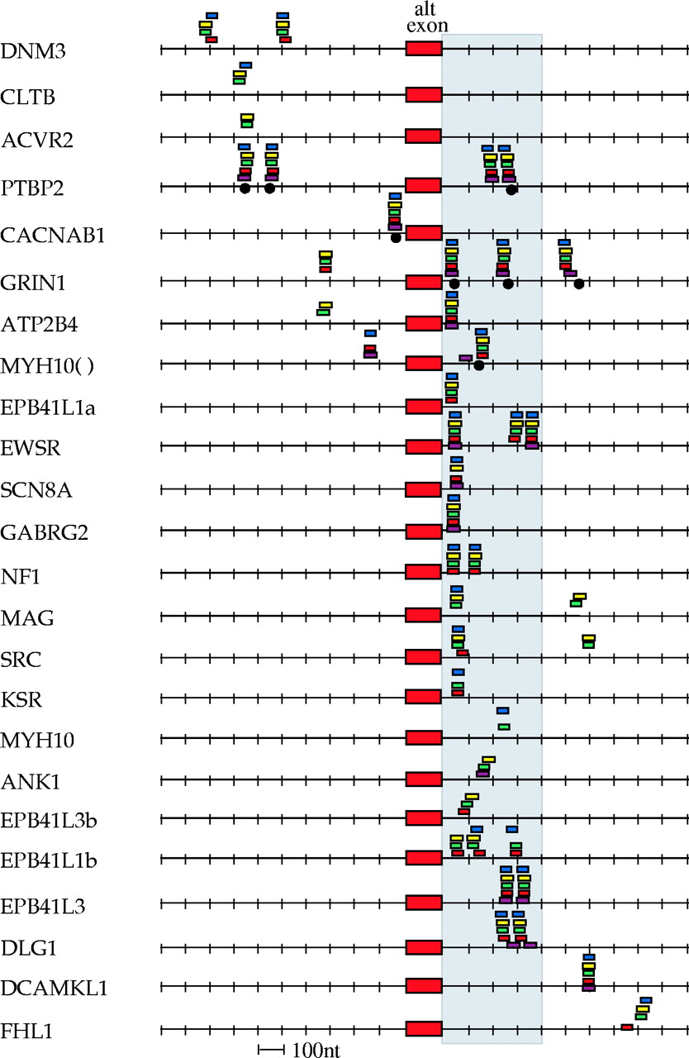
Figure 2 Specific location of UGCAUG hexamers near individual brain-enriched exons is highly conserved evolutionarily. ...
Notes:
Figure 2 Specific location of UGCAUG hexamers near individual brain-enriched exons is highly conserved evolutionarily. The figure shows all of the brain-enriched exons for which phylogenetically conserved UGCAUG elements were identified in the flanking introns. Location of hexamers is indicated by small rectangles or circles that are color coded to indicate species. Blue, human; yellow, mouse; green, rat; red, dog; brown, chicken; and black circle, Fugu. Regulated brain-enriched exons are at the center; intron sequences to the left represent upstream sequences while those to the right represent downstream sequences.
Unless provided in the caption above, the following copyright applies to the content of this slide: © The Author 2005. Published by Oxford University Press. All rights reserved The online version of this article has been published under an open access model. Users are entitled to use, reproduce, disseminate, or display the open access version of this article for non-commercial purposes provided that: the original authorship is properly and fully attributed; the Journal and Oxford University Press are attributed as the original place of publication with the correct citation details given; if an article is subsequently reproduced or disseminated not in its entirety but only in part or as a derivative work this must be clearly indicated. For commercial re-use, please contact journals.permissions@oupjournals.org

Slide 3
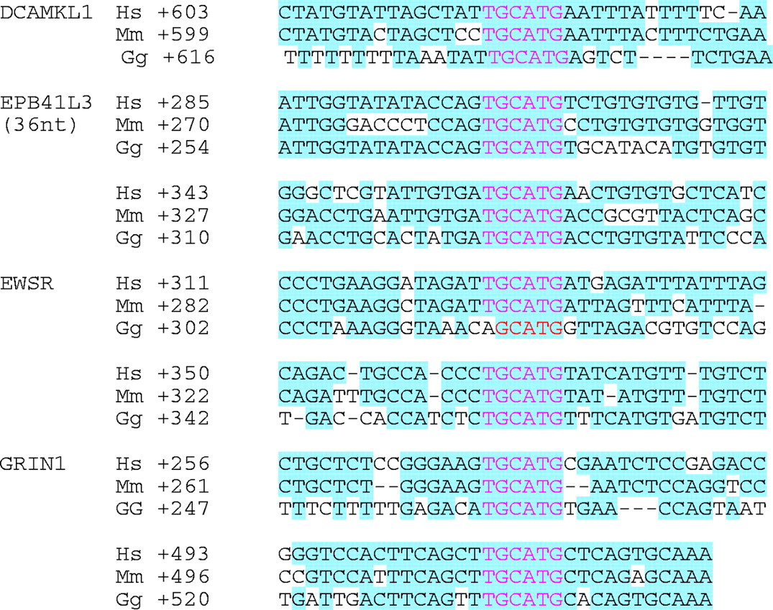
Figure 3 UGCAUG hexamers are often situated within larger regions of conserved intron sequence. Local alignments of ...
Notes:
Figure 3 UGCAUG hexamers are often situated within larger regions of conserved intron sequence. Local alignments of nucleotide sequences flanking several conserved UGCAUG elements are shown. Nucleotides shared among at least two species are shaded. Notably, UGCAUG hexamers are located within regions of conservation that may be several hundred nucleotides distal to the regulated exon. Numbers on the left indicate the distance of the UGCAUG element from the exon.
Unless provided in the caption above, the following copyright applies to the content of this slide: © The Author 2005. Published by Oxford University Press. All rights reserved The online version of this article has been published under an open access model. Users are entitled to use, reproduce, disseminate, or display the open access version of this article for non-commercial purposes provided that: the original authorship is properly and fully attributed; the Journal and Oxford University Press are attributed as the original place of publication with the correct citation details given; if an article is subsequently reproduced or disseminated not in its entirety but only in part or as a derivative work this must be clearly indicated. For commercial re-use, please contact journals.permissions@oupjournals.org

Slide 4
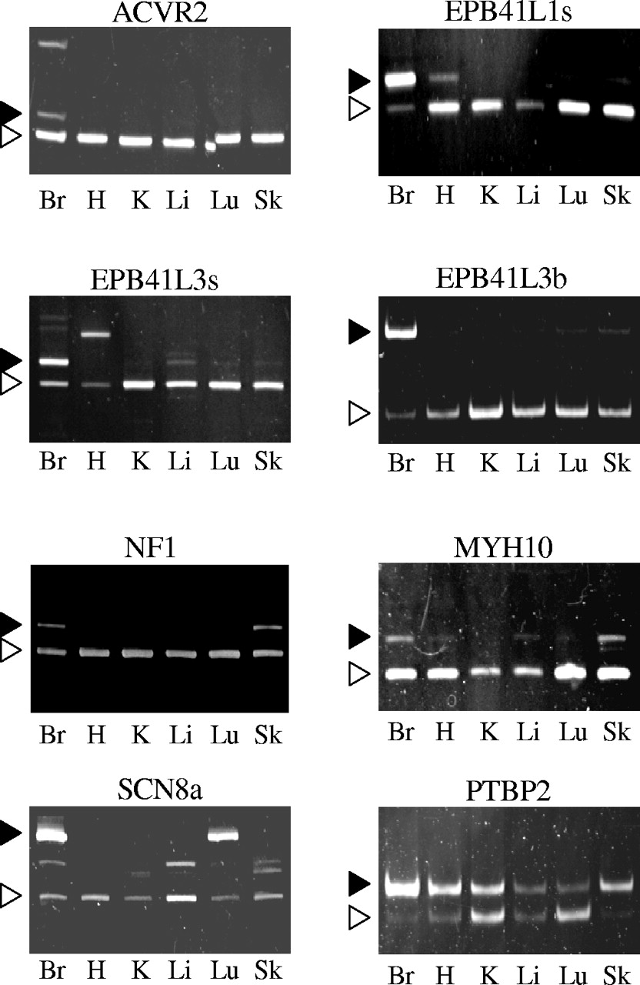
Figure 4 Alternative splicing of brain-enriched alternative exons is conserved in mouse. Alternative splicing of ...
Notes:
Figure 4 Alternative splicing of brain-enriched alternative exons is conserved in mouse. Alternative splicing of brain-enriched exons was examined by RT–PCR analysis of RNA isolated from six different mouse tissues. The figure shows polyacrylamide gel analyses indicating the amplification of brain-enriched isoforms (filled arrowheads) and non-tissue-specific isoforms (open arrowheads). The identity of the alternative exons is identified above each gel. Tissues used for PCR analysis: Br, brain; H, heart; K, kidney; Li, liver; Lu, lung and Sk, skeletal muscle.
Unless provided in the caption above, the following copyright applies to the content of this slide: © The Author 2005. Published by Oxford University Press. All rights reserved The online version of this article has been published under an open access model. Users are entitled to use, reproduce, disseminate, or display the open access version of this article for non-commercial purposes provided that: the original authorship is properly and fully attributed; the Journal and Oxford University Press are attributed as the original place of publication with the correct citation details given; if an article is subsequently reproduced or disseminated not in its entirety but only in part or as a derivative work this must be clearly indicated. For commercial re-use, please contact journals.permissions@oupjournals.org

