Slide 1
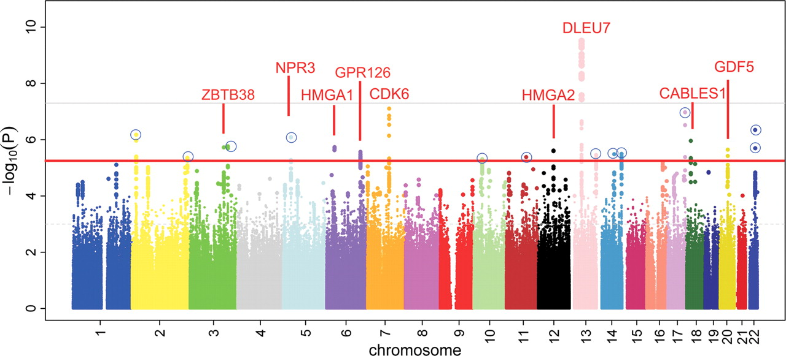
Figure 1. Manhattan plot of the height association test results (log₁₀(P)) for all SNPs in the stage 1 data ...
Notes:
Figure 1. Manhattan plot of the height association test results (log10(P)) for all SNPs in the stage 1 data set (n = 10 074). Red and grey lines are the suggestive (5 × 10−6) and genome-wide significance (5 × 10−8) P-value thresholds, respectively. Signals passing the suggestive threshold, and with the respective gene name given in red, are previously known regions of height association. Twelve loci for which SNPs were selected for the stage 2 analyses are emphasized by a blue circle.
Unless provided in the caption above, the following copyright applies to the content of this slide: © 2009 The Author(s)This is an Open Access article distributed under the terms of the Creative Commons Attribution Non-Commercial License (http://creativecommons.org/licenses/by-nc/2.0/uk/) which permits unrestricted non-commercial use, distribution, and reproduction in any medium, provided the original work is properly cited.

Slide 2
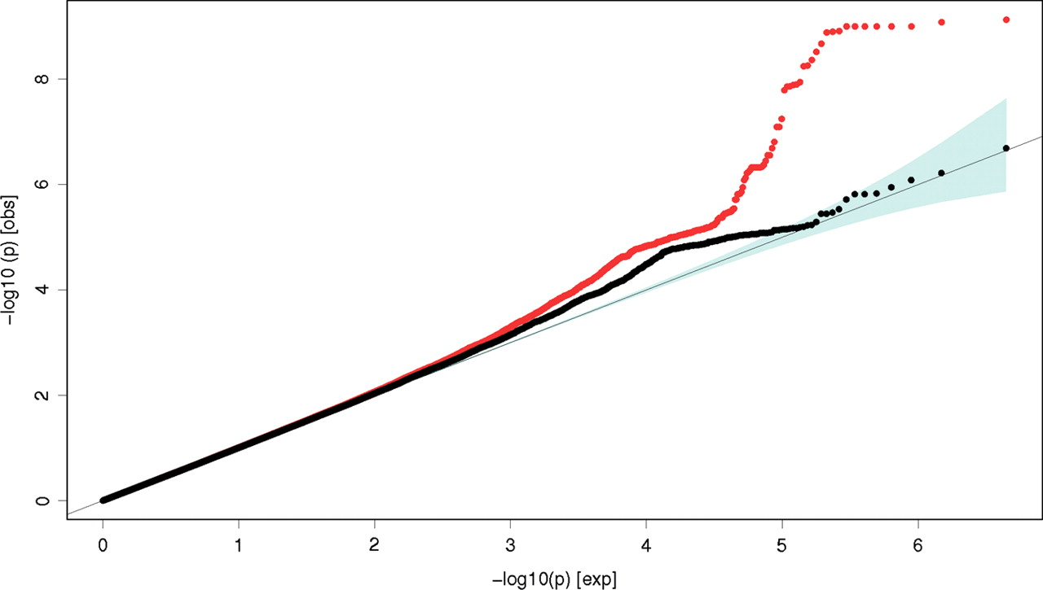
Figure 2. Quantile–quantile (Q–Q) plot of the height association test results (log₁₀(P)) for all SNPs ...
Notes:
Figure 2. Quantile–quantile (Q–Q) plot of the height association test results (log10(P)) for all SNPs passing quality control (red line) in the stage 1 analysis including 10 074 subjects, excluding variants in 48 independent loci previously associated with height on a genome-wide level (black line). Depicted P-values were corrected for population stratification using the over inflation factor λGC = 1.049.
Unless provided in the caption above, the following copyright applies to the content of this slide: © 2009 The Author(s)This is an Open Access article distributed under the terms of the Creative Commons Attribution Non-Commercial License (http://creativecommons.org/licenses/by-nc/2.0/uk/) which permits unrestricted non-commercial use, distribution, and reproduction in any medium, provided the original work is properly cited.

Slide 3
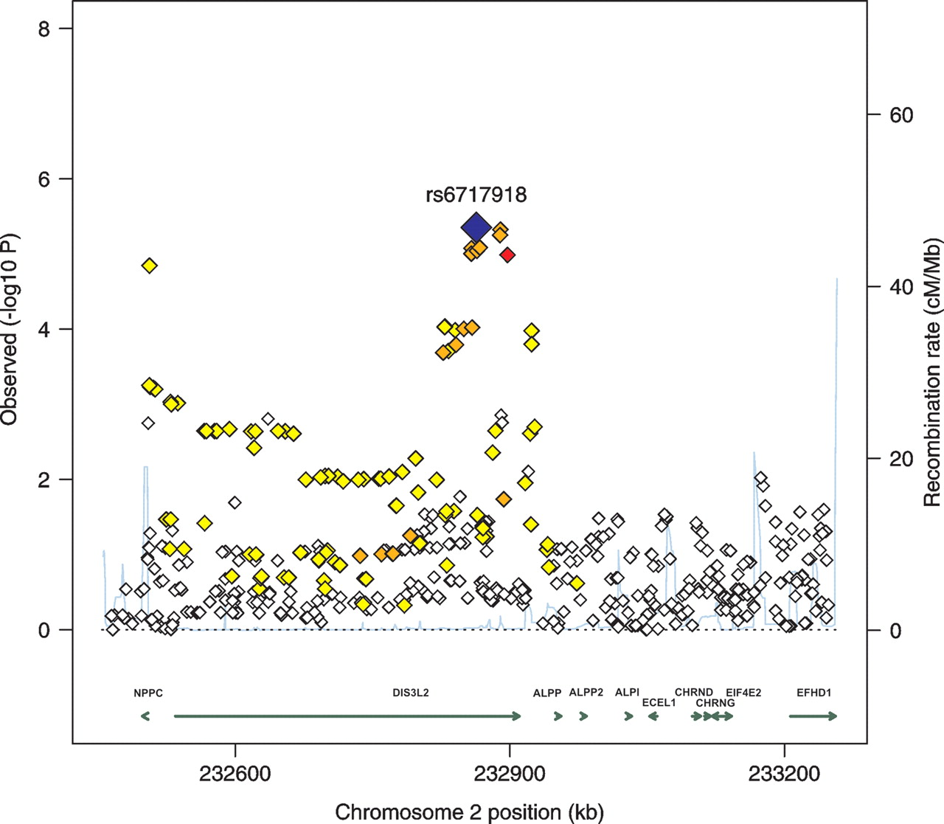
Figure 3. Local plot of the height association test results (log₁₀(P)) around SNP rs6717918 (blue diamond). ...
Notes:
Figure 3. Local plot of the height association test results (log10(P)) around SNP rs6717918 (blue diamond). P-values are as obtained from the meta-analysis of the stage 1 data set. The combined P-value from the meta-analysis of stage 1 and stage 2 data sets equals 3.4 × 10−9 for rs6717918. The coloring of SNPs indicates the strength of LD with rs6717918, coded as red (strong, r2 > 0.8), orange (moderate, 0.5 < r2 ≤ 0.8), yellow (weak, 0.2 < r2 ≤ 0.5) or white (limited or none, r2 ≤ 0.2). The blue line depicts local recombination rates.
Unless provided in the caption above, the following copyright applies to the content of this slide: © 2009 The Author(s)This is an Open Access article distributed under the terms of the Creative Commons Attribution Non-Commercial License (http://creativecommons.org/licenses/by-nc/2.0/uk/) which permits unrestricted non-commercial use, distribution, and reproduction in any medium, provided the original work is properly cited.

Slide 4
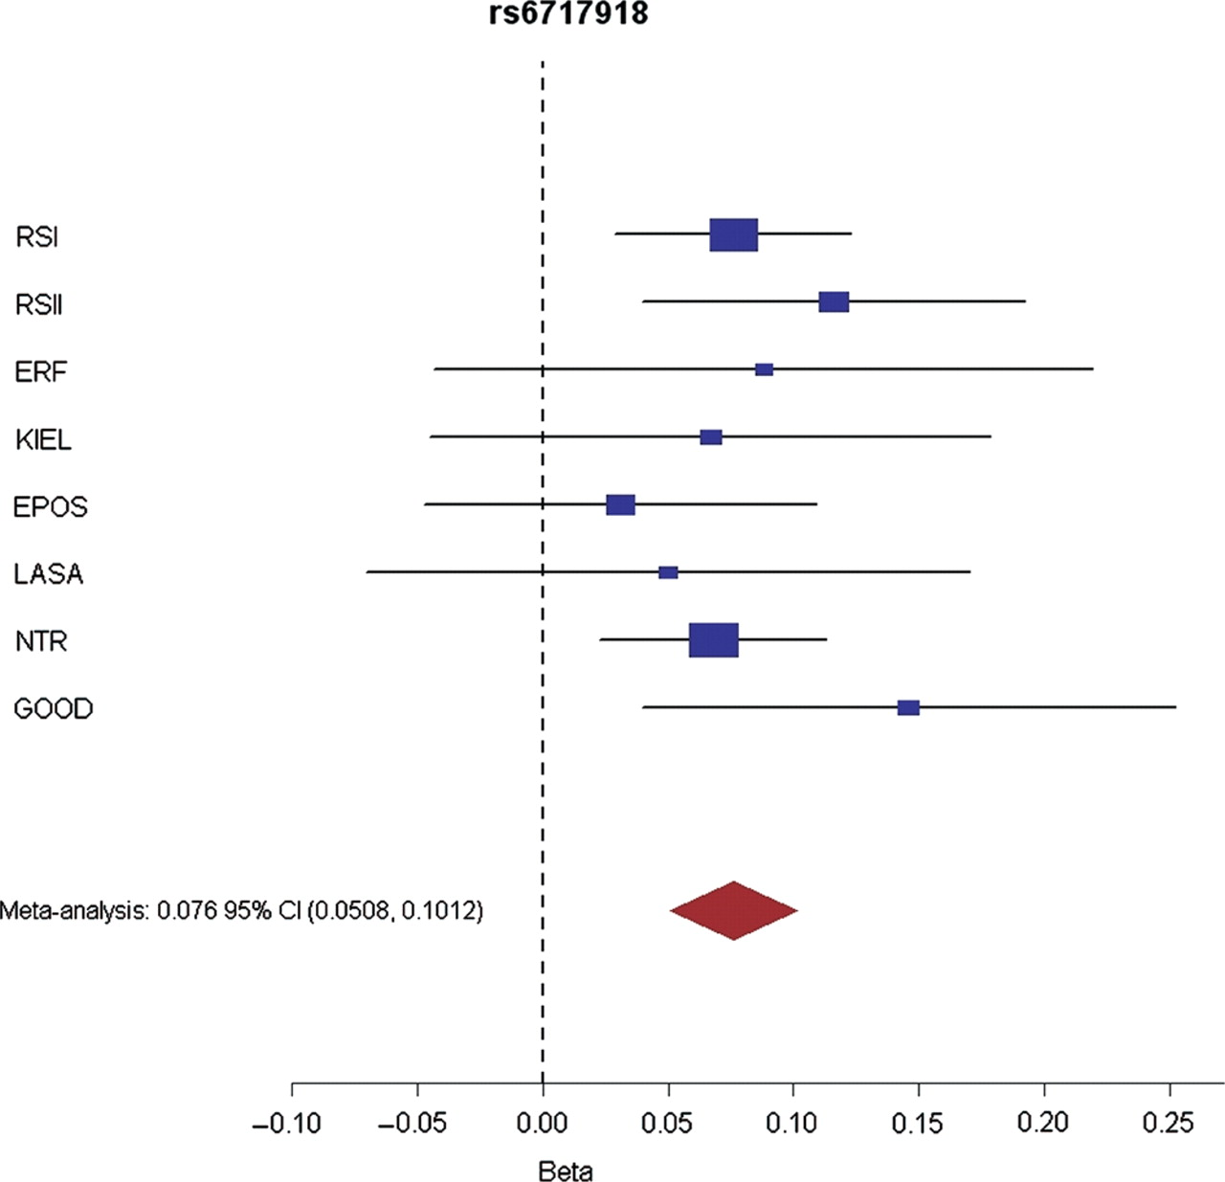
Figure 4. Forrest plot for the most significant SNP (rs6717918) in the combined meta-analysis of both the stage 1 and ...
Notes:
Figure 4. Forrest plot for the most significant SNP (rs6717918) in the combined meta-analysis of both the stage 1 and the stage 2 data sets. Beta: increase in height per SNP allele. Blue squares represent effect size estimates (measured in standard deviations of height) and 95% CI for each study. The red diamond represents the summary effect size estimate.
Unless provided in the caption above, the following copyright applies to the content of this slide: © 2009 The Author(s)This is an Open Access article distributed under the terms of the Creative Commons Attribution Non-Commercial License (http://creativecommons.org/licenses/by-nc/2.0/uk/) which permits unrestricted non-commercial use, distribution, and reproduction in any medium, provided the original work is properly cited.

