Slide 1
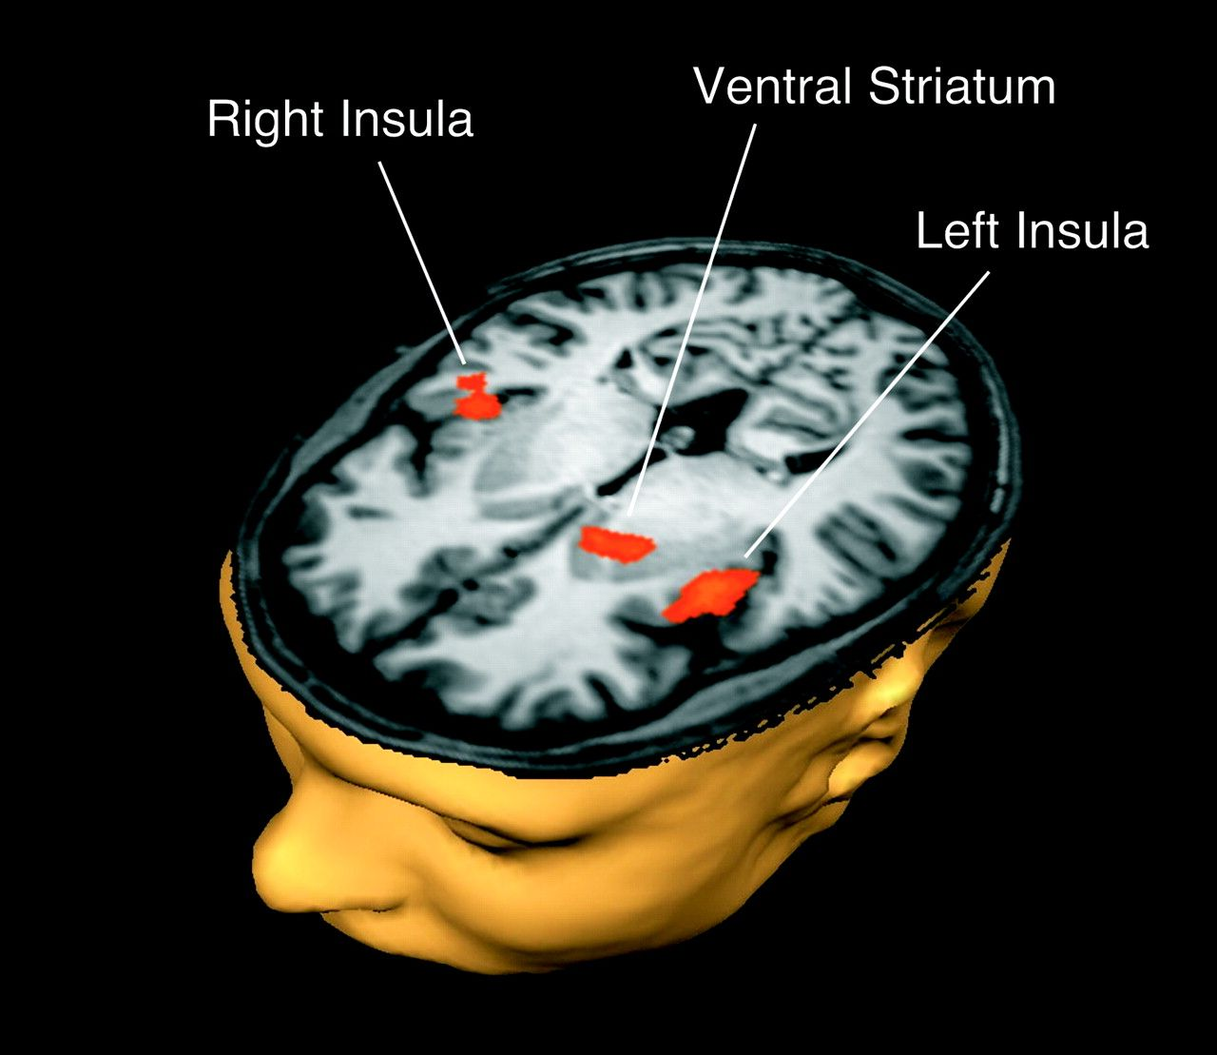
Figure 1. Results of the whole-brain analysis identifying regions that exhibit a significant interaction between group ...
Notes:
Figure 1. Results of the whole-brain analysis identifying regions that exhibit a significant interaction between group and the contrast alcohol pictures–neutral pictures. The overlaid statistical map shows positive t-values larger than 1.99 (P < 0.05) in red reflecting increased contrast differences in the heavy drinker group. The map is overlaid on a transversal cut of a 3D brain mesh derived from Talairach-transformed structural MRI images of a representative participant.
Unless provided in the caption above, the following copyright applies to the content of this slide: © The Author 2010. Published by Oxford University Press. All rights reserved. For permissions, please e-mail: journals.permissions@oup.com

Slide 2
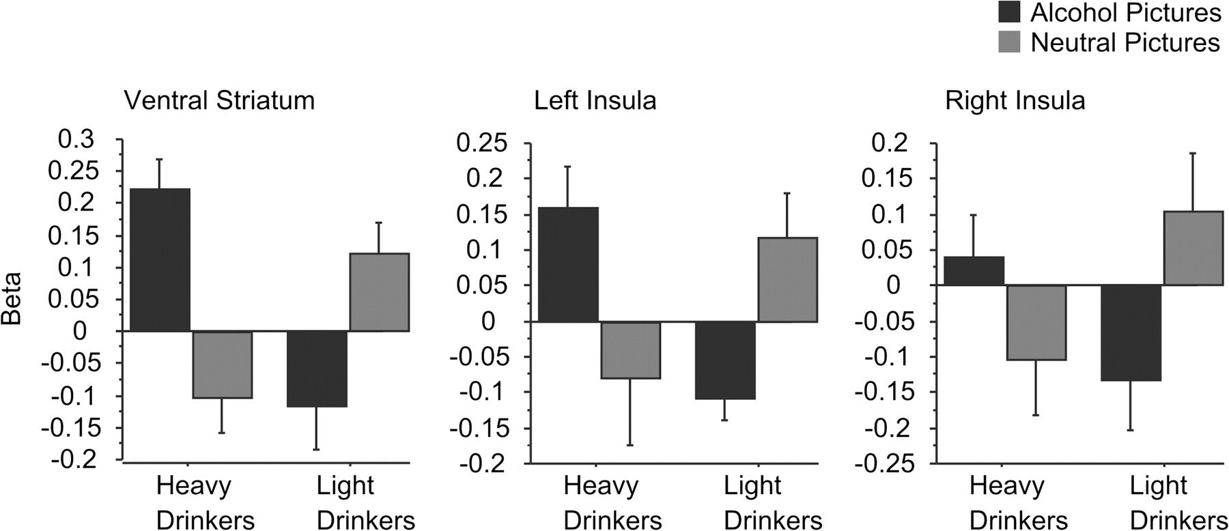
Figure 2. Heavy and light drinkers’ mean beta values (general linear model parameter estimates) for alcohol and neutral ...
Notes:
Figure 2. Heavy and light drinkers’ mean beta values (general linear model parameter estimates) for alcohol and neutral pictures in the ventral striatum and left and right insula.
Unless provided in the caption above, the following copyright applies to the content of this slide: © The Author 2010. Published by Oxford University Press. All rights reserved. For permissions, please e-mail: journals.permissions@oup.com

Slide 3
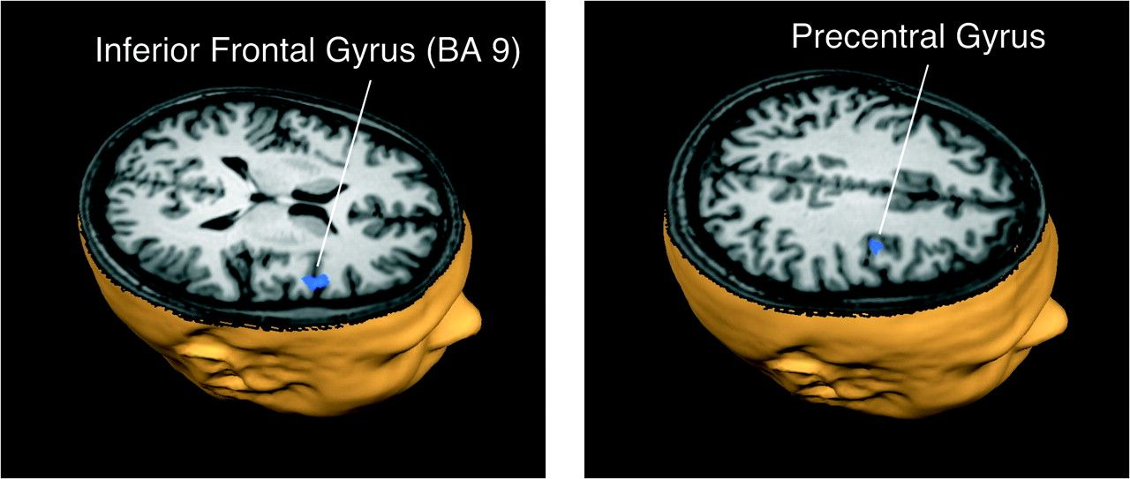
Figure 3. Transversal view of regions showing a significant interaction between group and the contrast concern–neutral ...
Notes:
Figure 3. Transversal view of regions showing a significant interaction between group and the contrast concern–neutral pictures. Blue colors indicate negative t-values (P < 0.05) reflecting reduced contrast differences for heavy drinkers.
Unless provided in the caption above, the following copyright applies to the content of this slide: © The Author 2010. Published by Oxford University Press. All rights reserved. For permissions, please e-mail: journals.permissions@oup.com

Slide 4
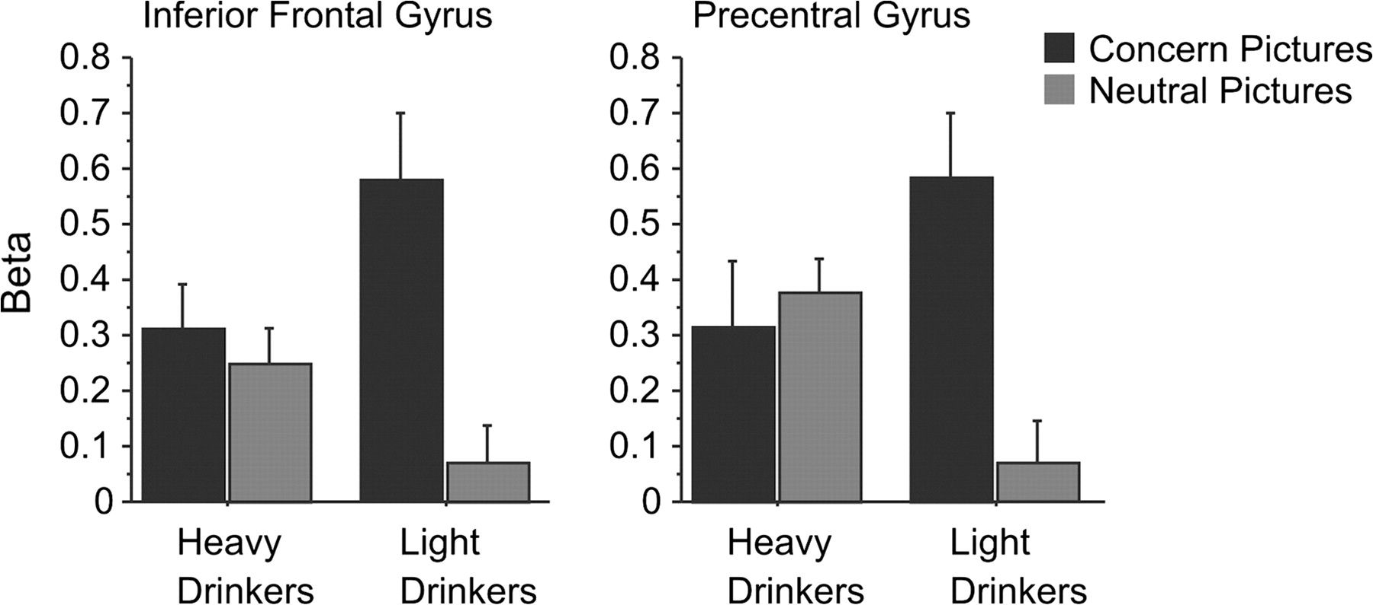
Figure 4. Mean beta values for concern and neutral pictures in the inferior frontal gyrus and precentral gyrus.
Notes:
Figure 4. Mean beta values for concern and neutral pictures in the inferior frontal gyrus and precentral gyrus.
Unless provided in the caption above, the following copyright applies to the content of this slide: © The Author 2010. Published by Oxford University Press. All rights reserved. For permissions, please e-mail: journals.permissions@oup.com

Slide 5
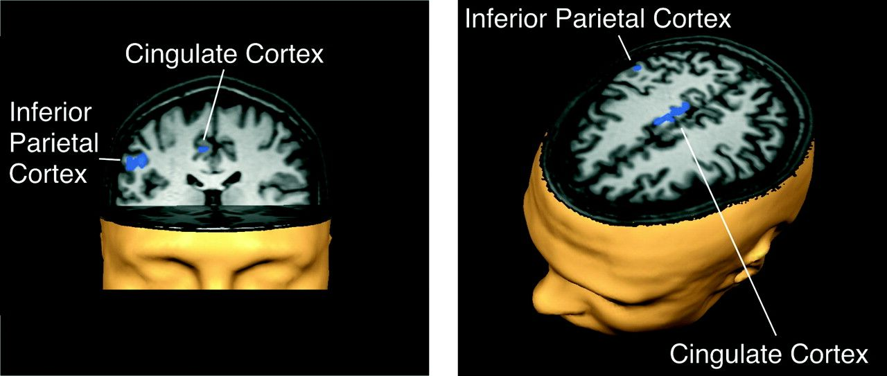
Figure 5. Coronal (left) and transversal (right) views of areas exhibiting a significant interaction between group and ...
Notes:
Figure 5. Coronal (left) and transversal (right) views of areas exhibiting a significant interaction between group and the contrast positive (food)–neutral pictures. Negative t-values (P < 0.05) are plotted in blue and indicate that heavy drinkers show reversed contrast differences.
Unless provided in the caption above, the following copyright applies to the content of this slide: © The Author 2010. Published by Oxford University Press. All rights reserved. For permissions, please e-mail: journals.permissions@oup.com

Slide 6
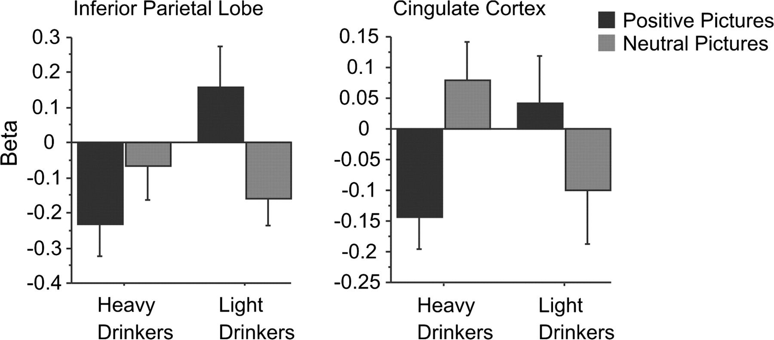
Figure 6. Mean beta values for positive and neutral pictures in statistically significant regions (inferior parietal ...
Notes:
Figure 6. Mean beta values for positive and neutral pictures in statistically significant regions (inferior parietal cortex, cingulate cortex).
Unless provided in the caption above, the following copyright applies to the content of this slide: © The Author 2010. Published by Oxford University Press. All rights reserved. For permissions, please e-mail: journals.permissions@oup.com

Slide 7
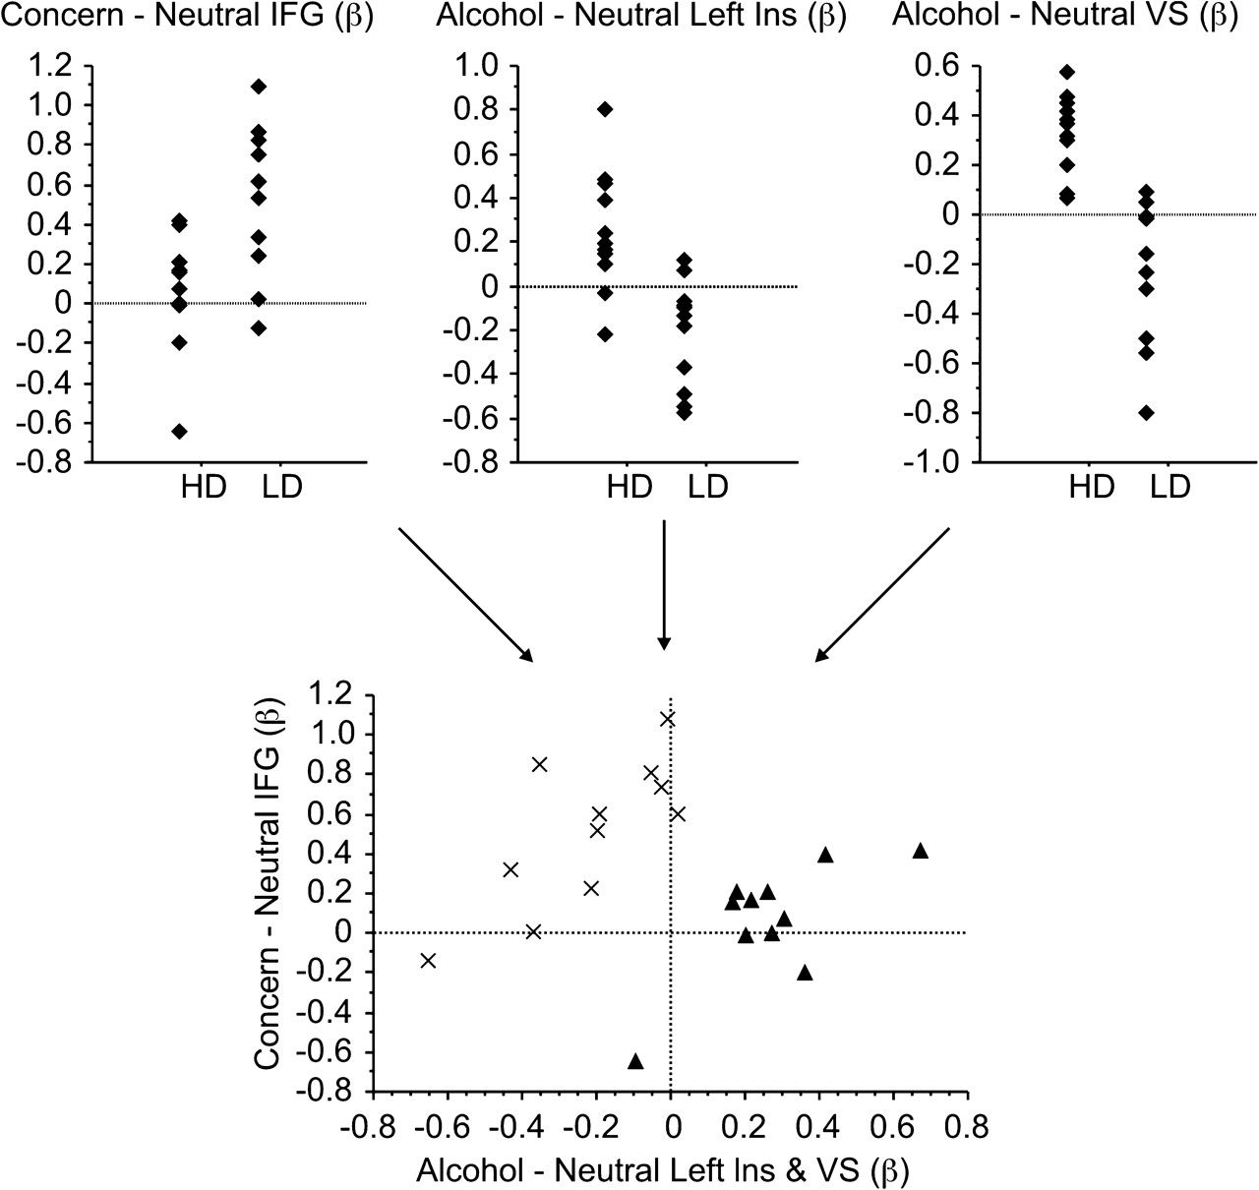
Figure 7. Top panel: Participants’ (HD, heavy drinkers; LD, light drinkers) beta difference values for those contrasts ...
Notes:
Figure 7. Top panel: Participants’ (HD, heavy drinkers; LD, light drinkers) beta difference values for those contrasts and activated clusters that linear discriminant function analysis identified as being most predictive of group status (IFG, right inferior frontal gyrus; left Ins, left insula; VS, left ventral striatum). Bottom panel: When the 3 activation patterns are combined into a 2D motivational space, the 2 groups (crosses, light drinkers; triangles, heavy drinkers) can be perfectly separated. x-axis: mean beta difference for alcohol minus neutral cues averaged across left ventral striatum and left insula, y-axis: beta difference for concern-related minus neutral pictures in the right inferior frontal gyrus.
Unless provided in the caption above, the following copyright applies to the content of this slide: © The Author 2010. Published by Oxford University Press. All rights reserved. For permissions, please e-mail: journals.permissions@oup.com

