Slide 1
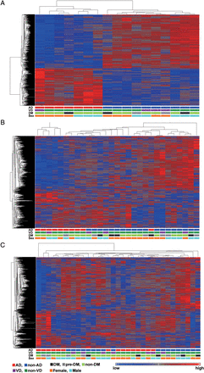
Figure 1. Hierarchical and partitioning clustering of the 1387 transcript clusters in the 3 regions of brain. (A) ...
Notes:
Figure 1. Hierarchical and partitioning clustering of the 1387 transcript clusters in the 3 regions of brain. (A) Cluster heat map of the 1387 transcript clusters based on expression data in the hippocampus. (B) Cluster heat map of the 1387 transcript clusters based on expression data in the temporal cortex. (C) Cluster heat map of the 1387 transcript clusters based on expression data in the frontal cortex. AD (red), non-AD (nAD, dark blue); vascular dementia (VD, dark green), non-VD (nVD, purple); diabetes mellitus (DM, black), prediabetes (pre-DM, gray), non-DM (light green); female (F, orange), male (M, light blue), In the heat map, blue represents a lower expression level and red indicates a higher expression level.
Unless provided in the caption above, the following copyright applies to the content of this slide: © The Author 2013. Published by Oxford University Press.This is an Open Access article distributed under the terms of the Creative Commons Attribution Non-Commercial License (http://creativecommons.org/licenses/by-nc/4.0/), which permits non-commercial re-use, distribution, and reproduction in any medium, provided the original work is properly cited. For commercial re-use, please contact journals.permissions@oup.com

Slide 2
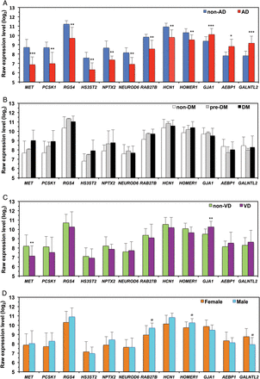
Figure 2. Comparison of the raw expression levels of 12 genes whose expression was significantly altered in the AD ...
Notes:
Figure 2. Comparison of the raw expression levels of 12 genes whose expression was significantly altered in the AD hippocampus. (A) Comparison between non-AD and AD cases. Dark blue box, non-AD (N = 10); red box, AD (N = 7). (B) Comparison between non-DM and pre-DM/DM cases. Open box, non-DM (N = 12); gray box, prediabetes (pre-DM, N = 2); black box, DM (N = 3). (C) Comparison between non-VD and VD cases. Green box, non-VD (N = 13); purple box, VD (N = 4). (D) Comparison between female and male cases. Orange box, female (N = 9); light blue box, male (N = 8). Four-way ANOVA was performed with the list of 1387 transcript clusters altered in the hippocampus, and the P-value for each comparison was determined by Fisher's Least Significant Difference method. Log2 transformed mean values with SD for the raw expression levels of 12 genes are shown in each bar graph. #P < 0.05, *P < 0.01, **P < 0.005, ***P < 0.001. In B, non-DM (N = 12) and pre-DM + DM (N = 5) were compared; none of the 12 altered genes showed a significant difference.
Unless provided in the caption above, the following copyright applies to the content of this slide: © The Author 2013. Published by Oxford University Press.This is an Open Access article distributed under the terms of the Creative Commons Attribution Non-Commercial License (http://creativecommons.org/licenses/by-nc/4.0/), which permits non-commercial re-use, distribution, and reproduction in any medium, provided the original work is properly cited. For commercial re-use, please contact journals.permissions@oup.com

Slide 3
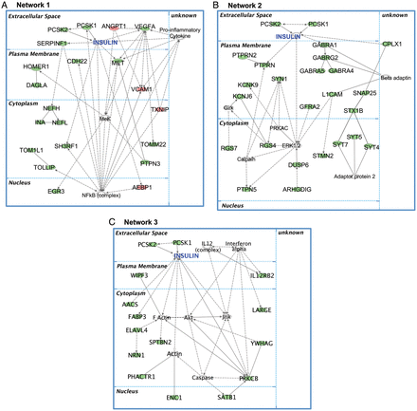
Figure 3. Top 3 networks of genes whose expression was significantly altered in the AD hippocampus. Among the top 200 ...
Notes:
Figure 3. Top 3 networks of genes whose expression was significantly altered in the AD hippocampus. Among the top 200 transcription clusters shown in Supplementary Table S6, 145 genes were eligible for generating networks excluding microRNA–mRNA interactions by IPA. (A) Network 1 includes 16 downregulated genes (MET, PCSK1, PTPN3, SERPINF1, VEGFA, NEFH, EGR3, HOMER1, INA, DAGLA, CDH22, NEFL, TOM1L1, TOLLIP, SH3RF1, TOMM22), and 4 upregulated genes (AEBP1, TXNIP, VCAM1, ANGPT1). (B) Network 2 consists of 23 downregulated genes (RGS4, GABRA1, GFRA2, CPLX1, KCNK9, RGS7, ARHGDIG, GABRG2, STMN2, L1CAM, SYT7, SYT5, GABRA4, KCNJ6, STX1B, GABRA5, SNAP25, PTPRN, SYT4, DUSP6, SYN1, PTPN5, PTPRN2). (C) Network 3 consists of 13 downregulated genes (IL12RB2, PRKCB, WIPF3, NRN1, ENC1, SATB1, PHACTR1, ELAVL4, FABP3, AACS, LARGE, SPTBN2, YWHAG). Solid lines indicate direct interactions and dashed lines indicate indirect interactions. Downregulated molecules are shown in green and upregulated ones are shown in red. Encoded molecules were placed in an appropriate subcellular compartment based on IPA, if known. We added PCSK2 into Network 1, insulin, PCSK1, and PCSK2 into Network 2, and PCSK1 and PCSK2 into Network 3. PCSK1 and PCKS2 are known to be localized in secretary granules in the cytoplasm, but some amount of these proteins may be secreted into the extracellular space.
Unless provided in the caption above, the following copyright applies to the content of this slide: © The Author 2013. Published by Oxford University Press.This is an Open Access article distributed under the terms of the Creative Commons Attribution Non-Commercial License (http://creativecommons.org/licenses/by-nc/4.0/), which permits non-commercial re-use, distribution, and reproduction in any medium, provided the original work is properly cited. For commercial re-use, please contact journals.permissions@oup.com

Slide 4
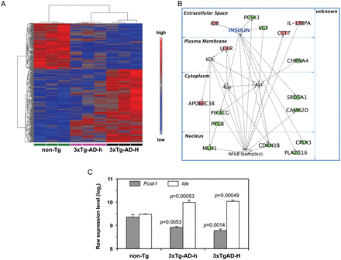
Figure 4. Results of microarray analysis of the 3xTg-AD mice. (A) Cluster heat map of the 406 transcript clusters based ...
Notes:
Figure 4. Results of microarray analysis of the 3xTg-AD mice. (A) Cluster heat map of the 406 transcript clusters based on individual expression data in the hippocampi of non-Tg (green), 3x-Tg-AD-h (magenta), and 3x-Tg-AD-H (black) mice (N = 3 for each group). Hierarchical and partitioning clustering of the 406 transcript clusters was performed among the 3 groups. In the heat map, blue represents a lower expression level and red indicates a higher expression level. (B) The top network of genes whose expression was significantly altered in the hippocampus of 3xTg-AD-H mice. Among the top 406 transcription clusters shown in Supplementary Table S7, only 120 genes were eligible for generating networks excluding microRNA–mRNA interactions; the most relevant network includes 11 downregulated genes (Srd5a1, Mlh1, Cdkn1b, Pcsk1, Camk2d, Cplx3, Vgf, Chrna4, Pygb, Pik3cg, Pla2g16), and 5 upregulated genes (Cst7, Ide, Apobec3b, Ldlr, Il18bp). Solid lines indicate direct interactions and dashed lines indicate indirect interactions. Downregulated molecules are shown in green and upregulated ones are shown in red. (C) Comparison of the raw expression levels for Pcsk1 and Ide genes whose expression was significantly altered in the 3xTg-AD hippocampus. One-way ANOVA was performed with the list of 406 transcript clusters in hippocampus, and a P-value for the comparison with non-TG was determined using Fisher's Least Significant Difference method. Log2 transformed mean values with SEMs of the raw expression levels for each gene are shown in the bar graph.
Unless provided in the caption above, the following copyright applies to the content of this slide: © The Author 2013. Published by Oxford University Press.This is an Open Access article distributed under the terms of the Creative Commons Attribution Non-Commercial License (http://creativecommons.org/licenses/by-nc/4.0/), which permits non-commercial re-use, distribution, and reproduction in any medium, provided the original work is properly cited. For commercial re-use, please contact journals.permissions@oup.com

Slide 5
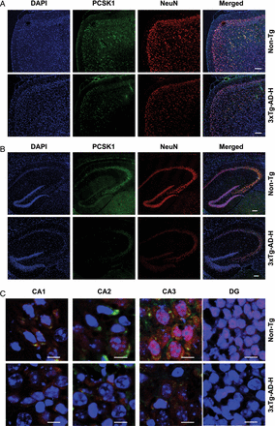
Figure 5. Evaluation of PCSK1 protein levels in mouse brain by laser scanning immunofluorescence confocal microscopy. ...
Notes:
Figure 5. Evaluation of PCSK1 protein levels in mouse brain by laser scanning immunofluorescence confocal microscopy. (A) PCSK1 expression in the cerebral cortex. (B) PCSK1 expression in the hippocampus. (C) Magnified images of the hippocampal subregions CA1, CA2, CA3, and DG. Brain sections were prepared from 15-month-old non-Tg and 3x-Tg-AD-H male mice. Sections were reacted with anti-PCSK1 antibody (green) and an anti-NeuN antibody (red), and nuclear DNA was counterstained with DAPI (blue). Scale bars: A, B, 100 μm; C, 20 μm.
Unless provided in the caption above, the following copyright applies to the content of this slide: © The Author 2013. Published by Oxford University Press.This is an Open Access article distributed under the terms of the Creative Commons Attribution Non-Commercial License (http://creativecommons.org/licenses/by-nc/4.0/), which permits non-commercial re-use, distribution, and reproduction in any medium, provided the original work is properly cited. For commercial re-use, please contact journals.permissions@oup.com

Slide 6
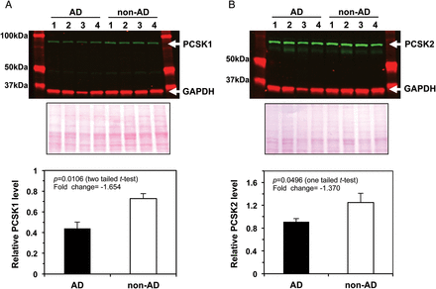
Figure 6. Evaluation of PCSK1 and PCSK2 protein levels in the hippocampal samples by western blot analysis. Hippocampal ...
Notes:
Figure 6. Evaluation of PCSK1 and PCSK2 protein levels in the hippocampal samples by western blot analysis. Hippocampal lysates (12 µg protein/lane) prepared from AD (No. 3, 4, 7, and 13 listed in see Supplementary Table S2) and non-AD brains (No. 19, 20, 21, and 28 listed in see Supplementary Table S2) were run on 10% SDS-PAGE gels and subjected to western blot analysis for PCSK1 (A), PCSK2 (B), and GAPDH proteins (top panels). Ponceau S staining (middle panels) was conducted to confirm the equal loading of samples and normalization. The relative intensities of bands were quantified using an Odyssey infrared imaging system, normalized to the intensity of Ponceau S staining, and are shown in bar graphs (bottom panels). P-values from an unpaired t-test are shown.
Unless provided in the caption above, the following copyright applies to the content of this slide: © The Author 2013. Published by Oxford University Press.This is an Open Access article distributed under the terms of the Creative Commons Attribution Non-Commercial License (http://creativecommons.org/licenses/by-nc/4.0/), which permits non-commercial re-use, distribution, and reproduction in any medium, provided the original work is properly cited. For commercial re-use, please contact journals.permissions@oup.com

