Slide 1
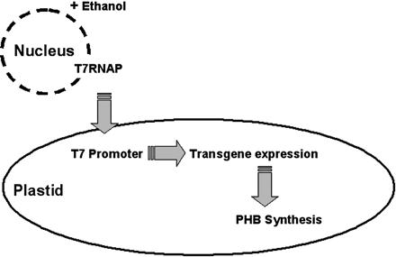
Fig. 1 Inducible trans-activation in plastids. A nuclear-located T7 RNAP gene was fused to a plastid ...
Notes:
Fig. 1 Inducible trans-activation in plastids. A nuclear-located T7 RNAP gene was fused to a plastid targeting sequence. The T7RNAP was expressed under control of an inducible promoter. Induction by ethanol application leads to import of the T7RNAP into the plastids. Transcription of plastid transgenes under control of polymerase-specific regulatory elements occurs and the PHB pathway becomes established in the chloroplasts.
Unless provided in the caption above, the following copyright applies to the content of this slide:

Slide 2
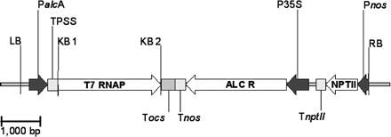
Fig. 2 Vector for nuclear transformation of tobacco. Transformation via Agrobacterium tumefaciens was carried ...
Notes:
Fig. 2 Vector for nuclear transformation of tobacco. Transformation via Agrobacterium tumefaciens was carried out with the Ti plasmid pSRNTPSST7 as detailed in the text. LB, left border; PalcA, 5′ promoter of the alcA gene from Aspergillus nidulans for ethanol induction; TPSS, DNA sequence for the transit peptide of the small subunit of RuBisCo from Pisum sativum for plastid targeting (Nawrath et al. 1994, Dasgupta et al. 1998); KB1 and KB2, primers for amplification of the T7RNAP; T7RNAP, RNA polymerase gene from λ bacteriophage T7; Tocs, Tnos, downstream untranslated region of the octopin and nopalin synthase genes from A. tumefaciens; ALCR, transcription factor necessary for induction at the alcA promoter; P35 S, promoter of cauliflower mosaic virus for constitutive expression; NPTII, kanamycin resistance TnptII terminator; Pnos, promoter of the nopalin synthase gene; RB, right border.
Unless provided in the caption above, the following copyright applies to the content of this slide:

Slide 3
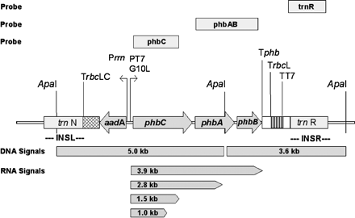
Fig. 3 Map of the phb operon under T7 regulatory elements integrated into the plastome. The map shows the ...
Notes:
Fig. 3 Map of the phb operon under T7 regulatory elements integrated into the plastome. The map shows the insertion cassette, targeted to the plastome by homologous flanks INSL and INSR containing trnN and trnR. For the test of the homoplastomy of the transformants, we used as probe ‘trnR’, a plastome-specific fragment containing trnR positioned at nucleotides 109,230–110,348 within the direct repeat of the tobacco plastome. The restriction sites for ApaI are indicated. Probe ‘phbAB’ used for Southern analysis consisted of a 2.3 kb PstI-cut fragment (nucleotides 1,968–4,290 from the start codon). Expected hybridization fragments for transformant lines are given at the bottom of the map. Intact transformant lines contained a 5,032 and a 3,550 bp fragment, when hybridized with the ApaI overlapping probe ‘phbAB’. The inserted phb operon was under control of the T7 leader and promoter sequence (G10L, PT7 promoter) with a termination sequence, containing a terminator from Ralstonia eutropha (Tphb), a rbcL 3′ region from tobacco (TrbcL) and a T7 terminator (TT7). The aadA cassette used for spectinomycin selection was expressed constitutively by the 16S rRNA promoter with the termination region from a ChlamydomonasrbcL gene (TrbcLC).
Unless provided in the caption above, the following copyright applies to the content of this slide:

Slide 4
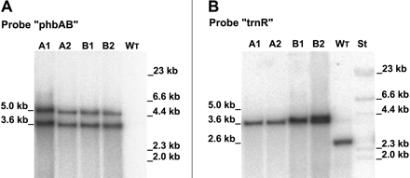
Fig. 4 Proof of correct insertion and homoplasmy by Southern hybridization. (A) In order to verify correct ...
Notes:
Fig. 4 Proof of correct insertion and homoplasmy by Southern hybridization. (A) In order to verify correct insertion of the phb operon, the transformant’s DNA was cut by ApaI. As indicated in Fig. 3, a specific overlapping fragment containing the phbA and phbB gene was used as probe, ‘phbAB’ (nucleotides 1,968–4,290 from the start codon). Lanes 1–4, DNAs of transformant A1, A2 and B1, B2. Lane 5 contains wild-type DNA. (B) For proof of homoplastomy, a second hybridization was performed. In order to test for residual wild-type plastome copies in lower expressing plants, we used as probe a plastome-specific fragment containing trnR positioned at nucleotides 109,230–110,348 within the direct repeat, as indicated in Fig. 3. Plant DNA of A1, A2 and B1, B2 was cut by ApaI. For intact homoplastomic transformant lines, a single signal of 3.6 kb was detected. If the transformants were heteroplastomic, they would exhibit an additional 2.6 kb fragment specific for a non-disrupted wild-type plastome insertion site. Lanes 1–4, DNAs of transformant A1, A2 and B1, B2; lane 5, wild-type DNA; lane 6, standard DNA.
Unless provided in the caption above, the following copyright applies to the content of this slide:

Slide 5
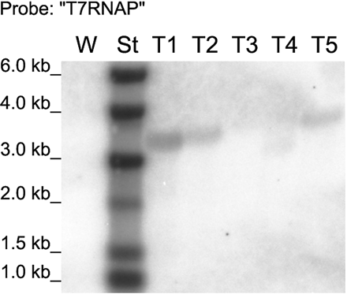
Fig. 5 Northern hybridization for T7RNAP mRNA. Following nuclear transformation by Agrobacterium tumefaciens, ...
Notes:
Fig. 5 Northern hybridization for T7RNAP mRNA. Following nuclear transformation by Agrobacterium tumefaciens, the transcription of T7RNAP was confirmed by probing with the 2.7 kb probe containing the T7RNAP gene. The analysis detected products of 3–4 kb length. After wild-type and RNA standard, lanes 1–5 were loaded with RNA of the nuclear transformants T1–T5. T3 and T4 did not show the expected signal, but were resistant to kanamycin.
Unless provided in the caption above, the following copyright applies to the content of this slide:

Slide 6
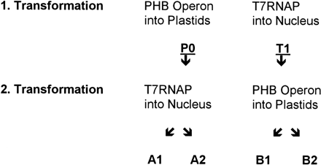
Fig. 6 Serial order of successive double transformation steps, yielding transformants A1, A2, B1 and B2.
Notes:
Fig. 6 Serial order of successive double transformation steps, yielding transformants A1, A2, B1 and B2.
Unless provided in the caption above, the following copyright applies to the content of this slide:

Slide 7
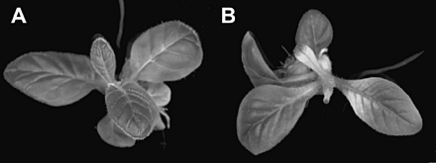
Fig. 7 Bleaching. Following spraying with a 5% ethanol solution, the wild type (A) did not exhibit symptoms. ...
Notes:
Fig. 7 Bleaching. Following spraying with a 5% ethanol solution, the wild type (A) did not exhibit symptoms. Only transformant lines showed severe bleaching on ethanol induction; here genotype B2 is depicted (B).
Unless provided in the caption above, the following copyright applies to the content of this slide:

Slide 8
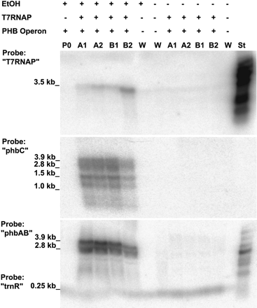
Fig. 8 Inducibility of operon transcription in the plastids by ethanol shown by Northern analysis. Following ...
Notes:
Fig. 8 Inducibility of operon transcription in the plastids by ethanol shown by Northern analysis. Following a 3 d application of 5% ethanol, mRNA signals were detected in tobacco lines with the plastome-located phb operon under control of the T7RNAP. The Northern blots contained RNA from the following plants: lane 1, primary plastome transformant ‘P0′ with the phb operon, without T7RNAP; lanes 2 and 3, double transformants A1 and A2, both derived from ‘P0′ with T7RNAP and the phb operon with ethanol application; lanes 4 and 5, double transformants B1 and B2, containing both T7RNAP and the phb operon, with ethanol application; lane 6, wild type (W) with ethanol application; lane 7, wild type (W) without ethanol application; lanes 8–11, double transformants A1, A2, B1 and B2, with T7RNAP and the phb operon without ethanol application; lane 12, wild type (W) without ethanol application. The Northern gel contained 10 µg of total plant RNA each. The sizes of RNA standard (St) are as follows: 6, 4, 3, 2, 1.5, 1, 0.5 and 0.2 kb. Signals of T7RNAP transcripts were identified in transformants with high PHB expression upon ethanol induction. Probes ‘phbC’ and ‘phbAB’ consisted of the respective DNA regions of the phb operon. RNA hybridization with ‘phbC’ detected transcripts in the range from 3.9 to 1 kb in the transformants A1, A2 and B1, B2. Probe ‘phbAB’ showed only a 3.9 and a 2.8 kb transcript. Hybridization of ‘phbAB’ was carried out together with the RNA probe trnR as an internal standard. The trnR signal of about 0.25 kb shows that the gel loading was balanced. The lanes of the Northern gel contained 5 µg of total plant RNA each.
Unless provided in the caption above, the following copyright applies to the content of this slide:

Slide 9
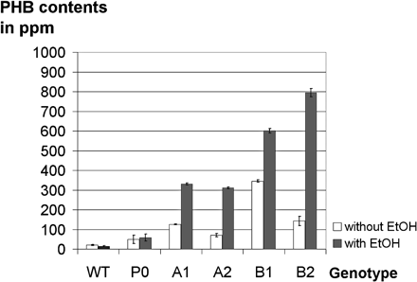
Fig. 9 Average PHB contents of transformants. Leaf material of each transformant line was analyzed by gas ...
Notes:
Fig. 9 Average PHB contents of transformants. Leaf material of each transformant line was analyzed by gas chromatography 4 weeks following 5% ethanol induction. PHB values were determined in dry matter of the transgenic tobacco lines. Standard deviations are indicated within the bars. Measurements were repeated eight times for each genotype.
Unless provided in the caption above, the following copyright applies to the content of this slide:

Slide 10
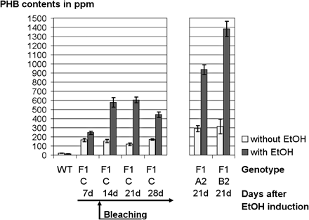
Fig. 10 PHB contents of F₁ plants in a time course. Following a 5% ethanol induction, tobacco leaf ...
Notes:
Fig. 10 PHB contents of F1 plants in a time course. Following a 5% ethanol induction, tobacco leaf material of F1 progeny was collected for gas chromatographic analysis after 7, 14, 21 and 28 d. PHB values were determined in dry matter of the plants. Standard deviations are indicated within the bars. Measurements were repeated six times for each state of genotype F1C, and three times for F1-A2 and F1-B2.
Unless provided in the caption above, the following copyright applies to the content of this slide:

