Slide 1
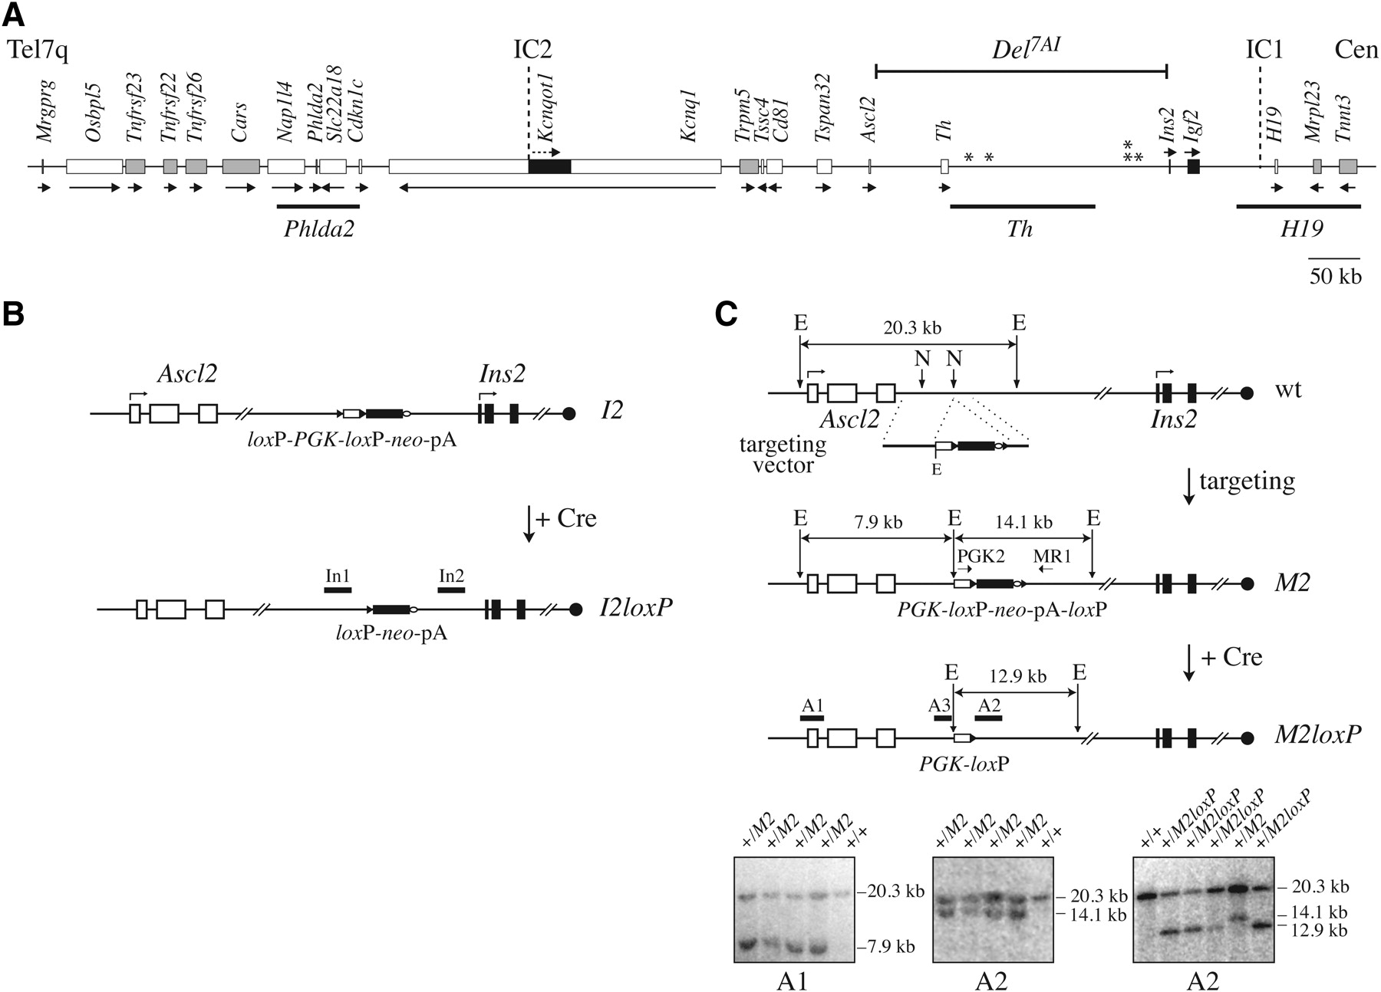
Figure 1. Targeted lox P site insertions on distal Chr7. (A) Gene arrangement on distal Chr 7 shown to scale ...
Notes:
Figure 1. Targeted lox P site insertions on distal Chr7. (A) Gene arrangement on distal Chr 7 shown to scale (coordinates from NCBI m37 build), oriented from the telomere (Tel7q, left) to the centromere (Cen, right). Genes showing biallelic, paternal and maternal expressions are represented by shaded, black and white rectangles, respectively, with arrows indicating their transcriptional orientation. The map also presents the positions of the following features: (above) the imprinting centres IC1 and IC2, the sites physically interacting with the maternal IC1 (asterisks) and the breakpoints of the deletion generated in this study (Del7AI); (below) three genomic PAC clones (Phlda2, Th, and H19) used in DNA FISH experiments. (B) Targeting of a loxP site at Ins2: the I2 and I2loxP alleles. The generation of these alleles has been described previously (30). White and black rectangles show the Ascl2 and Ins2 exons, respectively. The black circle on the right represents the centromere. In the I2 allele, the PGK promoter can be deleted by Cre. The remaining promoter-less loxP-neo-pA of the I2loxP allele can be activated by recombination with the PGK-loxP of the M2loxP allele, shown in C. The genomic probe In1 was used to analyze the duplication allele (Supplementary Material, Fig. S3); In2 was used to confirm the structure of the deletion allele (Fig. 3A). (C) Targeting of a loxP site at Ascl2: the M2 and M2loxP alleles. Diagrams centred on the Ascl2-Ins2 interval and showing, from the top, the wild-type locus (wt), the targeting vector, the targeted M2 allele and the M2loxP insertion. The selectable marker cassettes consist of a PGK promoter (white box), driving neo expression from a neo-pA construct (black box and open oval). In the M2 allele the neo-pA is flanked by loxP sites (black arrowheads). A1: external 5′ probe; A2, A3: 3′ and 5′ internal genomic probes. E, EcoRI; N, NcoI. Southern blot analysis of genomic DNA from ES cell clones, digested with EcoRI and hybridized with A1 and A2 (bottom left and middle). The M2loxP allele was obtained by transient Cre expression in Ascl2+/M2 cells and analyzed with probe A2 (bottom right). Samples include the parental R1 ES cell line (+/+), 4 positive Ascl2+/M2loxP and one un-recombined Ascl2+/M2 clones. PGK2 and MR1 on M2 allele: PCR primers used to genotype the M2 and M2loxP alleles (Supplementary Material, Fig. S2B). The A3 probe was used to monitor rearrangements at the M2 allele in vivo (Supplementary Material, Fig. S2A), and to confirm the structure of the deletion allele (Fig. 3A).
Unless provided in the caption above, the following copyright applies to the content of this slide: © The Author 2009. Published by Oxford University Press. All rights reserved. For Permissions, please email: journals.permissions@oxfordjournals.org

Slide 2
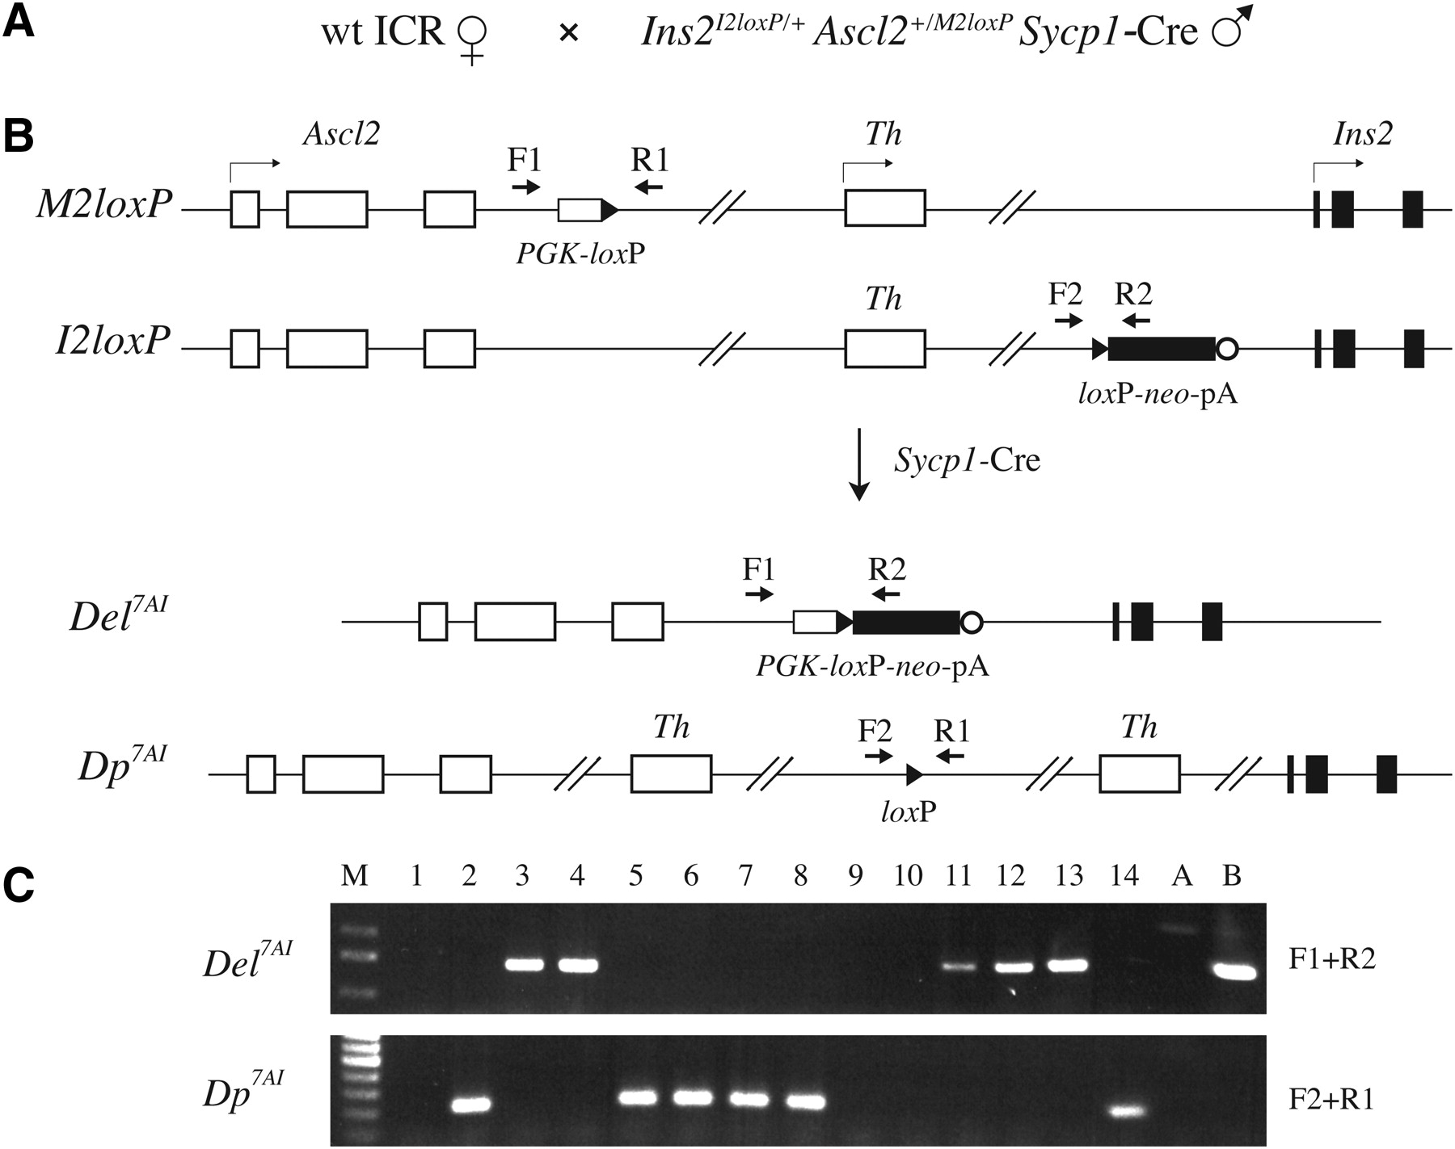
Figure 2. TAMERE from a triple transgenic male: the Del^{7AI} and Dp^{7AI} alleles. (A) Breeding scheme ...
Notes:
Figure 2. TAMERE from a triple transgenic male: the Del7AI and Dp7AI alleles. (A) Breeding scheme to produce novel recombined alleles from wild-type females crossed with triple transgenic males, carrying the Sycp1-Cre transgene as well as loxP site insertions at the maternal Ins2 and paternal Ascl2 loci. (B) Diagrams of the Ascl2–Ins2 interval presented as in Figure 1 and showing the positions of the genotyping PCR primers F1, F2, R1 and R2. From the top, these show the structures of the loxP insertion alleles at Ascl2 (M2loxP) and Ins2 (I2loxP) present in the male, as well as the two predicted reciprocal recombination products from a trans-allelic Cre reaction: the deletion allele Del7AI and the duplication allele Dp7AI. (C) Representative PCR genotyping of 14 progeny, including 5+/Del7AI heterozygotes (#3, 4, 11–13) and 6+/Dp7AI heterozygotes (#2, 5–8, 14). The new alleles were detected using specific PCR assays against novel unique junctions. Controls are: A, wild-type DNA; B, ES cells heterozygous for the deletion allele.
Unless provided in the caption above, the following copyright applies to the content of this slide: © The Author 2009. Published by Oxford University Press. All rights reserved. For Permissions, please email: journals.permissions@oxfordjournals.org

Slide 3
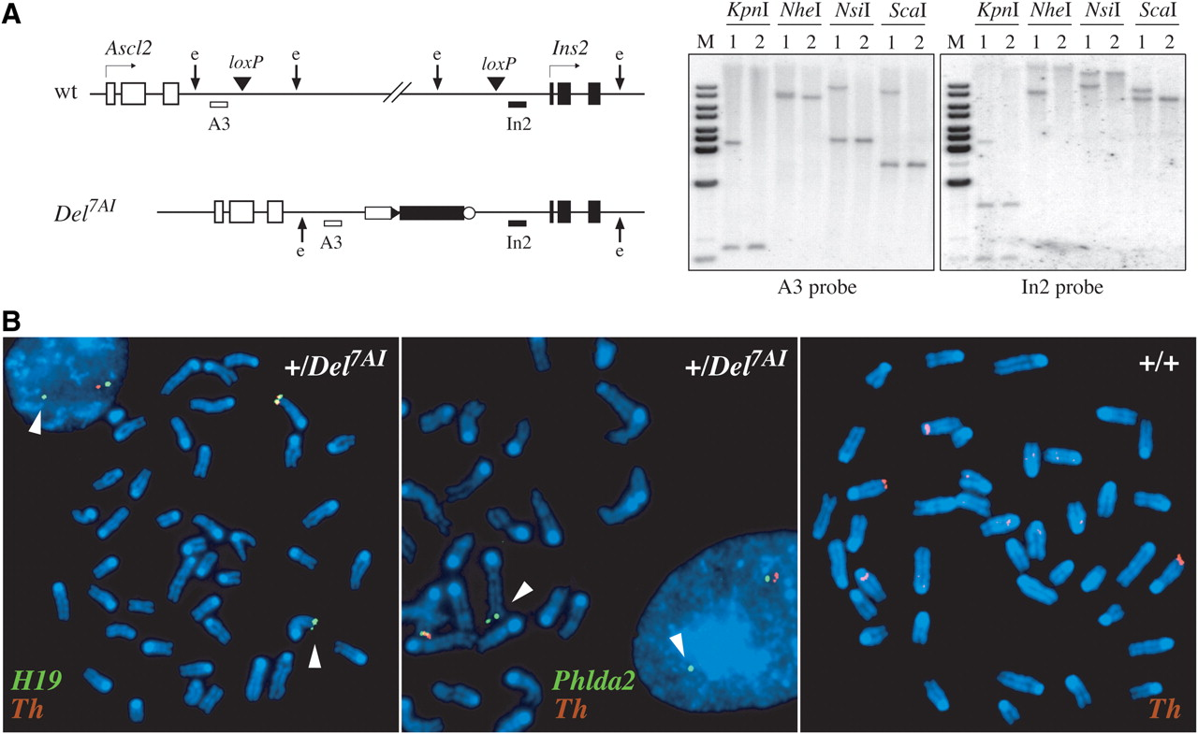
Figure 3. Molecular and cytogenetic characterization of the deletion allele Del^{7AI}. (A) Southern blot ...
Notes:
Figure 3. Molecular and cytogenetic characterization of the deletion allele Del7AI. (A) Southern blot analysis of tail genomic DNA, isolated from a +/Del7AI heterozygote (#1) and a wild-type littermate (#2), digested with different restriction enzymes, and probed with the Ascl2 and Ins2 genomic probes A3 and In2. The diagrams of the wild-type (wt) and mutant (Del7AI) alleles (left) present the positions of the probes A3 and In2 relative to the loxP site insertion sites. Representative restriction enzyme recognition sites (e) illustrate the presence of a new fragment shared by the two probes in the DNA sample from the +/Del7AI heterozygote (#1). (B) DNA FISH on interphase nuclei and metaphase chromosome spreads from wild-type or +/Del7AI primary embryonic fibroblasts, using genomic PAC clones from Chr 7 regions proximal (H19, green), internal (Th, red), or distal (Phlda2, green) to the Del7AI breakpoints as probes (Fig. 1A). Arrowheads point to Chr 7 variants negative for the Th probe and thus carrying the Del7AI allele.
Unless provided in the caption above, the following copyright applies to the content of this slide: © The Author 2009. Published by Oxford University Press. All rights reserved. For Permissions, please email: journals.permissions@oxfordjournals.org

Slide 4
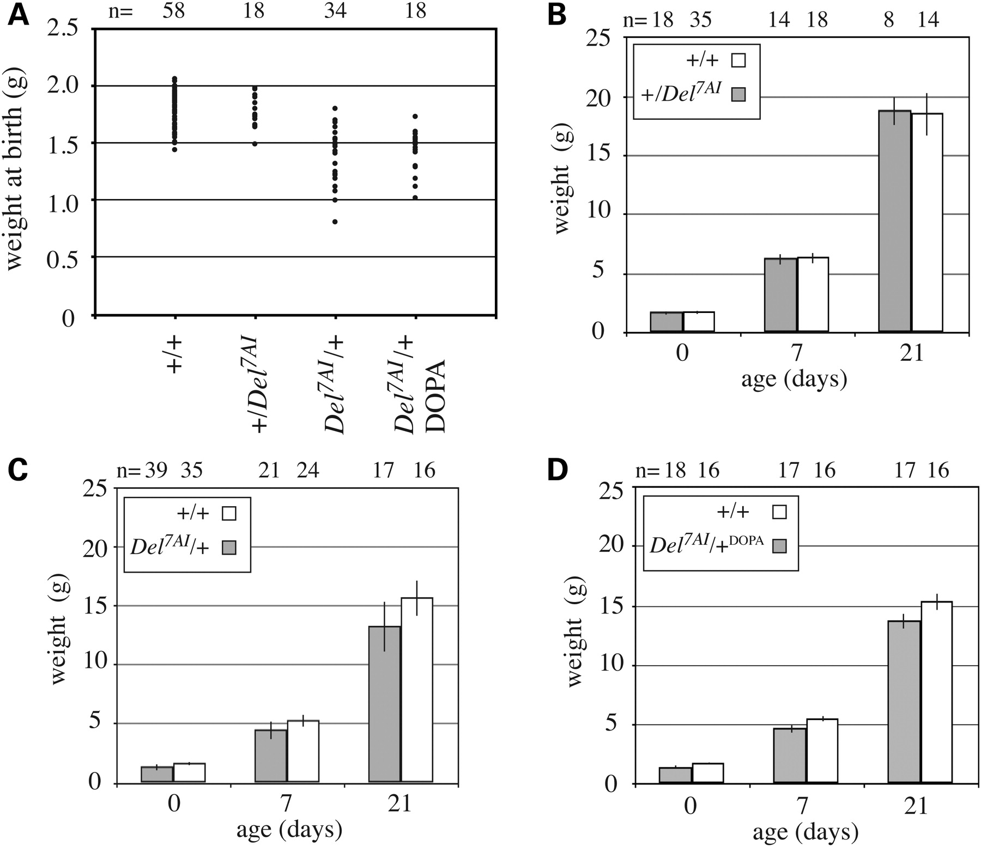
Figure 4. Intrauterine growth restriction in maternal Del^{7AI} heterozygotes. Newborns from five litters ...
Notes:
Figure 4. Intrauterine growth restriction in maternal Del7AI heterozygotes. Newborns from five litters obtained by crossing +/Del7AI heterozygous females to wild-type CD-1 outbred males and from six reciprocal crosses were weighted the morning of their delivery (p0) and genotyped. (A) Scatter plot showing the distribution of the weights at birth. The average weight of maternal heterozygous pups (1.42 g) is 17.4% smaller than that of their wild-type litter mates (1.72 g). Between the maternal heterozygotes and wild-type pups, P = 1.82E-8 (t-test). Number of animals analyzed: n = 58 wild-type, n = 18+/Del7AI, n = 34 Del7AI/+ and n = 18+/Del7AI treated with L-DOPA. (B–D) Body weight of mutant and wild-type litter mates at p0, p7 and p21 (time of weaning). Unlike the paternal heterozygotes (+/Del7AI), maternal heterozygous pups (Del7AI/+) do not catch up to their wild-type litter mates before weaning. This growth retardation is not rescue by addition of L-DOPA to the drinking water of pregnant females. Bars show the average weight ± standard deviation. At each time point, P < 0.001 (t-test) between maternal heterozygotes and wild-types in C. All values and numbers of animals analyzed are given in Supplementary Material, Table S2.
Unless provided in the caption above, the following copyright applies to the content of this slide: © The Author 2009. Published by Oxford University Press. All rights reserved. For Permissions, please email: journals.permissions@oxfordjournals.org

Slide 5
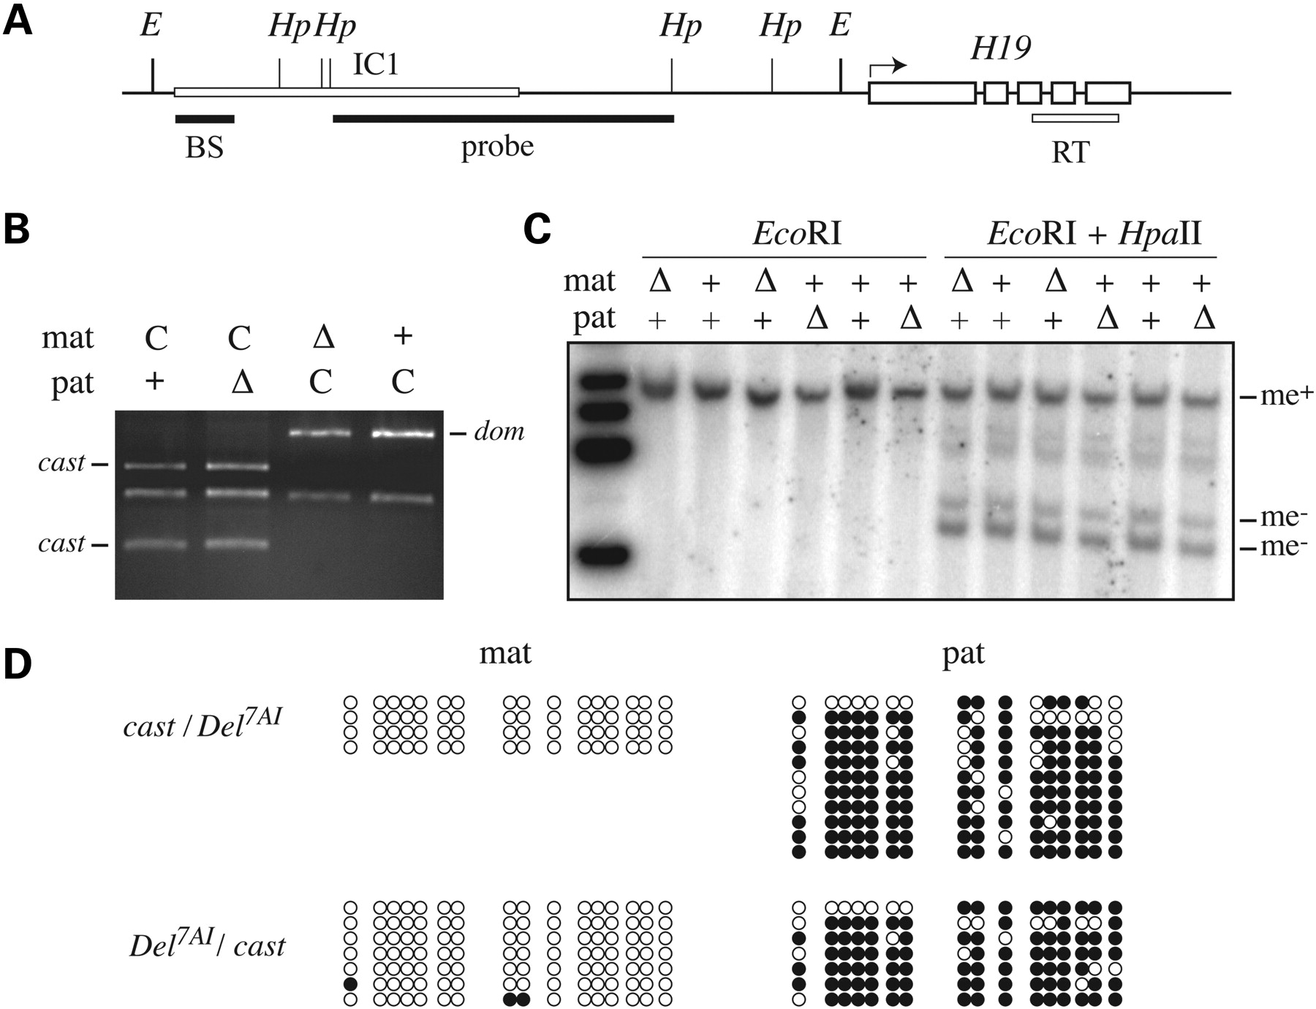
Figure 5. Maintenance of imprinting at IC1 in reciprocal Del^{7AI} heterozygotes. Expression and methylation ...
Notes:
Figure 5. Maintenance of imprinting at IC1 in reciprocal Del7AI heterozygotes. Expression and methylation imprinting at IC1 were analyzed in reciprocal heterozygotes for the Del7AI allele. E14.5 embryos were recovered from reciprocal crosses between +/Del7AI heterozygotes and M. m. castaneus (CAST/EiJ) adult mice. (A) Diagram of the IC1-H19 region showing the region amplified by RT–PCR to analyze H19 expression in (B) (RT), the position of the genomic probe used in (C) (probe) and the part of IC1 analyzed in (D) (BS). (B) Allele-specific RT–PCR analysis of embryonic H19 expression. Maternal (mat) and paternal (pat) alleles are as follows: C, wild-type castaneus; +, wild-type domesticus; and Δ, Del7AI. A Cac8I RFLP was used to distinguish the castaneus (cast) from the domesticus (dom) variants. (C) DNA methylation analysis by Southern blotting of genomic DNA digested with EcoRI (E) and the methylation sensitive restriction enzyme HpaII (Hp). Maternal (mat) and paternal (pat) alleles are identified as wild-type (+) or Del7AI (Δ). Also shown are the positions of methylated EcoRI fragment (me+) and the main unmethylated (me−) bands. (D) Allele-specific DNA methylation analysis by sodium bisulfite sequencing. The upstream region of the IC1 DMR was analyzed in reciprocal Del7AI heterozygotes carrying SNPs allowing the identification of the parental alleles. Methylated CpG sites are shown in black, unmethylated sites in white.
Unless provided in the caption above, the following copyright applies to the content of this slide: © The Author 2009. Published by Oxford University Press. All rights reserved. For Permissions, please email: journals.permissions@oxfordjournals.org

Slide 6
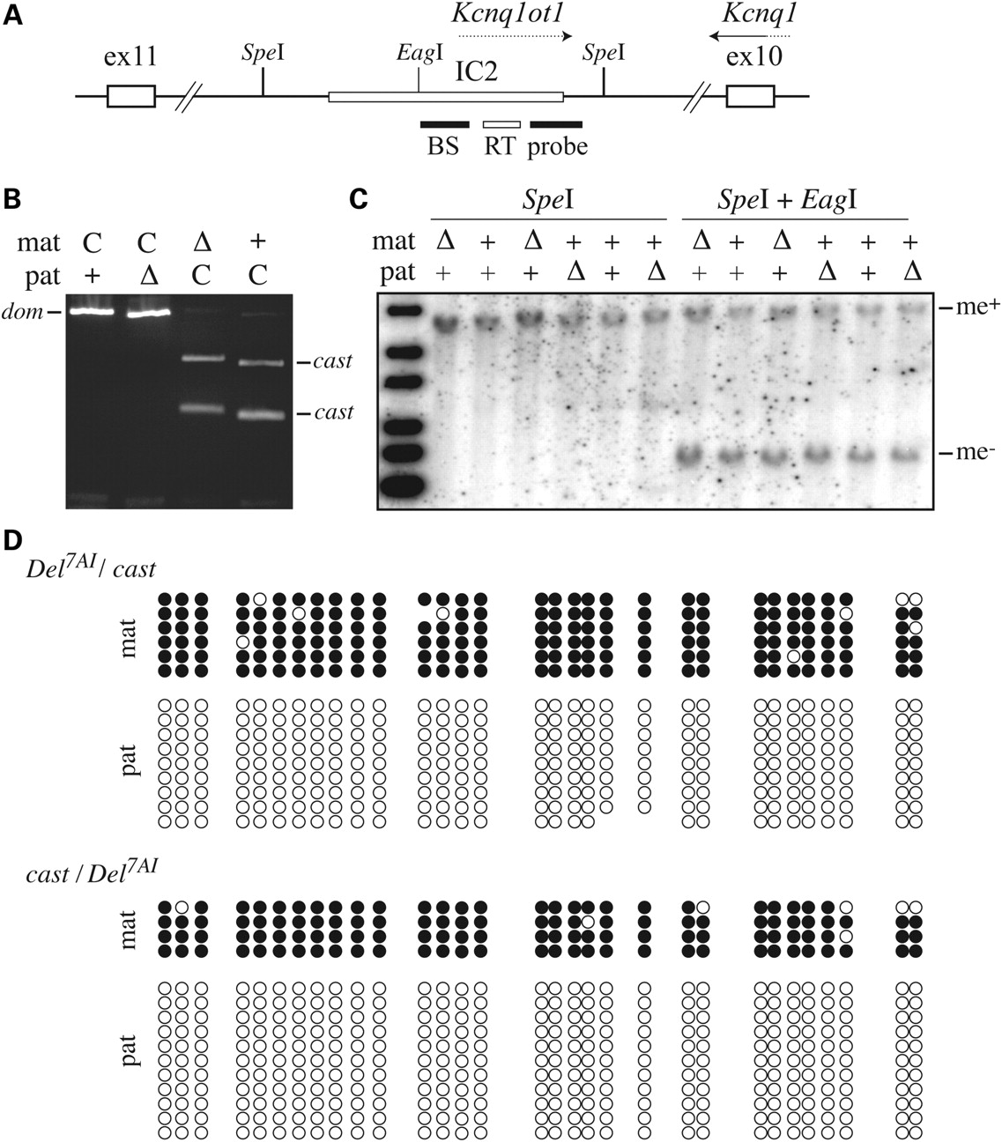
Figure 6. Imprinting at IC2 in reciprocal Del^{7AI} heterozygotes. Expression and methylation imprinting at IC2 ...
Notes:
Figure 6. Imprinting at IC2 in reciprocal Del7AI heterozygotes. Expression and methylation imprinting at IC2 were analyzed in reciprocal heterozygotes for the Del7AI allele. (A) Diagram of the IC2 region, located within the intron 10 of Kcnq1, showing the region amplified by RT–PCR to analyze Kcnq1ot1 expression in (B) (RT), the position of the genomic probe used in (C) (probe) and the 335-bp sequence containing the 31 CpG sites analyzed in (D) (BS). (B) Allele-specific RT–PCR analysis of embryonic Kcnq1ot1 expression. Maternal (mat) and paternal (pat) alleles are as follows: C, wild-type castaneus; +, wild-type domesticus; and Δ, Del7AI. An expressed StuI RFLP was used to distinguish the castaneus (cast) from the domesticus (dom) Kcnq1ot1 variants. (C) DNA methylation analysis by Southern blotting of genomic DNA digested with SpeI and the methylation sensitive restriction enzyme EagI. Maternal (mat) and paternal (pat) alleles are identified as wild-type (+) or Del7AI (Δ). Also shown are the positions of methylated (me+) and unmethylated (me−) SpeI fragment. (D) Allele-specific DNA methylation analysis by sodium bisulfite sequencing. The central region of the IC2 DMR was analyzed in reciprocal Del7AI heterozygotes carrying SNPs allowing the identification of the parental alleles. Methylated CpG sites are shown in black, unmethylated sites in white, and omitted sites denote sequencing ambiguities.
Unless provided in the caption above, the following copyright applies to the content of this slide: © The Author 2009. Published by Oxford University Press. All rights reserved. For Permissions, please email: journals.permissions@oxfordjournals.org

Slide 7
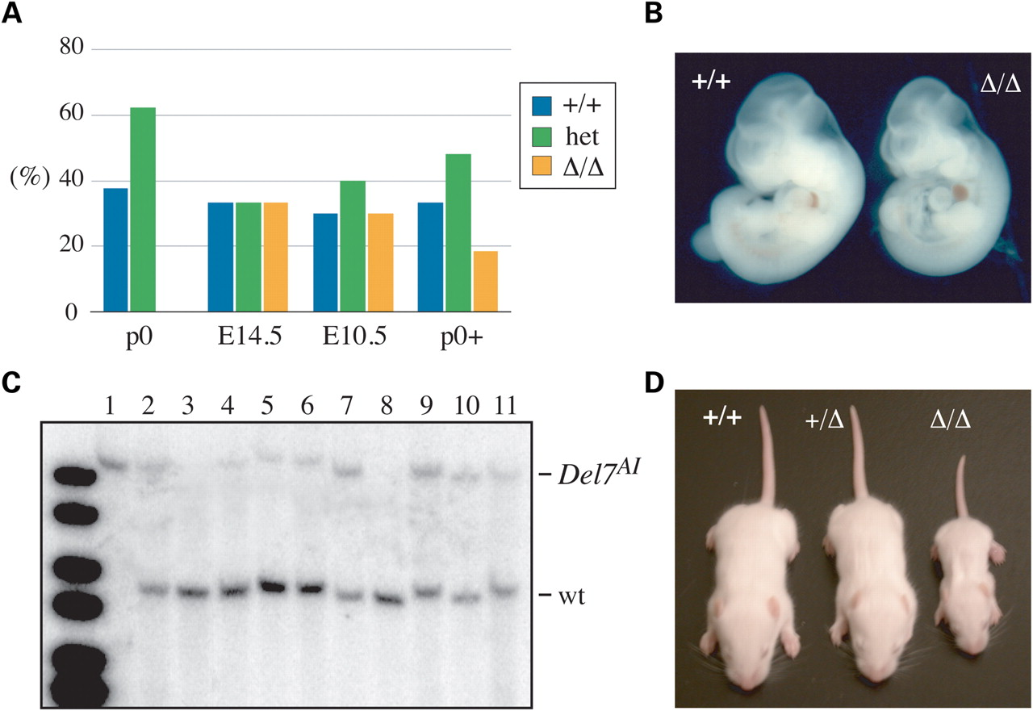
Figure 7. The embryonic lethality of Del^{7AI} homozygotes is pharmacologically rescued by provision of L-DOPA ...
Notes:
Figure 7. The embryonic lethality of Del7AI homozygotes is pharmacologically rescued by provision of L-DOPA in utero. (A) Live progeny from heterozygous crosses expressed in percentage (%) of wild-type (+/+), Del7AI heterozygotes (het) and Del7AI homozygous mutants (Δ/Δ) recovered at birth (p0) or at post-implantation embryonic stages (E14.5 and E10.5). Homozygous mutants were rescued to term when the pregnant +/Del7AI heterozygous female was provided with L-DOPA in her drinking water during gestation (p0+). (B) Wild-type (+/+) and homozygous mutant (Δ/Δ) E10.5 embryos from a heterozygous cross. (C) Southern blot analysis of tail genomic DNA from live progeny of heterozygous crosses. Samples 1–4 are from a mother treated with L-DOPA, sample 1 is from a rescued homozygote. The expected EcoRV bands are 5.2 kb for wild-type and 9.7 kb for Del7AI. (D) Picture of 12-day-old pups from a heterozygous cross with L-DOPA treatment.
Unless provided in the caption above, the following copyright applies to the content of this slide: © The Author 2009. Published by Oxford University Press. All rights reserved. For Permissions, please email: journals.permissions@oxfordjournals.org

