Slide 1
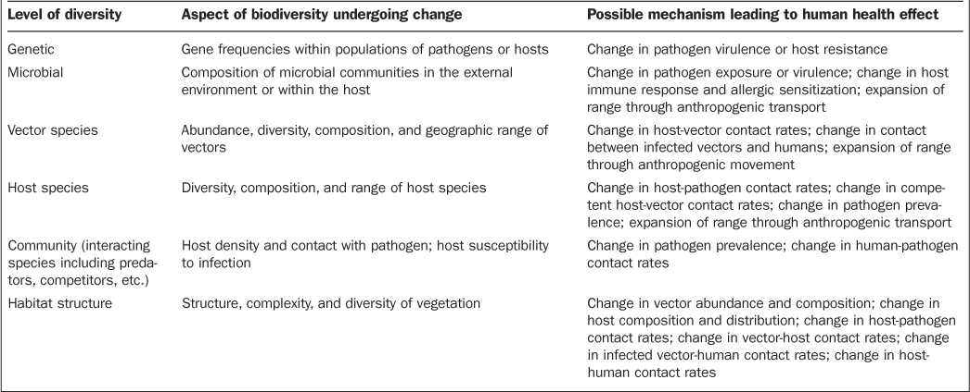
Table 1. Mechanisms linking biodiversity change and human health at different levels.
Notes:
Table 1. Mechanisms linking biodiversity change and human health at different levels.
Unless provided in the caption above, the following copyright applies to the content of this slide: © 2009 by American Institute of Biological Sciences.

Slide 2
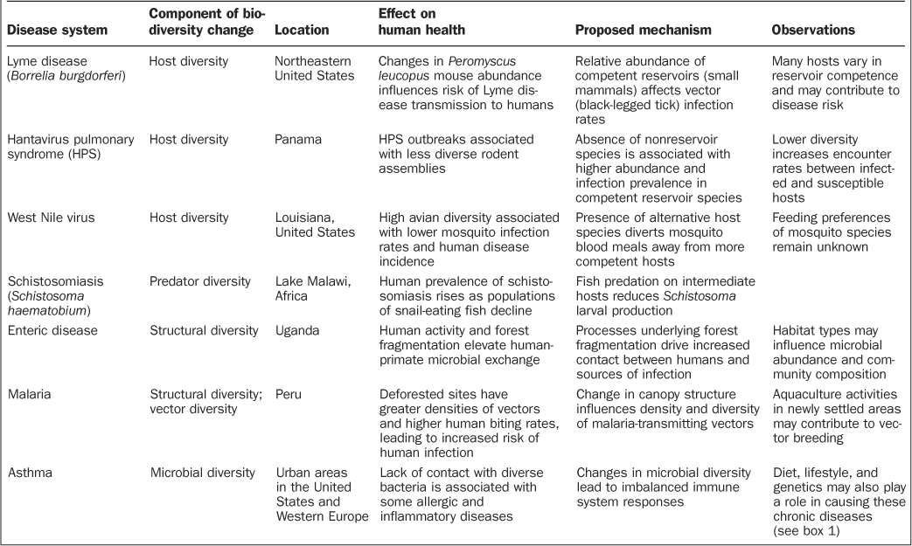
Table 2. Summary of case studies linking biodiversity change to health effects in humans.
Notes:
Table 2. Summary of case studies linking biodiversity change to health effects in humans.
Unless provided in the caption above, the following copyright applies to the content of this slide: © 2009 by American Institute of Biological Sciences.

