Slide 1
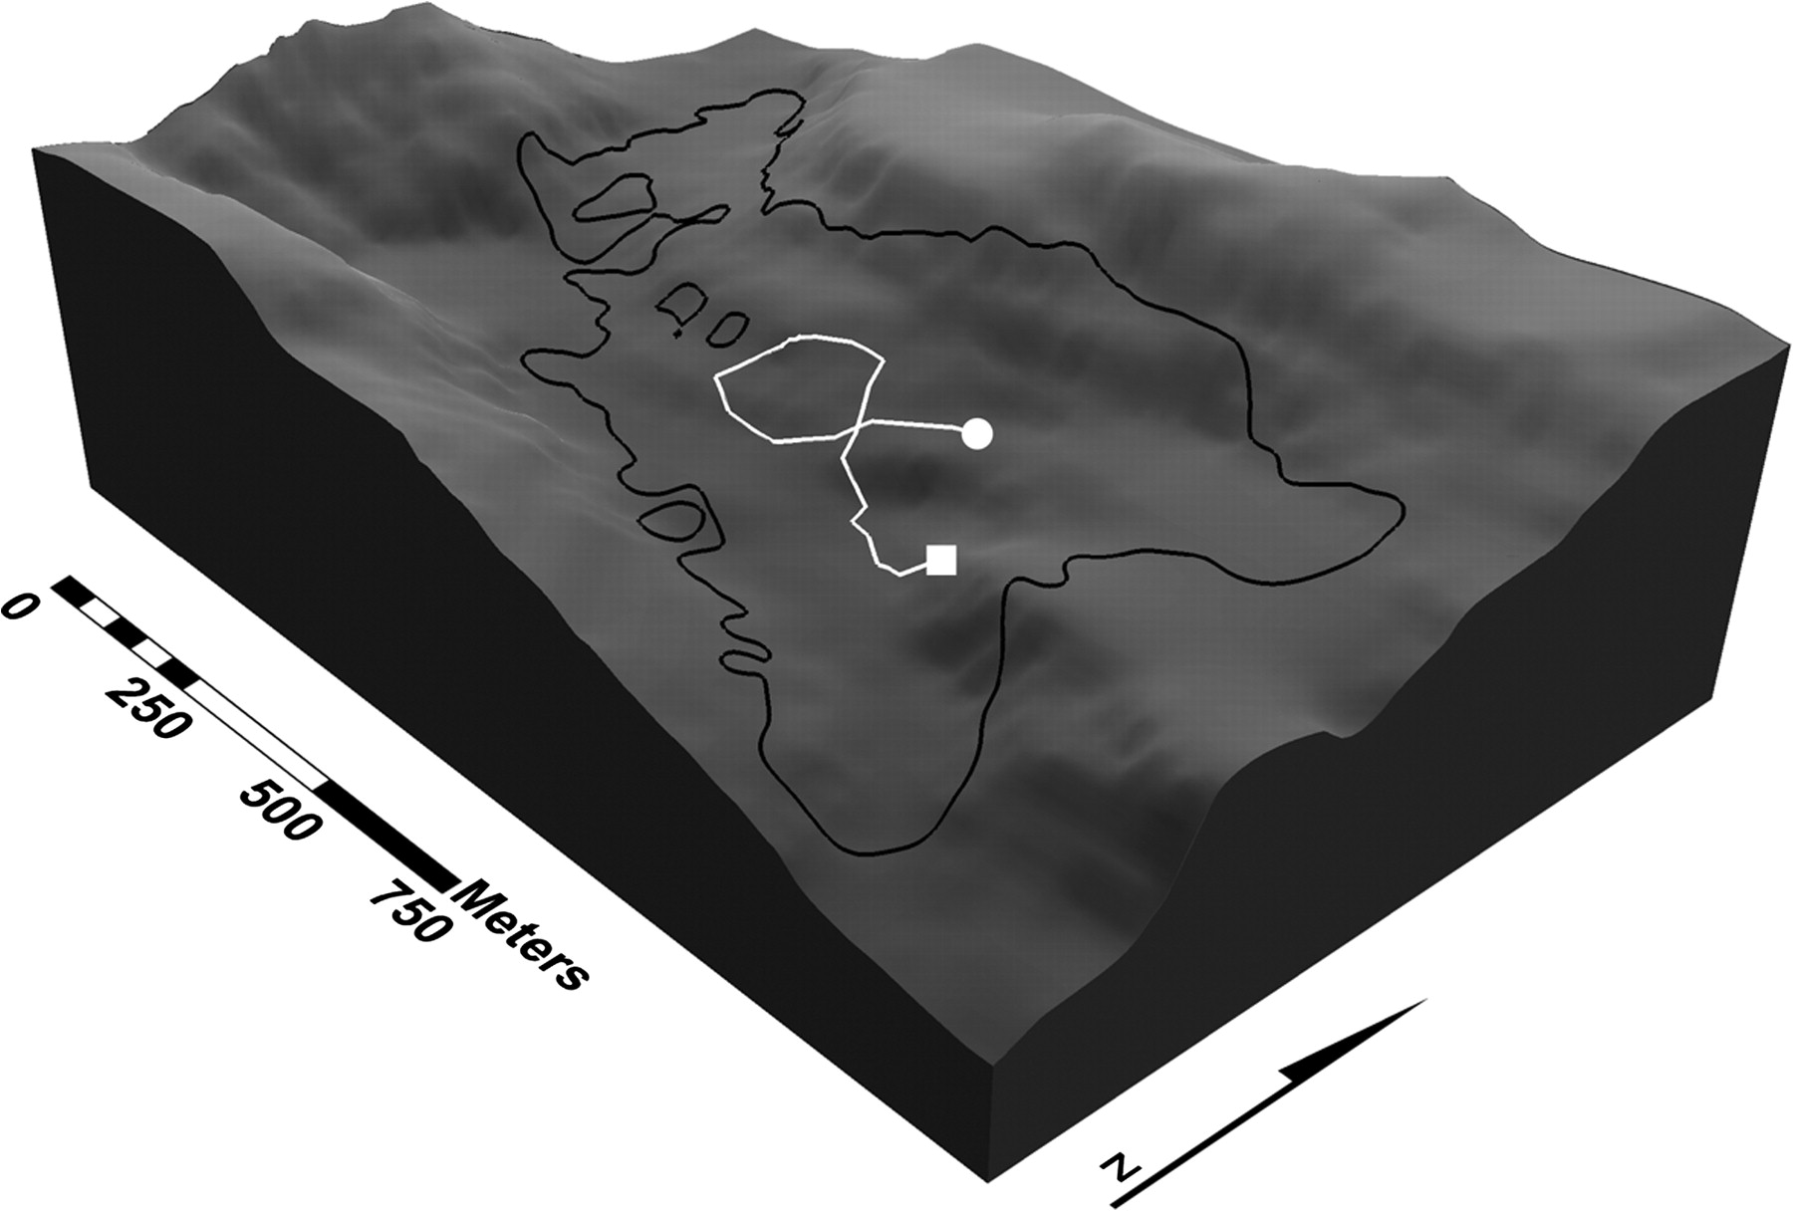
Figure 1 3D representation of the DEM of the study site. The black-outlined polygon demarcates the annual home range ...
Notes:
Figure 1 3D representation of the DEM of the study site. The black-outlined polygon demarcates the annual home range of the study group (1.14 km2), whereas the white line depicts an exemplar day journey trajectory (circle and square indicates the location of morning and evening sleeping trees, respectively).
Unless provided in the caption above, the following copyright applies to the content of this slide: © The Author 2009. Published by Oxford University Press on behalf of the International Society for Behavioral Ecology. All rights reserved. For permissions, please e-mail: journals.permissions@oxfordjournals.org

Slide 2
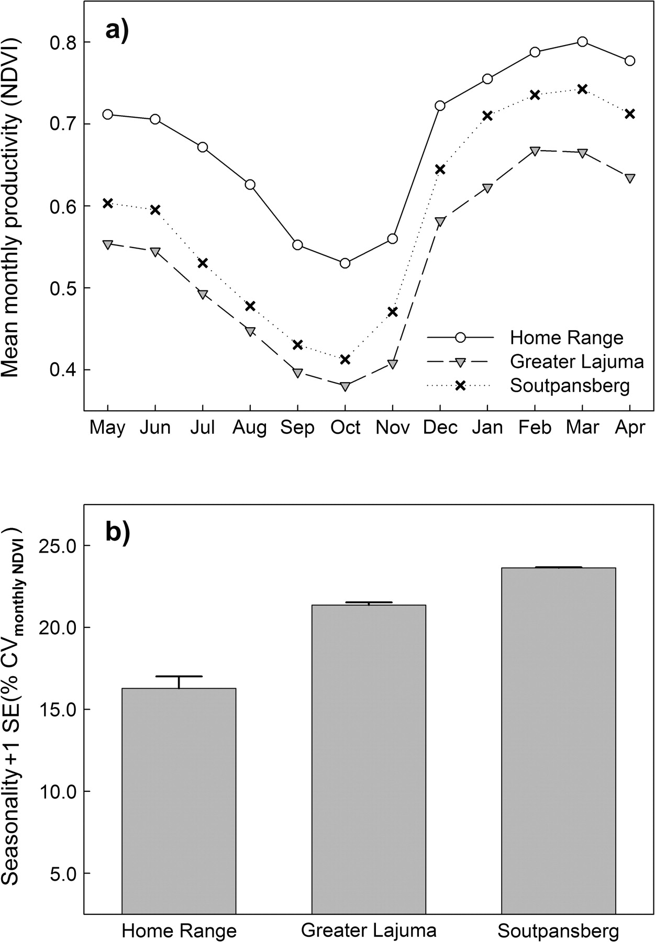
Figure 2 Mean monthly primary productivity (a) and annual seasonality (b) as expressed by simple NDVI metrics over the ...
Notes:
Figure 2 Mean monthly primary productivity (a) and annual seasonality (b) as expressed by simple NDVI metrics over the 3 areas under investigation (error bars in [a] are omitted for clarity).
Unless provided in the caption above, the following copyright applies to the content of this slide: © The Author 2009. Published by Oxford University Press on behalf of the International Society for Behavioral Ecology. All rights reserved. For permissions, please e-mail: journals.permissions@oxfordjournals.org

Slide 3
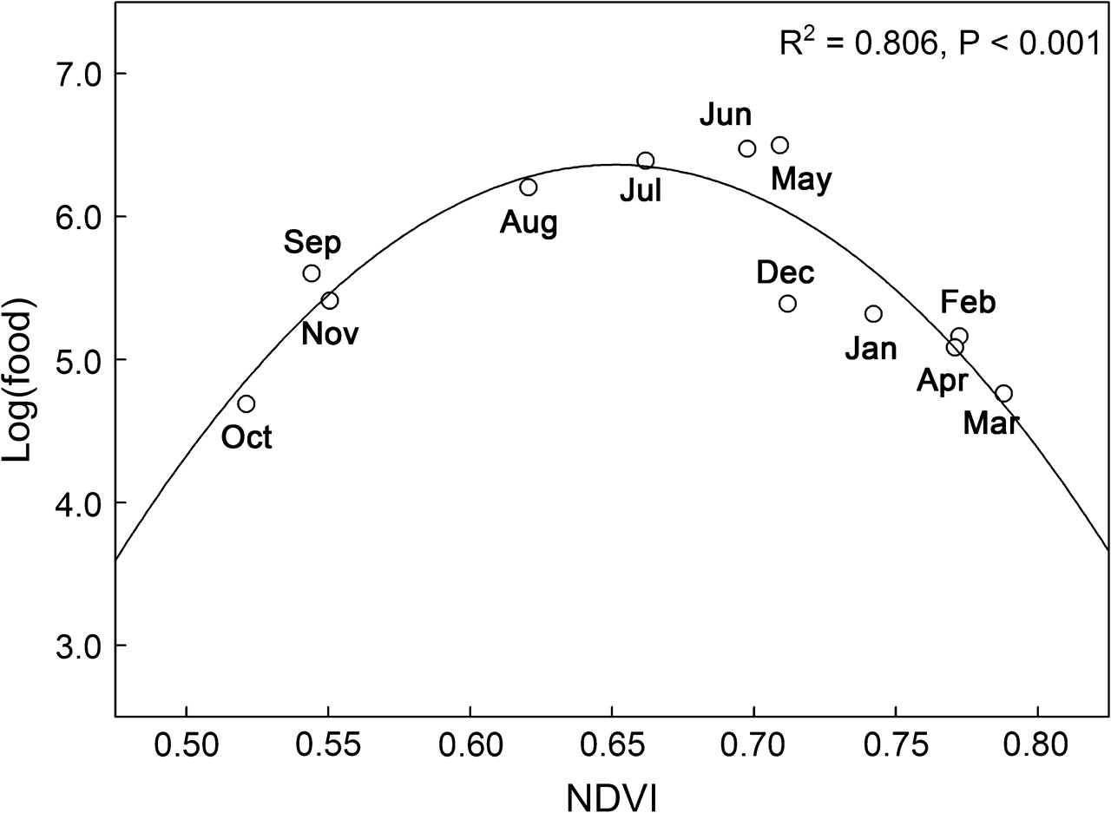
Figure 3 Scatter plot with fitted second-order polynomial curve relating monthly NDVI values over the home range to ...
Notes:
Figure 3 Scatter plot with fitted second-order polynomial curve relating monthly NDVI values over the home range to log-transformed field estimates of local food availability.
Unless provided in the caption above, the following copyright applies to the content of this slide: © The Author 2009. Published by Oxford University Press on behalf of the International Society for Behavioral Ecology. All rights reserved. For permissions, please e-mail: journals.permissions@oxfordjournals.org

Slide 4
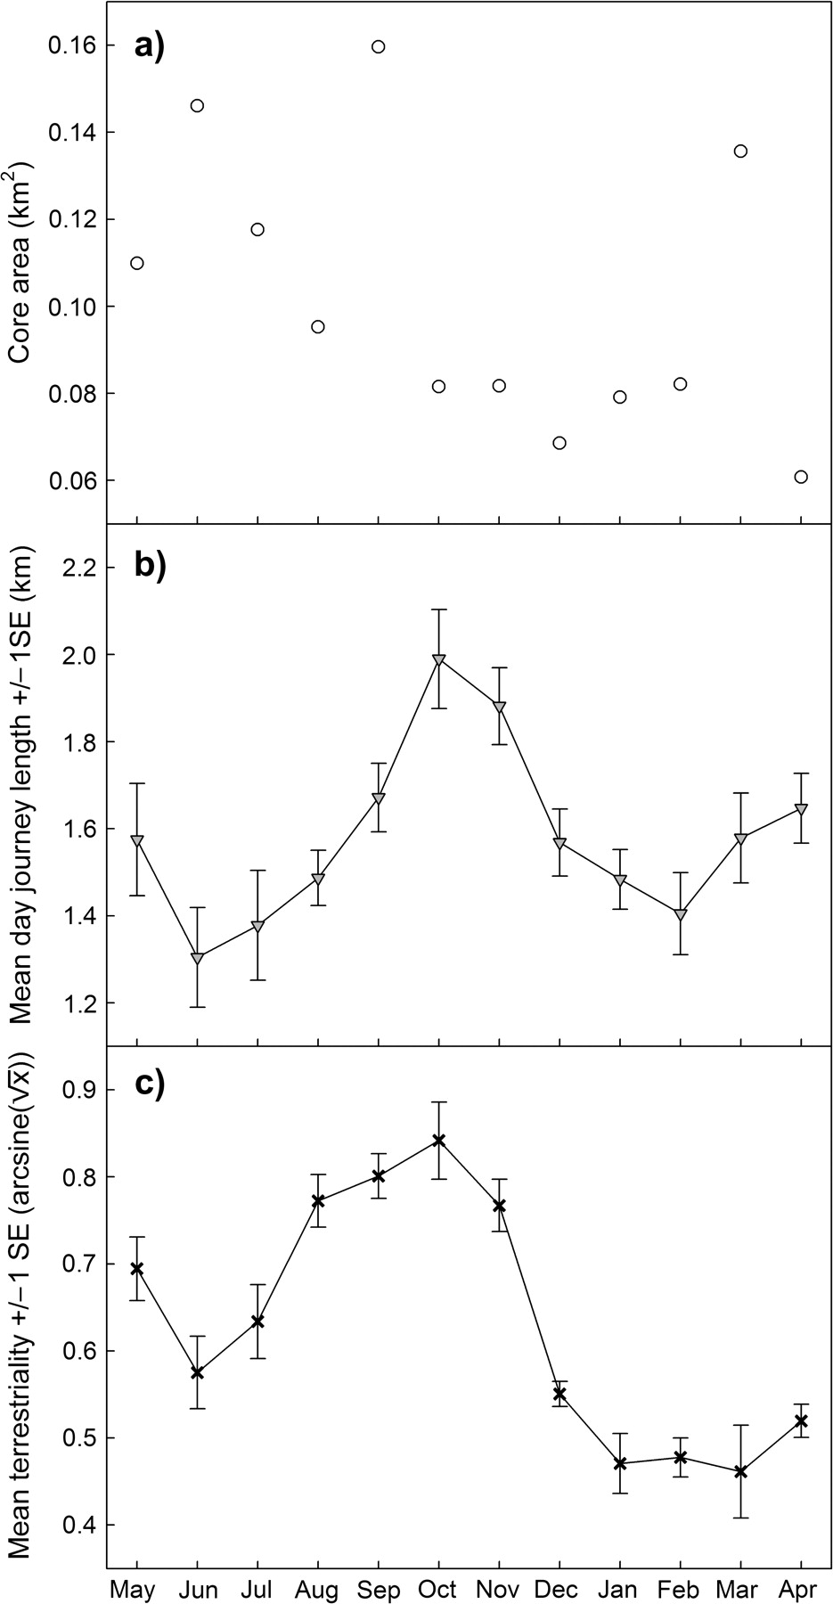
Figure 4 Temporal profiles of 3 parameters of local range use: (a) size of monthly core areas, (b) monthly averaged ...
Notes:
Figure 4 Temporal profiles of 3 parameters of local range use: (a) size of monthly core areas, (b) monthly averaged day journey length, and (c) monthly averaged level of terrestriality (transformed to allow parametric analysis). Lines indicate cubic trends within monthly values of mean day journey length and level of terrestriality.
Unless provided in the caption above, the following copyright applies to the content of this slide: © The Author 2009. Published by Oxford University Press on behalf of the International Society for Behavioral Ecology. All rights reserved. For permissions, please e-mail: journals.permissions@oxfordjournals.org

Slide 5
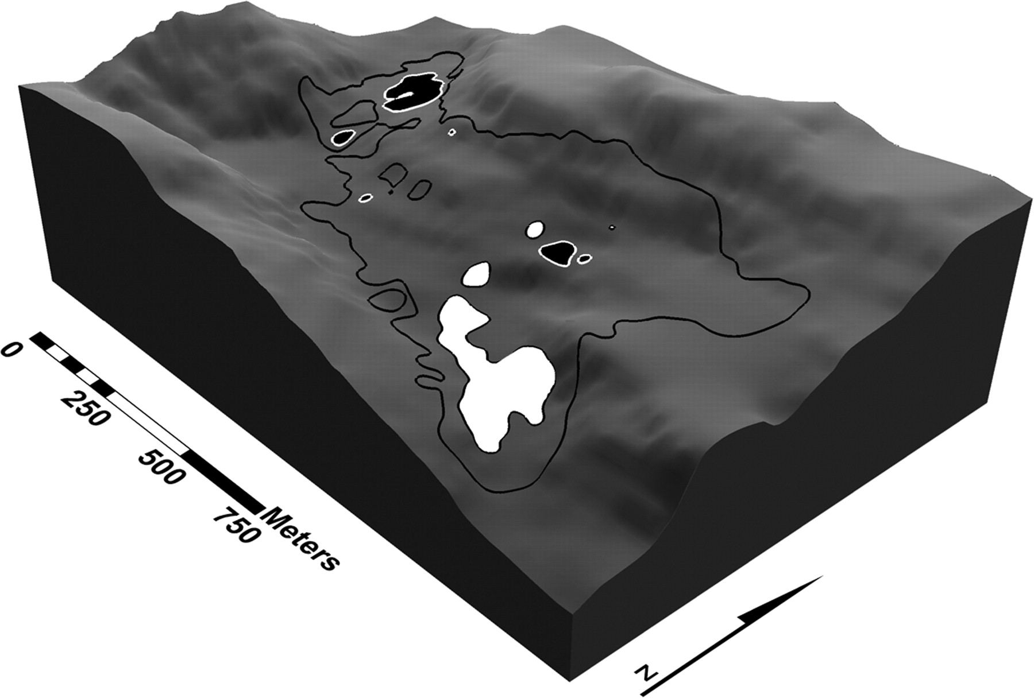
Figure 5 Locations of 2 exemplar monthly core areas (white-filled polygon, January 2006; black-filled polygon, April ...
Notes:
Figure 5 Locations of 2 exemplar monthly core areas (white-filled polygon, January 2006; black-filled polygon, April 2006) within the annual home range of the study group, suggesting that the location of monthly ranging areas may vary spatially.
Unless provided in the caption above, the following copyright applies to the content of this slide: © The Author 2009. Published by Oxford University Press on behalf of the International Society for Behavioral Ecology. All rights reserved. For permissions, please e-mail: journals.permissions@oxfordjournals.org

