Slide 1
Table 1 Lognormal fits to the PDFs of the DIG (Figs 1 and 2). The fitted function is Y = (√2ππ)⁻¹ ...
Notes:
Table 1 Lognormal fits to the PDFs of the DIG (Figs 1 and 2). The fitted function is Y = (√2ππ)−1 exp[-(log10X - γ)2/2π2].
Unless provided in the caption above, the following copyright applies to the content of this slide: © 2008 The Authors. Journal compilation © 2008 RAS

Slide 2
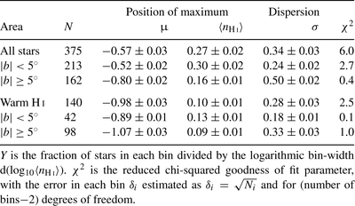
Table 2 Lognormal fits to the PDFs of 〈nHi)〉 (Fig. 3). The fitted function is Y = (√2πσ)₋₁ ...
Notes:
Table 2 Lognormal fits to the PDFs of 〈nHi)〉 (Fig. 3). The fitted function is Y = (√2πσ)−1 exp[-(log10〈nHi〉 - γ)2/2σ2].
Unless provided in the caption above, the following copyright applies to the content of this slide: © 2008 The Authors. Journal compilation © 2008 RAS

