Slide 1
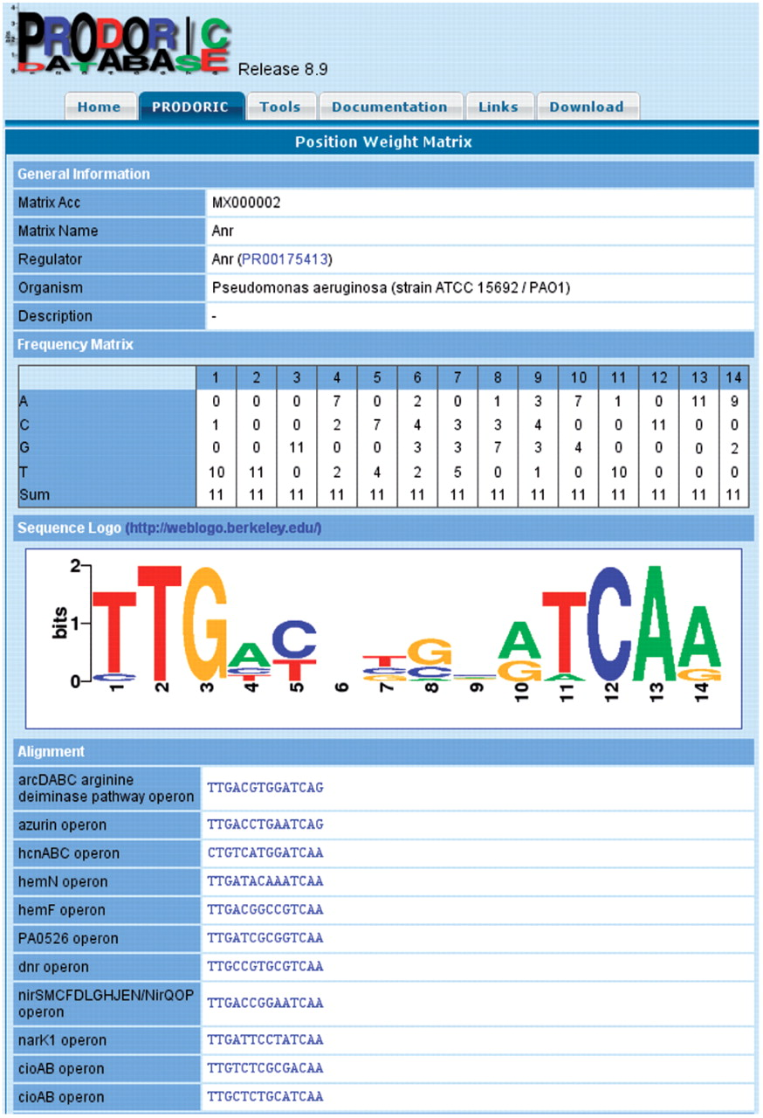
Figure 1. Position weight matrix view of PRODORIC for the binding site of the Anr transcription faction from ...
Notes:
Figure 1. Position weight matrix view of PRODORIC for the binding site of the Anr transcription faction from Pseudomonas aerugionosa.
Unless provided in the caption above, the following copyright applies to the content of this slide: © 2008 The Author(s)This is an Open Access article distributed under the terms of the Creative Commons Attribution Non-Commercial License (http://creativecommons.org/licenses/by-nc/2.0/uk/) which permits unrestricted non-commercial use, distribution, and reproduction in any medium, provided the original work is properly cited.

Slide 2
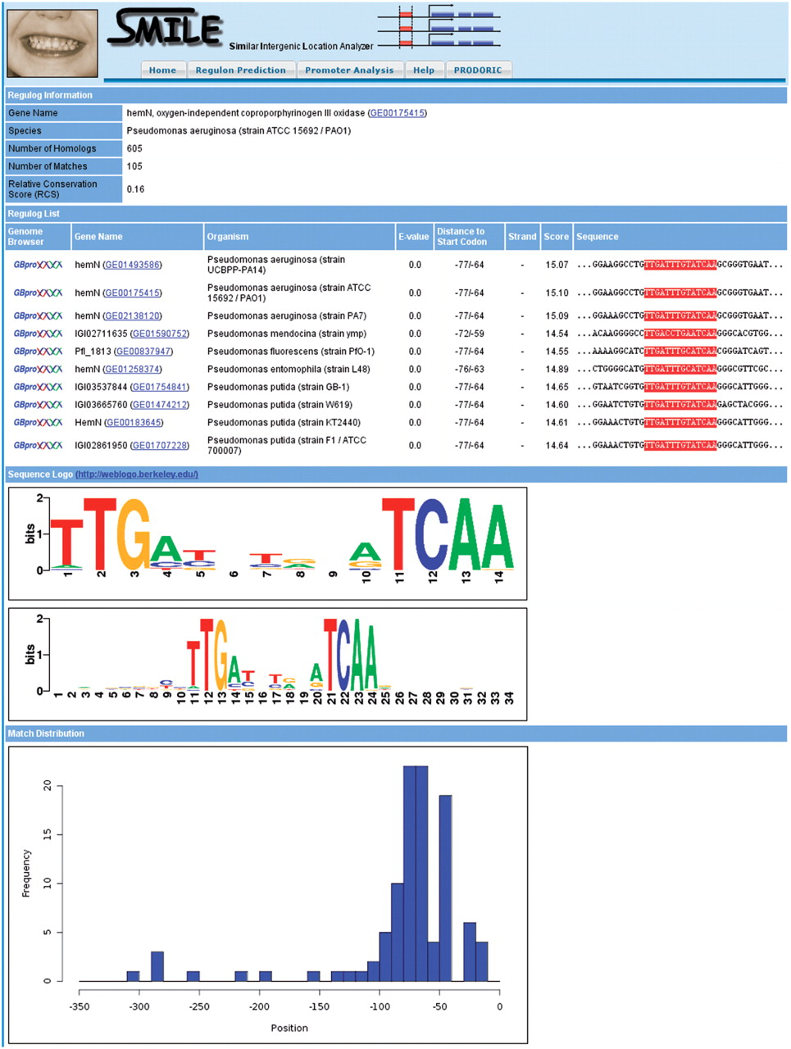
Figure 2. SMILE analysis using the Anr binding site in the promoter of the hemN gene. The results show both a high ...
Notes:
Figure 2. SMILE analysis using the Anr binding site in the promoter of the hemN gene. The results show both a high evolutional and positional conservation between the orthologous promoters (the list of matches was shortened).
Unless provided in the caption above, the following copyright applies to the content of this slide: © 2008 The Author(s)This is an Open Access article distributed under the terms of the Creative Commons Attribution Non-Commercial License (http://creativecommons.org/licenses/by-nc/2.0/uk/) which permits unrestricted non-commercial use, distribution, and reproduction in any medium, provided the original work is properly cited.

