Slide 1
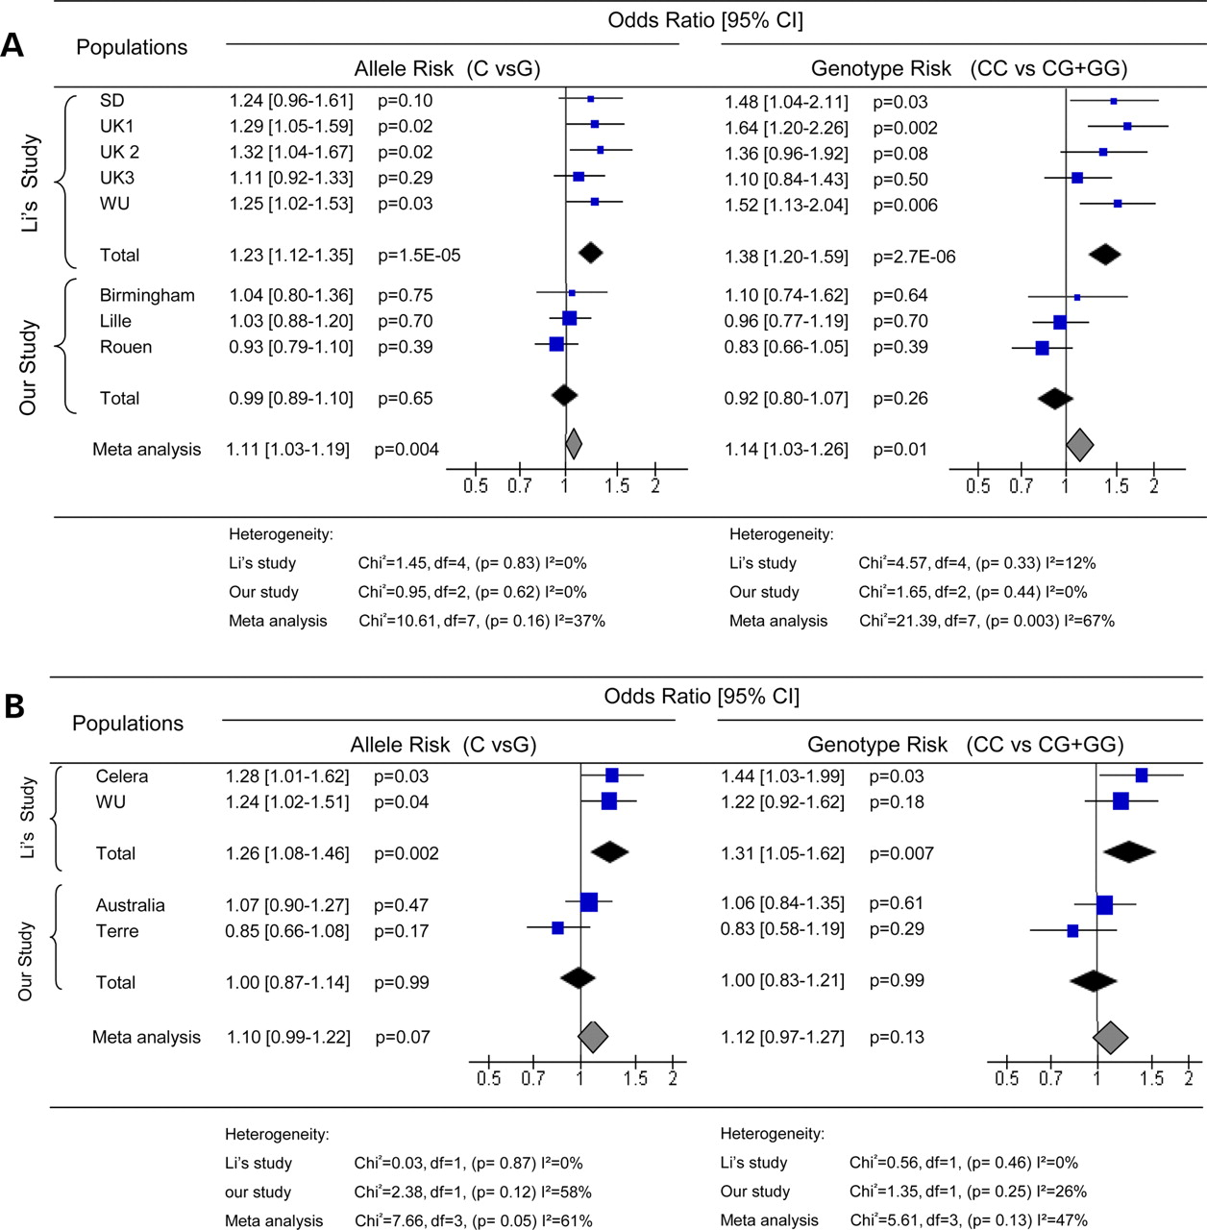
Figure 1. Association of the rs760678 C allele and CC genotype with the risk of developing AD in the Li et al. 's ...
Notes:
Figure 1. Association of the rs760678 C allele and CC genotype with the risk of developing AD in the Li et al. 's study, our study and the combined one.
Unless provided in the caption above, the following copyright applies to the content of this slide: © The Author 2008. Published by Oxford University Press. All rights reserved. For Permissions, please email: journals.permissions@oxfordjournals.org

