Slide 1
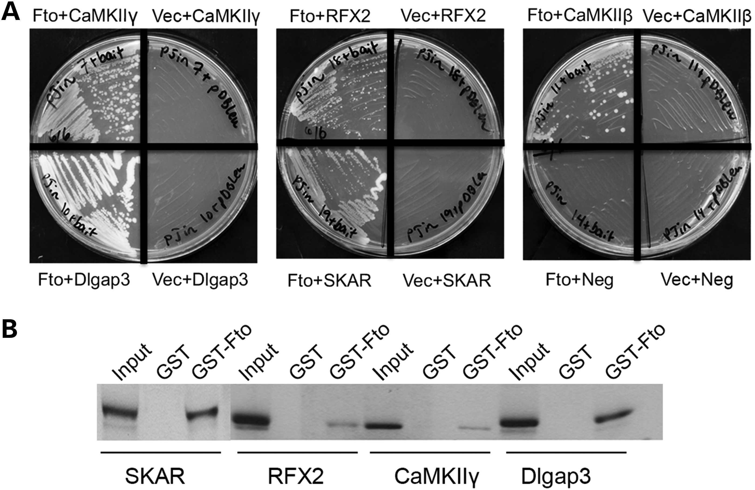
Figure 1. Identification of FTO-interacting partners through yeast two-hybrid screen. (A) Representative plates showing ...
Notes:
Figure 1. Identification of FTO-interacting partners through yeast two-hybrid screen. (A) Representative plates showing the specific interactions between FTO and the indicated proteins identified through yeast two-hybrid screen. (B) Direct interaction between FTO and SKAR (or RFX2, CaMKIIγ and Dlgap3) by glutathione S-transferases (GST) pull-down assay. One of the in vitro translated (35S) methionine-labeled proteins SKAR, RFX2, CaMKIIγ or Dlgap3 was incubated with GST-Fto or GST-coated beads. After extensive washing, the bound proteins and 10% input were resolved on a 6% polyacrylamide gel followed by autoradiography.
Unless provided in the caption above, the following copyright applies to the content of this slide: © The Author 2014. Published by Oxford University Press. All rights reserved. For Permissions, please email: journals.permissions@oup.com

Slide 2
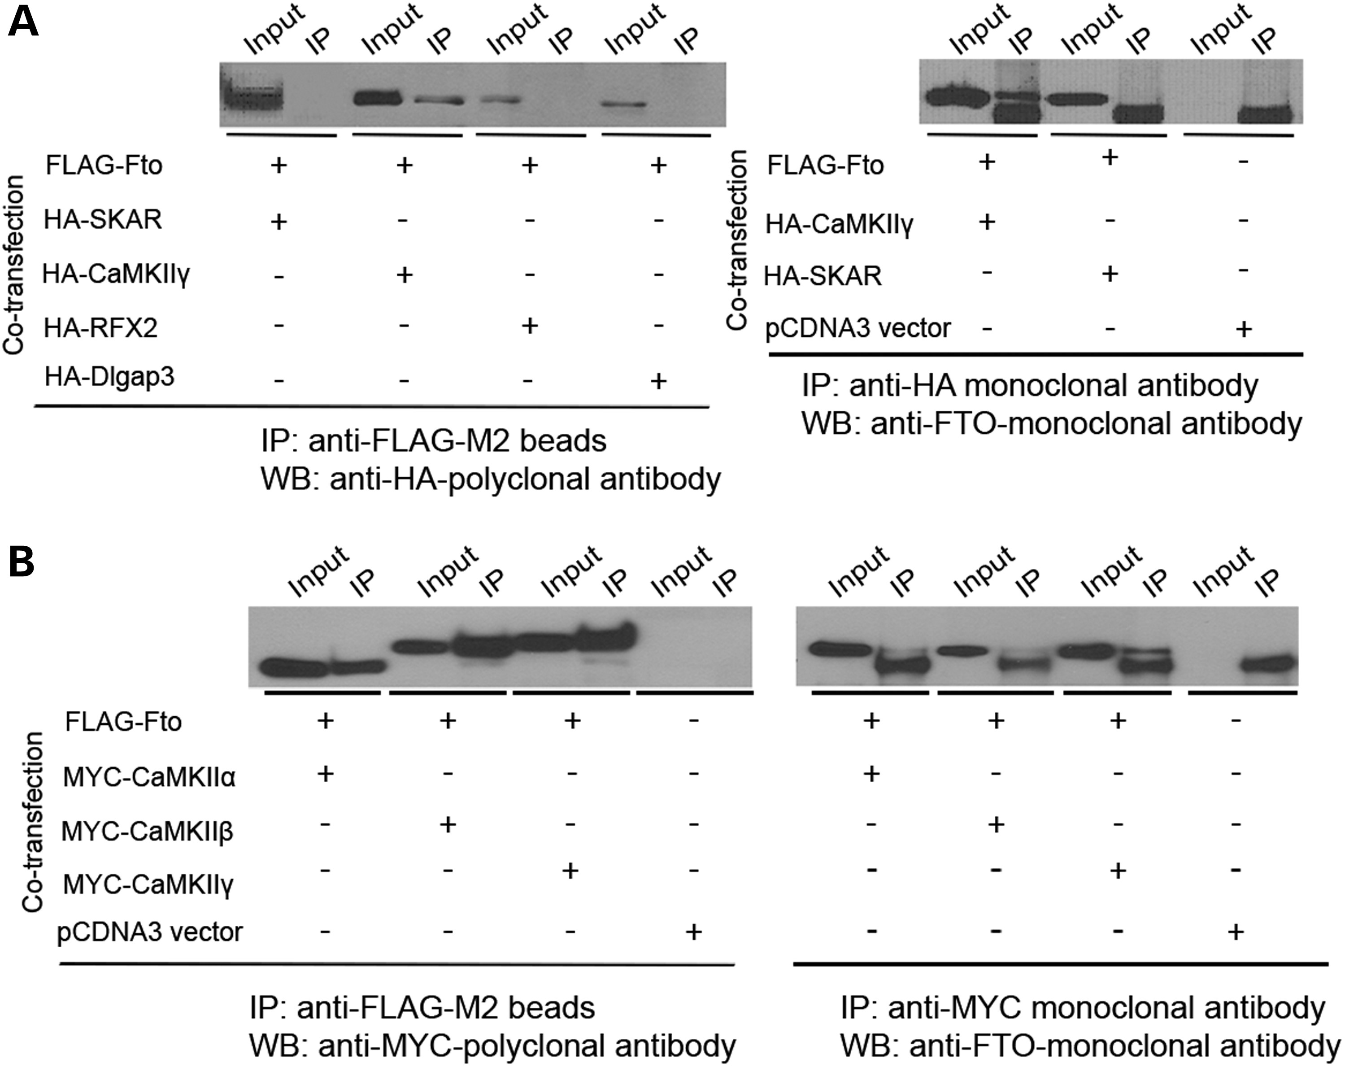
Figure 2. CaMKII isoforms are associated with FTO in vivo. (A) Co-IP of mouse FTO with SKAR, RFX2, CaMKIIγ and Dlgap3. ...
Notes:
Figure 2. CaMKII isoforms are associated with FTO in vivo. (A) Co-IP of mouse FTO with SKAR, RFX2, CaMKIIγ and Dlgap3. 293T cells were transfected with FLAG-tagged FTO and hemagglutinin (HA)-tagged SKAR (or RFX2, CaMKIIγ, Dlgap3) and subjected to IP with anti-FLAG beads or anti-HA antibody followed by immunoblotting with antibodies as indicated. 5% of cell lysate was loaded as input. (B) Co-IP of mouse FTO with CaMKIIα, β and γ. 293T cells were transfected with FLAG-tagged FTO and MYC-tagged CaMKII α (or β or γ) and subjected to IP with anti-FLAG beads or anti-MYC antibody followed by immunoblotting with antibodies as indicated. 5% of cell lysate was loaded as input.
Unless provided in the caption above, the following copyright applies to the content of this slide: © The Author 2014. Published by Oxford University Press. All rights reserved. For Permissions, please email: journals.permissions@oup.com

Slide 3
Figure 3. CaMKII does not phosphorylate Fto and Fto does not modulate CaMKII phosphorylation activity. (A) CaMKII does ...
Notes:
Figure 3. CaMKII does not phosphorylate Fto and Fto does not modulate CaMKII phosphorylation activity. (A) CaMKII does not phosphorylate Fto. The substrates included 25 μm of purified recombinant full-length mFto or the C-terminal domain of mFto, bovine serum albumin and a control peptide provided by the manufacturer. HEK293 cells were transfected with Myc-CaMKIIα, β or γ and cell lysates were immunoprecipitated with an anti-Myc antibody. The immunoprecipitated proteins were added to the reactions. (B) FTO does not modulate CaMKII phosphorylation activity. The CaMKII target peptide provided by the manufacturer was used as the substrate. The immunoprecipitated proteins and 100 ng of purified recombinant full-length mouse FTO or BSA were added to the reactions. CPM, counts per minute; Pos.Ctrl, positive control; mFto-FL, recombinant full-length mouse Fto; mFto-C, C-terminal domain of mouse Fto; BSA, bovine serum albumin.
Unless provided in the caption above, the following copyright applies to the content of this slide: © The Author 2014. Published by Oxford University Press. All rights reserved. For Permissions, please email: journals.permissions@oup.com

Slide 4
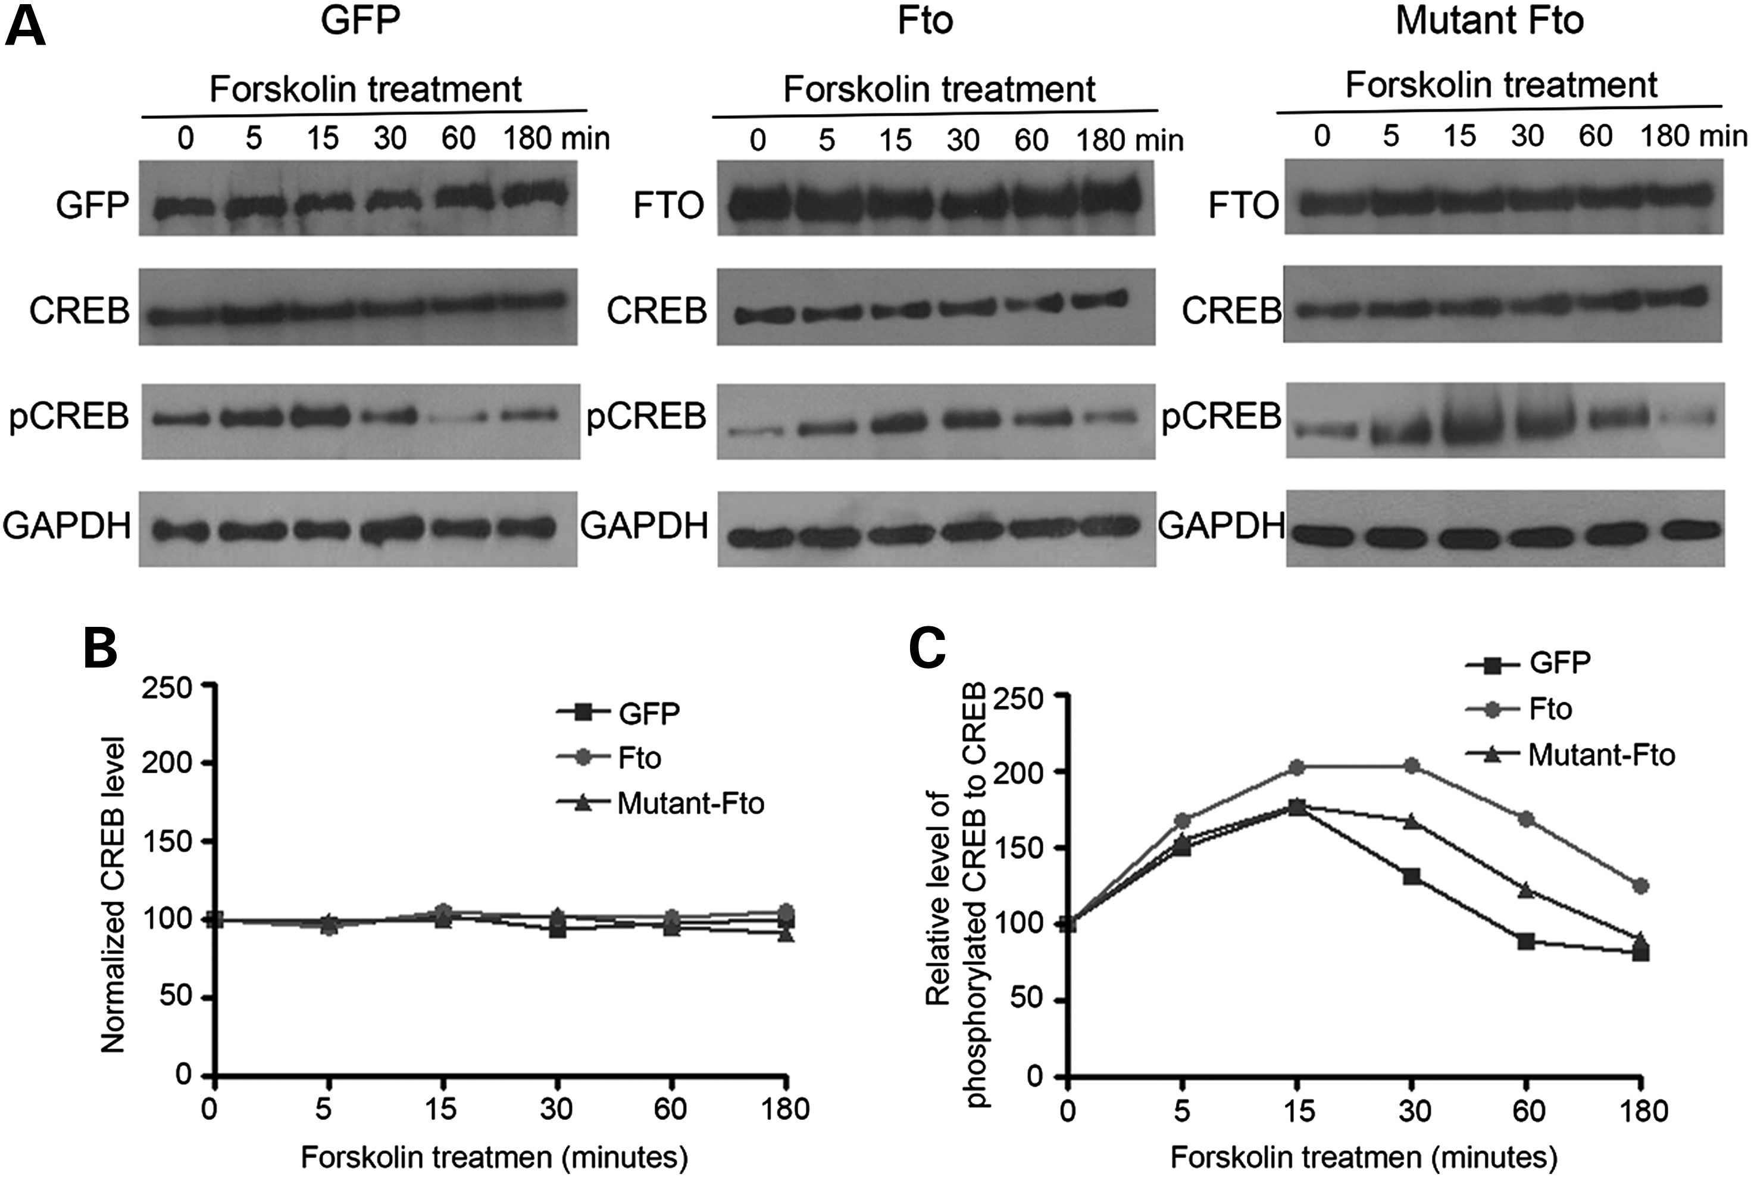
Figure 4. FTO modulates the dynamics of CREB phosphorylaion. SK-N-SH cells were infected with Lenti-GFP, Lenti-Fto or ...
Notes:
Figure 4. FTO modulates the dynamics of CREB phosphorylaion. SK-N-SH cells were infected with Lenti-GFP, Lenti-Fto or Lenti-mutant-Fto viruses for 72 h. After starving for another 24 h in FBS free medium, infected cells were treated with 20 µm of forskolin for 0, 5, 15, 30, 60 and 180 min, and then cells were harvested for western blotting with antibodies as indicated (top panel) and densitometry plots (bottom panel) of relative levels of phosphorylated CREB compared with total CREB. The x-axis is forskolin treatment time points and the y-axis is relative intensity of signal phosphorylated CREB to CREB by densitometry.
Unless provided in the caption above, the following copyright applies to the content of this slide: © The Author 2014. Published by Oxford University Press. All rights reserved. For Permissions, please email: journals.permissions@oup.com

Slide 5
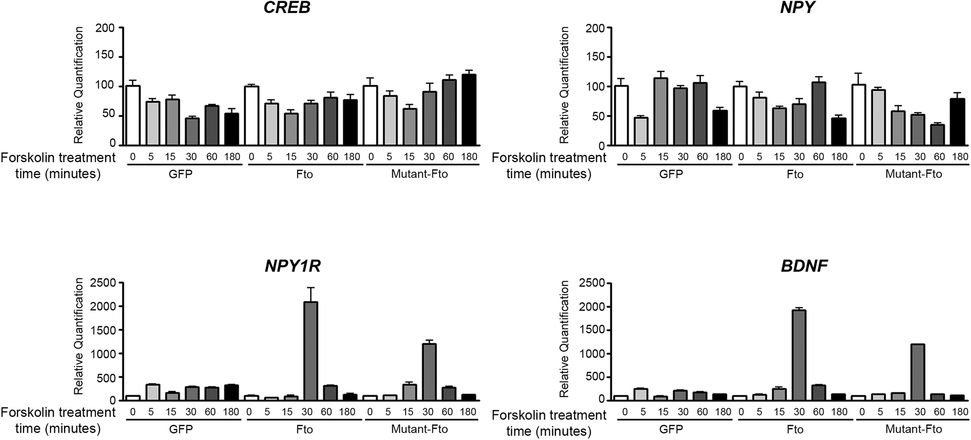
Figure 5. FTO modulates the expression dynamics of selective transcripts in response to forskolin stimulation. Total ...
Notes:
Figure 5. FTO modulates the expression dynamics of selective transcripts in response to forskolin stimulation. Total RNAs were purified from SK-N-SH cells that were infected with Lenti-GFP, Lenti-Fto or Lenti-mutant-Fto viruses and treated with 20 μm of forskolin for 0, 5, 15, 30, 60 and 180 min. A real-time reverse transcription polymerase chain reaction analysis was performed to quantify CREB, NPY, NPY1R and BDNF mRNA expression (n = 3, mean ± SD). Relative levels of each transcript are plotted relative to samples without forskolin stimulation.
Unless provided in the caption above, the following copyright applies to the content of this slide: © The Author 2014. Published by Oxford University Press. All rights reserved. For Permissions, please email: journals.permissions@oup.com

