Slide 1
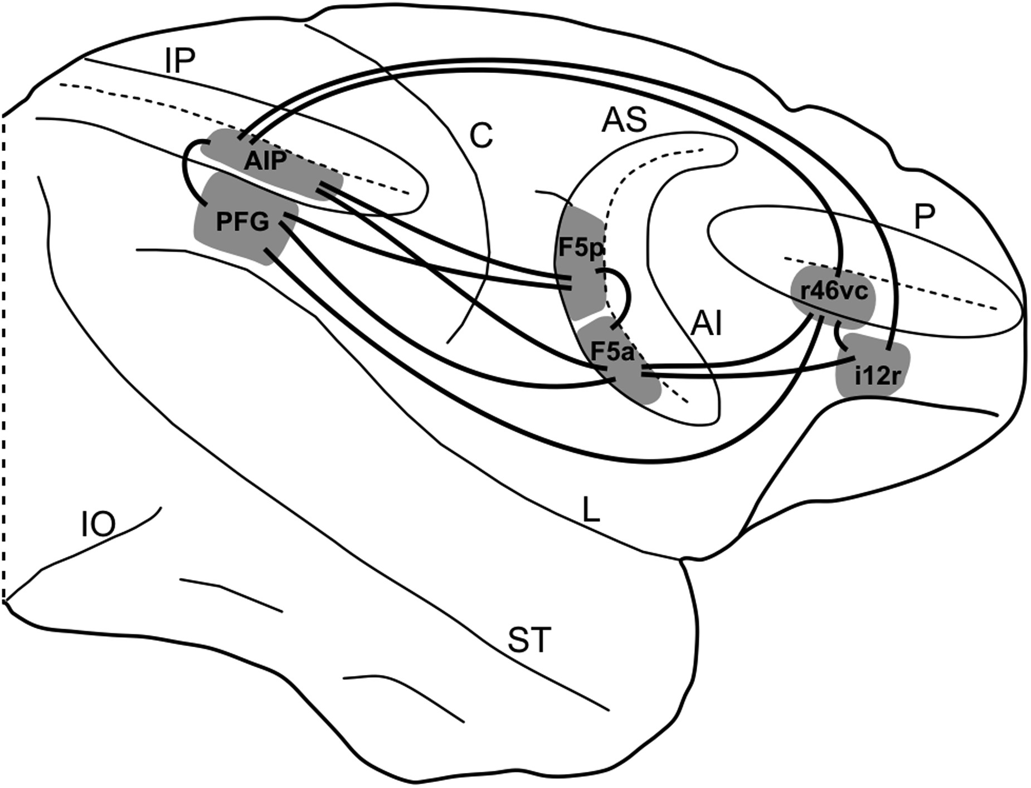
Figure 1. A summary view of the areas of the lateral grasping network object of the present study and of their ...
Notes:
Figure 1. A summary view of the areas of the lateral grasping network object of the present study and of their interconnections. AI, inferior arcuate sulcus; AS, superior arcuate sulcus; C, central sulcus; i12r, intermediate part of area 12r; IO, inferior occipital; IP, intraparietal sulcus; L, lateral fissure; P, principal sulcus; r46vc, rostral part of area 46vc; ST, superior temporal sulcus.
Unless provided in the caption above, the following copyright applies to the content of this slide: © The Author 2012. Published by Oxford University Press. All rights reserved. For Permissions, please e-mail: journals.permissions@oup.com

Slide 2
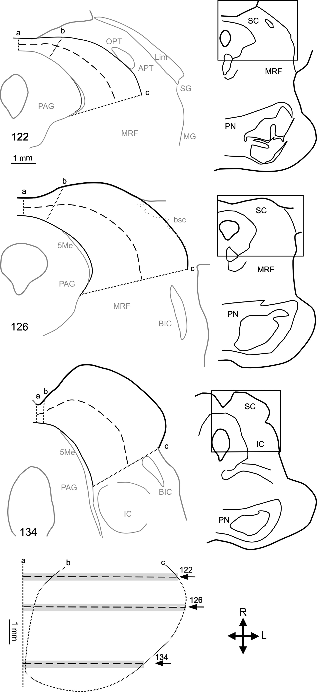
Figure 2. Unfolding procedure for obtaining 2D reconstructions of the SC, shown for 3 representative coronal sections ...
Notes:
Figure 2. Unfolding procedure for obtaining 2D reconstructions of the SC, shown for 3 representative coronal sections taken at a rostral, an intermediate, and a caudal level. In each section, the SC was flattened at the level of a virtual line (dashed line) starting from the midline (a) and running in the mediolateral direction along the middle of SC thickness. The medial and lateral borders of the SC are marked by the dotted lines (b and c). The 2D reconstruction shown in the lower part of the figure was then obtained by aligning the flattened sections to correspond with the midline and by assigning to each section a thickness of 300 µm (gray shading). Arrows mark the levels of the 3 representative sections. APT, anterior pretectal area; BIC, nucleus of the brachium of the inferior colliculus; bsc, brachium of the superior colliculus; IC, inferior colliculus; L, lateral; Lim, limitans nucleus of the thalamus; 5Me, mesencephalic trigeminal nucleus; MG, medial geniculate nucleus of the thalamus; MRF, mesencephalic reticular formation; OPT, olivary pretectal nucleus; PAG, periaqueductal gray; PN, pontine nuclei; R, rostral; SG, suprageniculate nucleus of the thalamus.
Unless provided in the caption above, the following copyright applies to the content of this slide: © The Author 2012. Published by Oxford University Press. All rights reserved. For Permissions, please e-mail: journals.permissions@oup.com

Slide 3
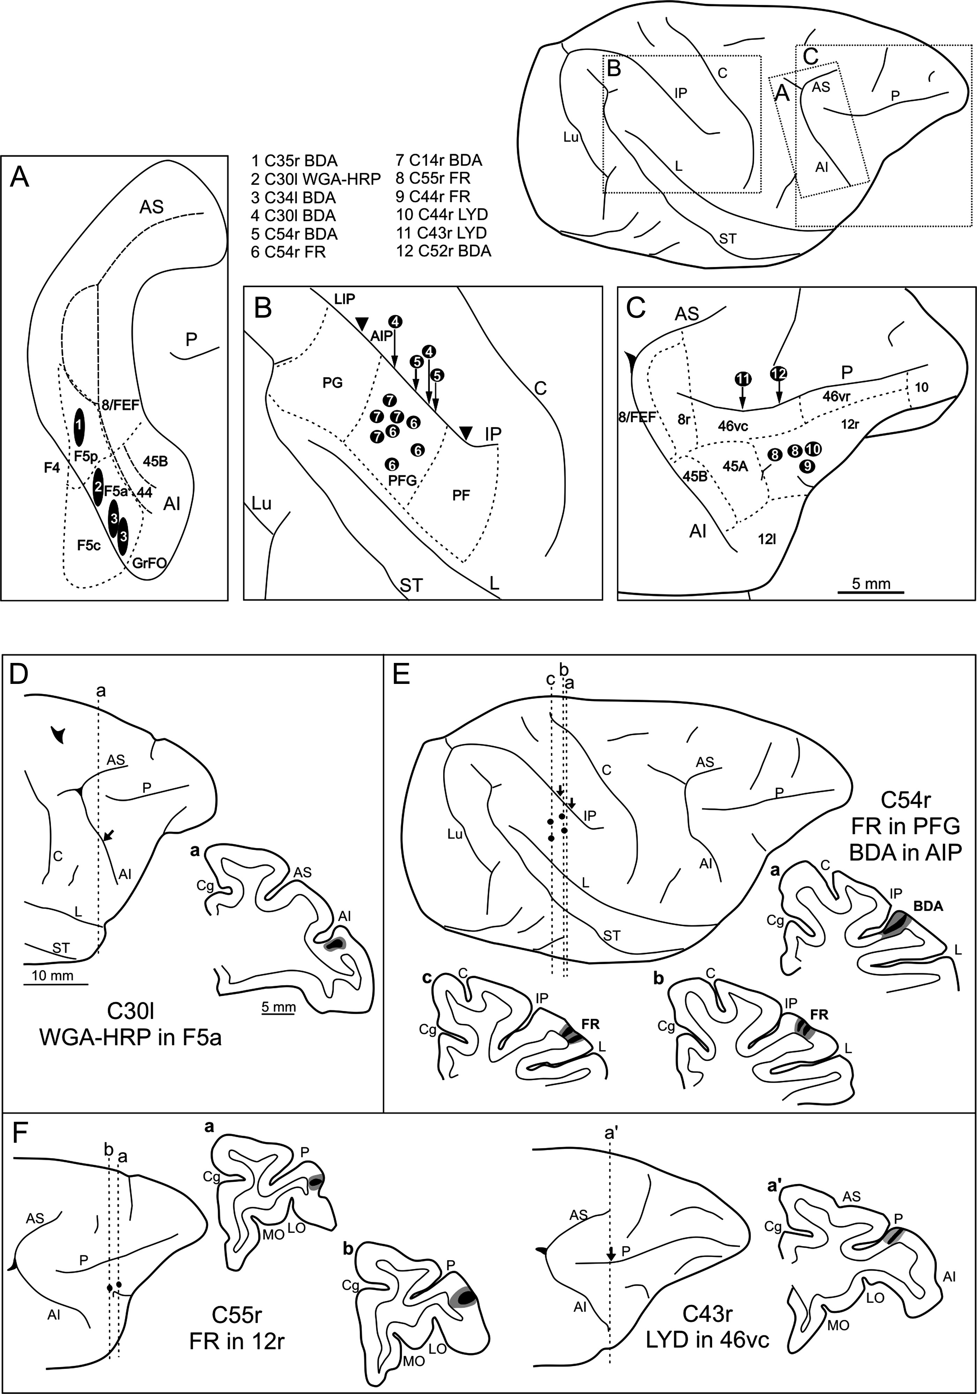
Figure 3. Location of injection sites. Upper part: composite view of all the injection sites mapped on a template right ...
Notes:
Figure 3. Location of injection sites. Upper part: composite view of all the injection sites mapped on a template right hemisphere. Each injection site was numbered and reported, based on anatomical landmarks and stereotaxic coordinates, in the posterior bank of the arcuate sulcus (A) in the IPL (B), and in the VLPF (C). In order to avoid distortions of the template hemisphere, the AP level of the injections sites in anterior intraparietal (AIP) in the ventral bank of the inferior parietal sulcus and in rostral area 46vc in the ventral bank of PS is indicated by arrows. Arrowheads in B indicate the rostro-caudal extent of area AIP, which does not extend on the lateral surface. Lower part: the location of injection sites in Cases 30l WGA-HRP (D), 54r FR and BDA (E), and 55r FR and 43r LYD (F), shown on dorsolateral views of the injected hemispheres and in coronal sections through the core (shown in black) and the halo (shown in lighter gray). The arrows in the dorsolateral views of the hemispheres in D, E, and F indicate the levels of the injection sites within sulci. For the sake of comparison, all the reconstructions in this figure are shown as a right hemisphere. Cg, cingulate sulcus; LO, lateral orbital sulcus; Lu, lunate sulcus; MO, medial orbital sulcus. Other abbreviations as in Figure 1.
Unless provided in the caption above, the following copyright applies to the content of this slide: © The Author 2012. Published by Oxford University Press. All rights reserved. For Permissions, please e-mail: journals.permissions@oup.com

Slide 4
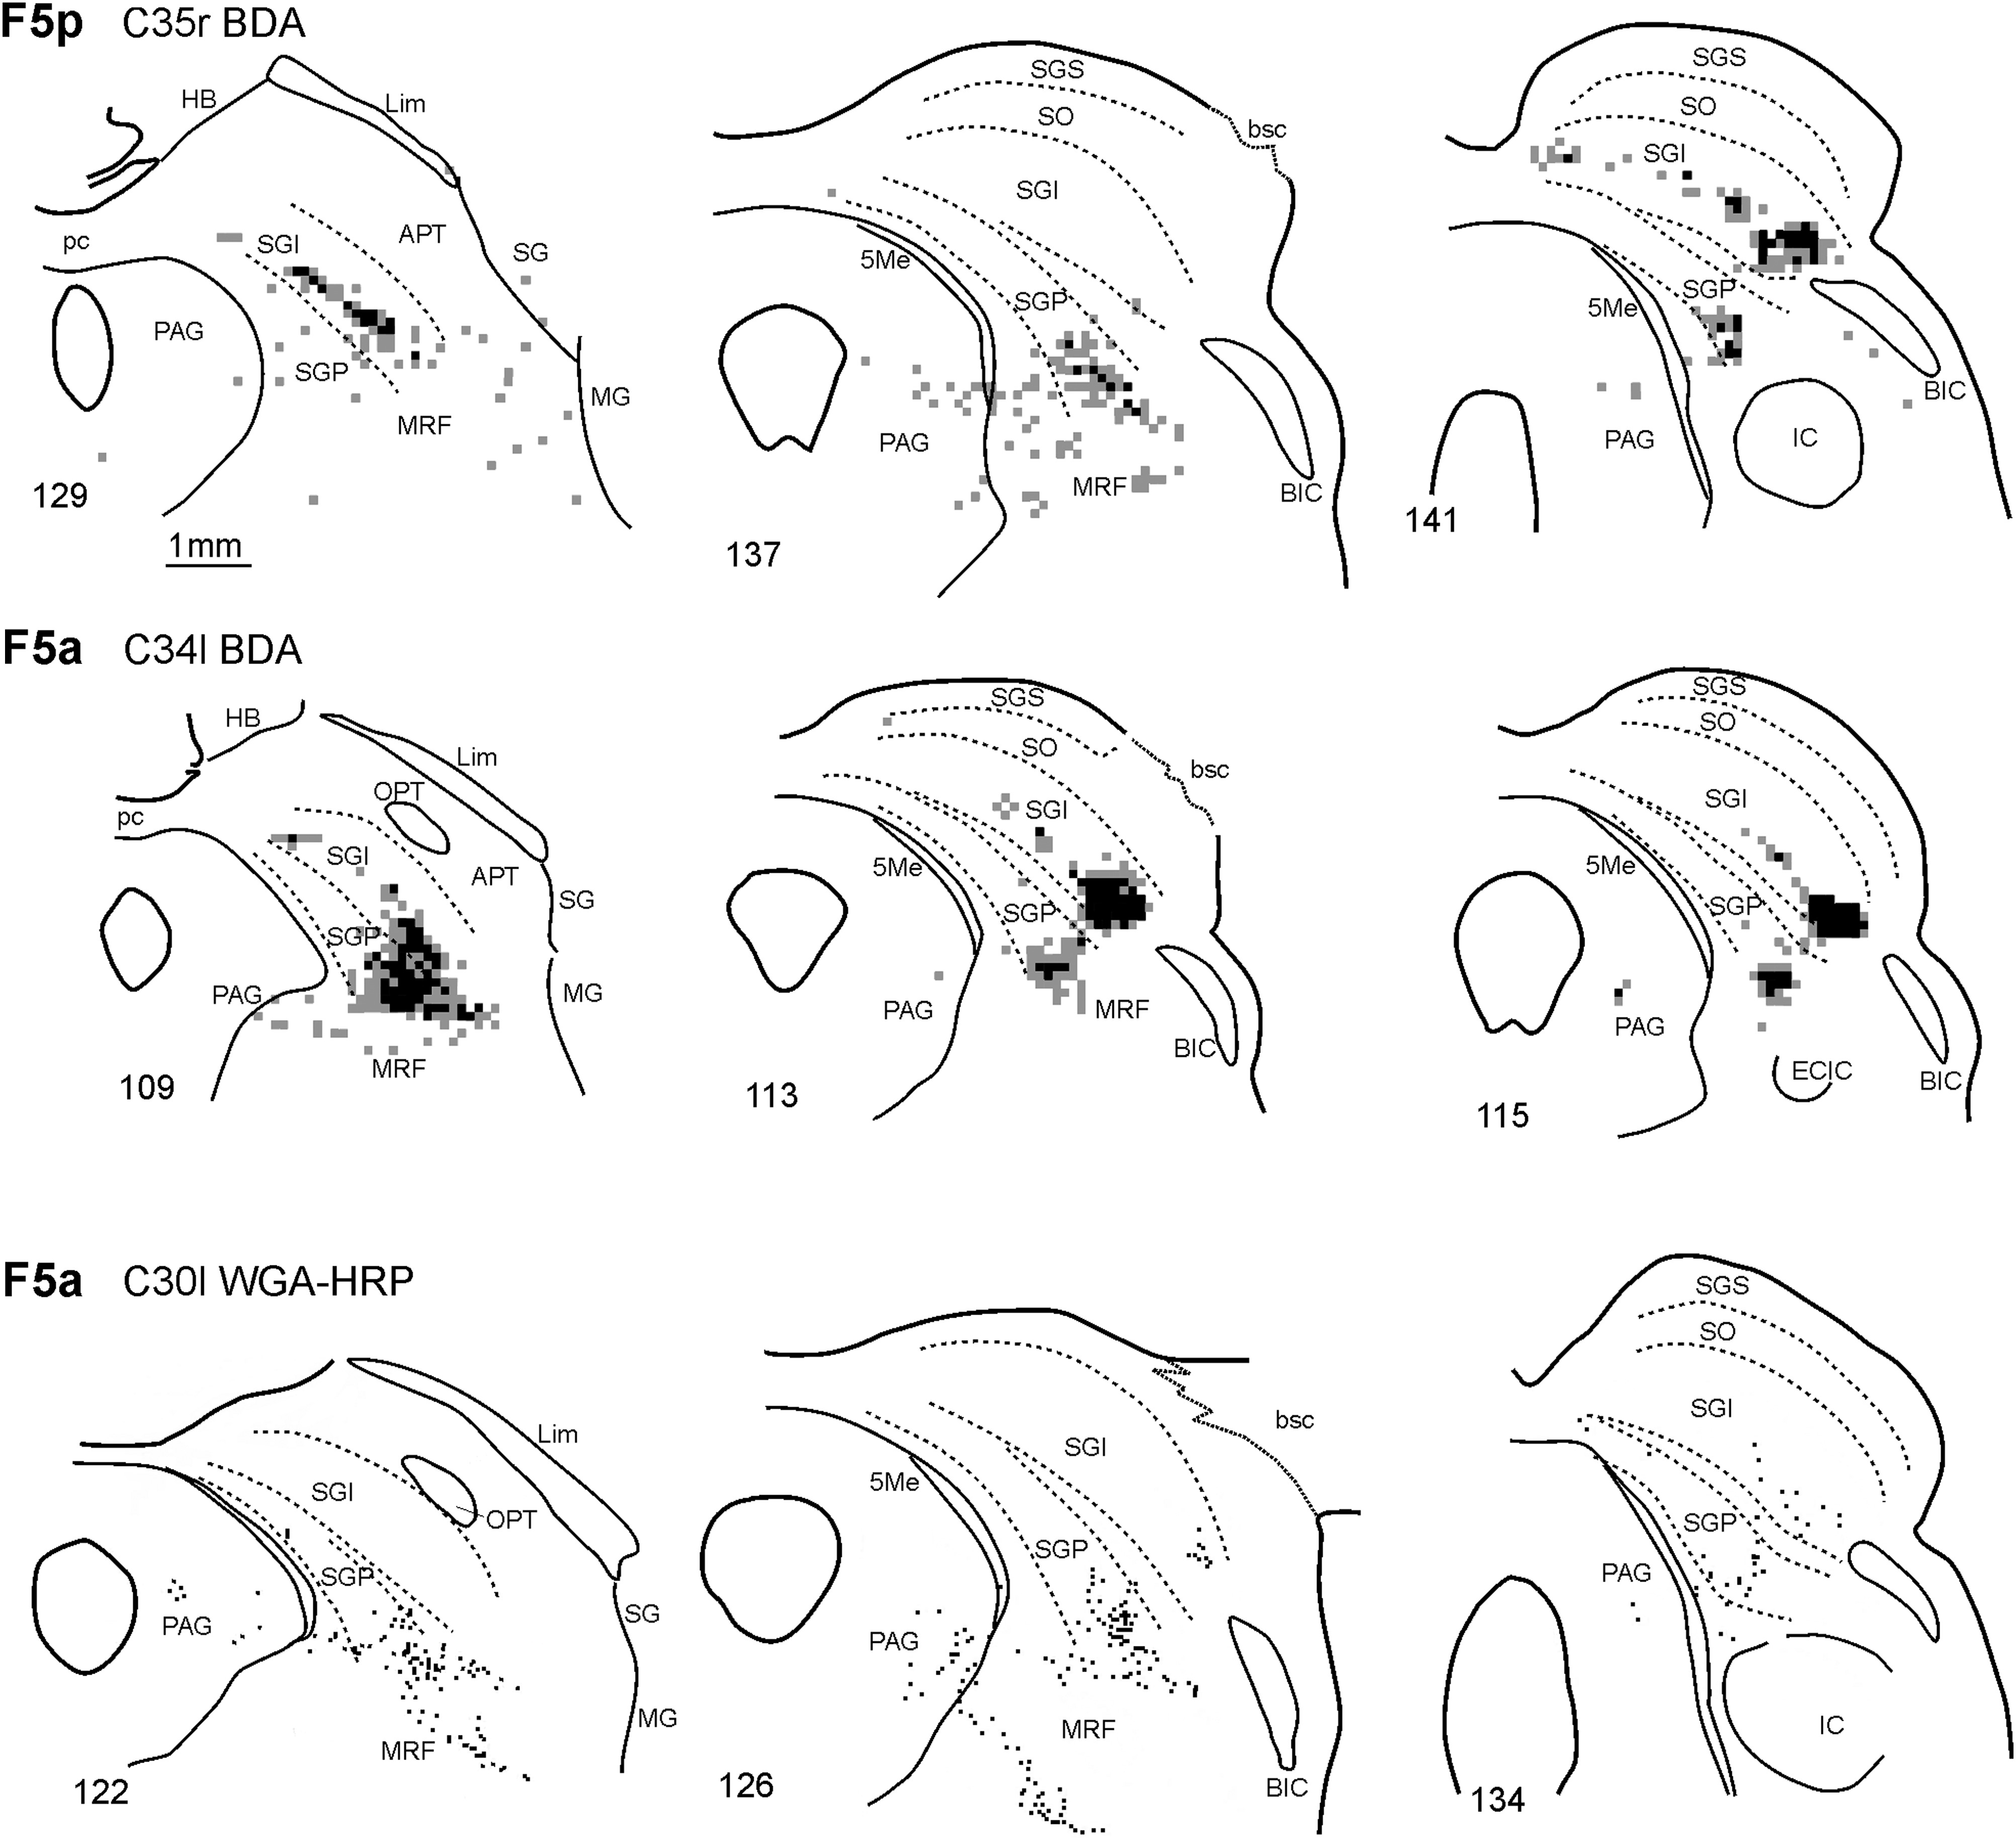
Figure 4. Drawings of coronal sections through the ipsilateral SC showing the distribution of anterograde labeling ...
Notes:
Figure 4. Drawings of coronal sections through the ipsilateral SC showing the distribution of anterograde labeling observed following tracer injections in the PMv areas F5p (Case 35r BDA) and F5a (Cases 34l BDA and 30l WGA-HRP). For each case, the sections are shown in a rostral to caudal order. In Cases 35r BDA and 34l BDA, each square corresponds to a 100 × 100 × 60 µm voxel containing: 3–8 labeled terminals (gray) and >8 labeled terminals (black). In Case 30l WGA-HRP, dot density is proportional to the density of the fine grain chromogen precipitate. For the sake of comparison, anterograde labeling in this and in the subsequent figures is shown as in a right SC. ECIC, external cortex of the inferior colliculus; HB, habenula; pc, posterior commissure; SGI, stratum griseum intermediale; SGP, stratum griseum profundum; SGS, stratum griseum superficiale; SO, stratum opticum. Other abbreviations as in Figure 2.
Unless provided in the caption above, the following copyright applies to the content of this slide: © The Author 2012. Published by Oxford University Press. All rights reserved. For Permissions, please e-mail: journals.permissions@oup.com

Slide 5
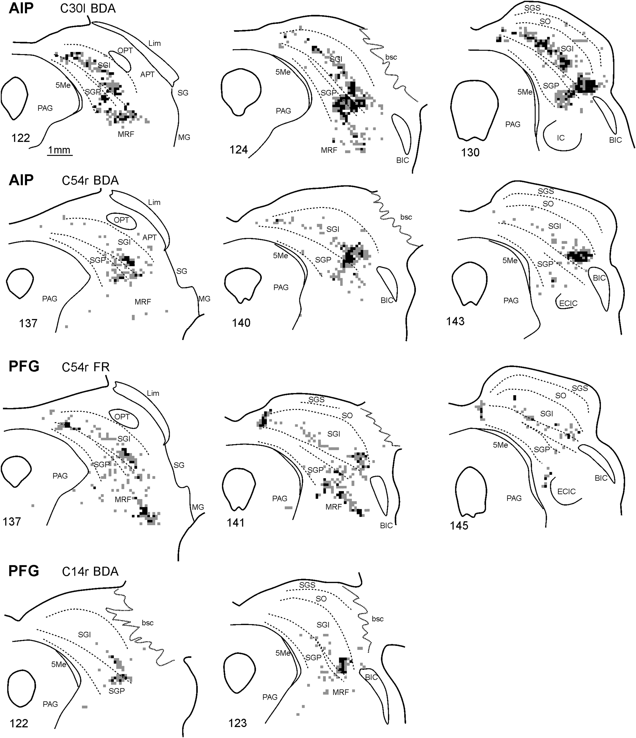
Figure 5. Drawings of coronal sections through the ipsilateral SC showing the distribution of anterograde labeling ...
Notes:
Figure 5. Drawings of coronal sections through the ipsilateral SC showing the distribution of anterograde labeling observed following tracer injections in the parietal areas AIP (Cases 30l BDA and 54r BDA) and PFG (Cases 54r FR and 14r BDA). In Case 14r BDA, sections through the caudal SC were not available. Conventions and abbreviations as in Figures 2 and 4.
Unless provided in the caption above, the following copyright applies to the content of this slide: © The Author 2012. Published by Oxford University Press. All rights reserved. For Permissions, please e-mail: journals.permissions@oup.com

Slide 6
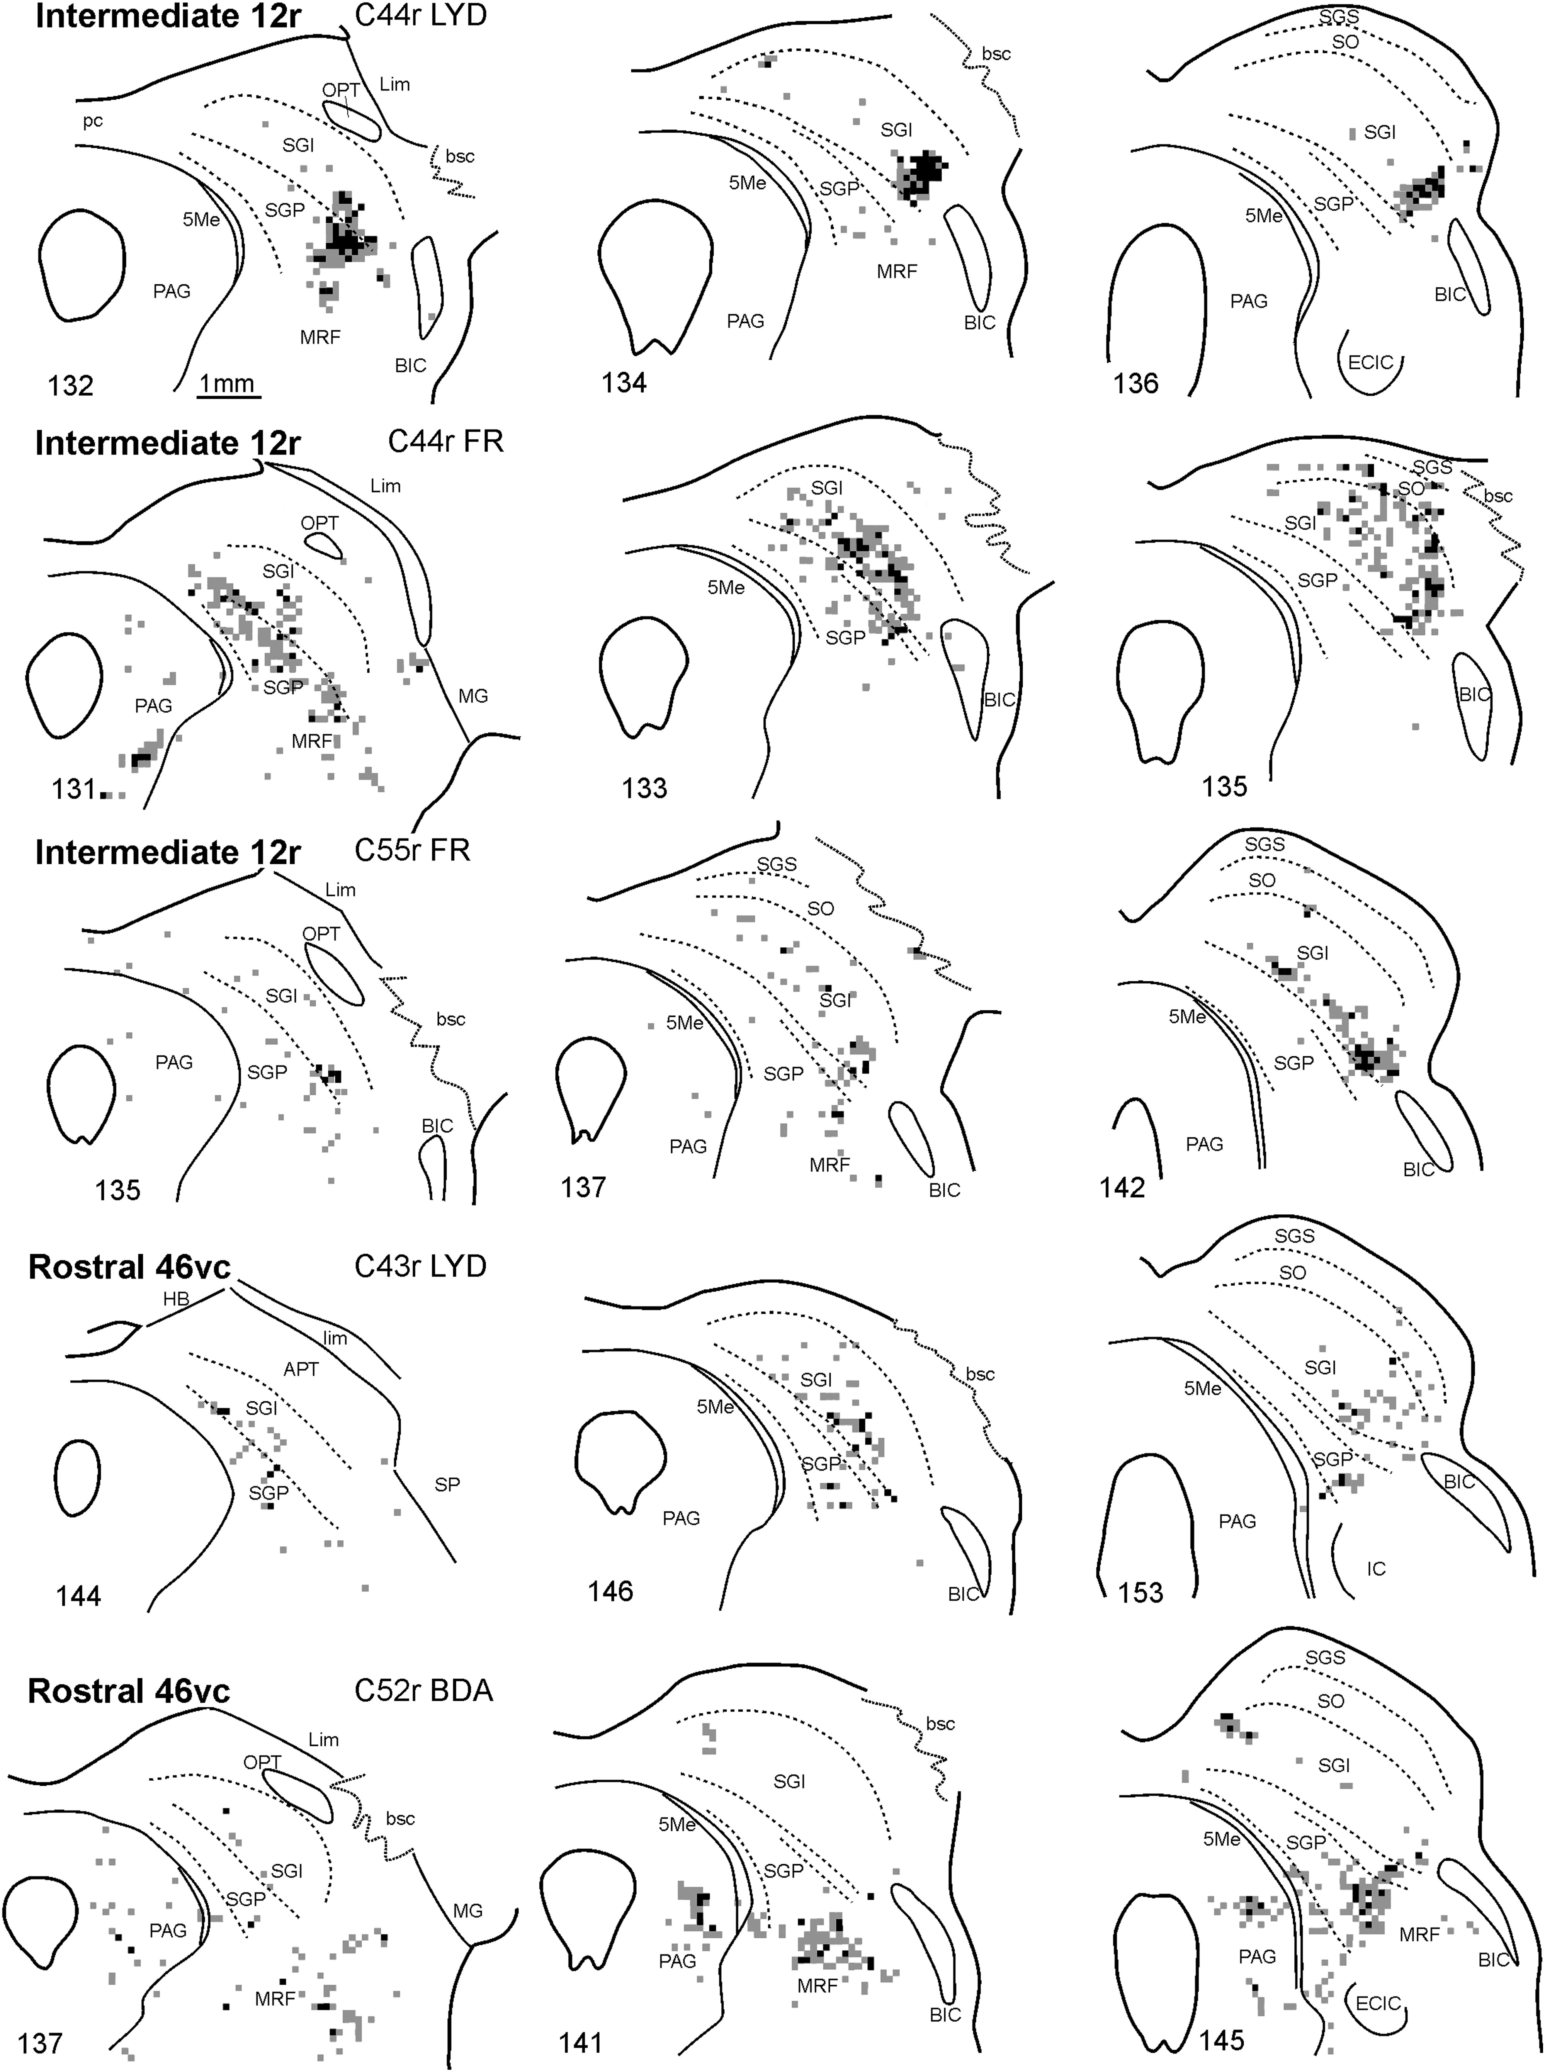
Figure 6. Drawings of coronal sections through the ipsilateral SC showing the distribution of anterograde labeling ...
Notes:
Figure 6. Drawings of coronal sections through the ipsilateral SC showing the distribution of anterograde labeling observed following tracer injections in the prefrontal fields intermediate 12r (Cases 44r LYD and FR, and 55r FR) and rostral 46vc (Cases 43r LYD and 52r BDA). Conventions and abbreviations as in Figures 2 and 4.
Unless provided in the caption above, the following copyright applies to the content of this slide: © The Author 2012. Published by Oxford University Press. All rights reserved. For Permissions, please e-mail: journals.permissions@oup.com

Slide 7
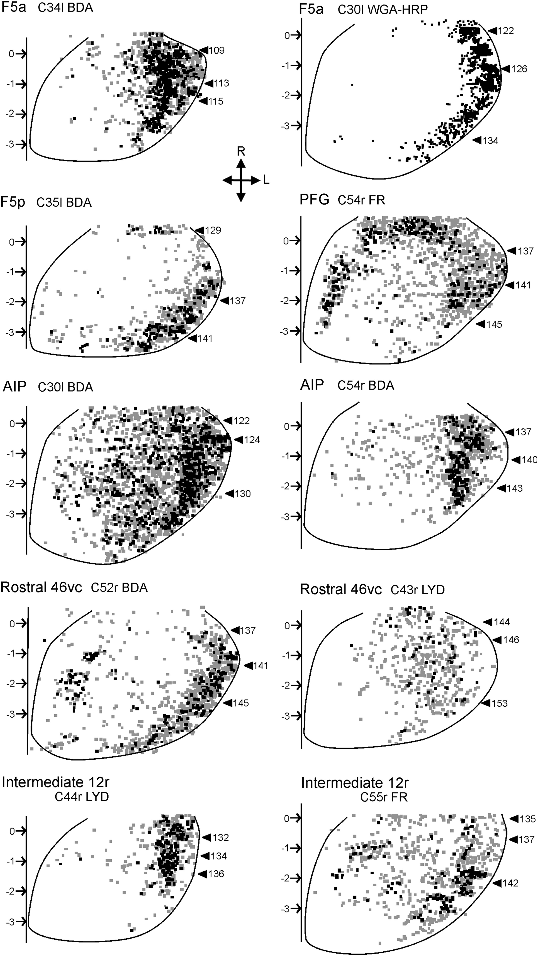
Figure 7. Distribution of anterograde labeling observed following injections in F5p, F5a, AIP, PFG, rostral 46vc, and ...
Notes:
Figure 7. Distribution of anterograde labeling observed following injections in F5p, F5a, AIP, PFG, rostral 46vc, and intermediate 12r shown in 2D reconstructions of the ipsilateral SC, aligned to the midline, and indicated by a solid straight line. Arrows pointing to the midline indicate AP stereotaxic levels. Arrowheads pointing to the lateral part of the SC indicate the levels of the sections shown in Figures 4–6. AP = 0 corresponds to the posterior commissure. Conventions and abbreviations as in Figures 2 and 4.
Unless provided in the caption above, the following copyright applies to the content of this slide: © The Author 2012. Published by Oxford University Press. All rights reserved. For Permissions, please e-mail: journals.permissions@oup.com

Slide 8
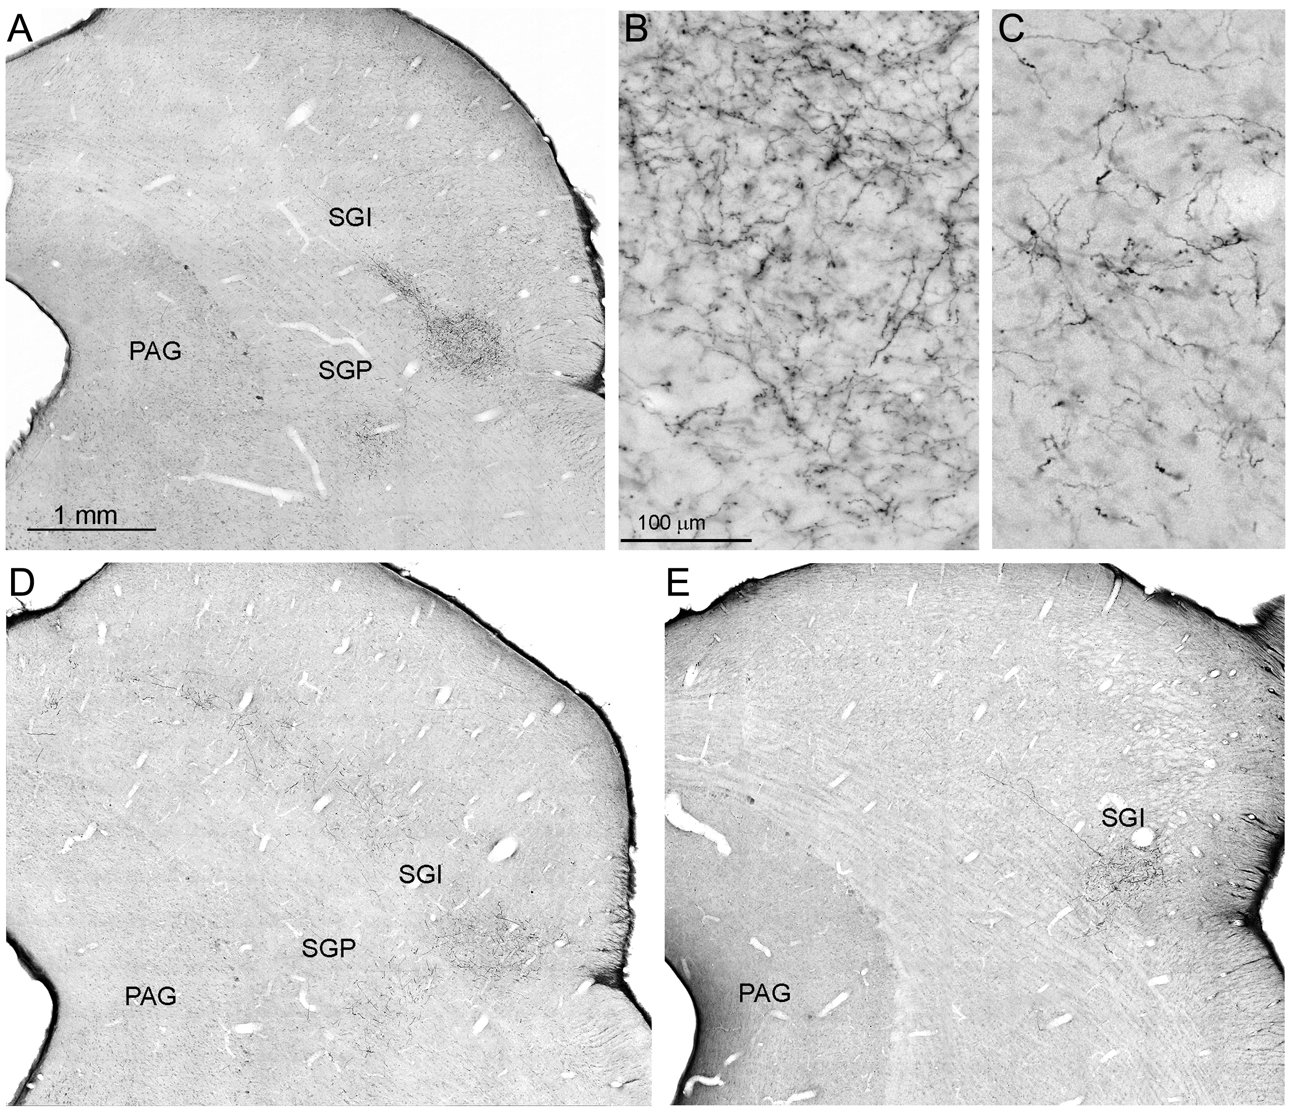
Figure 8. (A, D, and E) Low-power photomicrographs showing the distribution of anterograde labeling observed in the SC ...
Notes:
Figure 8. (A, D, and E) Low-power photomicrographs showing the distribution of anterograde labeling observed in the SC after tracer injections in F5a (A), AIP (D), and intermediate12r (E). (B and C) Higher magnification views, taken from the section shown in A, of anterograde labeling observed in SGI (B) and SGP (C). Scale bar in A applies also to D and E. Scale bar in B applies also to C. Abbreviations as in Figures 2 and 4.
Unless provided in the caption above, the following copyright applies to the content of this slide: © The Author 2012. Published by Oxford University Press. All rights reserved. For Permissions, please e-mail: journals.permissions@oup.com

