Slide 1
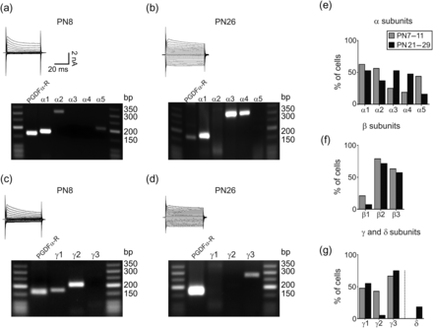
Figure 1. Molecular diversity of GABA_{A}R subunit expression in NG2 cells at PN7–11 and PN21–29. (a–d) The ...
Notes:
Figure 1. Molecular diversity of GABAAR subunit expression in NG2 cells at PN7–11 and PN21–29. (a–d) The co-expression of α (a and b), β, γ (c and d), and δ subunit mRNAs were investigated in recorded NG2 cells by single-cell RT–PCR at PN7–11 and PN21–29. Currents were induced in cells held at −70 mV by voltage steps from +20 to −160 mV (10 mV increments; upper-left panels). After recording, the cell content was harvested, and RT–PCR was performed. The gels display co-expression of transcripts for the cell type-specific marker PDGFRα together with α-subunits (a and b) or γ-subunits (c and d) of GABAARs. The expected product lengths were 167 bp for PDGFRα, 180 bp for α1, 306 bp for α2, 306 bp for α3, 308 bp for α4, 208 bp for α5, 180 bp for γ1, 211 bp for γ2, and 272 bp for γ3. (e–g) Summary of GABAAR subunit expression in single NG2 cells observed at PN7–11 and PN21–29. The number of tested cells is 16, 19, 21, and 19 for α, β, γ, and δ subunits at PN7–11, respectively, and 19, 14, 20, and 11 for α, β, γ, and δ subunits at PN21–29, respectively.
Unless provided in the caption above, the following copyright applies to the content of this slide: © The Author 2013. Published by Oxford University Press. All rights reserved. For Permissions, please e-mail: journals.permissions@oup.com

Slide 2
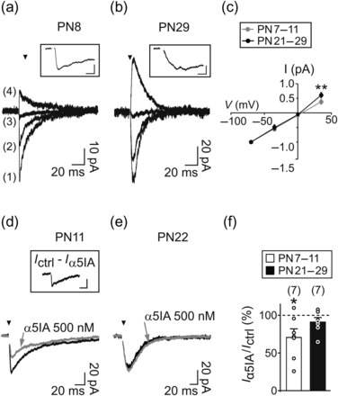
Figure 2. Effect of α5IA on evoked GABA_{A}R-mediated currents of cortical NG2 cells. (a and b). Evoked ...
Notes:
Figure 2. Effect of α5IA on evoked GABAAR-mediated currents of cortical NG2 cells. (a and b). Evoked GABAAR-mediated currents elicited by stimulation of neuronal fibers in 2 NG2 cells at PN8 (a) and PN29 (b) at holding potentials of −70 mV (1), −35 mV (2), 0 mV (3), and +35 mV (4). Note the fast rise time of currents elicited at a holding potential of −70 mV in (a, inset) compared with (b, inset). Inset scale bars: 5 ms, 20 pA (a); 5 ms, 40 pA (b). (c) I–V relationships of normalized (−70 mV) evoked currents at both developmental stages. Note the outward rectification of the I–V curve of cells at PN21–29. **P < 0.01 for currents at +35 mV (n = 7 and n = 6 at PN7–11 and PN21–29, respectively). (d and e) Effect of 500 nM α5IA (gray traces) on evoked GABAAR-mediated currents elicited in 2 NG2 cells held at −70 mV at PN11 (d) and PN22 (e). The inset illustrates the α5IA-sensitive current (Ictrl-α5IA) obtained after subtracting the resistant current from the control. Inset scale bar: 20 pA, 20 ms. For all traces, stimulus artifacts were blanked for visibility and the time of stimulation is indicated with a black arrowhead. (f) Histogram comparing the effect of 500 nM α5IA in NG2 cells recorded at PN7–11 and PN21–29. *P < 0.05.
Unless provided in the caption above, the following copyright applies to the content of this slide: © The Author 2013. Published by Oxford University Press. All rights reserved. For Permissions, please e-mail: journals.permissions@oup.com

Slide 3
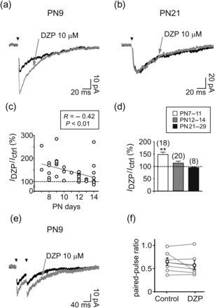
Figure 3. Effect of diazepam on evoked GABA_{A}R-mediated currents of cortical NG2 cells. (a and b) Effect of ...
Notes:
Figure 3. Effect of diazepam on evoked GABAAR-mediated currents of cortical NG2 cells. (a and b) Effect of diazepam (DZP, gray traces) on evoked GABAAR-mediated currents elicited in 2 NG2 cells held at −70 mV at PN9 (a) and PN21 (b). (c) Relationship between the percentage of amplitude increase induced by diazepam in evoked currents and postnatal days for individual cells. The gray solid line indicates a linear regression fit with a negative slope. (d) Histogram comparing the effect of 10 µM diazepam in NG2 cells recorded at PN7–11, PN12–14, and PN21–29. **P < 0.01. (e) Paired-pulse stimulation of neuronal fibers elicited inward currents in a NG2 cell held at −70 mV at PN9. For all traces, stimulus artifacts were blanked for visibility and the time of stimulation is indicated with a black arrowhead. (f) Plot comparing the paired-pulse ratio obtained in control and in the presence of diazepam for 8 NG2 cells sensitive to this agent in young mice. The paired-pulse ratios of currents obtained from individual cells are in gray and of averaged ratios in black.
Unless provided in the caption above, the following copyright applies to the content of this slide: © The Author 2013. Published by Oxford University Press. All rights reserved. For Permissions, please e-mail: journals.permissions@oup.com

Slide 4
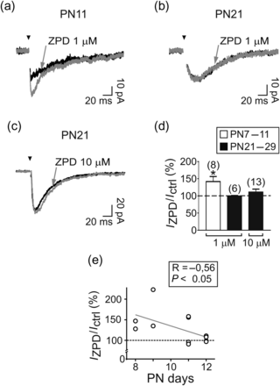
Figure 4. Effect of zolpidem on evoked GABA_{A}R-mediated currents of cortical NG2 cells. (a–c) Effect of ...
Notes:
Figure 4. Effect of zolpidem on evoked GABAAR-mediated currents of cortical NG2 cells. (a–c) Effect of zolpidem (ZPD; gray traces) on evoked GABAAR-mediated currents elicited in 3 NG2 cells held at −70 mV at PN11 (a), PN21 (b), and PN21 (c). For all traces, stimulus artifacts were blanked for visibility and the time of stimulation is indicated with a black arrowhead. (d) Histogram comparing the effect of zolpidem at different concentrations in NG2 cells recorded at PN7–11 and PN21–29. *P < 0.05. (e) Relationship between the percentage of amplitude increase induced by zolpidem in evoked currents and postnatal days for individual cells. The gray solid line indicates a linear regression fit with a negative slope.
Unless provided in the caption above, the following copyright applies to the content of this slide: © The Author 2013. Published by Oxford University Press. All rights reserved. For Permissions, please e-mail: journals.permissions@oup.com

Slide 5
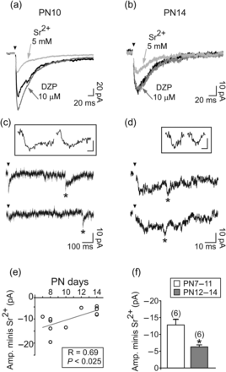
Figure 5. Postnatal down-regulation of γ₂ subunit expression in NG2 cells correlates with the loss of ...
Notes:
Figure 5. Postnatal down-regulation of γ2 subunit expression in NG2 cells correlates with the loss of synaptic activity and the switch of transmission mode. (a and b) Averaged traces of evoked currents of 2 NG2 cells held at −70 mV at PN10 (a) and PN14 (b) in control (black), in the presence of diazepam (dark gray) and when 2 mM Ca2+ was replaced by 5 mM Sr2+ (light gray). Note that currents were strongly decreased in the presence of Sr2+ in both cells. (c and d) Single traces of evoked currents in 5 mM Sr2+ of the NG2 cells shown in a and b. The insets illustrate individual currents at higher resolution (asterisk). Note the amplitude reduction of evoked miniature events in (d, inset). Inset scale bars: 10 pA, 2 ms. (e) Relationship between the amplitude of evoked asynchronous miniature currents and postnatal days for individual cells. The solid line indicates a linear regression fit with a positive slope. (f) Histogram comparing the amplitude of evoked miniature currents of NG2 cells recorded in Sr2+ at PN7–11 and PN12–14. *P < 0.05.
Unless provided in the caption above, the following copyright applies to the content of this slide: © The Author 2013. Published by Oxford University Press. All rights reserved. For Permissions, please e-mail: journals.permissions@oup.com

