Slide 1
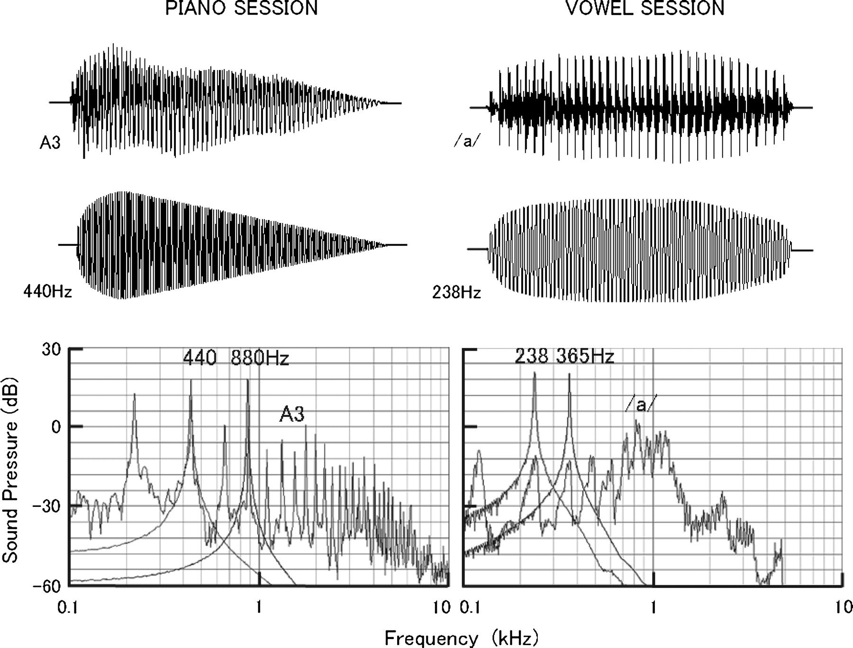
Figure 1. Waveforms and frequency spectra of stimulus sounds. In the piano session of measurement, the A3 piano tone ...
Notes:
Figure 1. Waveforms and frequency spectra of stimulus sounds. In the piano session of measurement, the A3 piano tone and pure tones of 440 and 880 Hz harmonics were used, whereas the vowel /a/ and pure tones of 238 and 365 Hz of the first Formant were used in the vowel session.
Unless provided in the caption above, the following copyright applies to the content of this slide: © The Author 2007. Published by Oxford University Press. All rights reserved. For permissions, please e-mail: journals.permissions@oxfordjournals.org

Slide 2
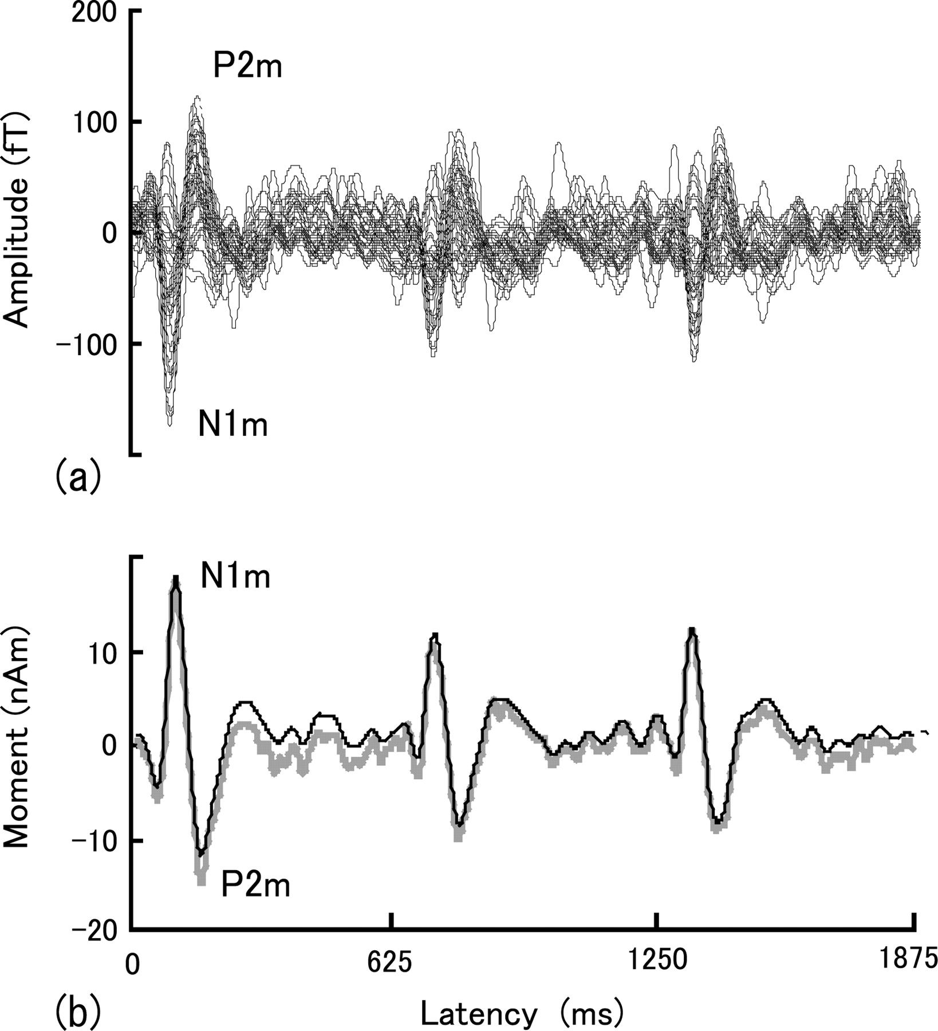
Figure 2. (a) Superposed MEG responses at 41 channels in the right hemisphere of one subject and (b) time series of the ...
Notes:
Figure 2. (a) Superposed MEG responses at 41 channels in the right hemisphere of one subject and (b) time series of the dipole moment (black line) calculated from the data of (a). The responses were measured in a piano session using 3 successive A3 tones. The moment was obtained by projecting the measured fields on the grand mean dipole fields of N1m. The dipole moment calculated using the data, in which the frequency range of MEG responses was widened from 1–20 to 0.3–40 Hz, was also shown in (b), as indicated by a gray line.
Unless provided in the caption above, the following copyright applies to the content of this slide: © The Author 2007. Published by Oxford University Press. All rights reserved. For permissions, please e-mail: journals.permissions@oxfordjournals.org

Slide 3
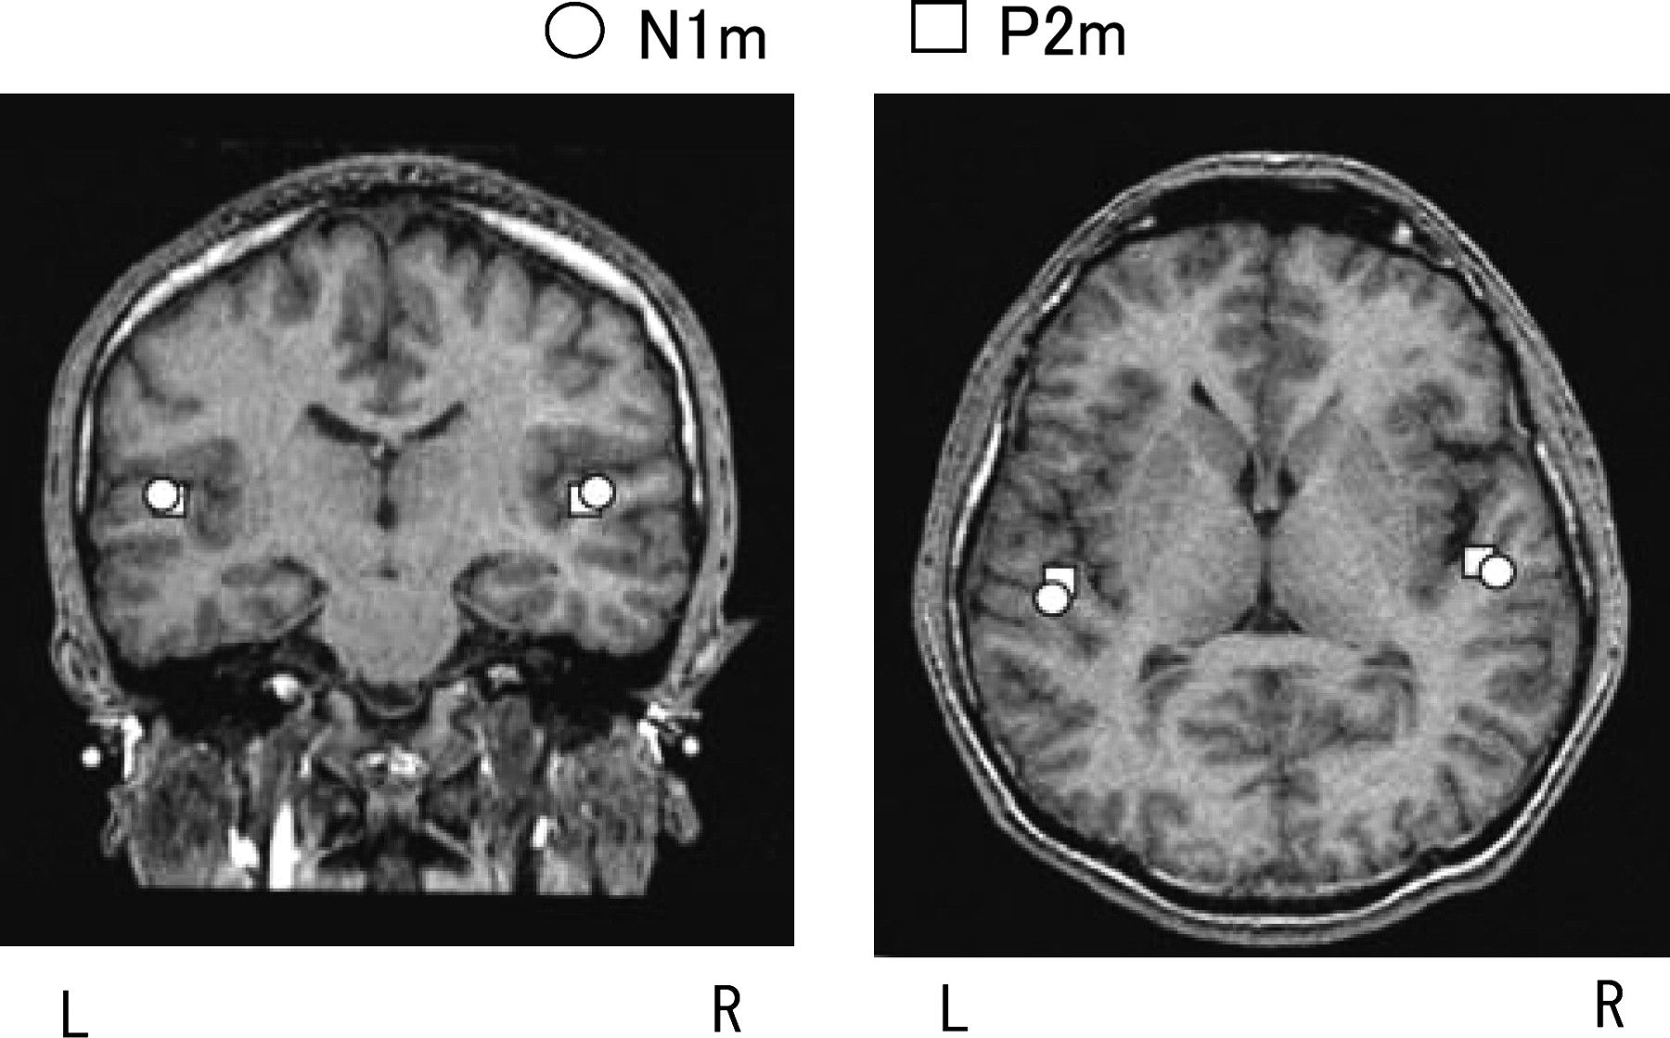
Figure 3. Grand mean location of N1m and P2m dipoles averaged over all the stimulus sounds. The dipoles were projected ...
Notes:
Figure 3. Grand mean location of N1m and P2m dipoles averaged over all the stimulus sounds. The dipoles were projected on coronal and axial magnetic resonance images of one subject who had an average skull size of all subjects.
Unless provided in the caption above, the following copyright applies to the content of this slide: © The Author 2007. Published by Oxford University Press. All rights reserved. For permissions, please e-mail: journals.permissions@oxfordjournals.org

Slide 4
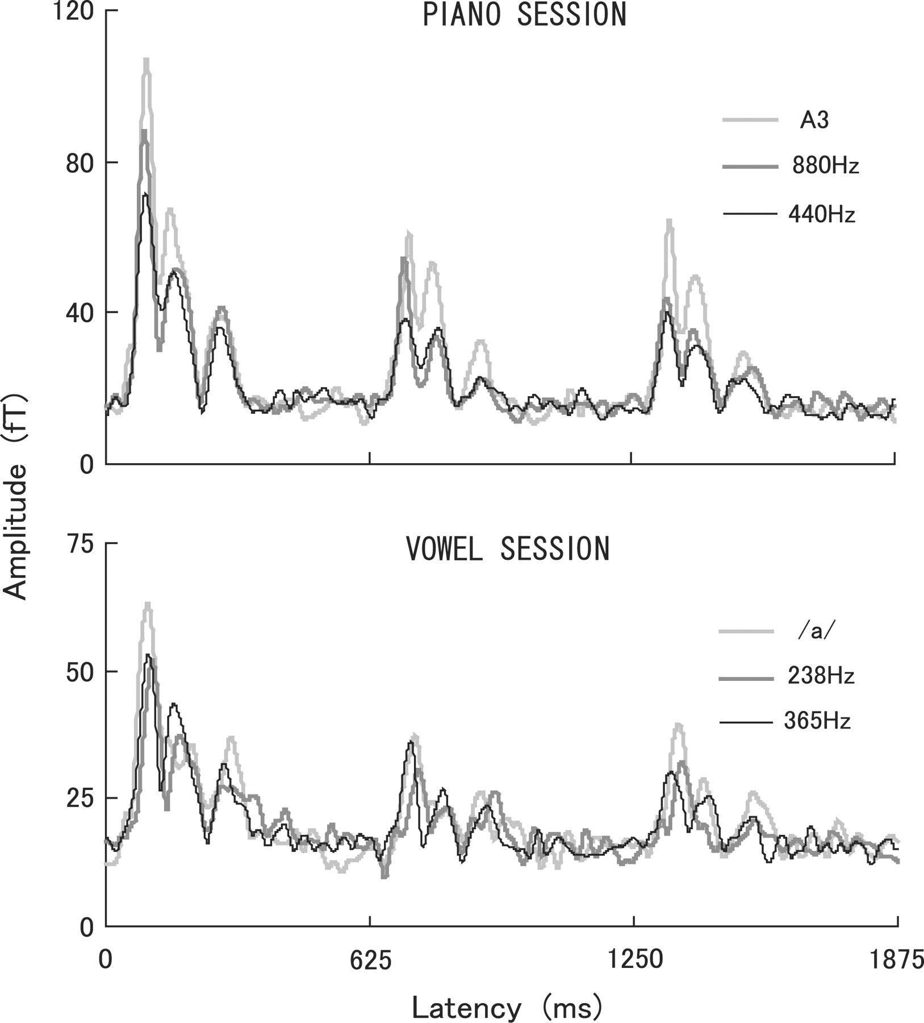
Figure 4. Grand mean amplitude of the RMS fields over 12 largest channels at the maximum N1m peak in the right ...
Notes:
Figure 4. Grand mean amplitude of the RMS fields over 12 largest channels at the maximum N1m peak in the right posterior temporal area. Results are shown for piano and vowel sessions.
Unless provided in the caption above, the following copyright applies to the content of this slide: © The Author 2007. Published by Oxford University Press. All rights reserved. For permissions, please e-mail: journals.permissions@oxfordjournals.org

Slide 5
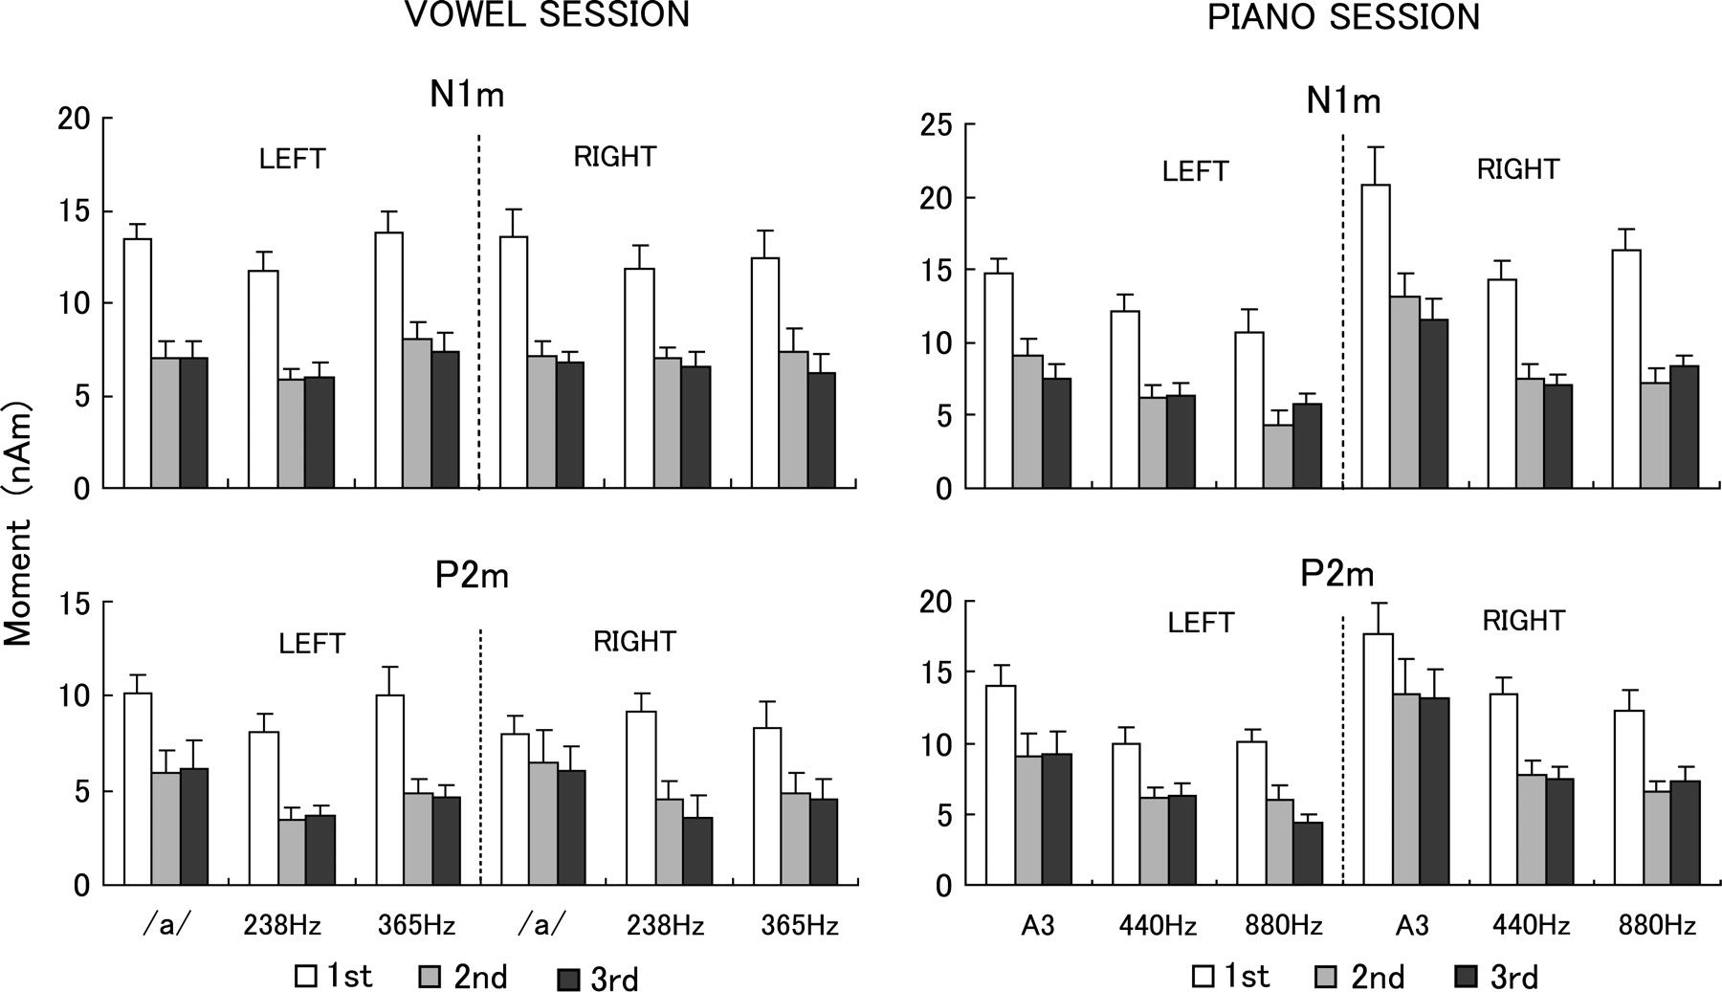
Figure 5. Grand mean dipole moments of N1m and P2m peaks for the first, second, and third stimuli obtained in piano and ...
Notes:
Figure 5. Grand mean dipole moments of N1m and P2m peaks for the first, second, and third stimuli obtained in piano and vowel sessions. Vertical bars indicate standard errors.
Unless provided in the caption above, the following copyright applies to the content of this slide: © The Author 2007. Published by Oxford University Press. All rights reserved. For permissions, please e-mail: journals.permissions@oxfordjournals.org

