Slide 1
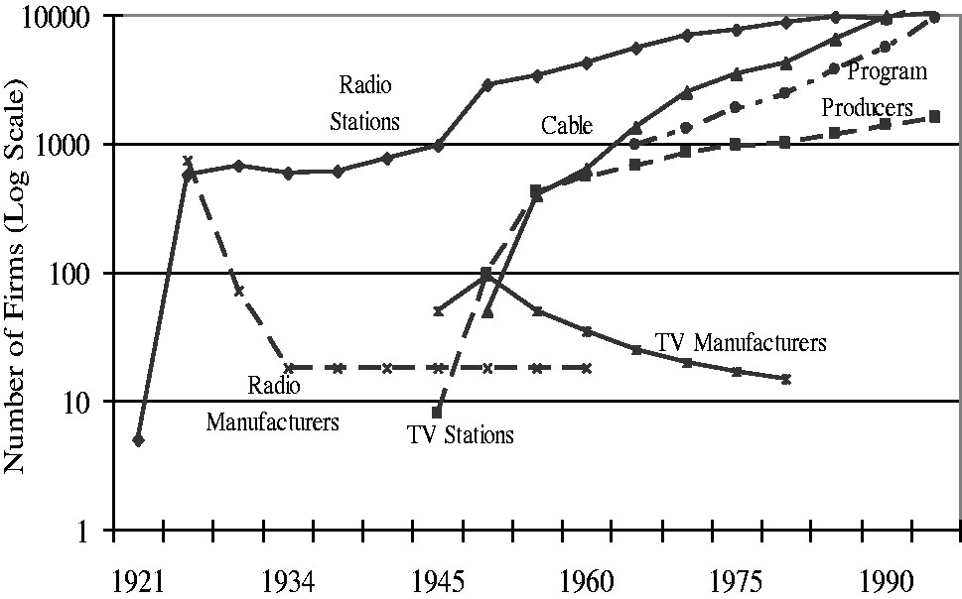
Figure 5 Number of firms for selected discontinuitites and layers. Sources: (Leblebici et al., 1991; Klepper and ...
Notes:
Figure 5 Number of firms for selected discontinuitites and layers. Sources: (Leblebici et al., 1991; Klepper and Simons, 1997; Sterling and Kittross, 2001; Storper and Christopherson, 1987; Scott, 2002).
Unless provided in the caption above, the following copyright applies to the content of this slide: © The Author 2014. Published by Oxford University Press on behalf of Associazione ICC. All rights reserved.

Slide 2
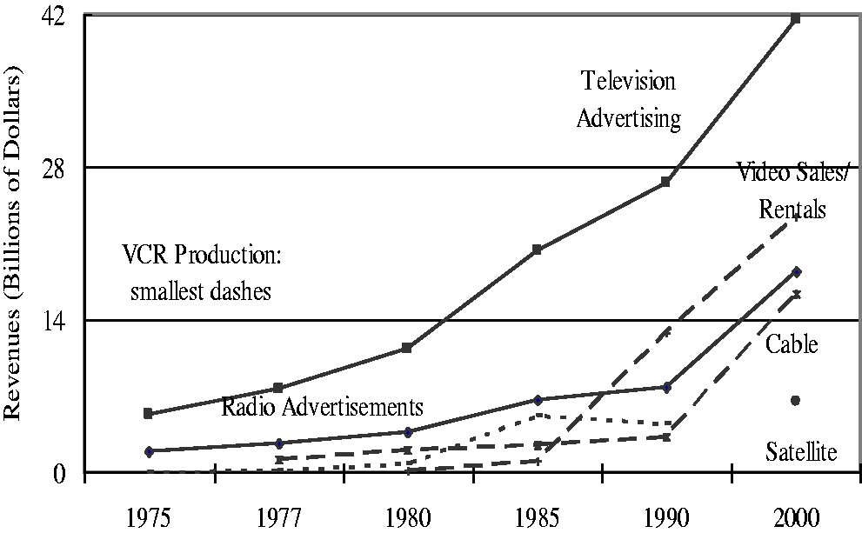
Figure 4 Revenues for selected discontinuitites and layers (1975–2000). Sources: (Klopfenstein, 1989; Gomery, 2000c: ...
Notes:
Figure 4 Revenues for selected discontinuitites and layers (1975–2000). Sources: (Klopfenstein, 1989; Gomery, 2000c: Sterling and Kittross, 2001).
Unless provided in the caption above, the following copyright applies to the content of this slide: © The Author 2014. Published by Oxford University Press on behalf of Associazione ICC. All rights reserved.

Slide 3
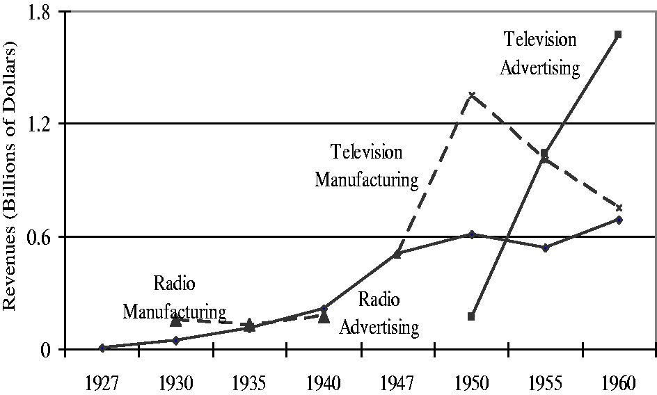
Figure 3 Revenues for selected discontinuitites and layers (1927–1960). Sources: (RETMA, 1954; Sterling and Kittross, ...
Notes:
Figure 3 Revenues for selected discontinuitites and layers (1927–1960). Sources: (RETMA, 1954; Sterling and Kittross, 2001).
Unless provided in the caption above, the following copyright applies to the content of this slide: © The Author 2014. Published by Oxford University Press on behalf of Associazione ICC. All rights reserved.

Slide 4
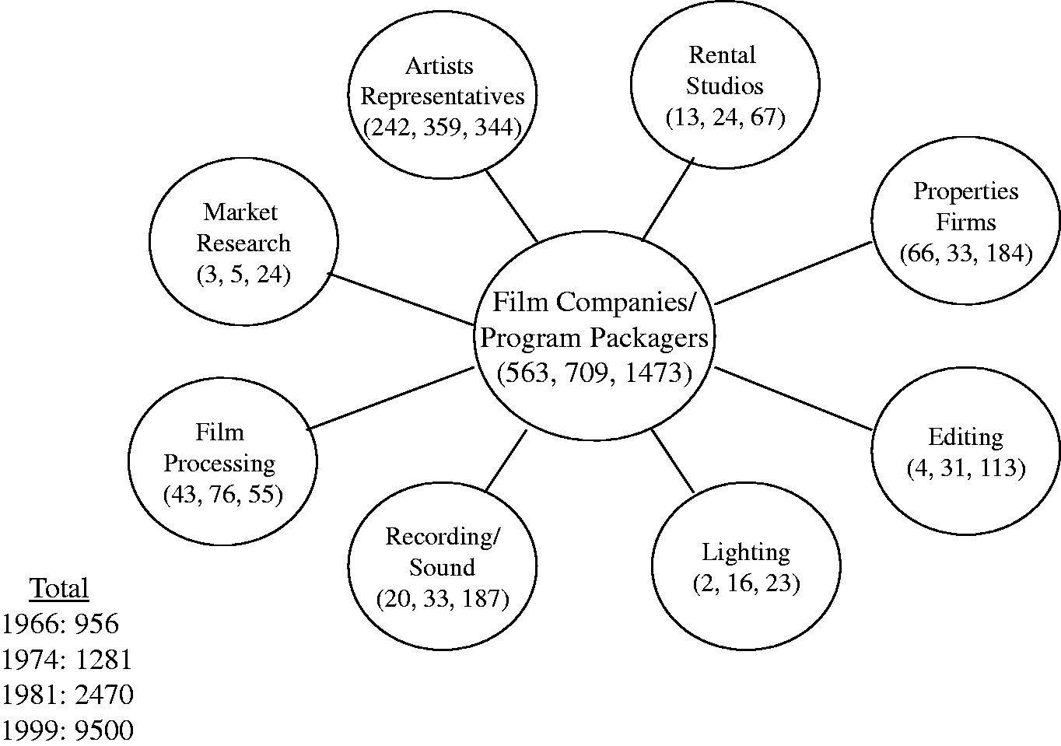
Figure 2 Increasing vertical disintegration in film companies and program packagers (number of firms in parentheses ...
Notes:
Figure 2 Increasing vertical disintegration in film companies and program packagers (number of firms in parentheses for 1966, 1974, and 1981). Source: Storper and Christopherson, 1987 (for number of firms in 1999: Scott, 2002).
Unless provided in the caption above, the following copyright applies to the content of this slide: © The Author 2014. Published by Oxford University Press on behalf of Associazione ICC. All rights reserved.

Slide 5
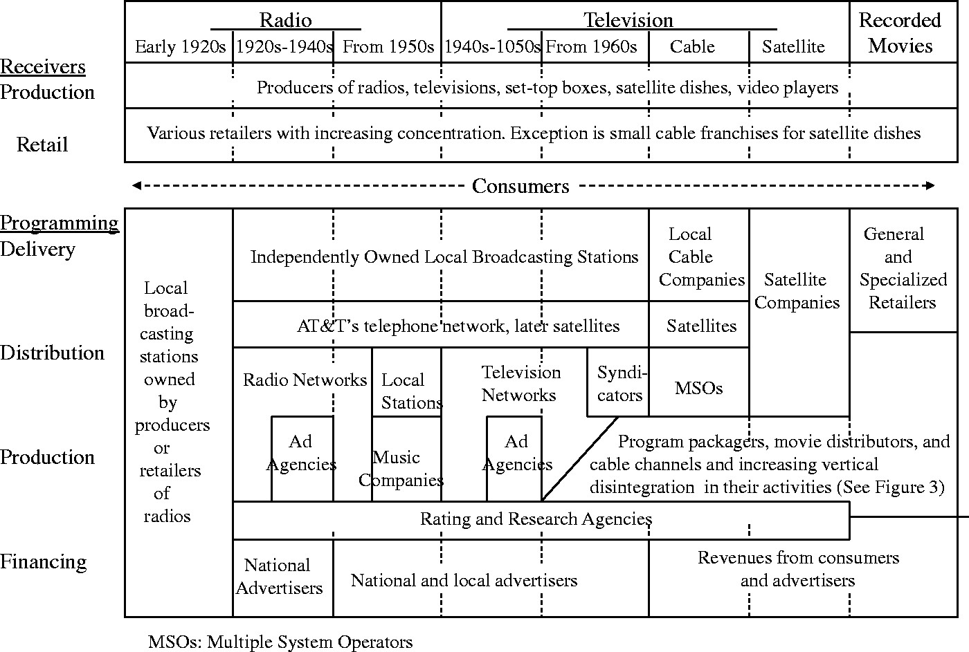
Figure 1 Evolution of vertical disintegration and industry architectures in broadcasting sector.
Notes:
Figure 1 Evolution of vertical disintegration and industry architectures in broadcasting sector.
Unless provided in the caption above, the following copyright applies to the content of this slide: © The Author 2014. Published by Oxford University Press on behalf of Associazione ICC. All rights reserved.

