Slide 1
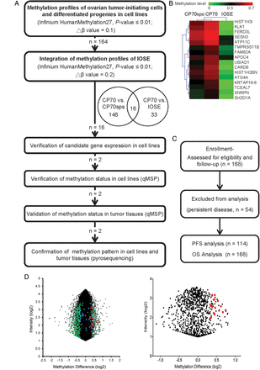
Figure 1. Flow chart of the present study. (A) The HumanMethylation27 BeadChip used to interrogate simultaneously the ...
Notes:
Figure 1. Flow chart of the present study. (A) The HumanMethylation27 BeadChip used to interrogate simultaneously the DNA methylation status of 27 578 probes spanning 14 489 unique genetic loci, which were used for methylomic profiling of OTICs (CP70sps), cells with differentiated progenies (CP70) and IOSE cells. qMSP was performed in a TaqMan probe system using the LightCycler 480 Real-Time PCR System. (B) Hierarchical clustering of methylomic profiles of CP70, CP70sps and IOSE cells (β-value 0–0.7, green and red color represents low and high methylation, respectively). (C) CONSORT diagram of the analytical strategy in all ovarian patients. (D) Selection of differential methylation probes in CP70 and CP70sps from a methylation microarray. The global differential methylation level and intensity in each probe between CP70 and CP70sps was displayed (left). After excluding probes that have a detection P > 0.01 in the assay, 973 probes show as black dots (right). Two hundred and five probes show as green dots that had at least 10% of differential methylation between CP70 and CP70sps cells. Forty-nine genes had at least 20% of differential methylation between CP70 and IOSE cells (blue dots). Sixteen genes exhibited significant differences between the two groups that were compared (red dots).
Unless provided in the caption above, the following copyright applies to the content of this slide: © The Author 2013. Published by Oxford University Press. All rights reserved. For Permissions, please email: journals.permissions@oup.com

Slide 2
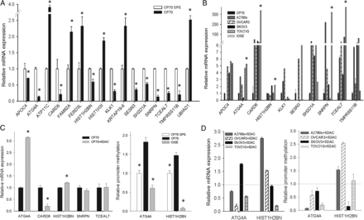
Figure 2. Verification of mRNA expression and DNA methylation of candidate genes in cell lines. (A) mRNA expression of ...
Notes:
Figure 2. Verification of mRNA expression and DNA methylation of candidate genes in cell lines. (A) mRNA expression of candidate genes in cancer cells (CP70) relative to TICs (CP70sps). (B) mRNA expression of candidate genes in various ovarian cell lines. DNA methylation of ATG4A, CARD6, HIST1H2BN, SNRPN and TCEAL7 in cancer cells have lower expression than the normal ovarian epithelium. (C) Reexpression of candidate genes in CP70 treated with 5-aza-2′-deoxycytidine (left). Methylation level of candidate genes in CP70, CP70sps and IOSE cells (right). (D) mRNA reexpression of candidate genes in ovarian cancer cell lines treated with 5-aza-2′-deoxycytidine. The y-axis indicates the change in mRNA expression (left). DNA demethylation of candidate genes in ovarian cancer cell lines treated with 5-aza-2′-deoxycytidine. The y-axis indicates the change in promoter methylation (right). The dotted line represents the mRNA and DNA methylation status of the original cell as a reference. *P < 0.05.
Unless provided in the caption above, the following copyright applies to the content of this slide: © The Author 2013. Published by Oxford University Press. All rights reserved. For Permissions, please email: journals.permissions@oup.com

Slide 3
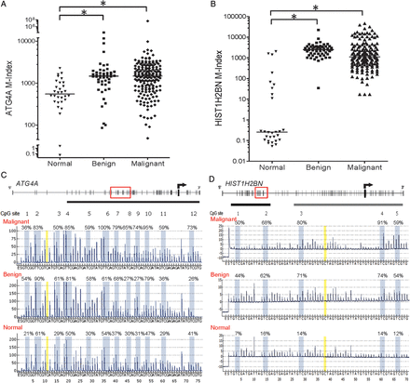
Figure 3. The promoter methylation status of ATG4A and HIST1H2BN in ovarian tissues. (A) ATG4A, (B) HIST1H2BN ...
Notes:
Figure 3. The promoter methylation status of ATG4A and HIST1H2BN in ovarian tissues. (A) ATG4A, (B) HIST1H2BN determined by qMSP in ovarian tissues. The M-index indicates the DNA methylation level estimated using the formula: 10 000 × 2[(Cp of COL2A) – (Cp of gene)]. (C) ATG4A, (D) HIST1H2BN representative methylation profile determined by pyrosequencing. The C base at nucleotide numbers 11 and 38 (marked in yellow) is a negative control for the assurance of complete bisulfite conversion. *P < 0.05.
Unless provided in the caption above, the following copyright applies to the content of this slide: © The Author 2013. Published by Oxford University Press. All rights reserved. For Permissions, please email: journals.permissions@oup.com

Slide 4
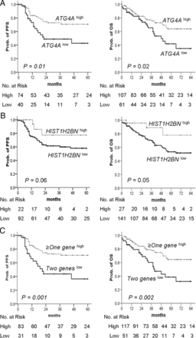
Figure 4. Kaplan–Meier plots of the probability of PFS and OS in ovarian cancer patients. (A–C) PFS (left) and OS ...
Notes:
Figure 4. Kaplan–Meier plots of the probability of PFS and OS in ovarian cancer patients. (A–C) PFS (left) and OS (right) stratified by the methylation status of (A) ATG4A and (B) HIST1H2BN are shown for ovarian cancer patients as estimated by Kaplan–Meier curves and the log-rank test. Straight line: high methylation; bold line: low methylation. (C) Two geneslow is defined as low methylation of both genes and ≥one geneshigh as high methylation of more than one gene. The clinical endpoint is indicated on the y-axis. PFS, progression-free survival; OS, overall survival; Prob., probability.
Unless provided in the caption above, the following copyright applies to the content of this slide: © The Author 2013. Published by Oxford University Press. All rights reserved. For Permissions, please email: journals.permissions@oup.com

Slide 5
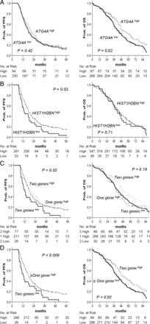
Figure 5. Kaplan–Meier plots of the probability of PFS and OS in TCGA ovarian cancer patients. (A–D) PFS (left) and OS ...
Notes:
Figure 5. Kaplan–Meier plots of the probability of PFS and OS in TCGA ovarian cancer patients. (A–D) PFS (left) and OS (right) stratified by the methylation status of (A) ATG4A and (B) HIST1H2BN are shown for ovarian cancer patients as estimated by Kaplan–Meier curves and the log-rank test. Straight line: high methylation; bold line: low methylation. (C) Two geneslow is defined as low methylation of both genes, one geneshigh as high methylation of any one gene, and two geneshigh as high methylation of both genes. (D) Two geneslow are defined as low methylation of both genes, ≥ one geneshigh as high methylation of more than one gene and ≥ one geneslow as low methylation of more than one gene. The clinical endpoint is indicated on the y-axis. PFS, progression-free survival; OS, overall survival; Prob., probability.
Unless provided in the caption above, the following copyright applies to the content of this slide: © The Author 2013. Published by Oxford University Press. All rights reserved. For Permissions, please email: journals.permissions@oup.com

Slide 6
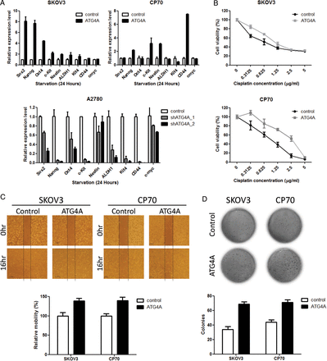
Figure 6. Effects of ATG4A on stem markers, drug resistance, cell migration and anchorage-independent growth in ovarian ...
Notes:
Figure 6. Effects of ATG4A on stem markers, drug resistance, cell migration and anchorage-independent growth in ovarian cancer cell lines. (A) The mRNA expression of the target genes was detected after 24 h of serum starvation. The expression of genes was measured by qRT-PCR and normalized to GAPDH levels. The relative levels of expression after qRT-PCR were compared with the vector control. Each bar represents the average of triplicate reactions ± SD. (B) The effect of ATG4A on the chemosensitivity of SKOV3 and CP70 cells to cisplatin was determined by MTS cytotoxicity assay. Cells were seeded on 96-well plates and treated with various concentrations of cisplatin for 3 days after 24 h of serum starvation. Cell numbers were determined by MTS assay and compared with untreated cells. Each bar represents the average of triplicate reactions ±SD. (C) The migration abilities of SKOV3 and CP70 cells were assayed after 24 h of serum starvation by wound-healing assay. Images were taken immediately after scratching the cultures (0 h) and 16 h later. The quantitation of wound healing was measured by ImageJ. The increased area of control was set as 100%. Data are presented as means ± SD. Three independent experiments were performed in triplicate. (D) The anchorage-independent growth of SKOV3 and CP70 cells was determined by soft agar assay after serum starvation for 24 h. The expression of ATG4A increased colony formation significantly in SKOV3 and CP70 cells. Each bar represents the average of triplicate reactions ±SD.
Unless provided in the caption above, the following copyright applies to the content of this slide: © The Author 2013. Published by Oxford University Press. All rights reserved. For Permissions, please email: journals.permissions@oup.com

