Slide 1
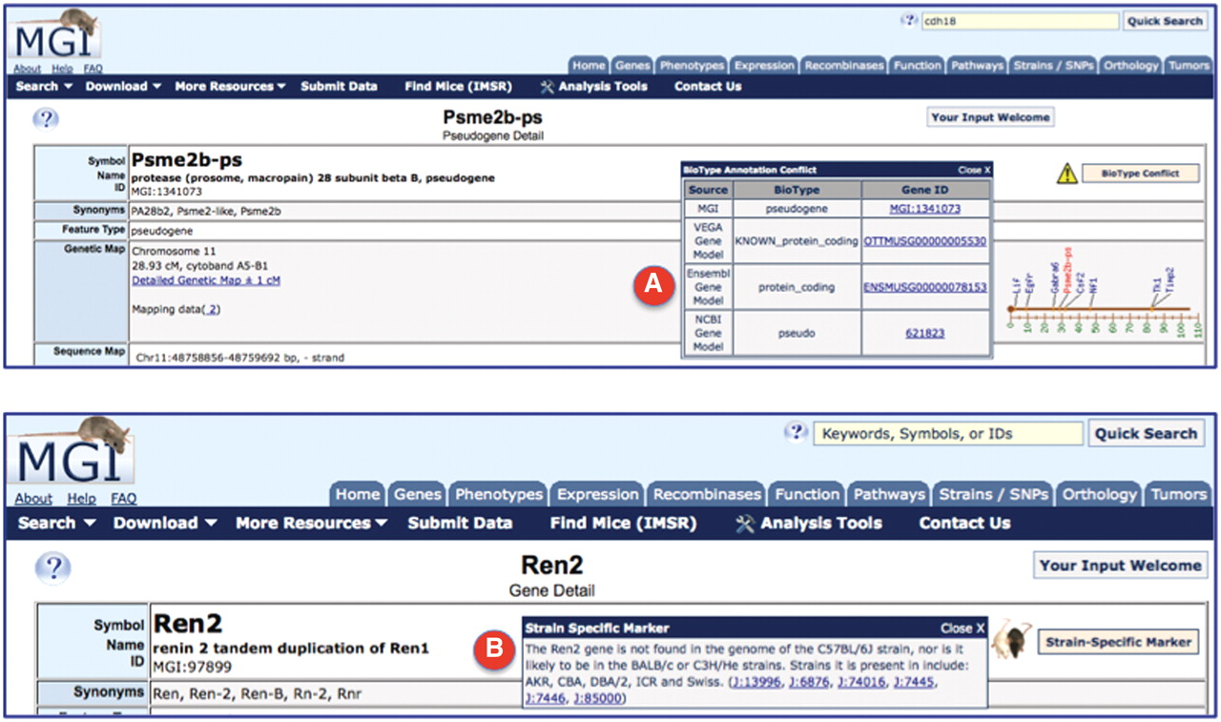
Figure 1. Screenshots of the upper portion of two locus detail pages. (A) The BioType Conflict indicator (upper right), ...
Notes:
Figure 1. Screenshots of the upper portion of two locus detail pages. (A) The BioType Conflict indicator (upper right), when opened, displays the different biotype annotations for Psme2b-ps. In this case, MGI and NCBI assign this marker as a pseudogene, where VEGA and Ensembl have assigned the status as protein coding gene. Links are provided to the underlying evidence that support the biotype assignments by different annotation groups. (B) The strain-specific marker indicator (upper right), when opened, displays information about strains in which the gene (in this case Ren2) is found or, not found, in the genome, with supporting reference links.
Unless provided in the caption above, the following copyright applies to the content of this slide: © The Author(s) 2011. Published by Oxford University Press.This is an Open Access article distributed under the terms of the Creative Commons Attribution Non-Commercial License (http://creativecommons.org/licenses/by-nc/3.0), which permits unrestricted non-commercial use, distribution, and reproduction in any medium, provided the original work is properly cited.

Slide 2
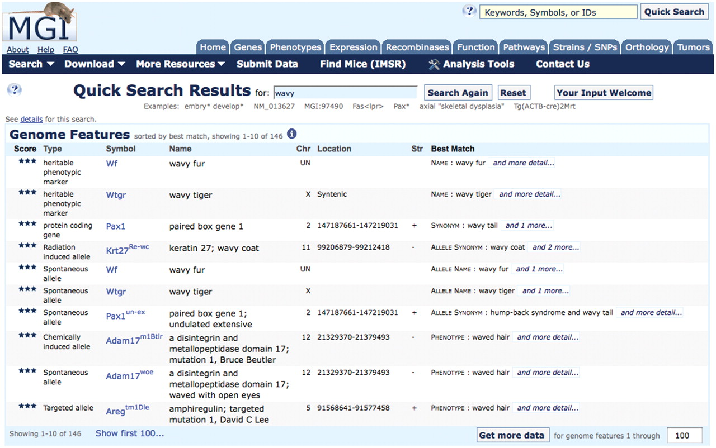
Figure 2. Screenshot of the results of querying for ‘wavy’ using the MGI Quick Search box. Note that heritable ...
Notes:
Figure 2. Screenshot of the results of querying for ‘wavy’ using the MGI Quick Search box. Note that heritable phenotypic markers that identify mutants whose underlying gene is not yet identified, such as Wf and Wtgr are retrieved, as well as genes (e.g. Pax1, with synonym of wavy tail), and other types of mutant alleles in defined genes (e.g. Pax1un-ex, undulated extensive mutation of the Pax1 gene).
Unless provided in the caption above, the following copyright applies to the content of this slide: © The Author(s) 2011. Published by Oxford University Press.This is an Open Access article distributed under the terms of the Creative Commons Attribution Non-Commercial License (http://creativecommons.org/licenses/by-nc/3.0), which permits unrestricted non-commercial use, distribution, and reproduction in any medium, provided the original work is properly cited.

