Slide 1
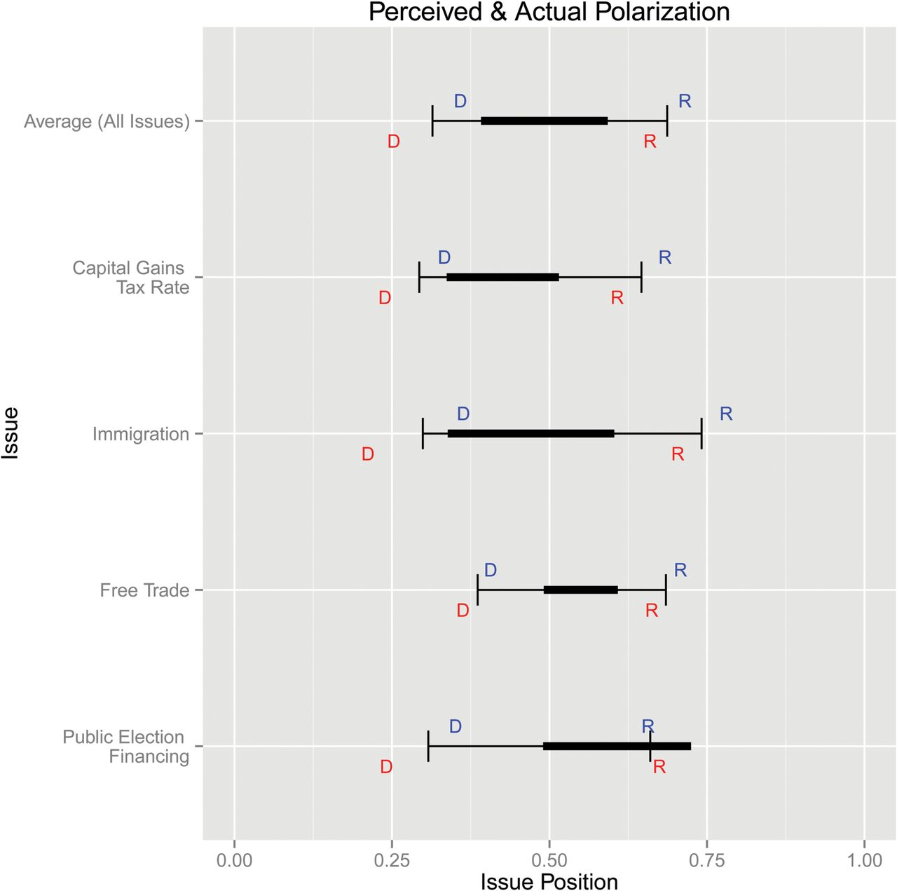
Figure 1. Perceived vs. Actual Polarization. The heavy black lines show the actual positions of Democrats and ...
Notes:
Figure 1. Perceived vs. Actual Polarization. The heavy black lines show the actual positions of Democrats and Republicans; the thin lines show the overall perceptions of Democrats and Republicans. Democrats’ perceptions of other Democrats are represented by the blue Ds above the line; Democrats’ perceptions of Republicans are represented by the blue Rs above the line; Republicans’ perceptions of Democrats are represented by the red Ds below the line; and Republicans’ perceptions of fellow Republicans are represented by the red Rs below the line. For a full-color version of the figure, please visit the POQ website.
Unless provided in the caption above, the following copyright applies to the content of this slide: © The Author 2015. Published by Oxford University Press on behalf of the American Association for Public Opinion Research. All rights reserved. For permissions, please e-mail: journals.permissions@oup.com

