Slide 1
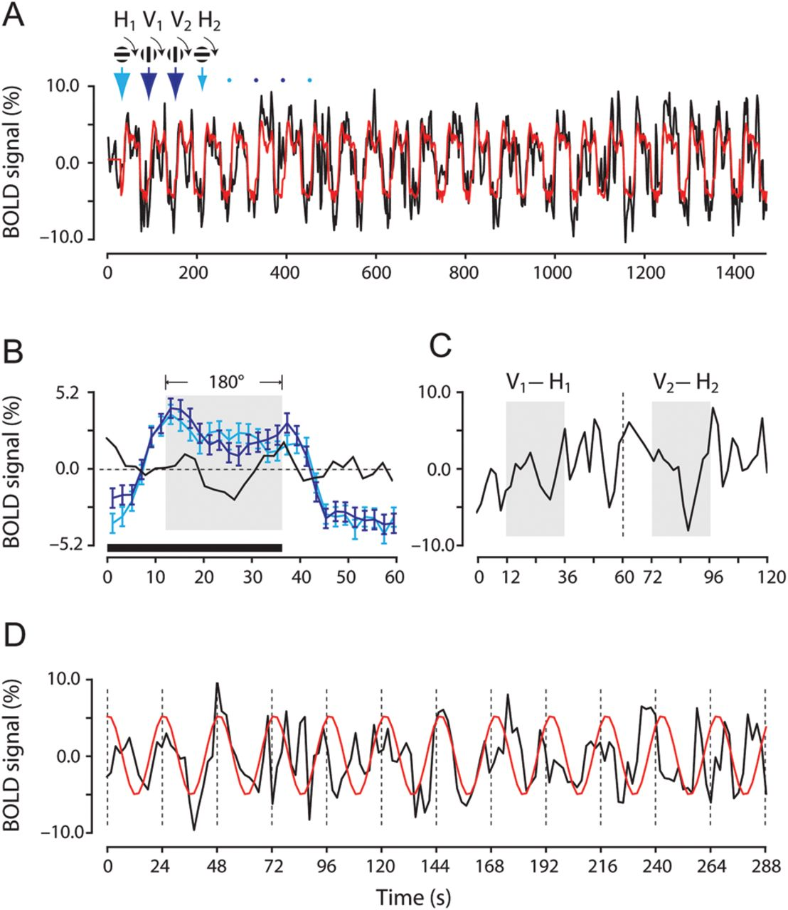
Figure 1. Orientation selectivity revealed by using a continuous and periodic stimulation paradigm and a differential ...
Notes:
Figure 1. Orientation selectivity revealed by using a continuous and periodic stimulation paradigm and a differential analysis method. (A) The raw and estimated time courses from a representative V1 voxel. The BOLD response was measured, while the subject viewed a grating that started to rotate either in horizontal (indicated by cyan arrows) or in vertical (blue arrows) orientation. Each rotation lasted 1.5 cycles, and critically, was followed by a 24 s blank period. A full-cycle (0–180°) rotation took 24 s and there were 12 repeats for each rotation condition in a functional scan. The initial orientation and rotation direction of the grating are schematically indicated above the time courses and the arrows point at the start times of individual rotations. (B) Estimated hemodynamic responses of the voxel to the grating that started to rotate in the horizontal (cyan) and vertical (blue) orientations, respectively. The black curve shows the difference between the 2 estimated hemodynamic responses (blue minus cyan curve). The horizontal bar indicates the stimulation period and the shaded area indicates the final full-cycle stimulation between 12 and 36 s. (C) Time course showing the difference between BOLD responses to the grating that started rotation from the vertical orientation (e.g. V1 and V2) and that to the grating that started rotation from the horizontal orientation (e.g. H1 and H2) for the first 2 pairs of gratings. Shaded areas indicate differential responses in the final full-cycle of rotation between 12 and 36 s. (D) The differential time course constructed by concatenating 12 truncated differential responses obtained in the final full-cycle. The red curve is the sinusoidal fit to the differential time course.
Unless provided in the caption above, the following copyright applies to the content of this slide: © The Authors 2012. Published by Oxford University Press.This is an Open Access article distributed under the terms of the Creative Commons Attribution Non-Commercial License (http://creativecommons.org/licenses/by-nc/2.5), which permits unrestricted non-commercial use, distribution, and reproduction in any medium, provided the original work is properly cited.

Slide 2
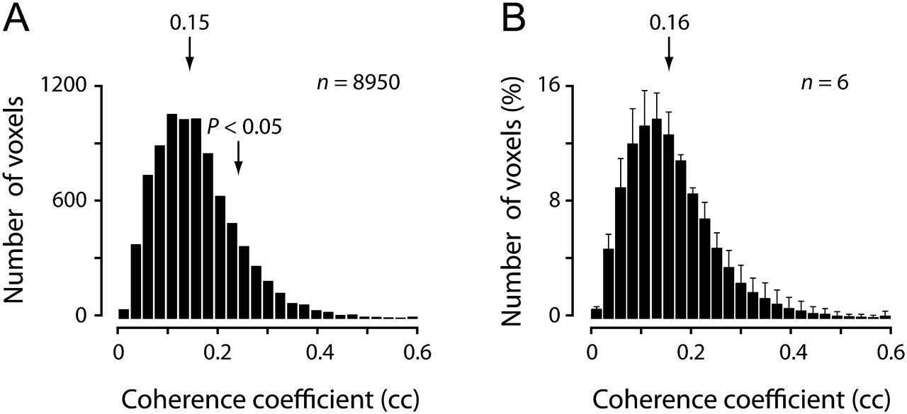
Figure 2. A voxel's orientation selectivity was assessed by its cc that reflects sinusoidal modulation at the ...
Notes:
Figure 2. A voxel's orientation selectivity was assessed by its cc that reflects sinusoidal modulation at the stimulation frequency. (A) Distribution of ccs of all voxels that responded significantly to the visual stimulation for a representative subject. Left arrow indicates the mean of the distribution and right arrow indicates the value of cc at P < 0.05. (B) Averaged distributions of ccs obtained from 6 subjects.
Unless provided in the caption above, the following copyright applies to the content of this slide: © The Authors 2012. Published by Oxford University Press.This is an Open Access article distributed under the terms of the Creative Commons Attribution Non-Commercial License (http://creativecommons.org/licenses/by-nc/2.5), which permits unrestricted non-commercial use, distribution, and reproduction in any medium, provided the original work is properly cited.

Slide 3
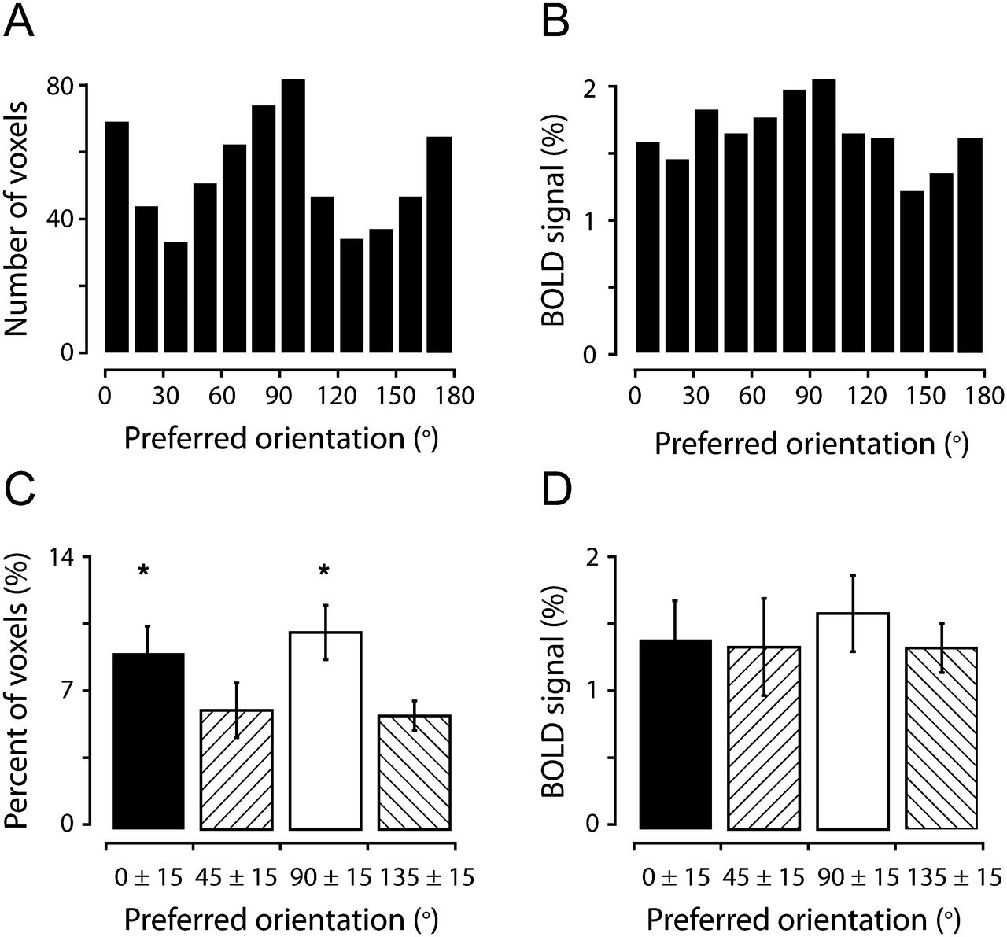
Figure 3. Horizontal and vertical orientations are over-represented in human V1. (A) The number of ...
Notes:
Figure 3. Horizontal and vertical orientations are over-represented in human V1. (A) The number of orientation-selective voxels plotted against the preferred orientation for a representative subject. (B) The averaged percent BOLD responses of voxels plotted against their preferred orientations. (C) Proportion of orientation-selective voxels preferring cardinal (around 0° and 90°) and oblique (around 45° and 135°) orientations across 6 subjects. Each bar represents pooled orientation preferences of single voxels in a 30° range, centered at 0°, 45°, 90°, or 135°. Voxels with an estimated preferred orientation at the borders between cardinal and oblique orientations (e.g. 15°–30°) were excluded in the analysis to avoid the possible overlap between the populations. (D) The averaged percent BOLD responses of voxels tuned to cardinal and oblique orientations, averaged across all 6 subjects. Error bars in C–D indicate 1 SD. *P < 0.05.
Unless provided in the caption above, the following copyright applies to the content of this slide: © The Authors 2012. Published by Oxford University Press.This is an Open Access article distributed under the terms of the Creative Commons Attribution Non-Commercial License (http://creativecommons.org/licenses/by-nc/2.5), which permits unrestricted non-commercial use, distribution, and reproduction in any medium, provided the original work is properly cited.

Slide 4
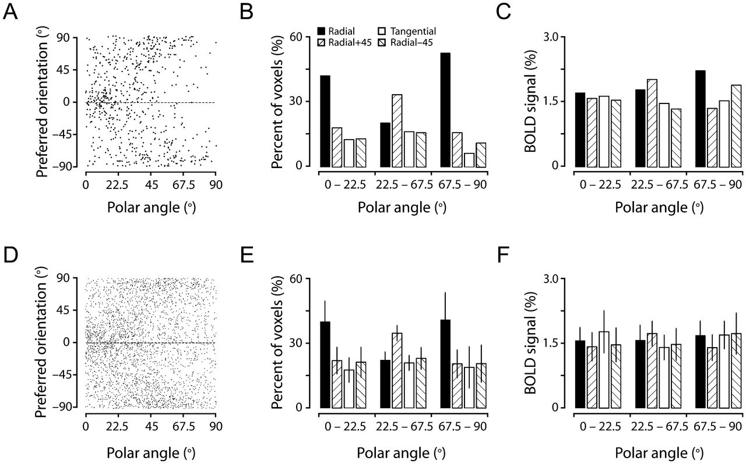
Figure 4. The radial bias manifested by the relationship between individual voxel orientation preferences and their ...
Notes:
Figure 4. The radial bias manifested by the relationship between individual voxel orientation preferences and their retinotopic polar angles. (A) Preferred orientations of the voxels from the same subject shown in Figure 3A plotted against their retinotopic polar angles. (B and C) Proportion and percent BOLD responses of the voxels classified into 1 of 4 categories of relationship between a voxel's preferred orientation at a given polar angle and the radial orientation expected for the polar angle, grouped in 3 ranges of polar angles. (D, E, and F) are the same as (A, B, and C), respectively, but are from the data pooled from all 6 subjects. Error bars in E and F indicate 1 SD. There were significant radial orientation biases for the voxels near horizontal- and vertical-meridians (E, see text for statistical details), but these biases were not significant in terms of percent BOLD responses (F).
Unless provided in the caption above, the following copyright applies to the content of this slide: © The Authors 2012. Published by Oxford University Press.This is an Open Access article distributed under the terms of the Creative Commons Attribution Non-Commercial License (http://creativecommons.org/licenses/by-nc/2.5), which permits unrestricted non-commercial use, distribution, and reproduction in any medium, provided the original work is properly cited.

Slide 5
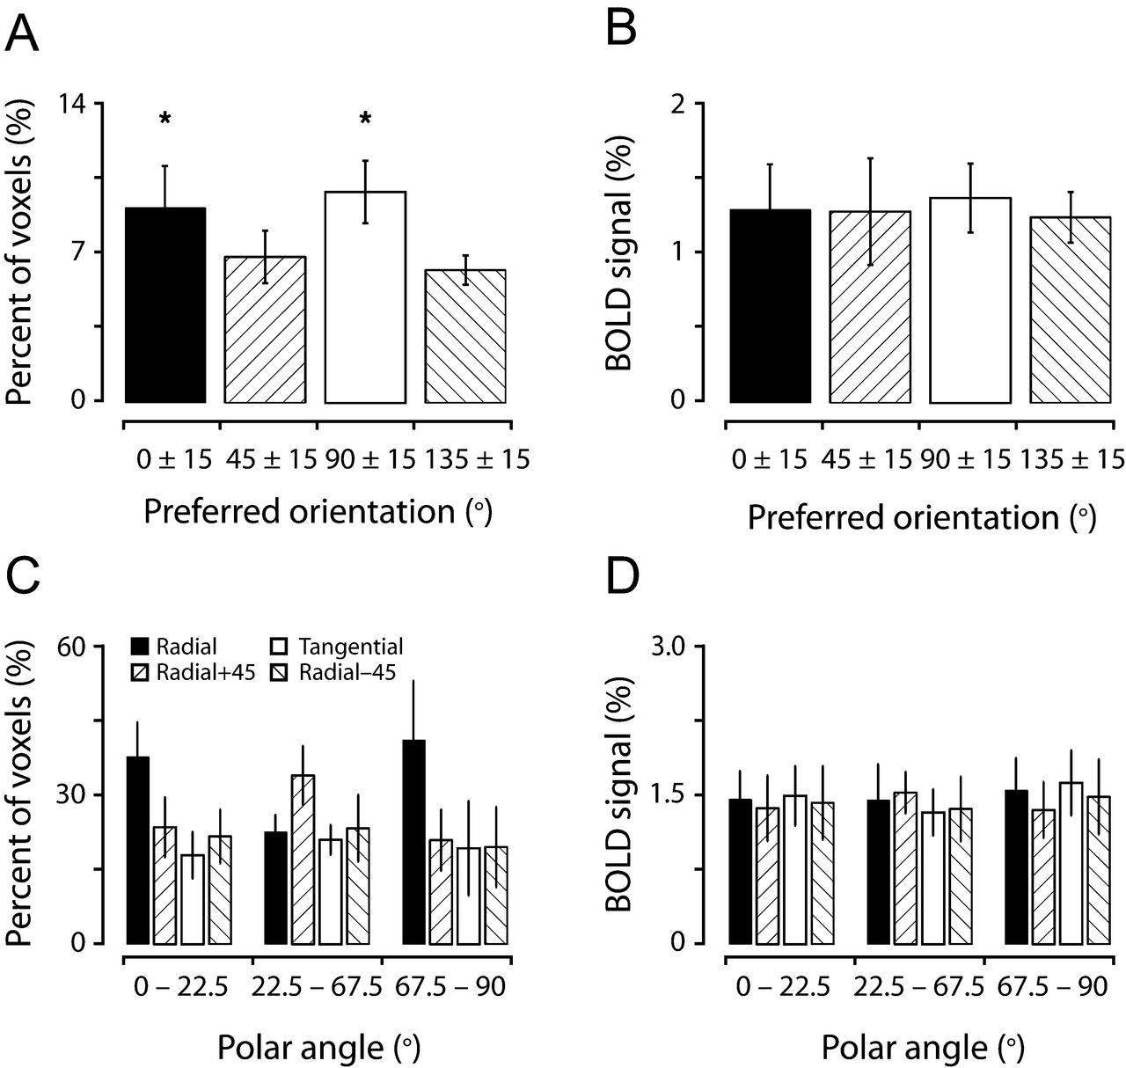
Figure 5. Preference for cardinal orientations and the radial bias are preserved after the removal of the voxels ...
Notes:
Figure 5. Preference for cardinal orientations and the radial bias are preserved after the removal of the voxels associated with large surface veins. The conventions in (A) and (B) are the same as in Figure 3C and D, respectively, and those in (C and D) are the same as in Figure 4E and F, respectively. In (C), a 2-way analysis of variance (ANOVA) revealed a main effect of orientation category and a significant interaction (P < 0.0001) between orientation category and polar angles. One-way ANOVA and multiple-comparison tests indicated that horizontal and vertical orientations were over-represented in horizontal- and vertical-meridians (P < 0.0005 and P < 0.005, respectively).
Unless provided in the caption above, the following copyright applies to the content of this slide: © The Authors 2012. Published by Oxford University Press.This is an Open Access article distributed under the terms of the Creative Commons Attribution Non-Commercial License (http://creativecommons.org/licenses/by-nc/2.5), which permits unrestricted non-commercial use, distribution, and reproduction in any medium, provided the original work is properly cited.

Slide 6
Figure 6. Discrimination thresholds of line orientations measured from 5 of the subjects who participated in the fMRI ...
Notes:
Figure 6. Discrimination thresholds of line orientations measured from 5 of the subjects who participated in the fMRI experiment. (A) Schematic drawing depicting measurement locations along the horizontal, vertical, and other principal oblique meridian locations at 2 eccentricities (4° and 8°). (B and C) Perceptual superiority, expressed by the inverse of the orientation discrimination threshold, was found for horizontal and vertical orientations throughout measurement locations at the eccentricity of either 4° (B) or 8° (C). The high sensitivity was particularly striking for the horizontal orientation near the horizontal meridian and the vertical orientation near the vertical meridian. Error bars in B and C indicate 1 SD.
Unless provided in the caption above, the following copyright applies to the content of this slide: © The Authors 2012. Published by Oxford University Press.This is an Open Access article distributed under the terms of the Creative Commons Attribution Non-Commercial License (http://creativecommons.org/licenses/by-nc/2.5), which permits unrestricted non-commercial use, distribution, and reproduction in any medium, provided the original work is properly cited.

