Slide 1
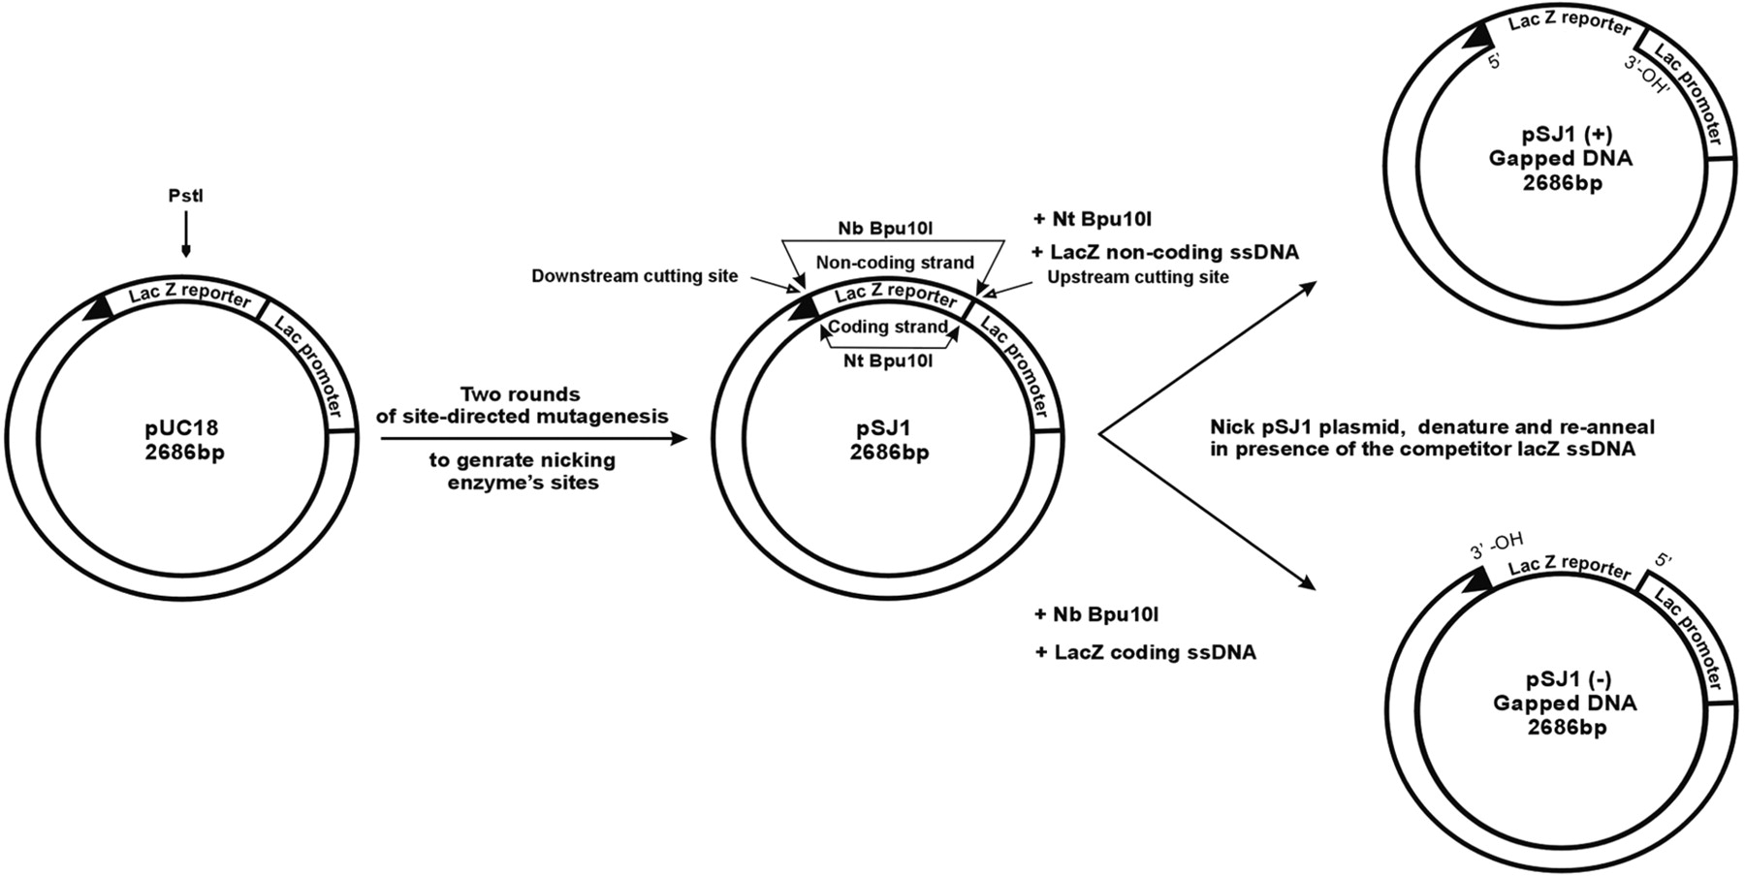
Figure 1. Gapped plasmids for measuring DNA polymerase fidelity. Site-directed mutagenesis is used to flank the lacZα ...
Notes:
Figure 1. Gapped plasmids for measuring DNA polymerase fidelity. Site-directed mutagenesis is used to flank the lacZα gene in pUC18 with sites for two related nicking endonucleases, Nt and Nb Bpu10I. Cutting the resulting pSJ1 with these nucleases liberates either the coding or non-coding strand to give pSJ1(+) and pSJ1(–). To completely remove the excised strand from the gapped plasmid it is necessary to add competitor DNA, complementary to the excised region. The unique PstI restriction site is important for analysis and purification.
Unless provided in the caption above, the following copyright applies to the content of this slide: © 2009 The Author(s)This is an Open Access article distributed under the terms of the Creative Commons Attribution Non-Commercial License (http://creativecommons.org/licenses/by-nc/2.0/uk/) which permits unrestricted non-commercial use, distribution, and reproduction in any medium, provided the original work is properly cited.

Slide 2
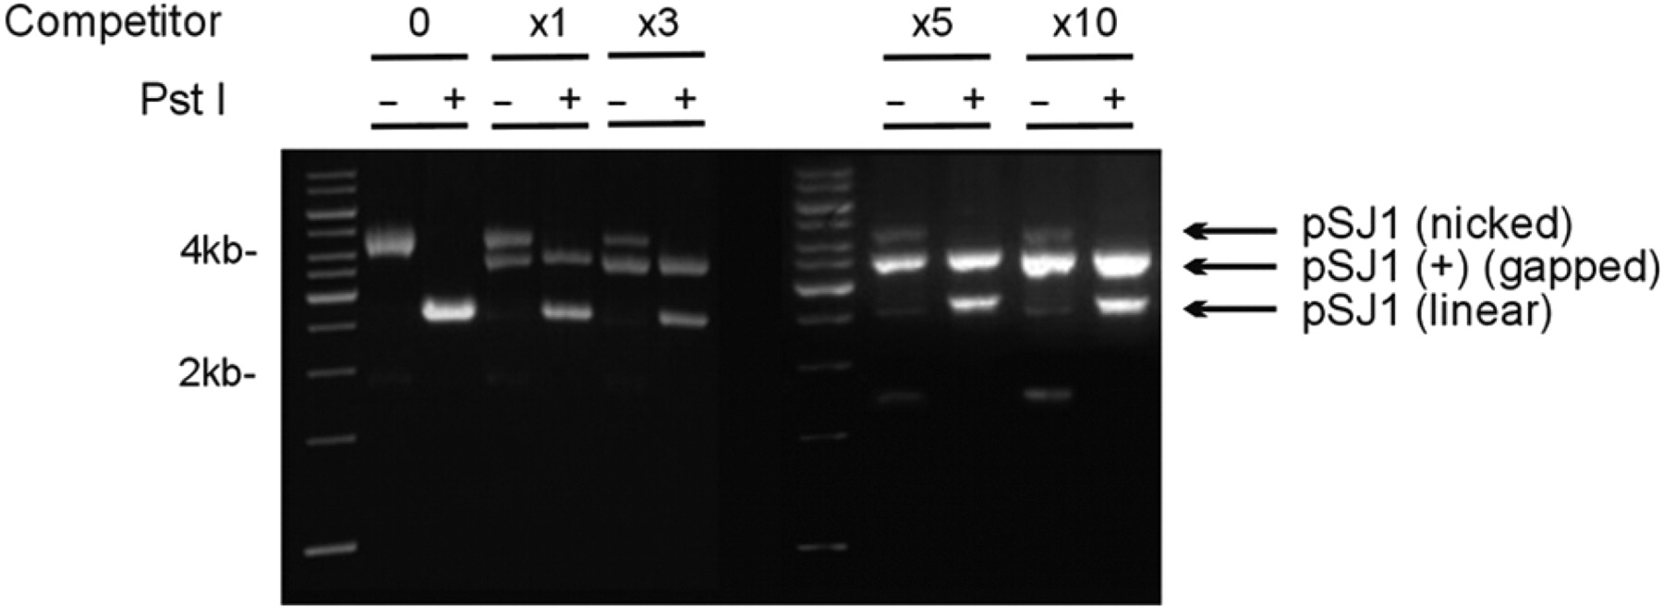
Figure 2. Preparation and purification of pSJ1(+). Gel electrophoretic analysis of pSJ1 following treatment with Nt ...
Notes:
Figure 2. Preparation and purification of pSJ1(+). Gel electrophoretic analysis of pSJ1 following treatment with Nt Bpu10I. In the absence of competitor DNA (lanes marked 0) a nicked plasmid, where the excised strand remains associated with the plasmid by Watson–Crick interactions, is produced. Cutting with PstI gives a linear plasmid as the PstI site remains in a double-stranded region. Adding increasing amounts of competitor (excess over plasmid denoted by x1, x3, x5 and x10) progressively gives more of the desired gapped pSJ1(+) at the expense of the nicked intermediate. Treatment with PstI destroys any remained nicked plasmid but not the gapped pSJ1(+) as, in this case, the PstI site is in a single-stranded DNA region.
Unless provided in the caption above, the following copyright applies to the content of this slide: © 2009 The Author(s)This is an Open Access article distributed under the terms of the Creative Commons Attribution Non-Commercial License (http://creativecommons.org/licenses/by-nc/2.0/uk/) which permits unrestricted non-commercial use, distribution, and reproduction in any medium, provided the original work is properly cited.

Slide 3
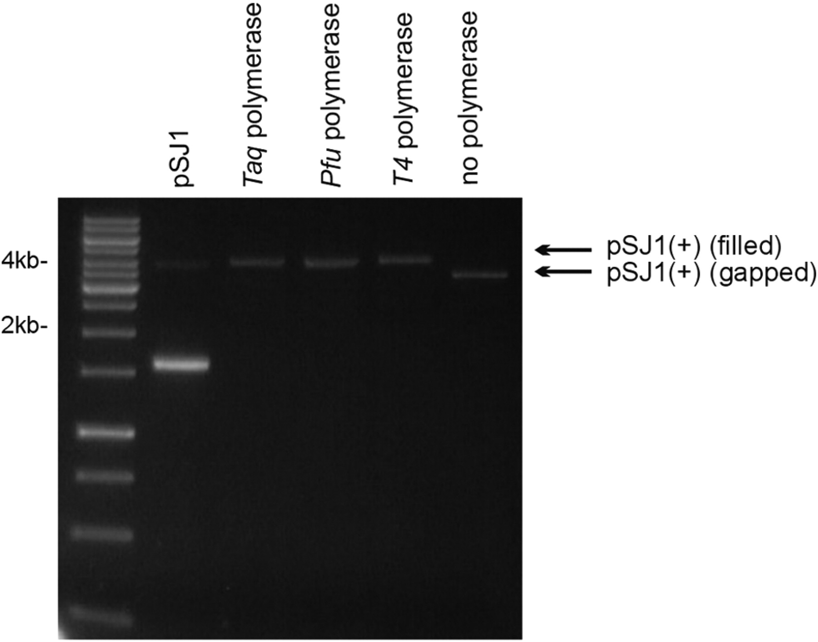
Figure 3. Copying pSJ1(+) with DNA polymerases. A standard is provided by pSJ1, which mainly runs as the supercoiled ...
Notes:
Figure 3. Copying pSJ1(+) with DNA polymerases. A standard is provided by pSJ1, which mainly runs as the supercoiled form (prominent fast migrating band) but with traces of the open-circle form due to the presence on nicks. The starting gapped pSJ1(+) (no polymerase) is also show. Treatment with Taq, Pfu and T4 polymerase results in copying of the single stranded region of pSJ1(+) to give a filled derivative, running, as expected, with mobility identical to the open circle form of pSJ1.
Unless provided in the caption above, the following copyright applies to the content of this slide: © 2009 The Author(s)This is an Open Access article distributed under the terms of the Creative Commons Attribution Non-Commercial License (http://creativecommons.org/licenses/by-nc/2.0/uk/) which permits unrestricted non-commercial use, distribution, and reproduction in any medium, provided the original work is properly cited.

