Slide 1
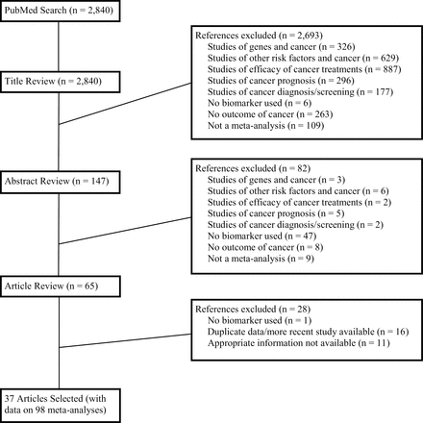
Figure 1. Flow diagram of the study selection process
Notes:
Figure 1. Flow diagram of the study selection process
Unless provided in the caption above, the following copyright applies to the content of this slide: © The Author 2012. Published by Oxford University Press. All rights reserved. For Permissions, please e-mail: journals.permissions@oup.com.

Slide 2
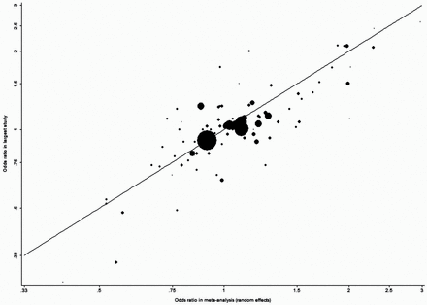
Figure 2. Odds ratio in each meta-analysis (random effects summary estimate) and in the largest study on each ...
Notes:
Figure 2. Odds ratio in each meta-analysis (random effects summary estimate) and in the largest study on each association. The size of each point is proportional to the weight of the evidence (inverse of the variance) of the largest study in each meta-analysis.
Unless provided in the caption above, the following copyright applies to the content of this slide: © The Author 2012. Published by Oxford University Press. All rights reserved. For Permissions, please e-mail: journals.permissions@oup.com.

