Slide 1
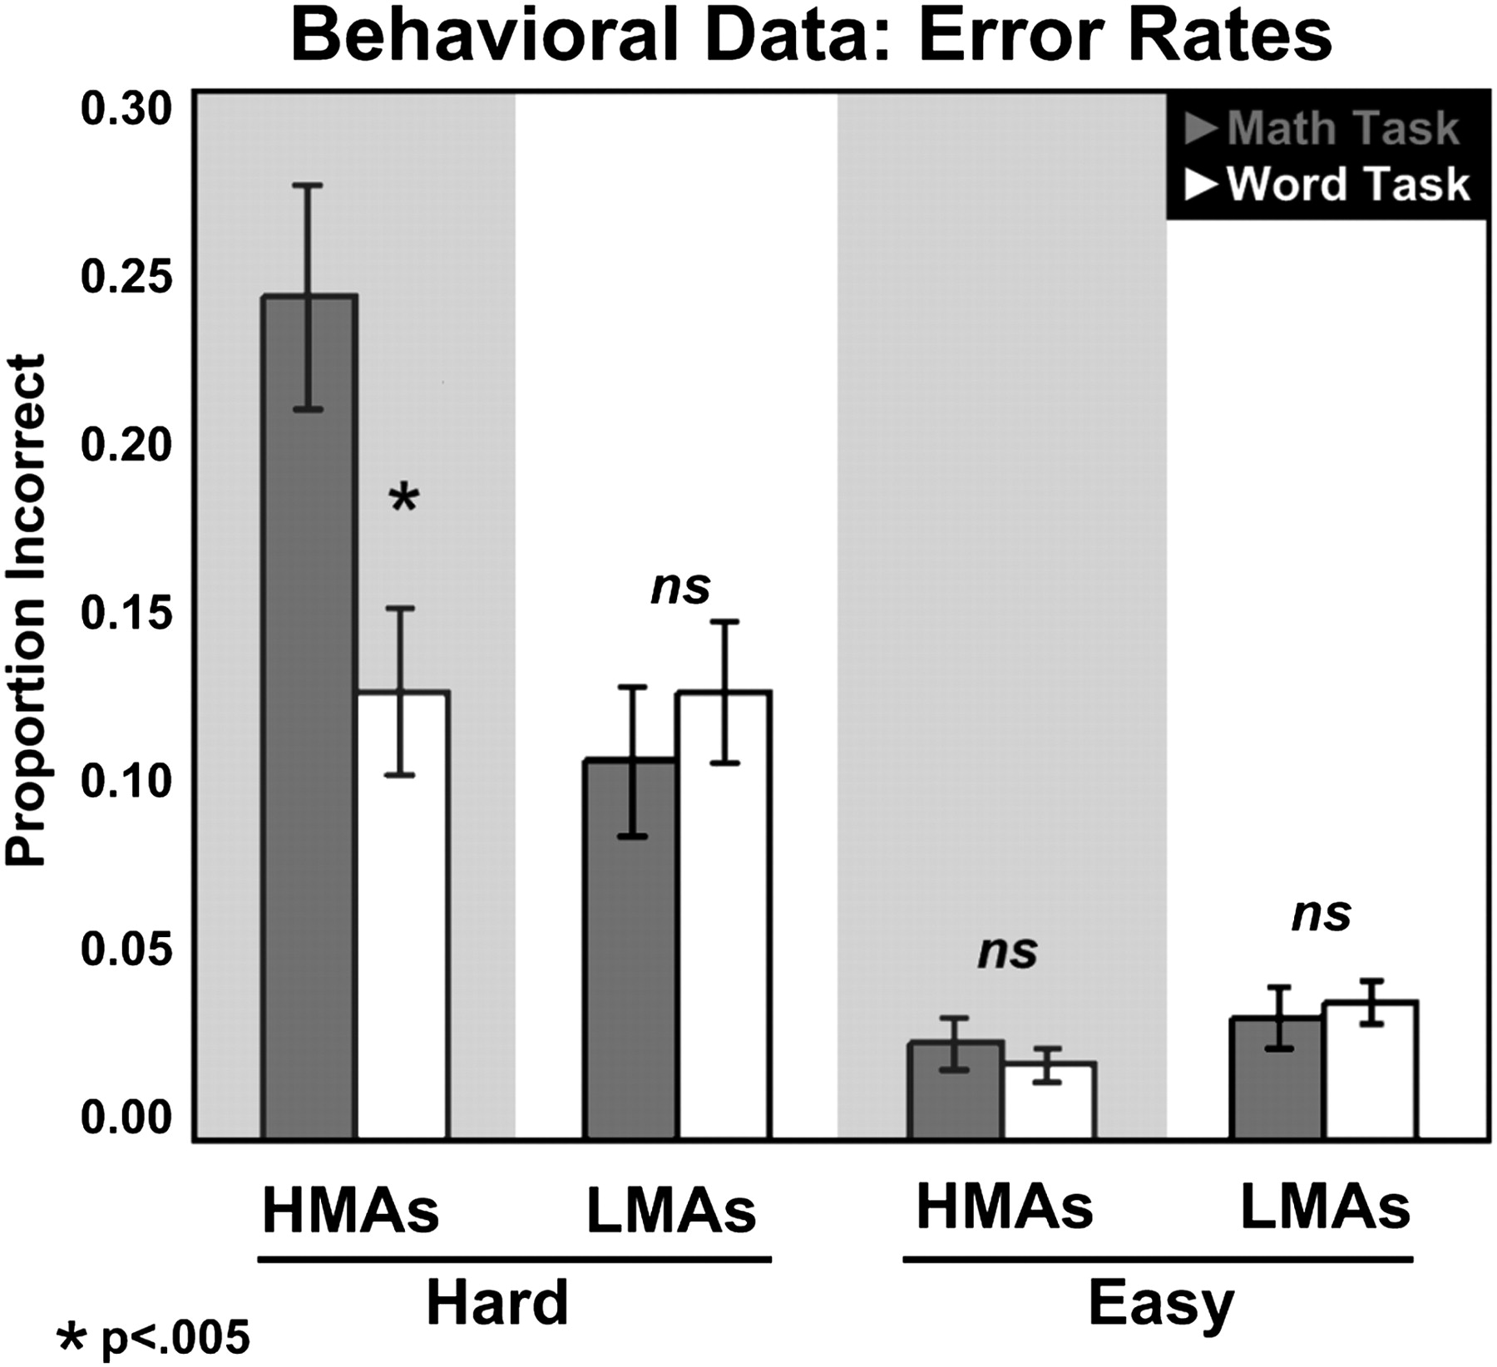
Figure 1. Behavioral results: error bars indicate standard errors of the mean. Note that only HMAs showed a significant ...
Notes:
Figure 1. Behavioral results: error bars indicate standard errors of the mean. Note that only HMAs showed a significant difference between tasks (more errors on the math task).
Unless provided in the caption above, the following copyright applies to the content of this slide: © The Author 2011. Published by Oxford University Press. All rights reserved. For permissions, please e-mail: journals.permissions@oup.com

Slide 2
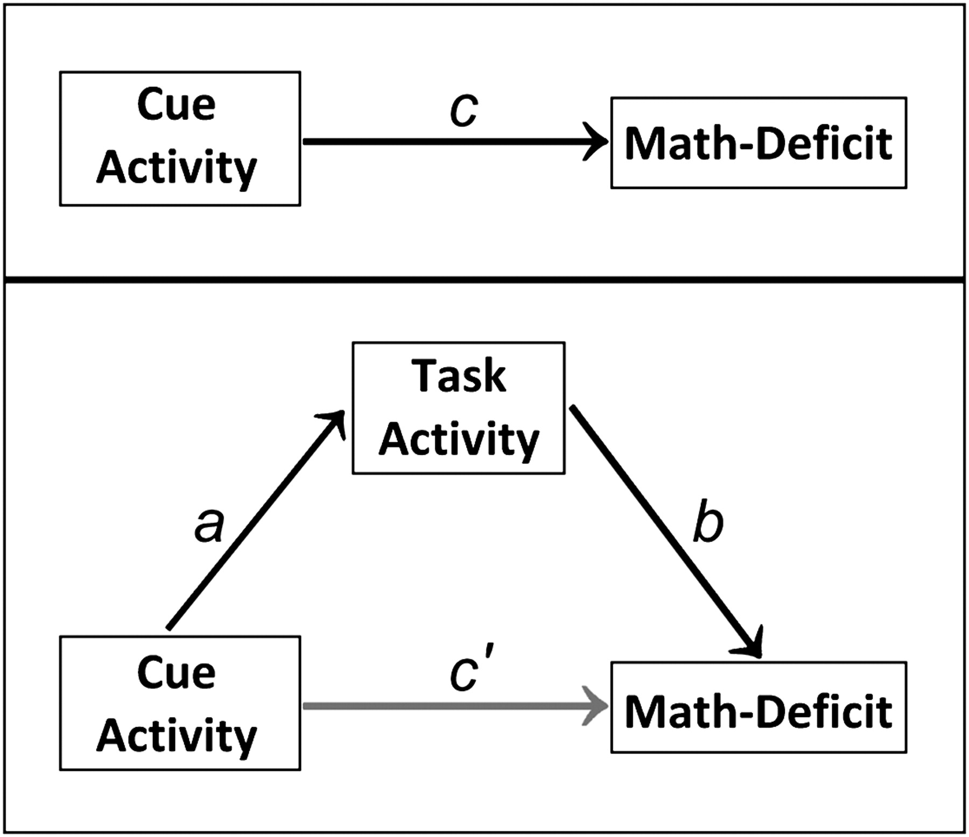
Figure 4. Mediation framework: we tested whether task activity in regions identified in Analysis 2 mediated the ...
Notes:
Figure 4. Mediation framework: we tested whether task activity in regions identified in Analysis 2 mediated the relationship c between math deficits and cue activity in regions identified in Analysis 1. In this framework, one asks whether there is a significant indirect effect of the mediator (quantified as the product of the unstandardized path coefficients, a and b, in the figure above) that accounts for some portion of the direct effect c originally observed between the independent (in this case, cue activity) and the dependent (in this case, math deficit) variables. When more than one mediator is considered at a time, the total mediating influence is the sum of the products aibi, for i = 1 … n mediators. The remaining (unmediated) direct effect is denoted c'. Full mediation occurs when ab is significant but c' is not; partial mediation refers to when both ab and c' remain significant. Note that in this framework, the model is constrained by the assumption that c = ab + c'. In other words, unlike in a standard multiple regression analysis, we are explicitly asking what portion of the IV–DV (cue activity–math deficit) relationship can be accounted for by the proposed mediating variable (task activity).
Unless provided in the caption above, the following copyright applies to the content of this slide: © The Author 2011. Published by Oxford University Press. All rights reserved. For permissions, please e-mail: journals.permissions@oup.com

Slide 3
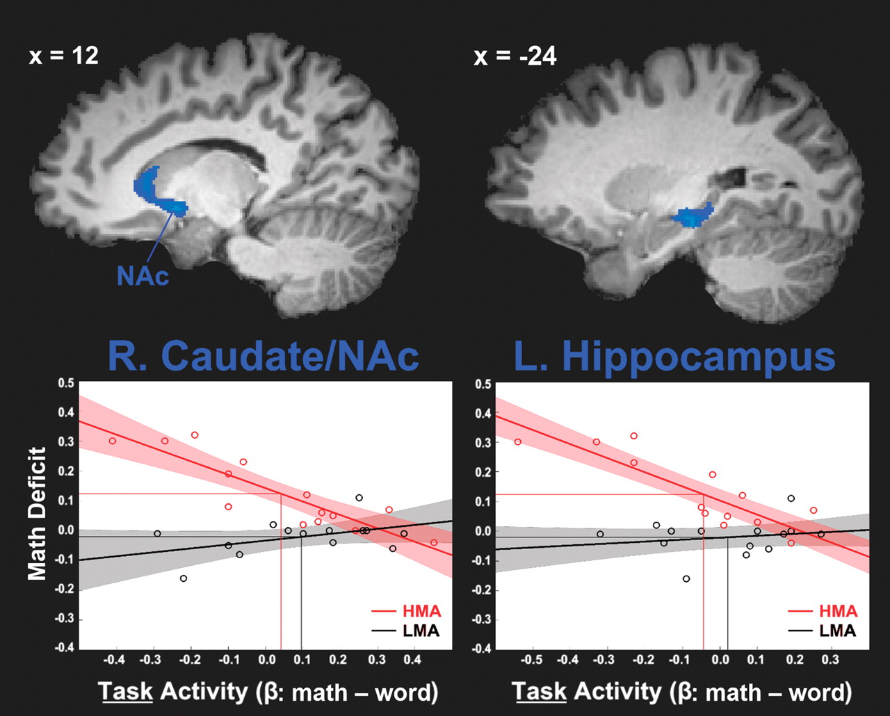
Figure 3. Analysis 2 regions and scatter plots. Note that the right caudate region spans both the medial head of the ...
Notes:
Figure 3. Analysis 2 regions and scatter plots. Note that the right caudate region spans both the medial head of the caudate and nucleus accumbens (NAc). Shaded areas in the scatter plots represent 95% confident intervals (observed) for the fitted linear regression line. Y-axis: math-deficits (higher number = higher math [relative to word] error rate).
Unless provided in the caption above, the following copyright applies to the content of this slide: © The Author 2011. Published by Oxford University Press. All rights reserved. For permissions, please e-mail: journals.permissions@oup.com

Slide 4
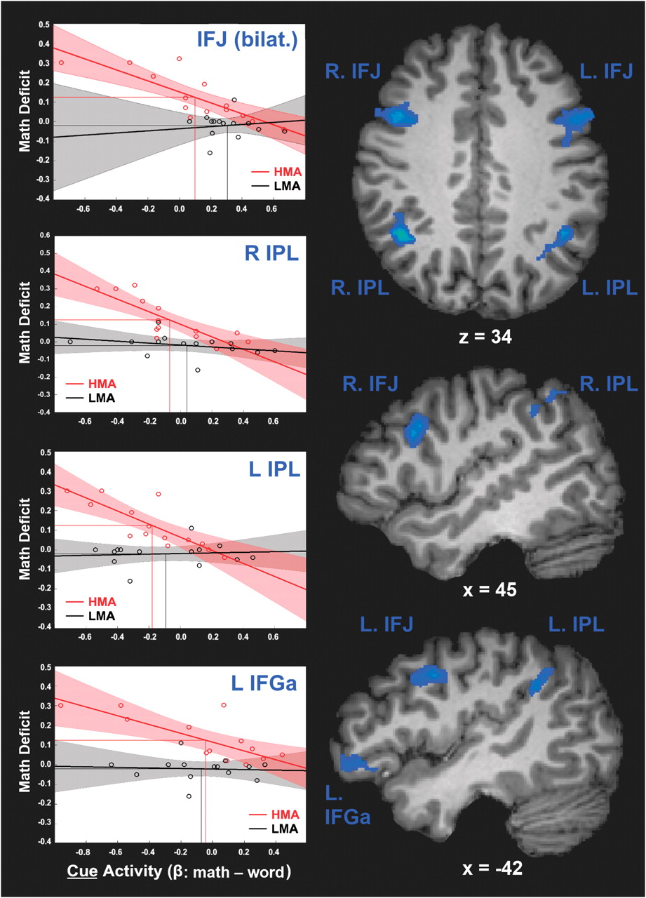
Figure 2. Depiction of regions and scatter plots from Analysis 1. No effects of hemisphere were found for IFJ regions; ...
Notes:
Figure 2. Depiction of regions and scatter plots from Analysis 1. No effects of hemisphere were found for IFJ regions; thus data are averaged across the 2 hemispheres in the scatter plot above. Shaded areas in the scatter plots represent 95% confident intervals (observed) for the fitted linear regression line. MC, math cue; WC, word cue. Y-axis: math deficits (higher number = higher math [relative to word] error rate).
Unless provided in the caption above, the following copyright applies to the content of this slide: © The Author 2011. Published by Oxford University Press. All rights reserved. For permissions, please e-mail: journals.permissions@oup.com

