Slide 1
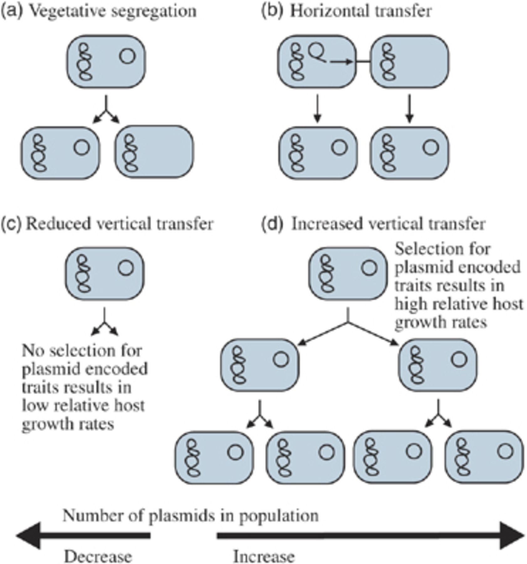
1 Plasmid survival, spread or demise is dictated by the combined rates of transmission processes (a, b) and ...
Notes:
1 Plasmid survival, spread or demise is dictated by the combined rates of transmission processes (a, b) and selection processes (c, d). Plasmids will only be stably maintained in a population if rates of loss, via vegetative segregation (a) and negative effects on host growth rate due to the fitness costs associated with plasmid carriage (c), are at least equalled by rates of gain, via horizontal transfer (b) and positive effects on host growth rate due to plasmid-encoded beneficial phenotypes (d).
Unless provided in the caption above, the following copyright applies to the content of this slide: © 2008 Federation of European Microbiological Societies

Slide 2
2 In total, 980 bacterial plasmids from the Plasmid Genome Database (http://www.genomics.ceh.ac.uk/plasmiddb/) ...
Notes:
2 In total, 980 bacterial plasmids from the Plasmid Genome Database (http://www.genomics.ceh.ac.uk/plasmiddb/) were binned according to size: 0–25, 25–50, 50–100 and >100 kb; and host environment: animal including animal products, e.g. milk and faeces (blue), nonanimal (green) and unknown (yellow). Of the 156 large plasmids (>100 kb), more were from nonanimal- (71.15%) than animal- (27.56%) associated hosts with the remainder unknown (1.28%). This is significantly different from the proportions in the total data set, where more were from animal- (55.20%) than nonanimal- (32.86%) associated hosts with the remainder unknown (11.94%) (χ2=67.99, P<0.0005). Of the 111 large plasmids from nonanimal-associated environments, 65.77% were from terrestrial (bright green) and 27.03% were from aquatic (mid green) environments with 7.21% unknown (light green). Of the 110 plasmids in the 50–100-kb size range, 45.95% were from terrestrial and 32.43% were from aquatic environments with 21.62% unknown.
Unless provided in the caption above, the following copyright applies to the content of this slide: © 2008 Federation of European Microbiological Societies

