Slide 1
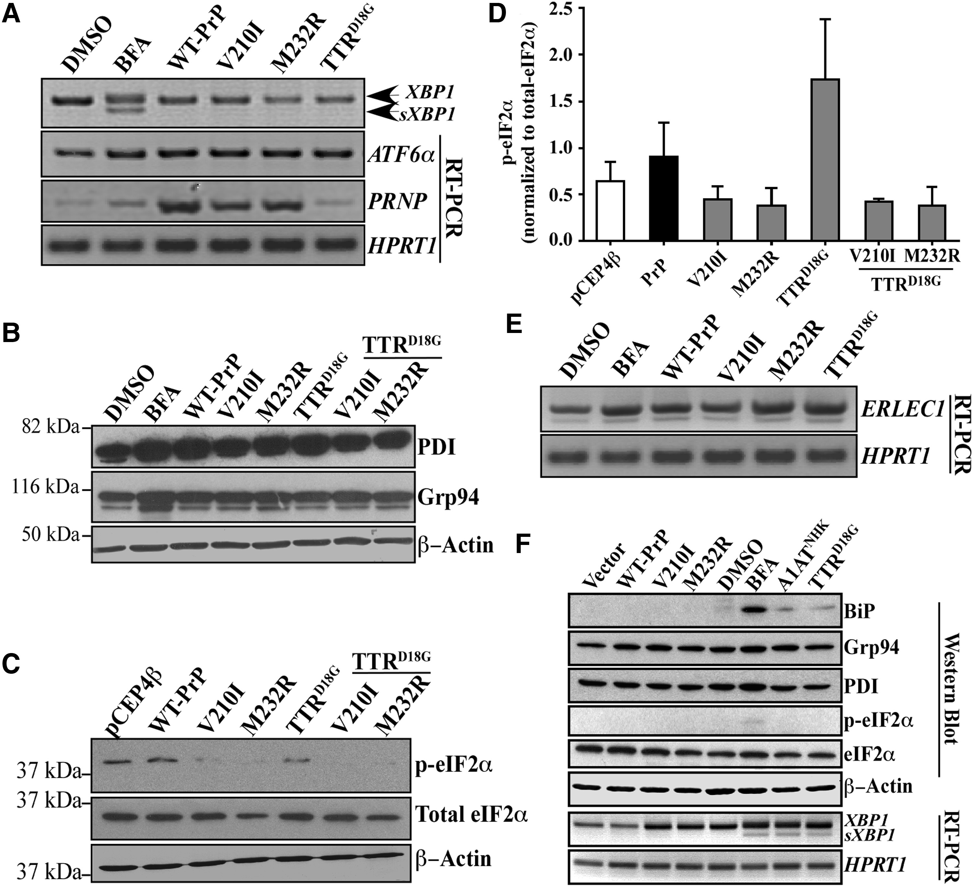
Figure 4. Familial PrP mutants inhibit eIF2α phosphorylation but, otherwise do not activate the unfolded protein ...
Notes:
Figure 4. Familial PrP mutants inhibit eIF2α phosphorylation but, otherwise do not activate the unfolded protein response. (A) Ethidium bromide agarose gel of XBP1, splice XBP1 (sXBP1), ATF6α, PRNP and HPRT1 amplicons obtained by RT-PCR from CR7 cells treated with DMSO, 5 µg/ml BFA or transfected with either WT-PrP, PrP-V210I129V, -M232R129V or mutant TTRD18G. (B) Western blot analysis with anti-PDI, anti-Grp94 and anti-β-actin. (C) Western blot analysis with anti-p-eIF2α, anti-eIF2α and anti-β-actin in transfected CR7 cells. (D) Densitometry quantitation of the levels of p-eIF2α relative to total eIF2α. Data represent the mean ± SEM of three independent experiments and are analyzed by one-way ANOVA followed by Tukey's post hoc tests. (E) Ethidium bromide-stained agarose gel of ERLEC1 and HPRT1 amplicons obtained by RT-PCR from CR7 cells transfected with WT PrP, mutant PrP or TTRD18G (no epoxomicin nor BFA in transfected cells). (F) Western blot analyses and RT-PCR from proteins and RNA extracts of SK-N-SH neuroblastoma cells transfected with WT PrP and mutant PrP, A1ATNHK, TTRD18G or treated with BFA.
Unless provided in the caption above, the following copyright applies to the content of this slide: © The Author 2016. Published by Oxford University Press. All rights reserved. For Permissions, please email: journals.permissions@oup.com

Slide 2
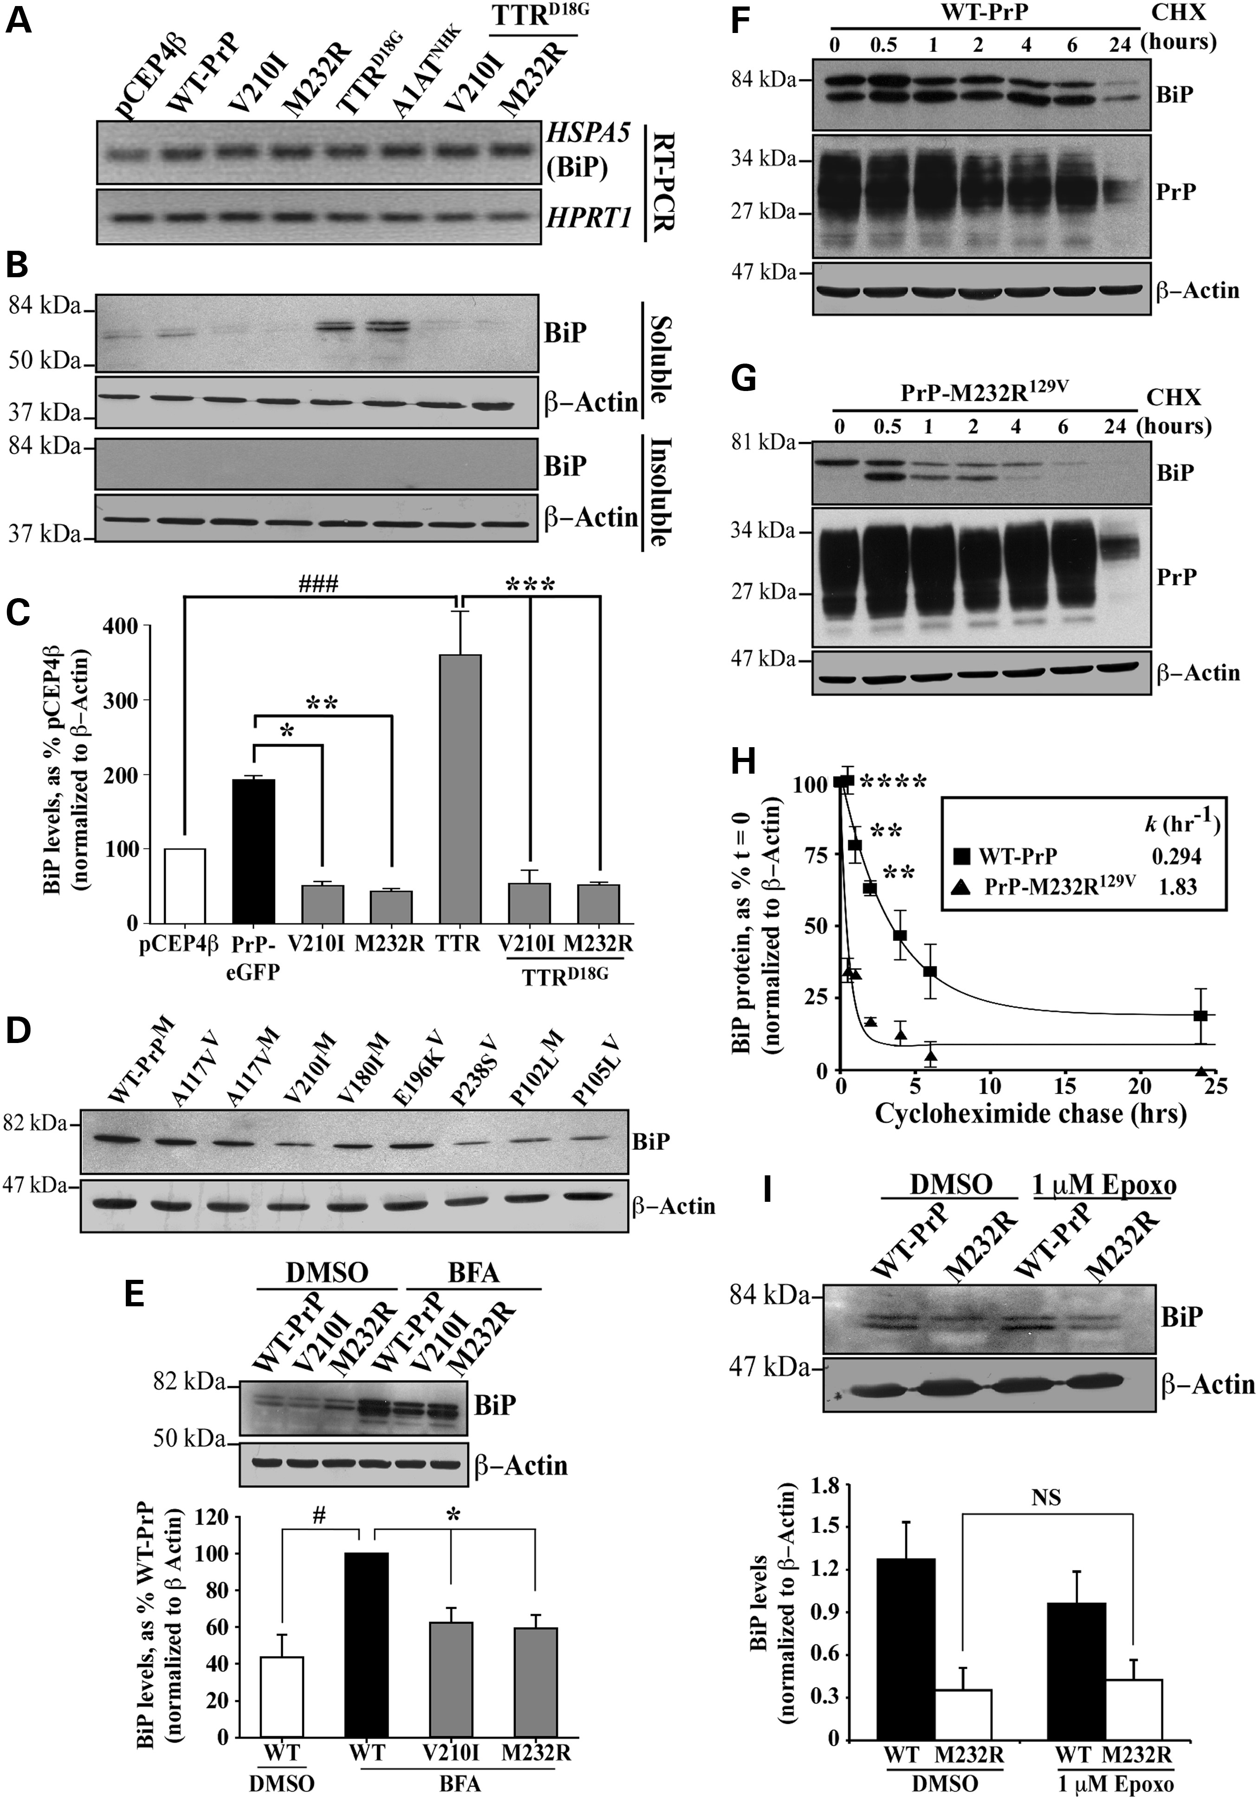
Figure 3. Familial PrP suppress the levels of unfolded protein response protein BiP. (A) Ethidium bromide-stained ...
Notes:
Figure 3. Familial PrP suppress the levels of unfolded protein response protein BiP. (A) Ethidium bromide-stained agarose gel of HSPA5 (BiP) and HPRT1 amplicons obtained by RT-PCR. (B) Western blot analysis with anti-BiP and anti-β-actin in CR7 cells transfected with WT-PrP, PrP-V210I129V or -M232R129V, TTRD18G-GFP and A1ATNHK-GFP either alone or co-transfected with PrP mutants (order is as depicted in A). Top and bottom panels represent detergent soluble and insoluble proteins, respectively. (C) Densitometry quantification of BiP protein levels presented in Figure 3B. ###P < 0.001, relative to pCEP4β and *P < 0.05, **P < 0.01 and ***P < 0.001, relative to WT-PrP-EGFP or TTRD18G. (D) Western blot with anti-BiP and β-actin of proteins extracted from CR7 cells transfected with WT PrP or different mutant PrPs. (E) Western blot analysis with anti-BiP and anti-β-actin in CR7 cells transfected with WT-PrP or mutant PrP and treated with either DMSO or BFA presented with corresponding quantification by densitometry of BiP protein levels. (F,G) Western blots with anti-BiP, anti-PrP 3F4 or anti-β-actin of proteins extracted from WT-PrP (F) or PrP-M232R (G) transfected cells treated with cycloheximide for the indicated times. (H) Kinetic analysis of BiP degradation following inhibition of total protein synthesis with 0.75 μg/ml cycloheximide in CR7 cells expressing WT-PrP or PrP-M232R129V PrP for 24 h. Graph represents an exponential decay plot for the degradation of BiP with respect to time. (I) Western blot analysis of anti-BiP and anti-β-actin in cells transfected with WT-PrP or PrP-M232R129V followed by treatment with 1 μM epoxomicin or DMSO. Data are presented with quantification of band intensities by densitometry. All graphed data represent the mean ± SEM of at least three independent experiments and were analyzed using one-way ANOVAs followed by Tukey's post-tests.
Unless provided in the caption above, the following copyright applies to the content of this slide: © The Author 2016. Published by Oxford University Press. All rights reserved. For Permissions, please email: journals.permissions@oup.com

Slide 3
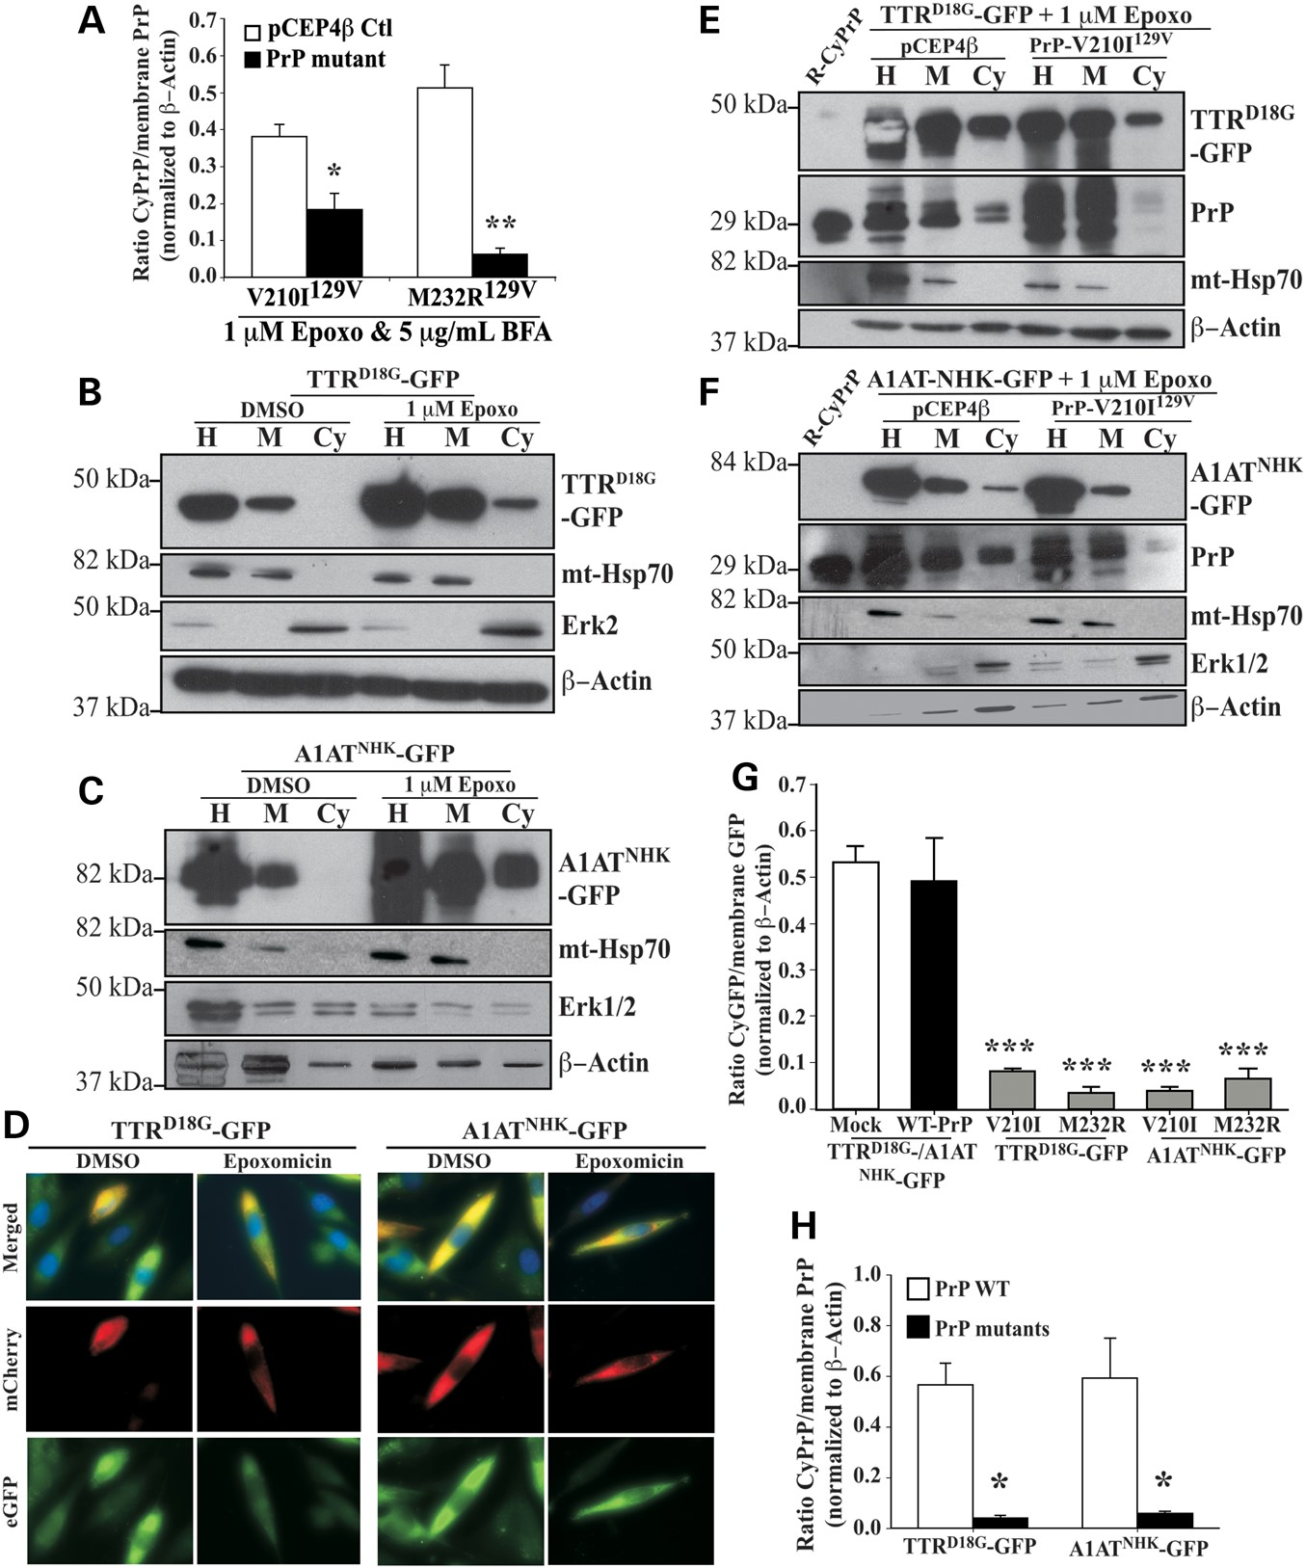
Figure 2. Familial PrP mutants inhibit retrotranslocation of both endogenous cellular PrP and other ERAD substrates. ...
Notes:
Figure 2. Familial PrP mutants inhibit retrotranslocation of both endogenous cellular PrP and other ERAD substrates. (A) Quantification by densitometry of western blot analyses of CyPrP levels relative to membrane PrP levels in CR7 cells transfected with pCEP4β-empty, pCEP4β-PrP-V210I129V or -PrP-M232R129V and subjected to the subcellular fractionation. Data are depicted as a ratio of CyPrP relative to membrane PrP after normalizing to actin levels. *P < 0.05, **P < 0.01 (B,C) Western blot analysis with anti-GFP, anti-mt-Hsp70, anti-Erk1/2 and anti-β Actin in CR7 cells transfected with pcDNA3.1(-)-TTRD18G-GFP or pcDNA3.1(-)-A1ATNHK-GFP and subjected to subcellular fractionation. Proteins were loaded as in Figure 1A. (D) Fluorescence microscopy of CR7 cells co-transfected with mCherry-ER and TTRD18G-GFP or A1ATNHK-GFP treated with DMSO or epoxomicin. Nuclear DNA is identified using Hoechst staining. (E,F) Western blot analysis with anti-GFP, anti-PrP, anti-mt-Hsp70, anti-Erk1/2 and anti-β-actin in CR7 cells co-transfected with TTRD18G-GFP (E) or A1ATNHK-GFP (F) and PrP-V210I129V, followed by the subcellular fractionation assay. (G) Densitometry quantification of western blot analysis for cytosolic GFP in CR7 cells co-transfected with either TTRD18G-GFP or A1ATNHK-GFP and with PrP-V210I129V or PrP-M232R129V. Data are depicted as a ratio of cytosolic GFP relative to membrane GFP, represent the mean ± SEM of at least three independent experiments and are analyzed using a one-way ANOVA followed by Tukey's post-tests. *P < 0.05, ***P < 0.001. (H) Densitometry quantification of western blots for wild-type or mutant CyPrP relative to membrane PrP in cells transfected with TTRD18G-GFP or A1ATNHK-GFP. Statistical evaluations were done as in G.
Unless provided in the caption above, the following copyright applies to the content of this slide: © The Author 2016. Published by Oxford University Press. All rights reserved. For Permissions, please email: journals.permissions@oup.com

Slide 4
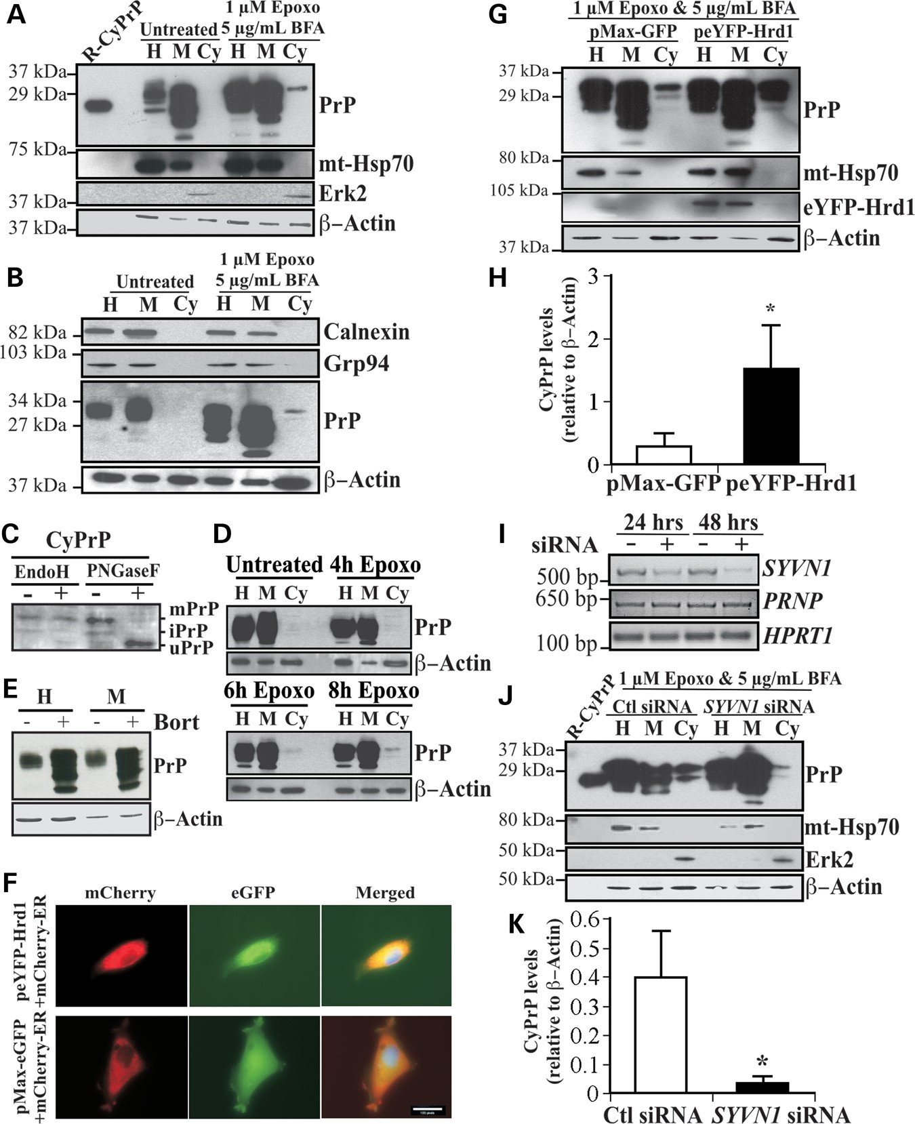
Figure 1. Overexpression of Hrd1 enhances PrP retrotranslocation while target knockdown by siRNA abolishes CyPrP in CR7 ...
Notes:
Figure 1. Overexpression of Hrd1 enhances PrP retrotranslocation while target knockdown by siRNA abolishes CyPrP in CR7 cells. (A) Western blot analysis with anti-PrP (3F4), anti-mitochondrial heat shock protein 70 (mt-Hsp70), anti-Erk2 and anti-β-Actin in CR7 cells treated for 18 h with epoxomicin (epoxo) and brefeldin A (BFA) and fractionated into homogenate (H), membrane (M) and cytosolic (Cy) fractions. Equal amounts of proteins from matched fraction pairs were loaded (example: Cy versus Cy). R-PrP; recombinant cytosolic PrP23–231. (B) Western blot with anti-calnexin, Grp94, PrP and actin of the subcellular fractions. (C) Western blot analyses of Endo H and PNGase F treated CyPrP with the 3F4 anti-PrP antibody show mature PrP (mPrP), immature PrP (iPrP) and unglycosylated PrP (uPrP). The small bar left to the panel represents the 27 kDa molecular weight marker. (D) Western blot analyses with anti-PrP 3F4 of proteins from subcellular fractionated CR7 cells treated with epoxomicin for 0, 4, 6 and 8 h. (E) Western blot analyses of the whole homogenate (H) or membrane fraction (M) of proteins from CR7 cells without or with bortezomib. (F) Fluorescent light microscopy of CR7 cells co-transfected with mCherry-ER and peYFP-Hrd1 or GFP mammalian expression vector. Nuclear DNA was stained with Hoechst 33342 staining. Scale bar represents 200 μm. (G) Western blot analysis with anti-PrP, anti-mt-Hsp70, anti-Hrd1, anti-Erk2 and anti-β-actin in CR7 cells transfected with either pMaxGFP or peYFP-Hrd1 and subjected to the subcellular fractionation. Proteins were loaded as in Figure 1A. (H) Relative CyPrP to membrane PrP levels evaluated by densitometry and depicted as fold increase over β-actin protein levels. (I) Ethidium bromide agarose gel of SYVN1, PRNP and HPRT1 amplicons obtained by RT-PCR from CR7 cells transfected for 24 or 48 h with either scrambled non-targeting control or SYVN1-targeting siRNA. (J) Western blot analysis with anti-PrP, anti-mt-Hsp70, anti-Erk2 and anti-β-actin in proteins extracted from subcellular fractions of CR7 cells transfected with 250 nm of either non-targeting scrambled or SYVN1-targeting siRNA followed by 18 h treatment with 1 µM epoxomicin and 5 µg/ml BFA. Proteins are loaded as in Figure 1A. (K) PrP in the cytosolic fraction relative to PrP in the membrane fraction of CR7 cells transfected with either non-targeting scrambled or SYVN1-targeting siRNA. CyPrP levels, evaluated by densitometry, are depicted as fold increase over β-actin. All graphed data represent the mean ± SEM of at least three independent experiments and were analyzed by independent samples t-test, *P < 0.05.
Unless provided in the caption above, the following copyright applies to the content of this slide: © The Author 2016. Published by Oxford University Press. All rights reserved. For Permissions, please email: journals.permissions@oup.com

Slide 5
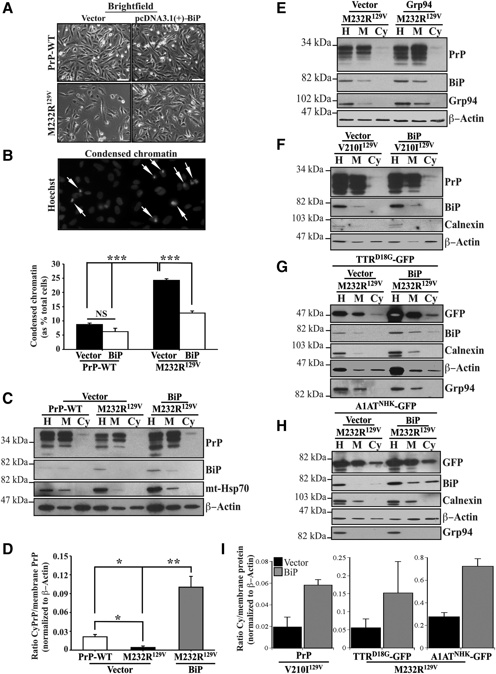
Figure 5. Overexpression of BiP rescues PrP-mutants-induced loss of protein retrotranslocation. (A) Brightfield of CR7 ...
Notes:
Figure 5. Overexpression of BiP rescues PrP-mutants-induced loss of protein retrotranslocation. (A) Brightfield of CR7 cells co-transfected with WT-PrP or PrP-M232R129V, in combination with either empty pcDNA3.1(+) vector or pcDNA3.1(+)-BiP. Scale bar represents 200 μm. (B) Fluorescent light microscopy shows normal and condensed (arrows) nuclear DNA with Hoechst 33342 staining. Quantification of condensed chromatin in CR7 cells presented in Figure 5A. Data are depicted as a percentage of total Hoechst positive nuclei displaying condensed chromatin. (C,D) Western blot analysis with anti-PrP, anti-BiP, anti-mt-Hsp70 and anti-β-actin presented with corresponding quantification by densitometry of proteins extracted from CR7 cells co-transfected with WT-PrP or PrP-M232R129V, in combination with either empty pcDNA3.1(+) vector or pcDNA3.1(+)-BiP. All graphed data represent the mean ± SEM of at least three independent experiments and are analyzed by one-way ANOVA followed by Tukey's post-tests. *P < 0.05, **P < 0.01, ***P < 0.001. (E,F) Western blot analysis with anti-PrP, anti-BiP, anti-calnexin, anti-Grp94 and anti-β-actin of proteins extracted from CR7 cells co-transfected with WT-PrP or PrP-V210I129V, in combination with either empty pcDNA3.1(+) vector or pcDNA3.1(+)-BiP. (G,H) Western blot analysis with anti-GFP, anti-BiP, anti-calnexin, anti-Grp94 and anti-β-actin of proteins extracted from CR7 cells co-transfected with TTRD18G (G) or A1ATNHK (H) and WT-PrP or PrP-M232R129V, in combination with either empty pcDNA3.1(+) vector or pcDNA3.1(+)-BiP. (I) Densitometry of cytosolic PrP relative to membrane PrP from experiments in Figure 5F–H. Data represent the mean and SD or variance of 3 (V210I) and 2 (TTRD18G or A1ATNHK) independent experiments.
Unless provided in the caption above, the following copyright applies to the content of this slide: © The Author 2016. Published by Oxford University Press. All rights reserved. For Permissions, please email: journals.permissions@oup.com

