Slide 1
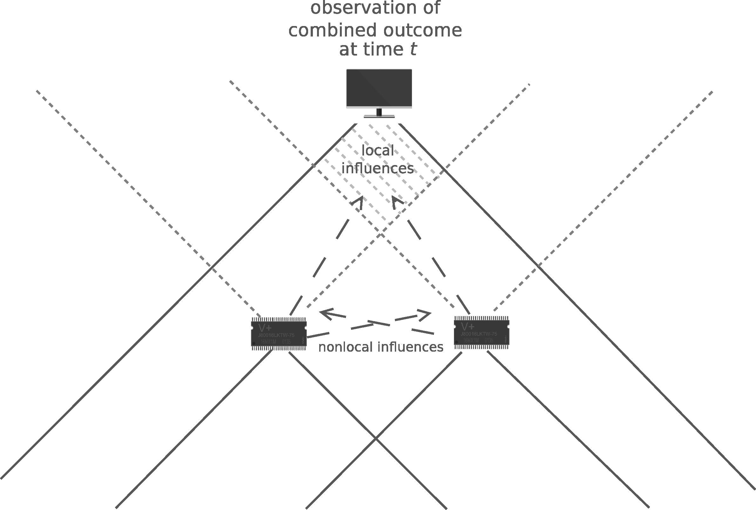
Figure 1. The observation of the result of a joint experimental outcome can be explained by positing non-local ...
Notes:
Figure 1. The observation of the result of a joint experimental outcome can be explained by positing non-local influences, or alternately (albeit conspiratorially) by positing local influences.
Unless provided in the caption above, the following copyright applies to the content of this slide: © The Author 2015. Published by Oxford University Press on behalf of British Society for the Philosophy of Science. All rights reserved. For Permissions, please email: journals.permissions@oup.com

Slide 2
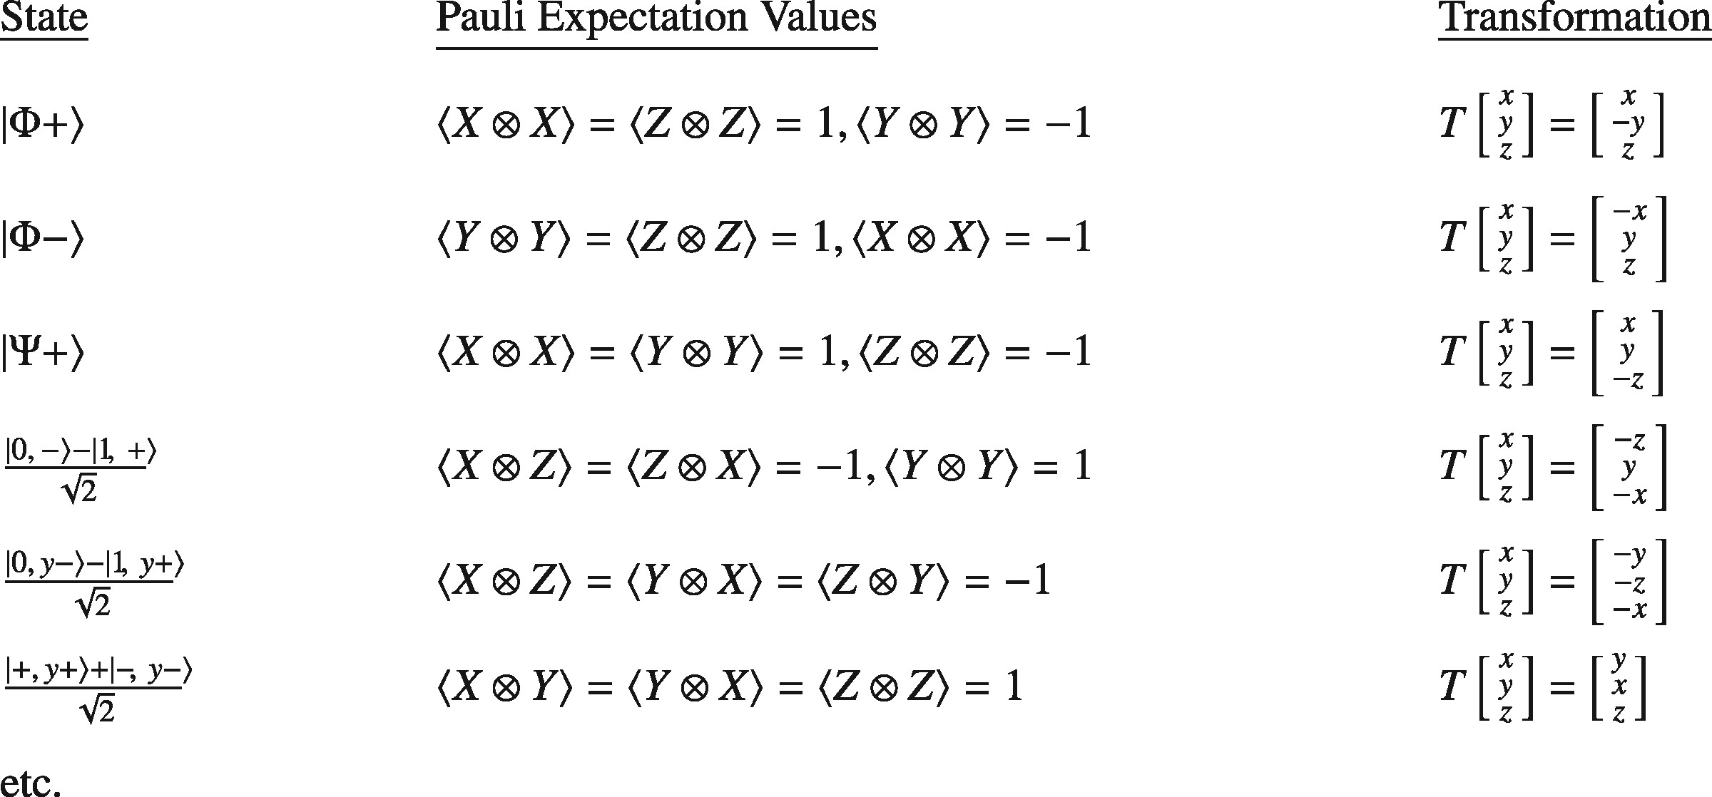
Figure 2. Examples of local hidden variables theories for bipartite entangled combinations of Pauli eigenstates. ...
Notes:
Figure 2. Examples of local hidden variables theories for bipartite entangled combinations of Pauli eigenstates. Expectation values for joint measurements of Pauli observables not indicated above are all equal to zero.
Unless provided in the caption above, the following copyright applies to the content of this slide: © The Author 2015. Published by Oxford University Press on behalf of British Society for the Philosophy of Science. All rights reserved. For Permissions, please email: journals.permissions@oup.com

Slide 3
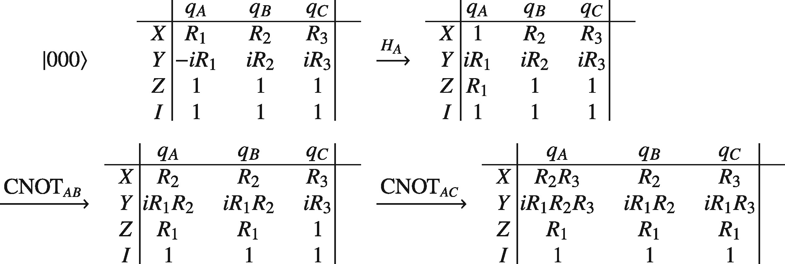
(B.1) A series of hidden variables tables modelling the preparation of the state GHZ =(|000〉+|111〉)/2 (Tessier ...
Notes:
(B.1) A series of hidden variables tables modelling the preparation of the state GHZ =(|000〉+|111〉)/2 (Tessier [2004]). The update rules for the H and CNOT gates are H: Xf=Zi, Yf=−Yi, Zf=Xi, and CNOT: Xsf=XsiXti, Ysf=YsiXti, Zsf=Zsi, Xtf=Xti, Ytf=ZsiYti, Ztf=ZsiZti, where Pi is the specification of P before the given transformation and Pf is its new specification. s and t refer to the control and target qubits, respectively, involved in a given CNOT operation.
Unless provided in the caption above, the following copyright applies to the content of this slide: © The Author 2015. Published by Oxford University Press on behalf of British Society for the Philosophy of Science. All rights reserved. For Permissions, please email: journals.permissions@oup.com

