Slide 1
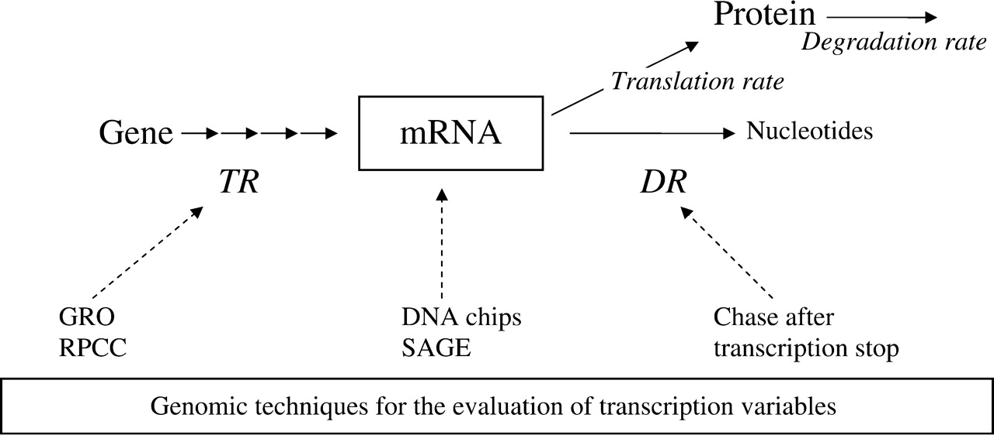
Figure 1: mRNA turnover. mRNA is transcribed, processed and transported from genes to the cytoplasm. The amount ...
Notes:
Figure 1: mRNA turnover. mRNA is transcribed, processed and transported from genes to the cytoplasm. The amount (concentration) of mRNA (RA) is dependent on the dynamic equilibrium between its transcription (TR) and degradation (DR) rates. Genomic techniques to evaluate TR, DR and RA are indicated. Current techniques evaluate only nascent TR. Gene regulation can be performed at various levels that include TR, DR and other steps in mRNA maturation and, obviously, at the level of protein turnover and maturation.
Unless provided in the caption above, the following copyright applies to the content of this slide: © Oxford University Press, 2008, All rights reserved. For permissions, please email: journals.permissions@oxfordjournals.org

