Slide 1
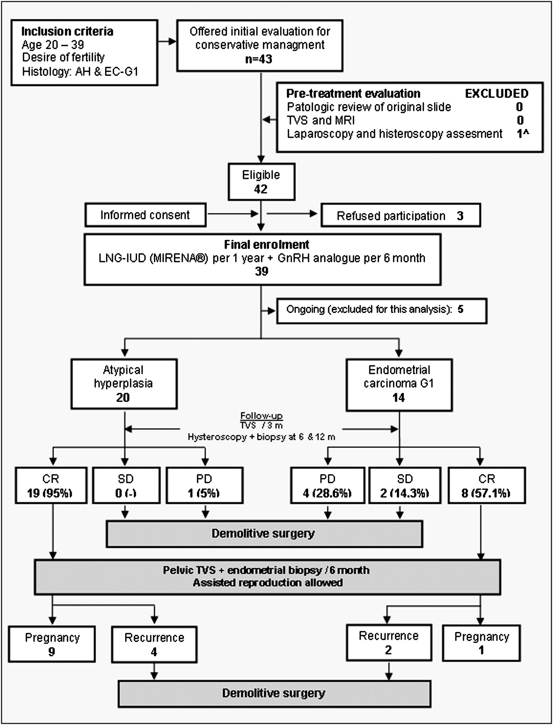
Figure 1. Graphic design. AEH, atypical endometrial hyperplasia; EC, endometrial carcinoma; TVS, vaginal ...
Notes:
Figure 1. Graphic design. AEH, atypical endometrial hyperplasia; EC, endometrial carcinoma; TVS, vaginal ultrasonography; MRI, magnetic resonance imaging; LNG-IUD, levonorgestrel intrauterine device; GnRH, gonadotropin-releasing hormone; CR, complete response; PD, progressive disease; SD, stable disease; G1, well differentiated; ^One patient was excluded after hysteroscopy + biopsy evaluation because EC; G2, moderately differentiated.
Unless provided in the caption above, the following copyright applies to the content of this slide: © The Author 2010. Published by Oxford University Press on behalf of the European Society for Medical Oncology. All rights reserved. For permissions, please email: journals.permissions@oxfordjournals.org

