Slide 1
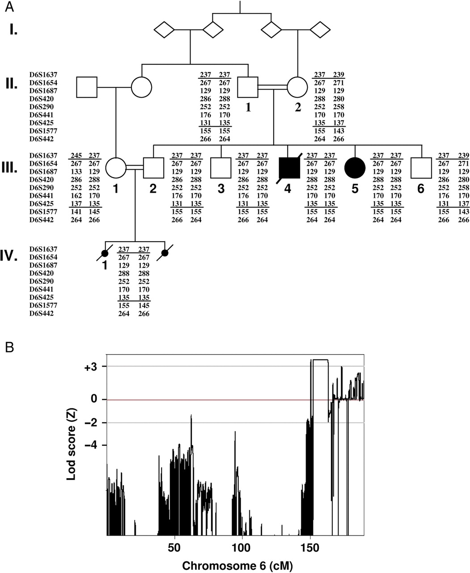
Figure 1. Linkage analysis of the family suffering from autosomal recessive AMC. (A) Haplotypes of family members at ...
Notes:
Figure 1. Linkage analysis of the family suffering from autosomal recessive AMC. (A) Haplotypes of family members at the 6q25 locus using polymorphic microsatellite markers. Filled and unfilled symbols represent affected and unaffected individuals, respectively. The numbers denote individuals whose DNA samples were analyzed. Note the homozygosity of genotypes between the crossing-over events (horizontal bars). The centromeric boundary was established on the basis of SNP analysis. (B) Multipoint linkage analysis using SNP data showing LOD score Zmax = 3.55 at θ = 0.0 on chromosome 6q25. X-axis: genetic distance in centimorgan, Y-axis: Lod score.
Unless provided in the caption above, the following copyright applies to the content of this slide: © The Author 2009. Published by Oxford University Press. All rights reserved. For Permissions, please email: journals.permissions@oxfordjournals.org

Slide 2
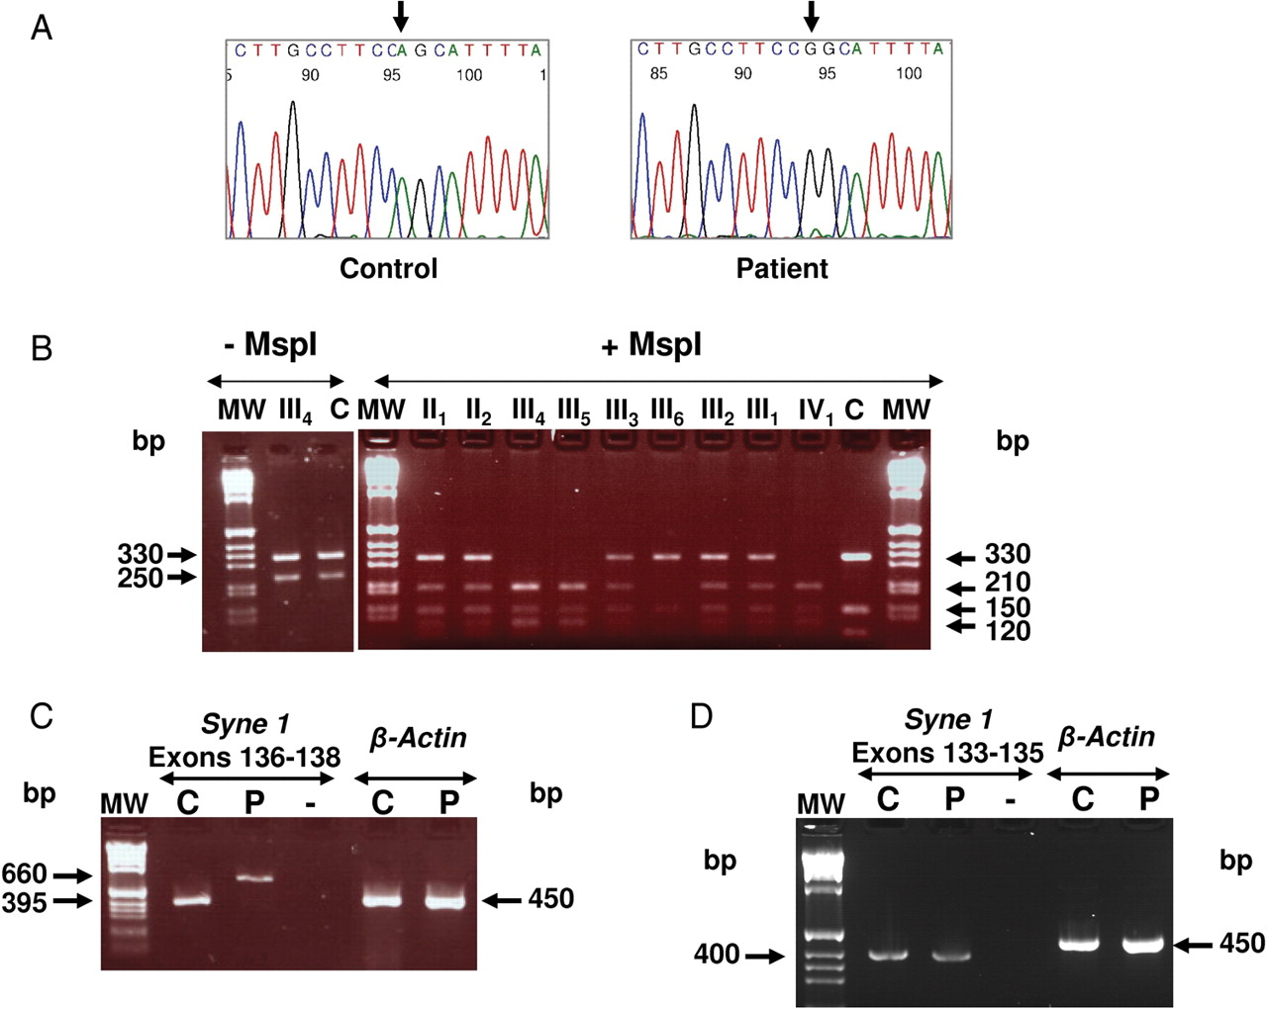
Figure 2. Analysis of SYNE-1 at the DNA and RNA level in AMC patient and control. (A) Sequence of the SYNE-1 gene ...
Notes:
Figure 2. Analysis of SYNE-1 at the DNA and RNA level in AMC patient and control. (A) Sequence of the SYNE-1 gene revealed a homozygous A to G nucleotide substitution of the AG splice acceptor site at the intron 136 and exon 137 junction in patient (arrow). (B) Analysis of the mutation in family members and control. Left panel: undigested PCR amplification products of SYNE-1 intron 136–exon 137 (330 bp) and MLH1 exon 18 (250 bp, −MspI). Right panel: the PCR amplification products were digested using MspI restriction enzyme (+MspI). The mutation of SYNE-1 gene creates an MspI restriction site leading to two products (210 and 120 bp) in patients or carriers. MLH1 exon 18 is used as internal control for MspI digestion leading to 150 bp fragment. This test confirms the cosegregation of the SYNE-1 mutation with the phenotype and haplotypes in the family. C: control. (C) RT–PCR analysis of exons 136–138 of SYNE-1 transcripts in control (C) and patient (P). Note the abnormal size (660 bp) of the RT–PCR product in patient when compared with control (395 bp). (D) RT–PCR analysis of exons 133–135 of SYNE-1 transcript in control (C) and patient (P). (-), water. β-Actin was used as internal control for RT–PCR analysis.
Unless provided in the caption above, the following copyright applies to the content of this slide: © The Author 2009. Published by Oxford University Press. All rights reserved. For Permissions, please email: journals.permissions@oxfordjournals.org

Slide 3
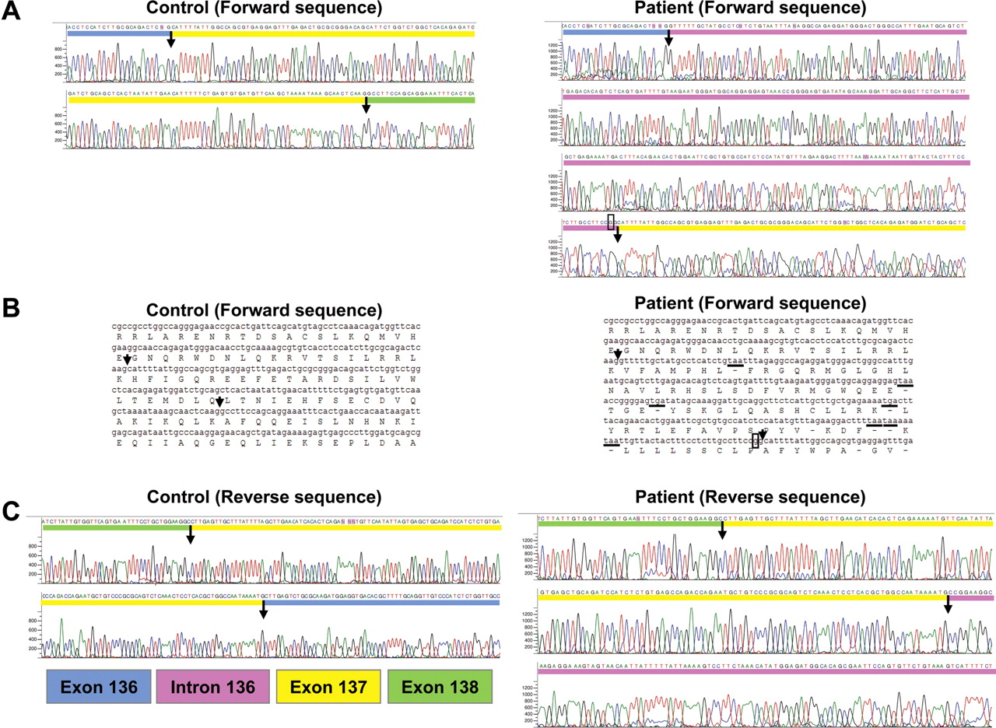
Figure 3. Sequence analysis of the SYNE-1 transcripts in AMC patient and control. RT–PCR products of exons 136–138 of ...
Notes:
Figure 3. Sequence analysis of the SYNE-1 transcripts in AMC patient and control. RT–PCR products of exons 136–138 of SYNE-1 were sequenced in control and patients using forward and reverse primers. Arrows indicate intron–exon junctions. (A) Forward sequence: note the insertion of intron 136 in RT–PCR products of the patient. The A to G substitution is indicated as box (right panel). (B) The deduced amino acid sequence shows that the retention of intron 136 leads to several stop codons in patient (underlined). (C) Reverse sequence: note the correct splicing of intron 137 in patient.
Unless provided in the caption above, the following copyright applies to the content of this slide: © The Author 2009. Published by Oxford University Press. All rights reserved. For Permissions, please email: journals.permissions@oxfordjournals.org

Slide 4
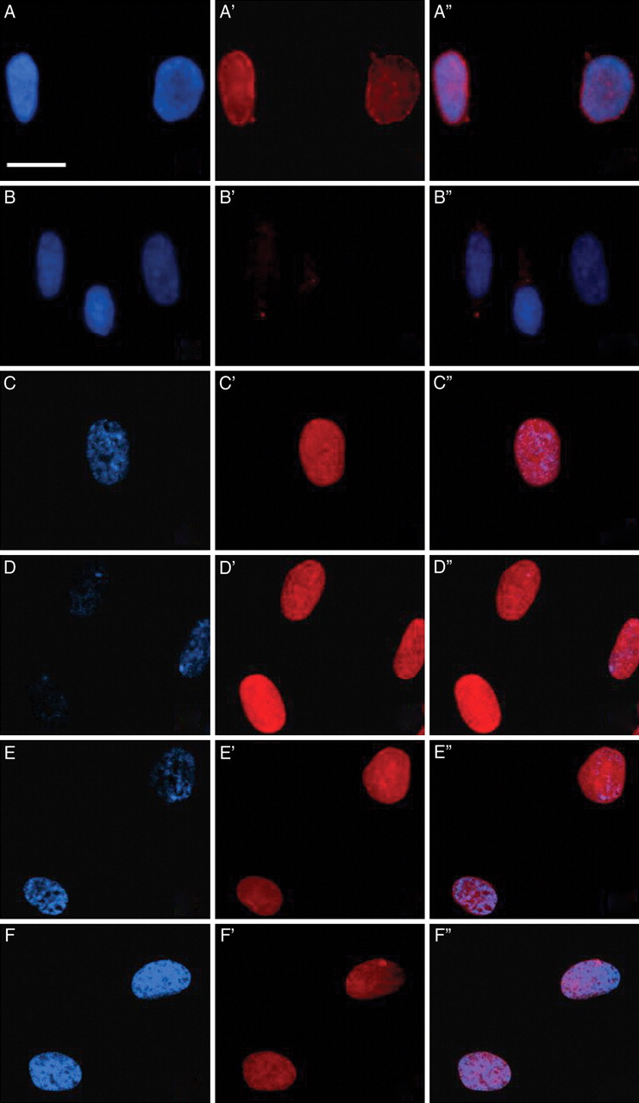
Figure 4. Immunolabeling experiments of nesprin-1, emerin and lamin A/C in control and patient fibroblasts. Cultures of ...
Notes:
Figure 4. Immunolabeling experiments of nesprin-1, emerin and lamin A/C in control and patient fibroblasts. Cultures of fibroblasts derived from control (A–A″, C–C″, E–E″) and patients (B–B″, D–D″, F–F″) were immunolabeled using anti-nesprin-1 (A′, B′, AN1), emerin (C′, D′, MANEM5-8A1) or lamin A/C (E′, F′, MANLAC1-4A7) antibodies. Nuclei were stained with Dapi (A–F). (A″–F″) are merged images. Note the lack of nesprin-1 immunolabeling in patient (B′) when compared with control (A′). In contrast, no difference in either emerin or lamin A/C immunolabeling is found between control and patient. Scale bar: 100 µm.
Unless provided in the caption above, the following copyright applies to the content of this slide: © The Author 2009. Published by Oxford University Press. All rights reserved. For Permissions, please email: journals.permissions@oxfordjournals.org

