Slide 1
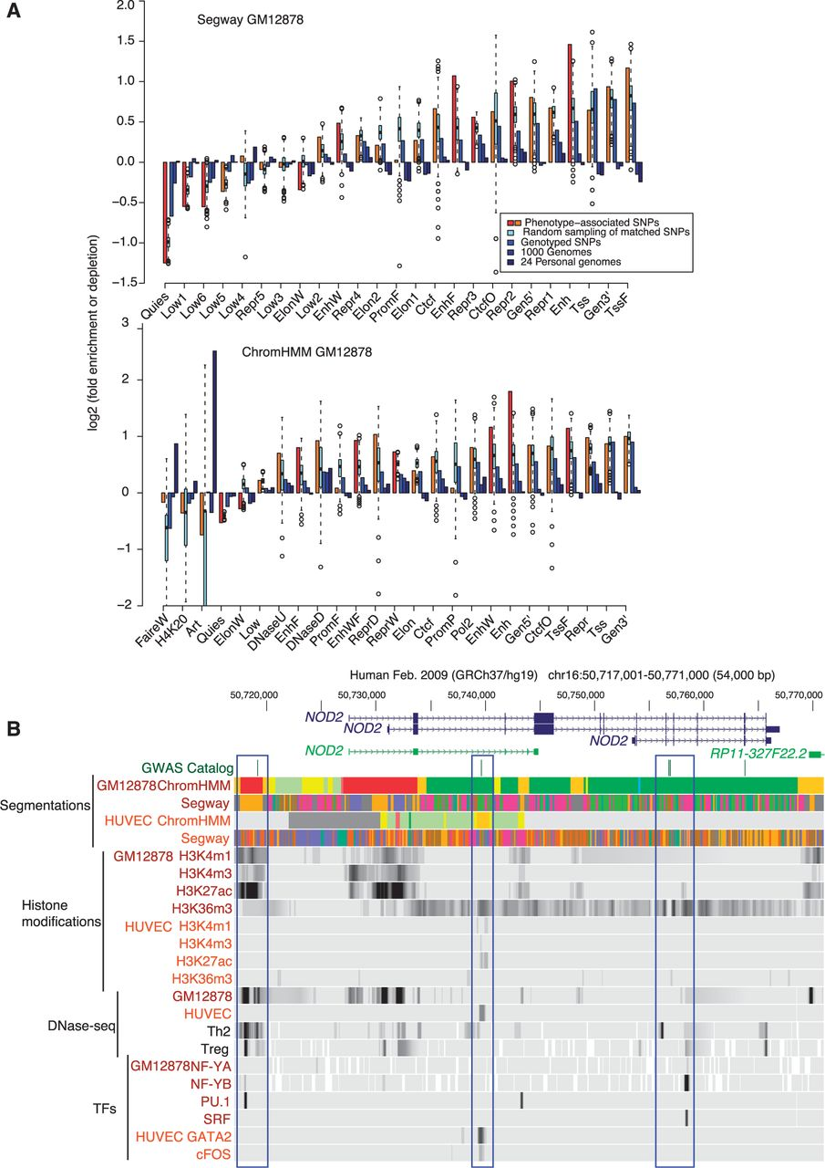
Figure 3. (A) Enrichment or depletion of GWAS SNPs (and several comparison SNP sets) in function-associated segments. ...
Notes:
Figure 3. (A) Enrichment or depletion of GWAS SNPs (and several comparison SNP sets) in function-associated segments. The bars extend to the level of enrichment or depletion of each SNP set in the 25 segmentation classes from Segway (top) and ChromHMM (bottom) in GM12878. The results for 1000 random samplings of the SNPs matched to the phenotype-associated SNPs are displayed as a box plot, with the box extending from the 25th to the 75th percentiles, the whiskers extending to 1.5 times the interquartile range, and any outliers beyond shown as circles. If the enrichment for the phenotype associated, GWAS lead SNPs exceeded the 95th percentile of the results from the matched SNPs, then the bar is colored red (orange if otherwise). (B) An example of Crohn’s disease SNPs in non-coding sequences that could serve to regulate expression of NOD2. The figures show gene models from the GENCODE group (version 12), locations of SNPs associated with Crohn’s disease by GWAS, results of ChromHMM and Segway segmentations, selected histone modifications measured in GM12878 and HUVEC cells, locations of DNase hypersensitive sites in several cell types, and sites of occupancy by selected transcription factors. Regions discussed in the text are outlined by blue rectangles.
Unless provided in the caption above, the following copyright applies to the content of this slide: © The Author(s) 2012. Published by Oxford University Press.This is an Open Access article distributed under the terms of the Creative Commons Attribution License (http://creativecommons.org/licenses/by-nc/3.0/), which permits non-commercial reuse, distribution, and reproduction in any medium, provided the original work is properly cited. For commercial re-use, please contact journals.permissions@oup.com.

Slide 2
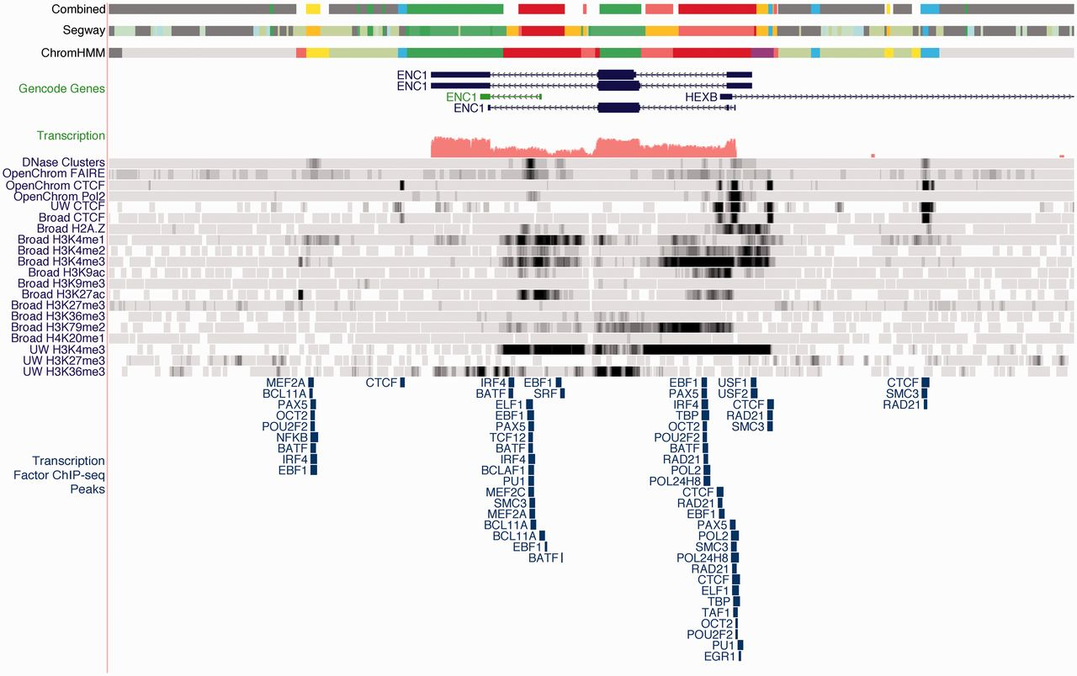
Figure 2. View of the ENC1 locus on the minus strand using the ENCODE GM12878 segmentations. The unusual state pattern ...
Notes:
Figure 2. View of the ENC1 locus on the minus strand using the ENCODE GM12878 segmentations. The unusual state pattern in middle of the gene in all three segmentations reveals a potential intronic regulatory element, which is confirmed by H3K4me1, H3K27ac, DNaseI hypersensitivity and transcription factor binding, and overlaps a putative GENCODE processed transcript.
Unless provided in the caption above, the following copyright applies to the content of this slide: © The Author(s) 2012. Published by Oxford University Press.This is an Open Access article distributed under the terms of the Creative Commons Attribution License (http://creativecommons.org/licenses/by-nc/3.0/), which permits non-commercial reuse, distribution, and reproduction in any medium, provided the original work is properly cited. For commercial re-use, please contact journals.permissions@oup.com.

Slide 3
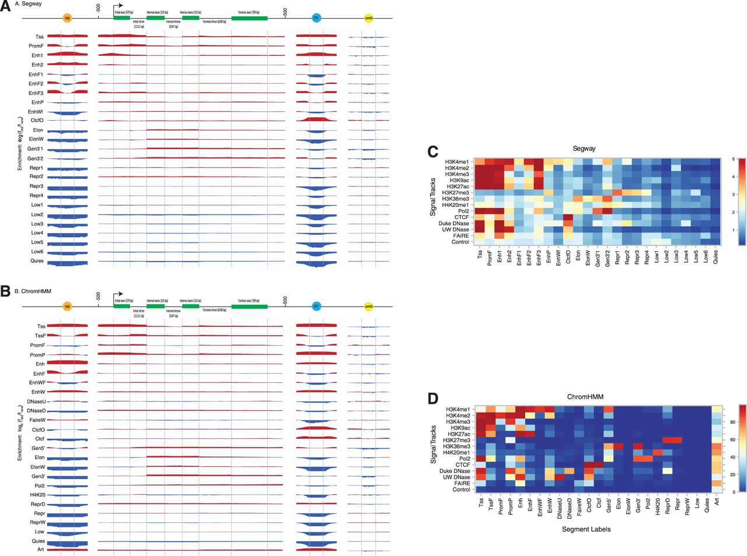
Figure 1. Enrichment of various segment labels (vertically, labeled by green panels) from (A) Segway and (B) ChromHMM ...
Notes:
Figure 1. Enrichment of various segment labels (vertically, labeled by green panels) from (A) Segway and (B) ChromHMM K562 segmentations over positions on an idealized p300 binding site, gene, CTCF binding site, and LaminB1 binding site. We calculated enrichment as the base-2 logarithm of the observed frequency of a label at a particular position along an annotation divided by the expected frequency of the label from its prevalence in the genome overall. Enriched positions are shown in red, and depleted positions are shown in blue. The labels for idealized gene components at the top include the mean length of that component in parentheses. (C) Heat map of parameters from Segway training for 14 GM12878 signal tracks against 25 segment labels. Color indicates the mean of a Gaussian according to the color bar on the right. (D) Heat map of parameters from ChromHMM concatenated training on 84 signal tracks from 6 ENCODE Tier 1–2 cell types. Color indicates the probability of a present mark, as a percentage, according to the color bar on the right.
Unless provided in the caption above, the following copyright applies to the content of this slide: © The Author(s) 2012. Published by Oxford University Press.This is an Open Access article distributed under the terms of the Creative Commons Attribution License (http://creativecommons.org/licenses/by-nc/3.0/), which permits non-commercial reuse, distribution, and reproduction in any medium, provided the original work is properly cited. For commercial re-use, please contact journals.permissions@oup.com.

Slide 4
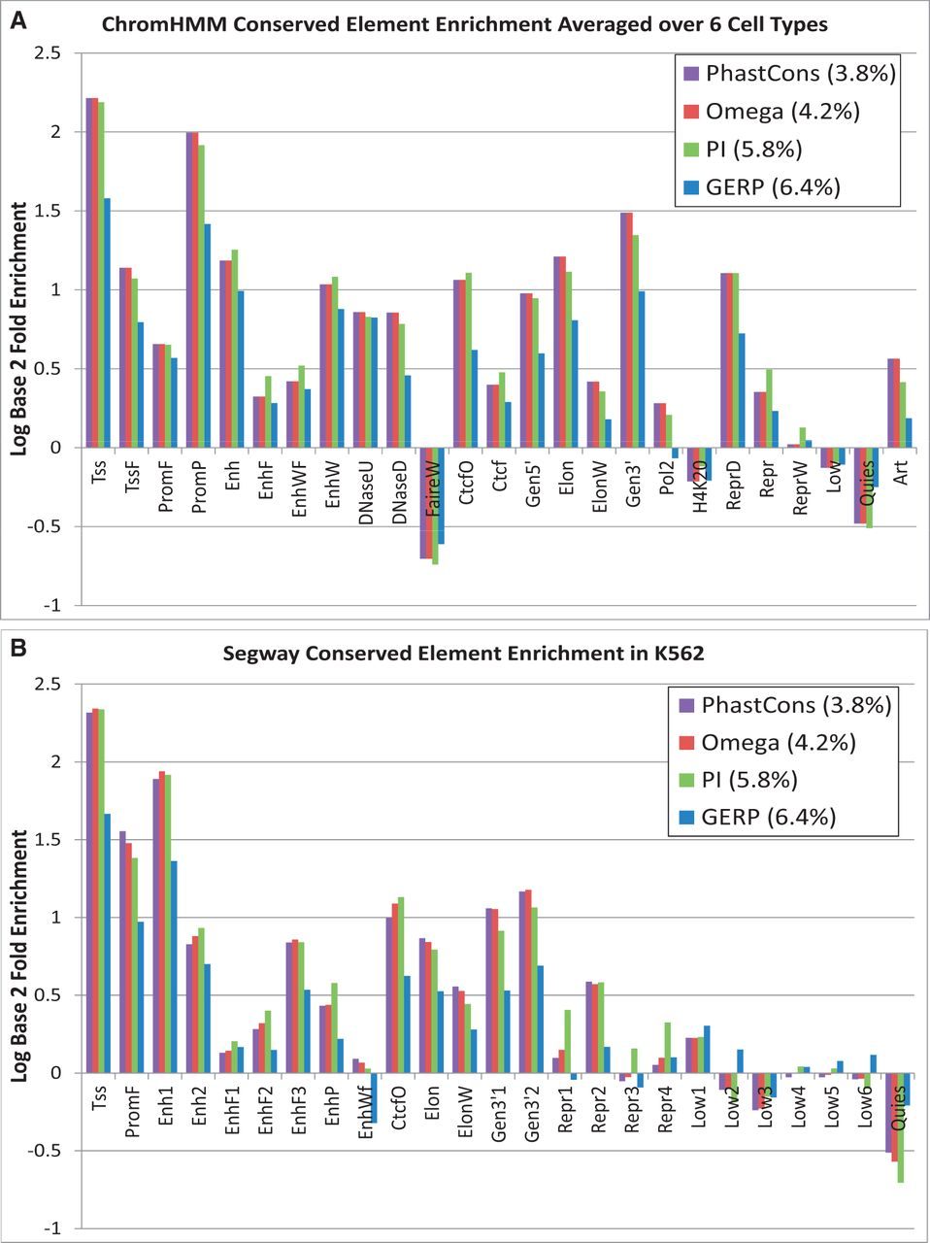
Figure 5. (A) Average log₂ enrichment or depletion of four different conserved element sets—PhastCons (33), ...
Notes:
Figure 5. (A) Average log2 enrichment or depletion of four different conserved element sets—PhastCons (33), SiPhy-ω, SiPhy-π (16,35), and GERP (34)—for the 25 ChromHMM states averaged across all 6 cell types. (B) The same comparison for Segway states, but restricted to the K562 segmentation.
Unless provided in the caption above, the following copyright applies to the content of this slide: © The Author(s) 2012. Published by Oxford University Press.This is an Open Access article distributed under the terms of the Creative Commons Attribution License (http://creativecommons.org/licenses/by-nc/3.0/), which permits non-commercial reuse, distribution, and reproduction in any medium, provided the original work is properly cited. For commercial re-use, please contact journals.permissions@oup.com.

Slide 5
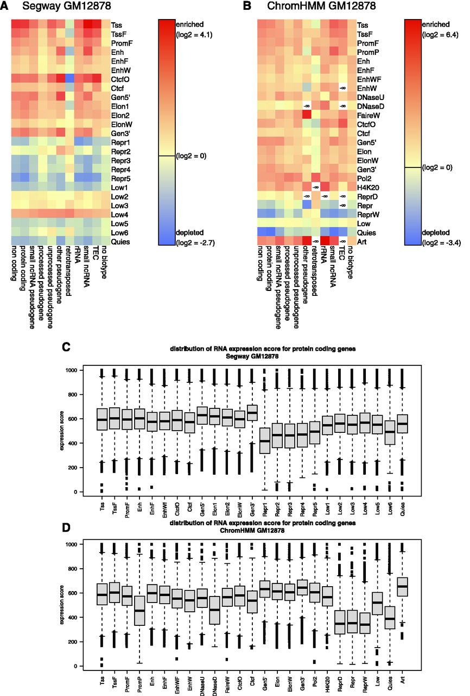
Figure 4. Distribution of various classes of transcripts in the segmentations. Enrichment (red) or depletion (blue) of ...
Notes:
Figure 4. Distribution of various classes of transcripts in the segmentations. Enrichment (red) or depletion (blue) of RNA-seq transcript categories (‘biotypes’) in each state for two 25-state segmentations: (A) Segway GM12878 and (B) ChromHMM GM12878. White cells indicate an absence of an RNA biotype in the corresponding state. Distribution of expression levels in segmentation states. The level of expression of each protein-coding RNA-seq contig intersecting a protein-coding gene in each state for (C) Segway GM12878 and (D) ChromHMM GM12878 was extracted from the data in Djebali et al. (29). The distribution of those values for all RNA contigs in the DNA segments for each state is shown as a box plot.
Unless provided in the caption above, the following copyright applies to the content of this slide: © The Author(s) 2012. Published by Oxford University Press.This is an Open Access article distributed under the terms of the Creative Commons Attribution License (http://creativecommons.org/licenses/by-nc/3.0/), which permits non-commercial reuse, distribution, and reproduction in any medium, provided the original work is properly cited. For commercial re-use, please contact journals.permissions@oup.com.

