Slide 1
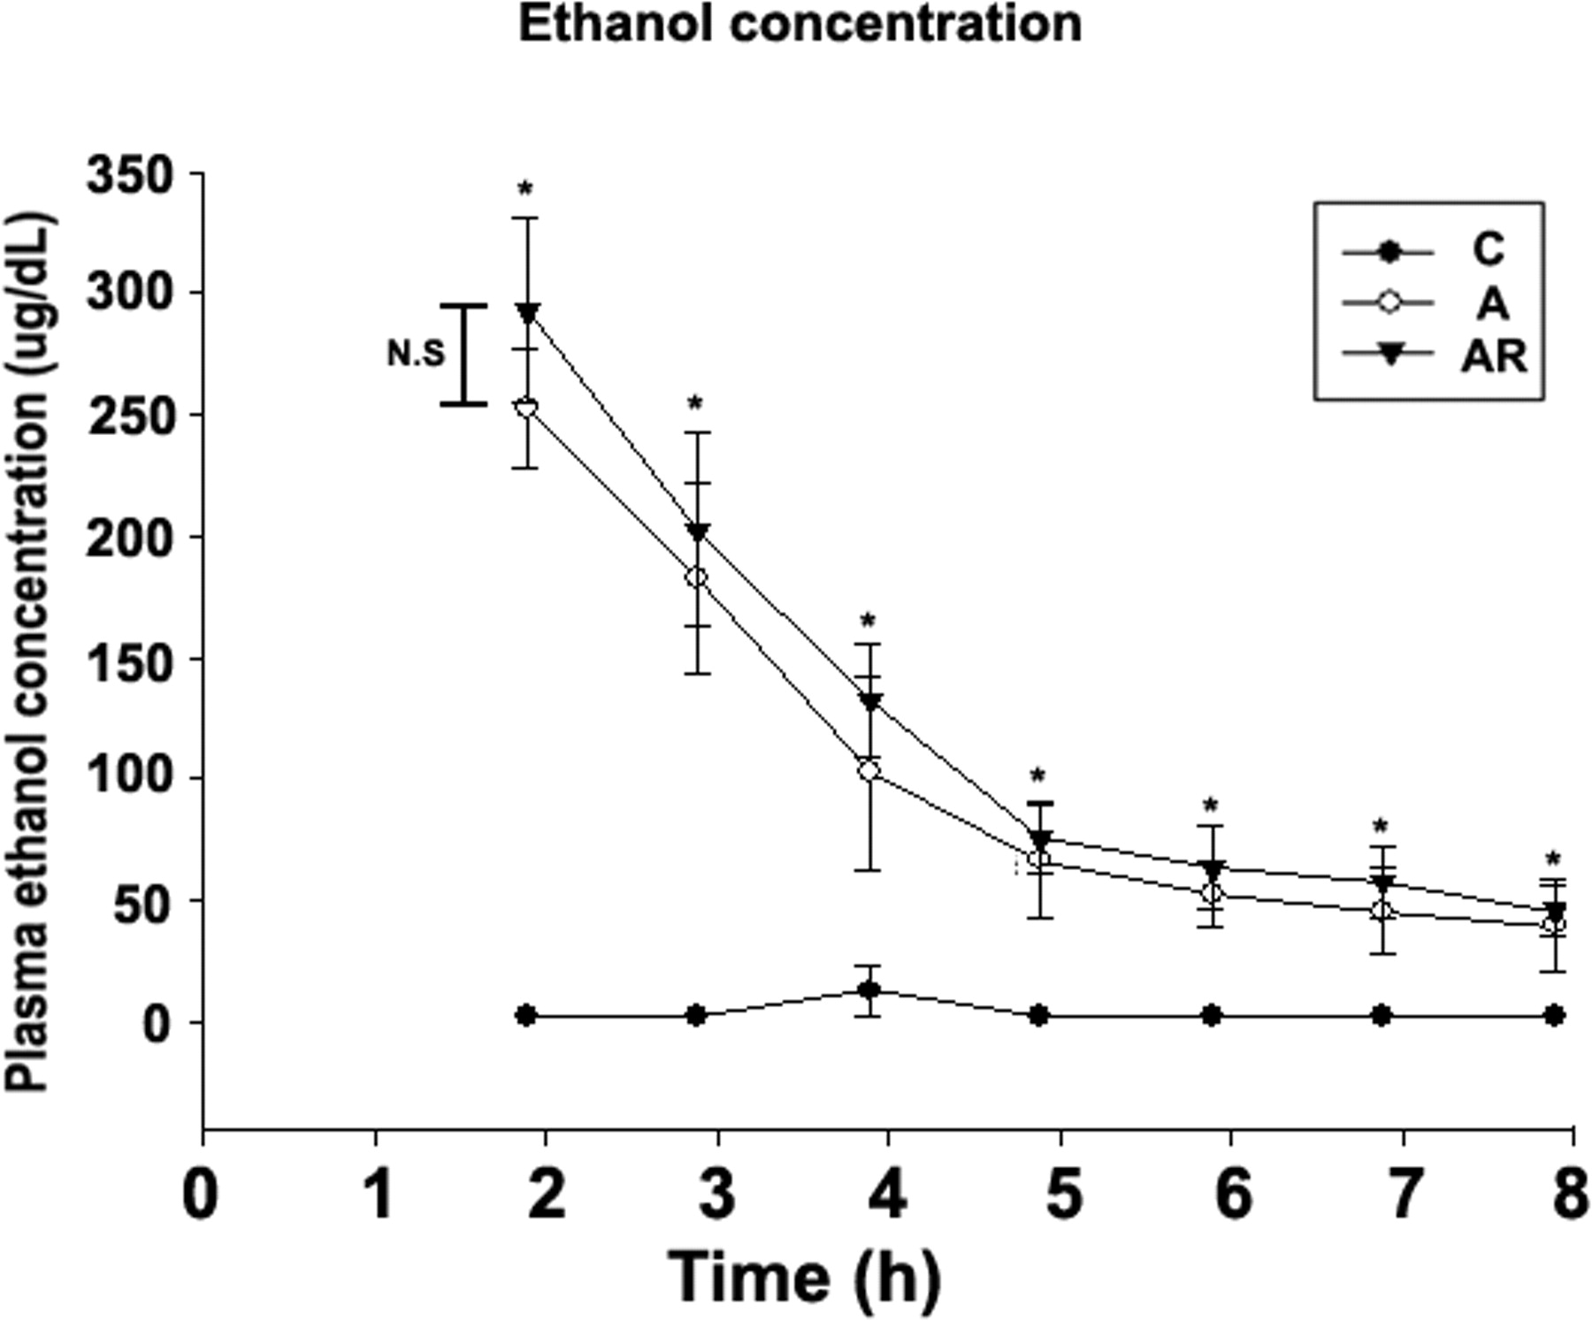
Fig. 1. Plasma ethanol concentration in experimental rats. Data are means ± SD (n = 4). *P < 0.05, ...
Notes:
Fig. 1. Plasma ethanol concentration in experimental rats. Data are means ± SD (n = 4). *P < 0.05, ethanol-treated and ethanol plus rosiglitazone-treated group compared with the control group. The difference between the ethanol-treated and ethanol plus rosiglitazone-treated groups was not significant (N.S.). C, control (closed circle); A, ethanol 4 g/kg body weight treatment (open circle); AR, ethanol plus rosiglitazone 5 mg/kg body weight/day treatment (closed triangle).
Unless provided in the caption above, the following copyright applies to the content of this slide: © The Author 2006. Published by Oxford University Press on behalf of the Medical Council on Alcohol. All rights reserved

Slide 2
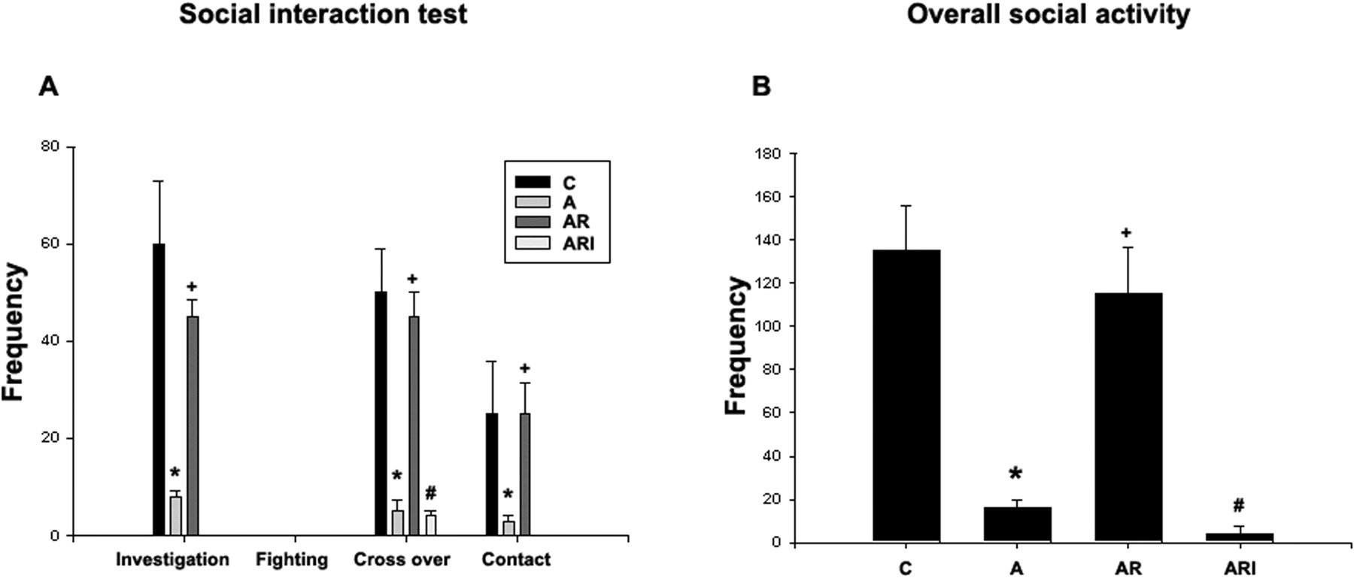
Fig. 2. Social investigation, contact behaviour, play fighting and locomotor activity (overall number of crossovers) ...
Notes:
Fig. 2. Social investigation, contact behaviour, play fighting and locomotor activity (overall number of crossovers) during the test session, 18 h after an acute ethanol challenge (A). Overall social activity was scored as the sum of social investigation, contact, play fighting and crossover frequencies (B). Data for familiar and unfamiliar situations were similar (data not shown). Cyanamide-only treatment was also tested, but that group was not significantly different from the control group. Data are means ± SD. *P < 0.05, compared with the control group; +P < 0.05, compared with the ethanol treatment group; #P < 0.05, compared with the ethanol plus rosiglitazone treatment group. C, control; A, ethanol 4 g/kg body weight treatment; AR, ethanol plus rosiglitazone 5 mg/kg body weight/day treatment; ARI, ethanol plus rosiglitazone plus cyanamide 10 mg/kg body weight treatment.
Unless provided in the caption above, the following copyright applies to the content of this slide: © The Author 2006. Published by Oxford University Press on behalf of the Medical Council on Alcohol. All rights reserved

Slide 3
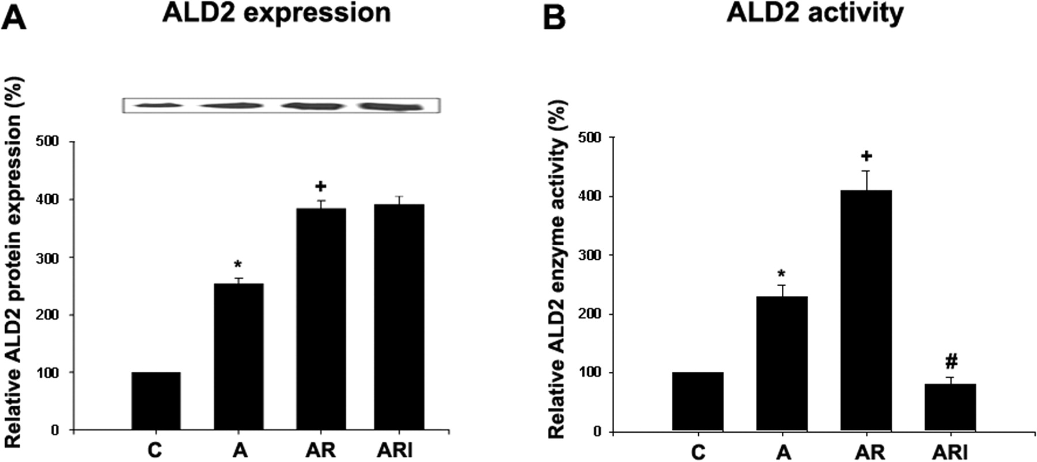
Fig. 3. ALD2 expression and activity in experimental rats. ALD2 expression was determined by western blot analysis. ...
Notes:
Fig. 3. ALD2 expression and activity in experimental rats. ALD2 expression was determined by western blot analysis. The expression of ALD2 was estimated by densitometric analysis of each protein band (A). ALD2 activity was measured (B). Cyanamide-only treatment was also tested, but that group was not significantly different from the control group. Data are means ± SD (n = 4). *P < 0.05, compared with the control group; +P < 0.05, compared with the ethanol treatment group; #P < 0.05, compared with the ethanol plus rosiglitazone treatment group. C, control; A, ethanol 4 g/kg body weight treatment; AR, ethanol plus rosiglitazone 5 mg/kg body weight/day treatment; ARI, ethanol plus rosiglitazone plus cyanamide 10 mg/kg body weight treatment.
Unless provided in the caption above, the following copyright applies to the content of this slide: © The Author 2006. Published by Oxford University Press on behalf of the Medical Council on Alcohol. All rights reserved

