Slide 1
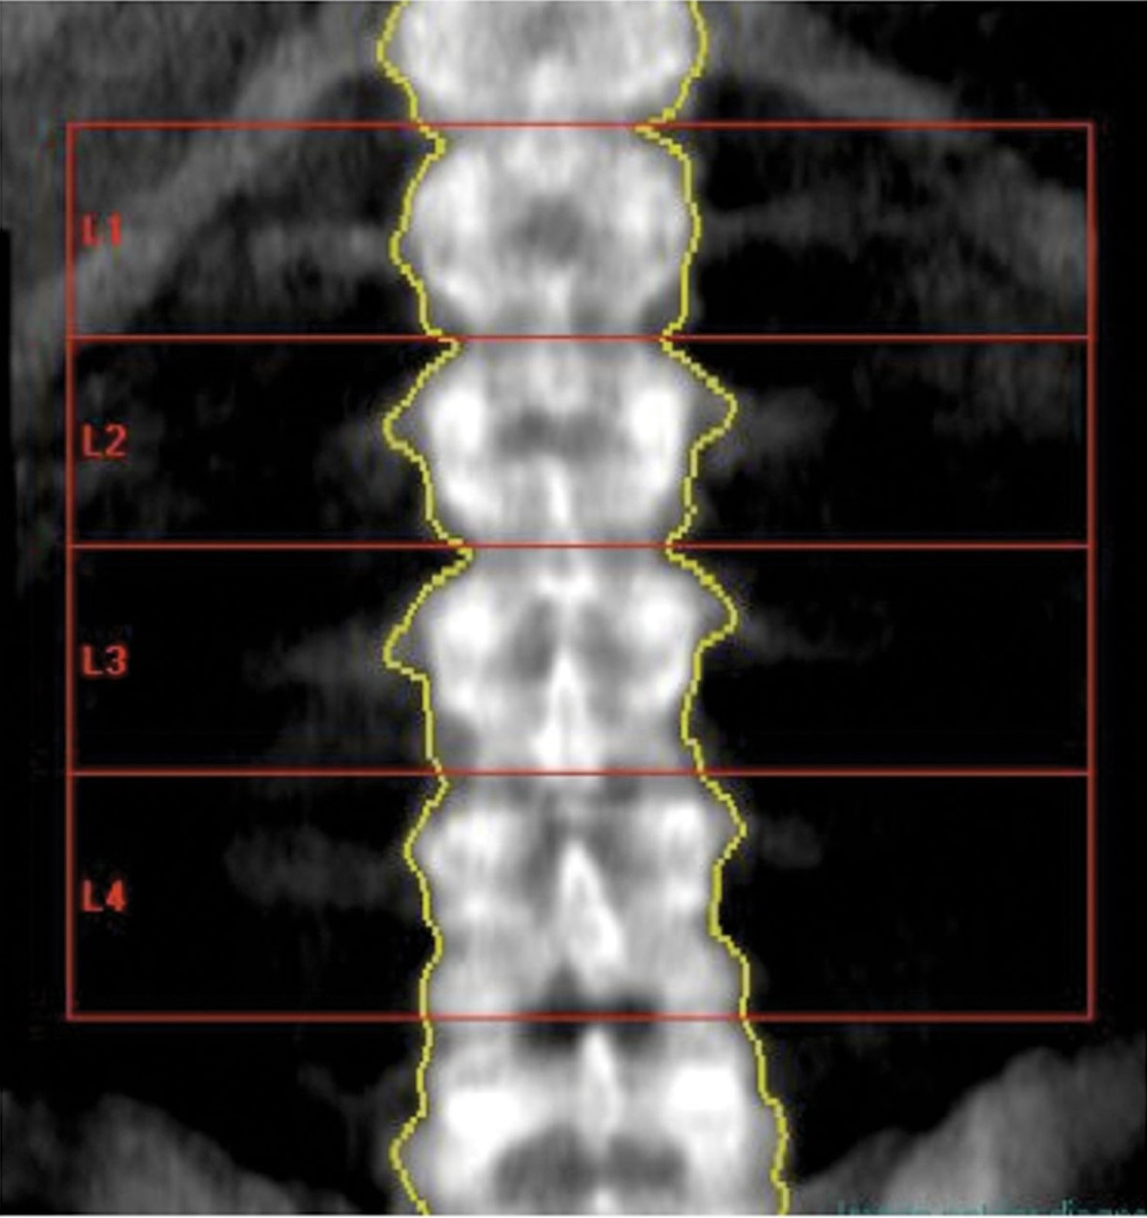
Figure 1. The bone mineral density (BMD) of the lumbar spine was calculated as the average BMD of L1 to L4 vertebrae.
Notes:
Figure 1. The bone mineral density (BMD) of the lumbar spine was calculated as the average BMD of L1 to L4 vertebrae.
Unless provided in the caption above, the following copyright applies to the content of this slide: © 2012 The American Society for Aesthetic Plastic Surgery, Inc.

Slide 2
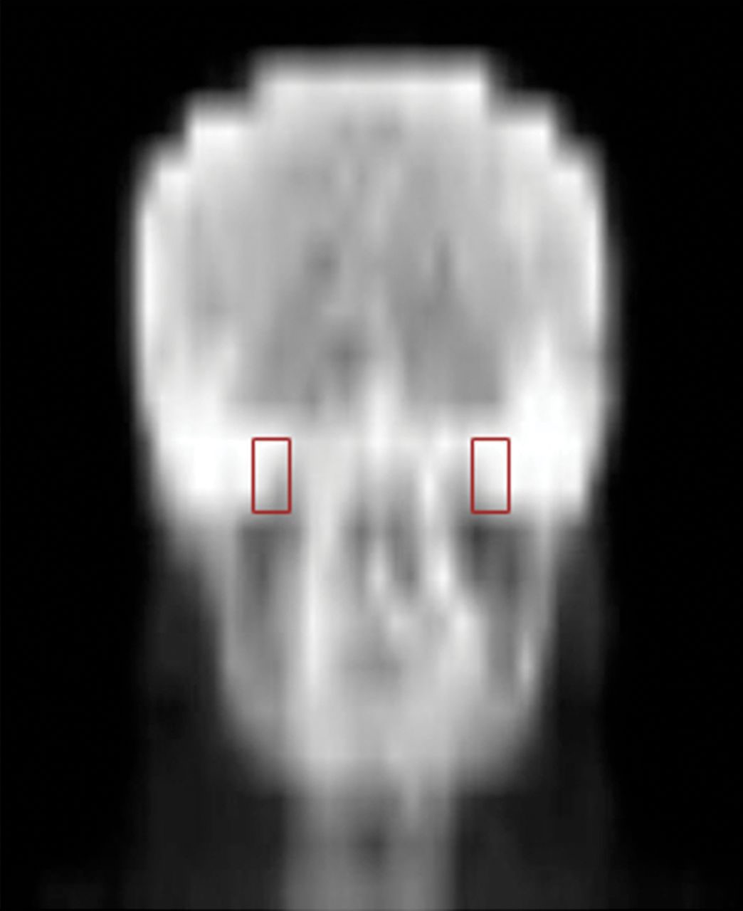
Figure 2. The bone mineral density (BMD) of the maxilla was calculated as the average of the right and left maxilla ...
Notes:
Figure 2. The bone mineral density (BMD) of the maxilla was calculated as the average of the right and left maxilla BMD, as determined by the region of interest described in the article.
Unless provided in the caption above, the following copyright applies to the content of this slide: © 2012 The American Society for Aesthetic Plastic Surgery, Inc.

Slide 3
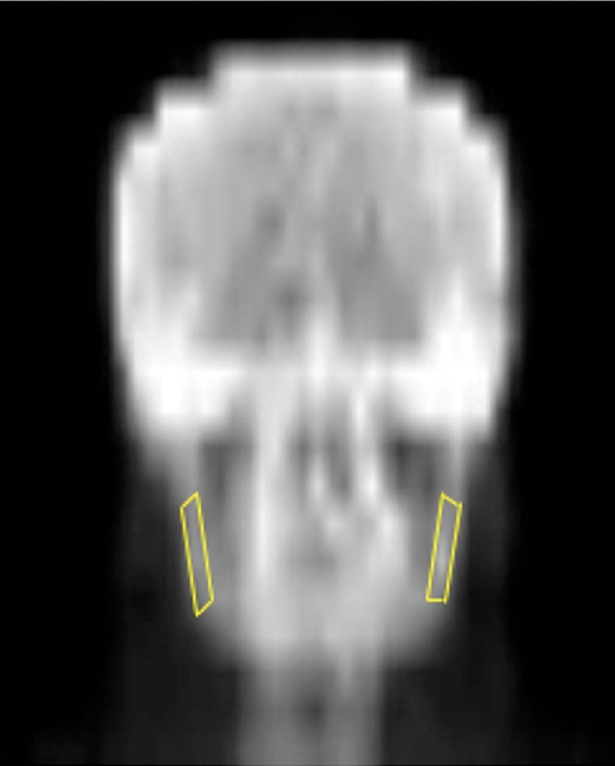
Figure 3. The bone mineral density (BMD) of the mandible BMD was calculated as the average of the right and left ...
Notes:
Figure 3. The bone mineral density (BMD) of the mandible BMD was calculated as the average of the right and left mandibular ramus BMD, as determined by the region of interest described in the article.
Unless provided in the caption above, the following copyright applies to the content of this slide: © 2012 The American Society for Aesthetic Plastic Surgery, Inc.

Slide 4
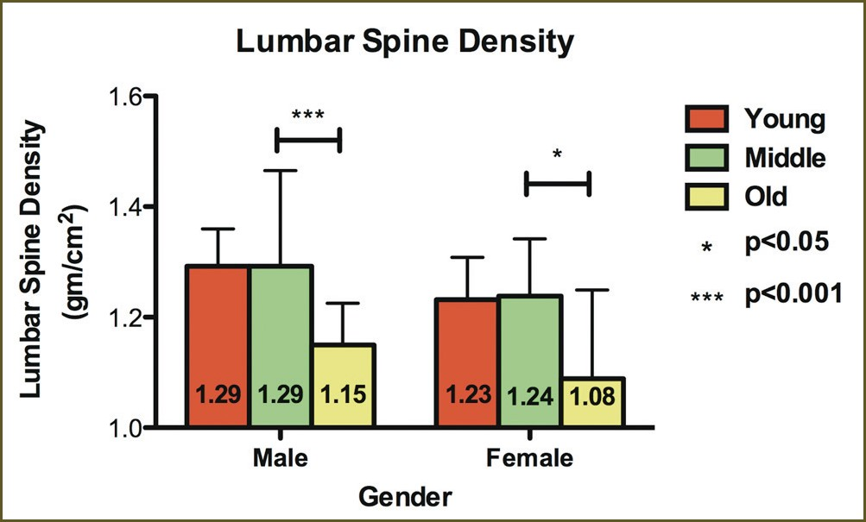
Figure 4. Column graph illustrating the statistically significant decrease in lumbar spine bone mineral density with ...
Notes:
Figure 4. Column graph illustrating the statistically significant decrease in lumbar spine bone mineral density with increasing age for both sexes.
Unless provided in the caption above, the following copyright applies to the content of this slide: © 2012 The American Society for Aesthetic Plastic Surgery, Inc.

Slide 5
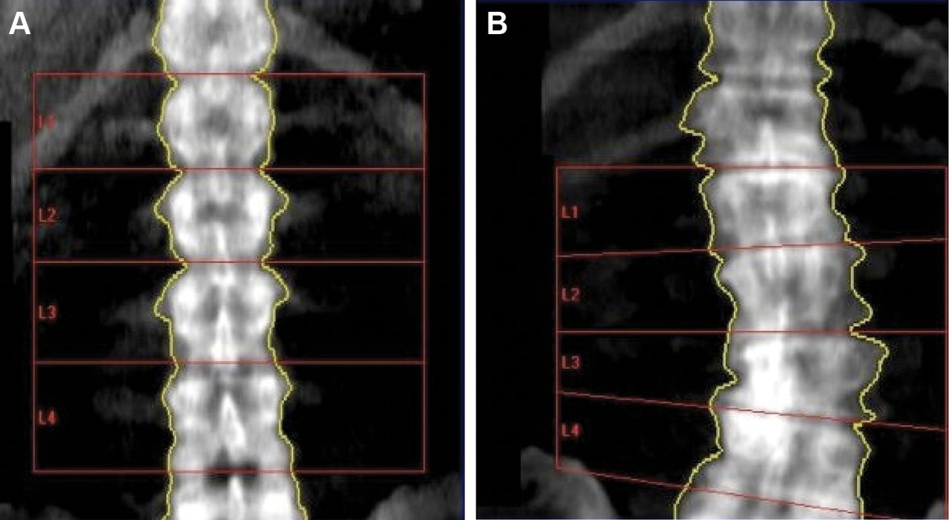
Figure 5. (A) This image shows the bone mineral density (BMD) of the lumbar spine of a young woman with dual-energy ...
Notes:
Figure 5. (A) This image shows the bone mineral density (BMD) of the lumbar spine of a young woman with dual-energy X-ray absorptiometry (DEXA) imaging. (B) This image shows the lumbar spine BMD of an old woman with DEXA imaging. Observe the corresponding difference in the appearance of the lumbar spine.
Unless provided in the caption above, the following copyright applies to the content of this slide: © 2012 The American Society for Aesthetic Plastic Surgery, Inc.

Slide 6
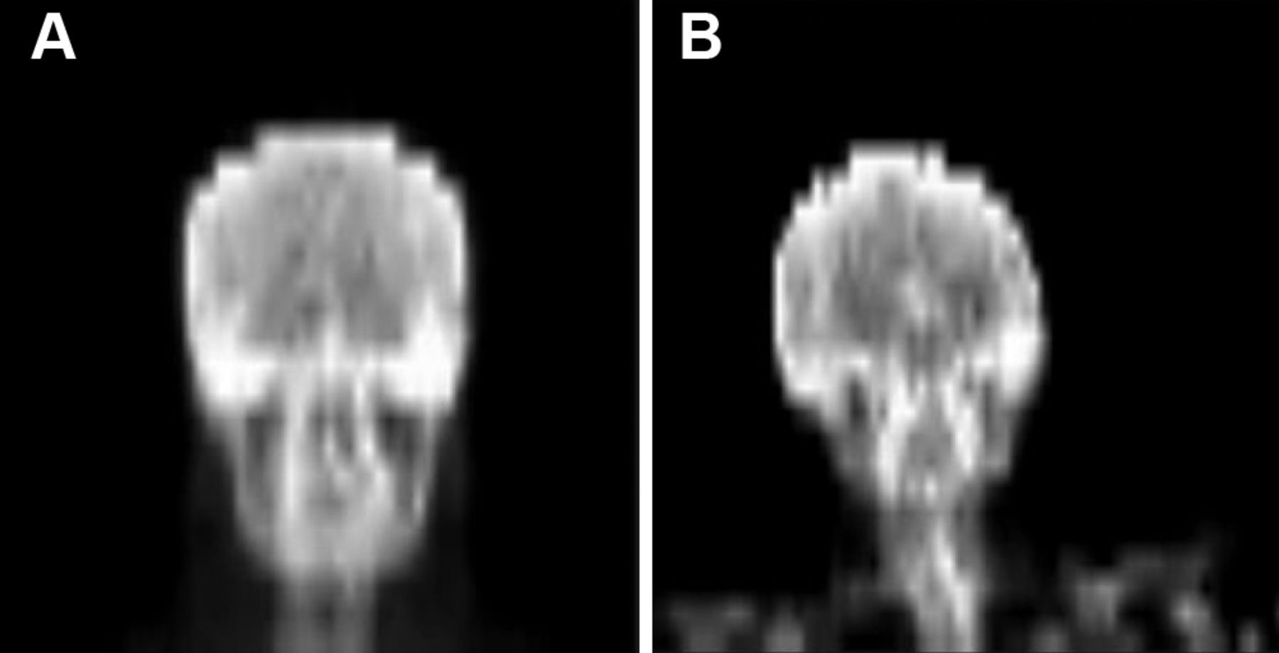
Figure 6. (A) This image shows the bone mineral density (BMD) of the maxilla and mandible of a young woman with ...
Notes:
Figure 6. (A) This image shows the bone mineral density (BMD) of the maxilla and mandible of a young woman with dual-energy X-ray absorptiometry (DEXA) imaging. (B) This image shows the maxillar and mandibular BMD of an old woman with DEXA imaging. Observe the corresponding difference in the appearance of the facial skeleton.
Unless provided in the caption above, the following copyright applies to the content of this slide: © 2012 The American Society for Aesthetic Plastic Surgery, Inc.

Slide 7
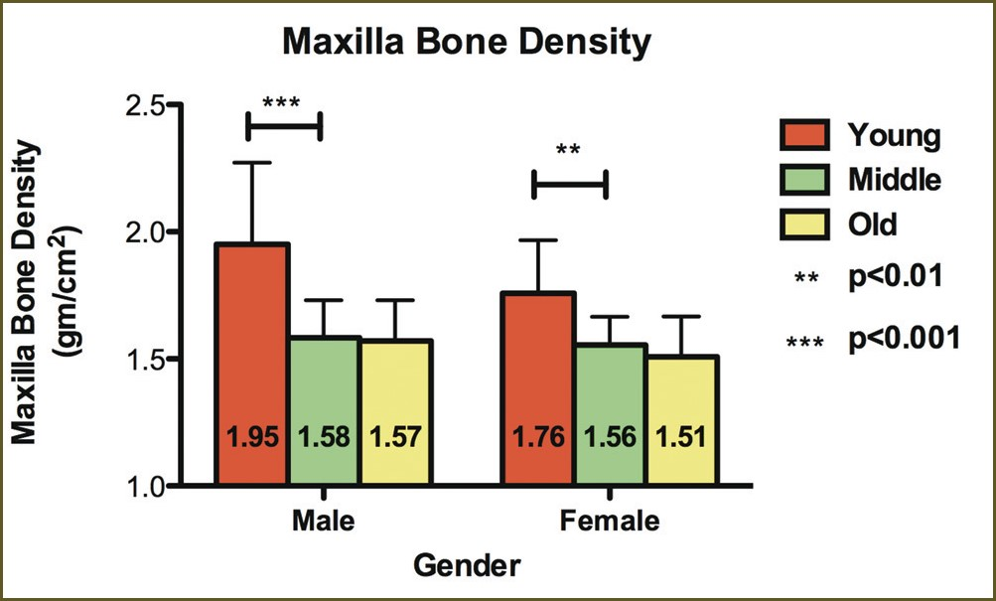
Figure 7. Column graph illustrating the statistically significant decrease in maxillary bone mineral density with ...
Notes:
Figure 7. Column graph illustrating the statistically significant decrease in maxillary bone mineral density with increasing age for both sexes.
Unless provided in the caption above, the following copyright applies to the content of this slide: © 2012 The American Society for Aesthetic Plastic Surgery, Inc.

Slide 8
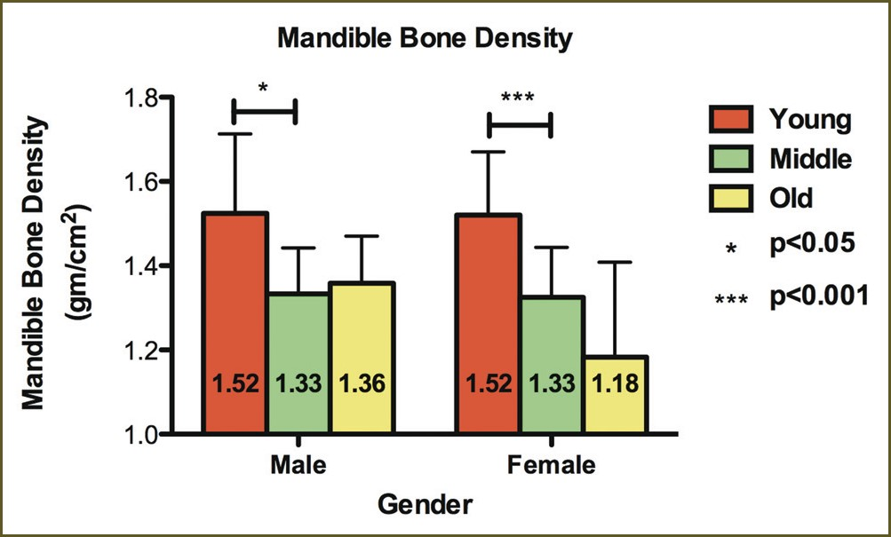
Figure 8. Column graph illustrating the statistically significant decrease in mandibular bone mineral density with ...
Notes:
Figure 8. Column graph illustrating the statistically significant decrease in mandibular bone mineral density with increasing age for both sexes.
Unless provided in the caption above, the following copyright applies to the content of this slide: © 2012 The American Society for Aesthetic Plastic Surgery, Inc.

