Slide 1
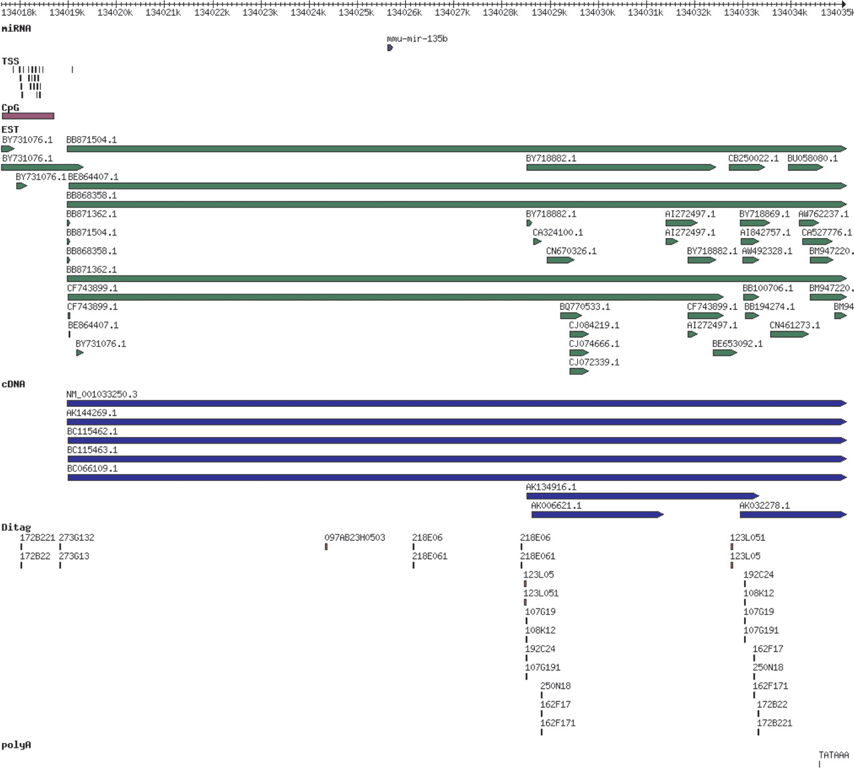
Figure 1. miRBase view of the distribution of genomic features around mmu-mir-135b on mouse chromosome 1, showing TSS, ...
Notes:
Figure 1. miRBase view of the distribution of genomic features around mmu-mir-135b on mouse chromosome 1, showing TSS, CpG island, EST, cDNA, DITAG (172B221 and 172B22) and polyA site support for a 15 kb primary transcript.
Unless provided in the caption above, the following copyright applies to the content of this slide: © 2007 The Author(s)This is an Open Access article distributed under the terms of the Creative Commons Attribution Non-Commercial License (http://creativecommons.org/licenses/by-nc/2.0/uk/) which permits unrestricted non-commercial use, distribution, and reproduction in any medium, provided the original work is properly cited.

